Slide 1

Introduction To HTML5

Slide 2
SGML
SGML stands for the Standard Generalized Markup Language. It is an ISO-standard technology for defining generalized markup languages for documents.
SGML was derived from IBM's Generalized Markup Language (GML)
Many such documents are required to remain readable for a long time in the field of information technology. It is also used extensively by the military, the aerospace, technical reference and industrial publishing industries. The introduction of the XML profile has made SGML more suitable for its widespread applications in small-scale, general-purpose use.

Slide 3
SGML vs HTML

Slide 4
Comparision between HTML5 and Silverlight
Now recommend you to use html instead of Silverlight. Microsoft, in fact, stopped to develop the Silverlight framework, shifting to more open iniciatives like HTML with Javascript. With the capabilities of browsers you can do most of the things that Silverlight does, in a common space: you don't need to install a plugin to run your app like in Silverlight. As we have HTML and Silverlight apps, and the experience with Silverlight is far off from good. The plugin is very slow and the framework on the client side is very limited. Compilation and execution time is a pain... Now we are trying to migrate our applications to plain HTML with ASPX or MVC.
Silverlight is limited if mobile deployment is required. Currently, Silverlight is only supported on Windows Phone. It may be supported on other platforms in the future, but this is not certain. It’s not something that is likely to happen in the short term. Currently, to develop a Silverlight application that mobile clients can use, the Windows Phone device must be mandated.

Slide 5
HTML5 Browser Support
You can teach older browsers to handle HTML5 correctly.
HTML5 is supported in all modern browsers.
In addition, all browsers, old and new, automatically handle unrecognized elements as inline elements.
Because of this, you can "teach" older browsers to handle "unknown" HTML elements.

Slide 6

Define Semantic Elements as Block Elements
HTML5 defines eight new semantic elements. All these are block-level elements.
To secure correct behavior in older browsers, you can set the CSS display property for these HTML elements to block:

Slide 7
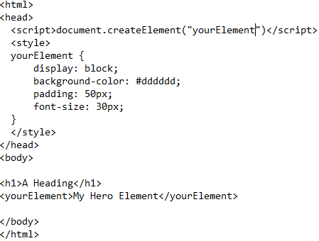
Add New Elements to HTML
You can also add new elements to an HTML page with a browser trick.
For example, add a new element called <YourElement> to an HTML page, and defines a style for it:
The JavaScript statement document.createElement(“ElementName") is needed to create a new element in IE 9, and earlier.

Slide 8
Problem With Internet Explorer 8
You could use the solution described above for all new HTML5 elements.
However, IE8 (and earlier) does not allow styling of unknown elements!
Thankfully, Sjoerd Visscher created the HTML5Shiv! The HTML5Shiv is a JavaScript workaround to enable styling of HTML5 elements in versions of Internet Explorer prior to version 9.
You will require the HTML5shiv to provide compatibility for IE Browsers older than IE 9.

Slide 9
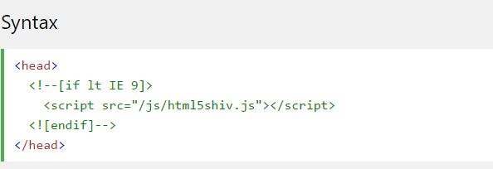
Syntax For HTML5Shiv
The HTML5Shiv is placed within the <head> tag.
The HTML5Shiv is a javascript file that is referenced in a <script> tag.
You should use the HTML5Shiv when you are using the new HTML5 elements such as: <article>, <section>, <aside>, <nav>, <footer>.
You can download the latest version of HTML5shiv from github or reference the CDN version at https://oss.maxcdn.com/libs/html5shiv/3.7.0/html5shiv.js

Slide 10
HTML5Shiv Example
If you do not want to download and store the HTML5Shiv on your site, you could reference the version found on the CDN site.
The HTML5Shiv script must be placed in the <head> element, after any stylesheets:
Example :
Notes:
<!DOCTYPE html>
<html>
<head>
<meta charset="UTF-8">
<!--[if lt IE 9]>
<script src="https://oss.maxcdn.com/libs/html5shiv/3.7.0/html5shiv.js"></script>
<![endif]-->
</head>
<body>
<section>
<h1>Famous Cities</h1>
<article>
<h2>London</h2>
<p>London is the capital city of England. It is the most populous city in the United Kingdom,
with a metropolitan area of over 13 million inhabitants.</p>
</article>
<article>
<h2>Paris</h2>
<p>Paris is the capital and most populous city of France.</p>
</article>
<article>
<h2>Tokyo</h2>
<p>Tokyo is the capital of Japan, the center of the Greater Tokyo Area,
and the most populous metropolitan area in the world.</p>
</article>
</section>
</body>
</html>

Slide 11
How Html 5 is different from older versions
Local storage is a powerful replacement for cookies.
No support for media etc.
Some element are removed from HTML5.

Slide 12
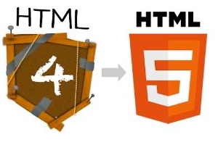
HTML 5 vs HTML4
HTML (Hyper Text Markup Language) is the language used to make every page on the web.
HTML4 and HTML5 are the two versions of the same standard developed by W3C and WHATWG(Web Hypertext Application Technology Working Group)

Slide 13
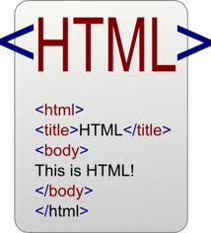
HTML 4 vs HTML5
HTML4 used common structures such as :
<div id= “header”></div>
HTML5 is developed keeping in mind the usage of modern websites.
New semantics tags like the header, footer, section,nav have been added

Slide 14

HTML4 vs HTML5
HTML4 lacks rules for parsing, which makes it more difficult to handle.
HTML5 is attempting to solve this, so that browser developers can standardize. It is also more flexible to handle inaccurate syntax, and it specifies the rules related to the parsing.

Slide 15
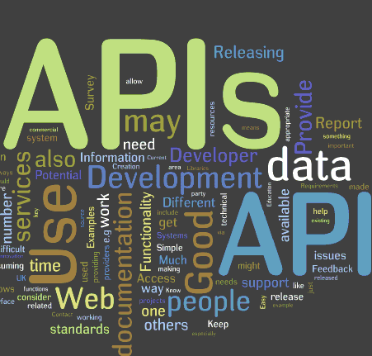
HTML4 vs HTML5
HTML5 introduces a number of APIs (application programming interfaces) that help in creating Web applications, like: Drag and drop Offline database storage Document edition Canvas 2D, that makes it easier to integrate video elements.

Slide 16

HTML4 vs HTML5
Browser support HTML4 is the markup language used for writing websites worldwide, and it is supported by all web browsers.
Although HTML5 is not yet an official standard, all major browsers (Safari, Chrome, Firefox, Opera, Internet Explorer) support most of its features.

Slide 17

HTML4 vs HTML5
Multimedia features HTML4 needed external software, like Flash, to play videos and multimedia content. This sometimes caused problems due to incompatibility, etc.
HTML5 can embed video on web-pages without using any special software or plug-in.

Slide 18
HTML5
HTML5 is popular because of
Enhanced API’s
Semantic Tags
Canvas
Audio & Video
Animations
and many more…..
HTML 5 is combination of SSS
Source : HTML5 elements & attributes
Style : CSS3
Script : JavaScript and DOM

Slide 19
HTML5
HTML 5 =
+
New Markup Elements
And
Attributes
New
JavaScript
API

Slide 20
HTML5 < HTML4
HTML4 DOCTYPE
<!DOCTYPE html PUBLIC "-//W3C//DTD XHTML 1.0 Transitional//EN" "http://www.w3.org/TR/xhtml1/DTD/xhtml1-transitional.dtd">
HTML5 DOCTYPE
<!DOCTYPE html>
Note : Doctypes are required for legacy reasons
Other tags that have been simplified
<style>, <script>, <meta> etc
Notes:
Including doctype ensures a best effort to attempt to render with current standards
When omitted browsers tend to render in an incompatible mode.
<meta charset=“utf-8”>
<html lang=“en”>

Slide 21
What are Semantic Elements? Semantic elements = elements with a meaning.
A semantic element clearly describes its meaning to both the browser and the developer.
Examples of non-semantic elements: <div> and <span> - Tells nothing about its content.
Examples of semantic elements: <form>, <table>, and <article> - Clearly defines its content.
HTML5 semantic elements are supported in all modern browsers.
In addition, you can "teach" older browsers how to handle "unknown elements".

Slide 22
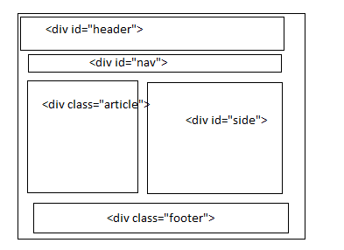
Why and How of Semantics
Semantics are used for differentiating data.
HTML4 had no semantic tags . The layout could be created as below
The naming of id and class may be different by different developers.
There is no standard in nomenclature.

Slide 23
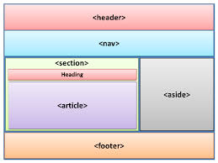
Why and How of Semantics
The HTML5 semantic tags provides consistency .
The new semantic tags provide a consistent information to the browsers and the servers as well.

Slide 24
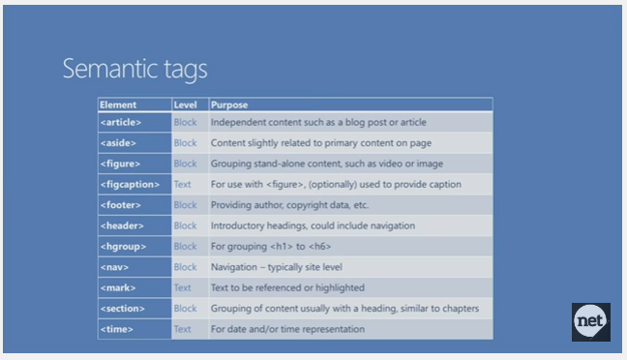
Semantic Tags

Slide 25
Why and How of Semantics
The semantics tags can be tested using the link below
www.html5.org/outliner
HTML5 element like <article>, <section>, <nav>, and <aside> are sectioning content, which begin new sections in the outline.
Demo (HTML without Semantics tag)
<h1>Hello</h1>
<div>
<h1>World</h1>
</div>
OutPut : 1. Hello
2. World

Slide 26
Why and How of Semantics
After changing the meaningless <div> to an <article>, which is sectioning content:
<h1>Hello</h1>
<article>
<h1>World</h1>
</article>
Output:
1. Hello
1. World

Slide 27
Selection Basics in HTML5
New DOM selection has been introduced in HTML5
This makes the selection of DOM elements easier and super fast.
DOM selection was usually done using Jquery.
eg : var clsNames =document.getElementByClassName(‘item’).
This will query the DOM, looking for all the elements having the class name as ‘item’.
Unlike jquery this is not a css selector.

Slide 28
Selection Basics
Var query= document.querySelector(‘#log’);
This function accepts a css3 selector and returns the result.
This will return the first element matched.
Var query = document.querySelectorAll(‘item’);
This will return all the elements matched with the specified css3 selector.

Slide 29
Changed Elements…
They are called so as their meaning is redefined in HTML5
As in HTML4, <address> is for contact details of the author, not as a generic element for postal addresses.
In HTML5, we can have multiple addresses in a document, one inside each <article>.
Contents of <address> element can be email, url address etc.

Slide 30
Changed Elements…
<address>
<a href="http://introducinghtml5.com">
<img src=qr.png alt="">
Bruce Lawson, Remy Sharp</a>
</address>
<dl>
In HTML 4, <dl> was a definition list containing a term and one or more definitions for that term.
HTML5 widens the element to be an association list consisting of zero or more name-value groups .

Slide 31
Changed Elements…
<dl>
<dt>History of French plastic sandals</dt>
<dd>Phillipe Philloppe</dd>
<dt>J-Lo’s plastic surgery: a profile</dt>
<dd>Hugh Jarce</dd>
<dt>The Orpheus and Eurydice myth</dt>
<dd>Helen Bach</dd>
<dt>The Proctologist and the Dentist</dt>
<dd>Ben Dover</dd>
<dd>Phil McCavity</dd>
</dl>

Slide 32
HTML5 Forms and New Input Types
HTML5 makes developing forms quicker as javascript validations are now not required for the fundamental types
The extensions are largely new values of the type attribute of the input element.
legacy browsers that don’t understand the new extensions will fall back to the default and allow the user to enter data in a plain text field.
Different browsers and different devices will present different user interfaces.

Slide 33
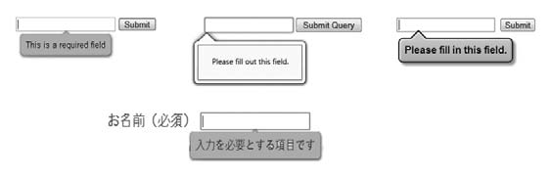
New Input Types
.

Slide 34
New Form Input Types
<input type=email> : Checks for a valid email -id
<input type=url> : Checks for a valid url format
<input type=date> : Provides a native datepicker widget that’s rendered directly by the browser.
<input type=time> : Allows input of a time in 24-Hr format and validates it.
<input type=week> : allows entry and validation of a week number.
<input type=number> : Validates numeric entry
<input type=range> : Renders a slider, UI of which is rendered differently in different browsers

Slide 35
<output> element
Across the web, you’ll see a range of sites that feature calculators for working out things like loan repayments, mortgage rates, tax, insurance, and more. Until now, we’ve had no way of semantically marking up the result of those calculations.
The <output> element, new in HTML5, is used in forms. The WHATWG HTML specification describes <output> very simply:
The output element represents the result of a calculation.
— WHATWG HTML specification

Slide 36
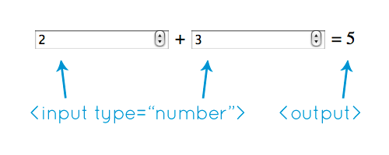
<form onsubmit="return false" oninput="o.value =parseInt(a.value) + parseInt(b.value)"> <input name="a" type="number" step="any"> + <input name="b" type="number" step="any"> = <output name="o"></output> </form>

Slide 37
<form onsubmit="return false" oninput="o.value =parseInt(a.value) + parseInt(b.value)"> <input name="a" id="a" type="number" step="any"> + <input name="b" id="b" type="number" step="any"> = <output name="o" for="a b"></output> </form>

Slide 38
The valueAsNumber Property
HTML5 has also introduced , valueAsNumber property of JavaScript input objects (specifically those of type number, date, and range). This returns the value as a number rather than as a string, meaning we no longer need to use parseInt or parseFloat, and the+ operator adds rather than concatenates:
<form onsubmit="return false" oninput="o.value = a.valueAsNumber + b.valueAsNumber"> <input name="a" id="a" type="number" step="any"> + <input name="b" id="b" type="number" step="any"> = <output name="o" for="a b"></output> </form>

Slide 39
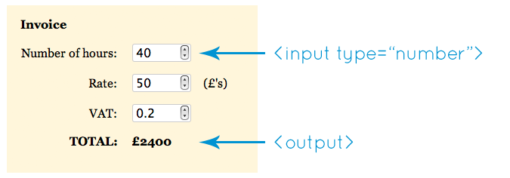
Example
Notes:
<form onsubmit="return false" oninput="amount.value =(hours.valueAsNumber * rate.valueAsNumber) +((hours.valueAsNumber * rate.valueAsNumber) *vat.valueAsNumber)"> <legend>Invoice</legend> <p><label for="hours">Number of hours</label> <input type="number" min="0" id="hours" name="hours"></p> <p><label for="rate">Rate</label> <span>£</span><input type="number" min="0" id="rate"name="rate"></p> <p><label for="vat">VAT</label> <input type="number" min="0" id="vat" value="0.20"name="vat"></p> <p>Total: <strong>£<output name="amount" for="hours rate vat">0</output></strong></p> </form>

Slide 40
Example:
<form oninput="output.value = (val1.valueAsNumber || 0) * (val2.valueAsNumber || 0)" id=foo> <input type=number name=val1> X <input type=number name=val2> = <output name=output for="val1 val2" form=foo>0</output> </form>

Slide 41
New Form Attributes
As well as new input types, the <input> element has several new attributes to specify behaviour and constraints: autocomplete, min, max, multiple, pattern, and step.
There’s also a new attribute, list, that hooks up with a new element to allow a new data input method.
The list attribute and <datalist> : The combination of an <input> with a list attribute and a <datalist> is a combo box—a combination of a drop-down list and a single-line textbox, that allows users to enter their own text if they don’t want to choose one of the predefined options.

Slide 42
New Form Attributes
The list is contained in a new <datalist> element, the id of which is referenced in the value of the list attribute:
<input id=form-person-title type=text list=mylist> <datalist id=mylist>
<option label=Mr value=Mr>
<option label=Ms value=Ms>
<option label=Prof value=”Mad Professor”>
</datalist>

Slide 43
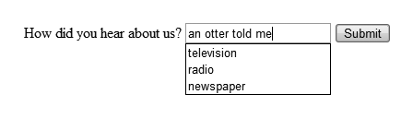
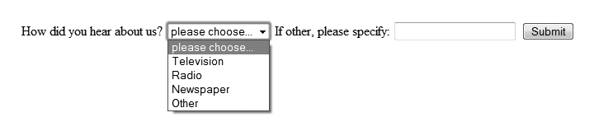
New Form Attributes

Slide 44
New Form Attributes
Few more attributes are
Autofocus
Required
Placeholder
Multiple : for type= file to upload multiple files

Slide 45
Audio and Video
Earlier to include audio & video in a web page plugins and <object> element was used.
The <object> was a generic foreign object.
The code of which looked as below:
<object width=”425” height=”344”>
<param name=”movie” value=”url”></param>
<param name=”allowFullScreen”
value=”true”></param>

Slide 46
Audio and Video
<embed src=”url”
type=”application/x-shockwave-flash”
allowscriptaccess=”always”
allowfullscreen=”true” width=”425”
height=”344”></embed>
</object>

Slide 47
HTML5 Video Tags
Tag | Description
<video> | Defines a video or movie
<source> | Defines multiple media resources for media elements, such as <video> and <audio>
<track> | Defines text tracks in media players

Slide 48
The HTML <video> Element
To show a video in HTML, use the <video> element.
<video width="320" height="240" controls>
Controls attribute will add controls for play, pause, etc.
You may add autoplay to play video automatically.
“controls autoplay” will play video automatically, also giving the controls for the video.

Slide 49
How it works
The controls attribute adds video controls, like play, pause, and volume.
It is a good idea to always include width and height attributes.
If height and width are not set, the browser does not know the size of the video. The effect will be that the page will change (or flicker) while the video loads.
Text between the <video> and </video> tags will only display in browsers that do not support the <video> element.
Multiple <source> elements can link to different video files. The browser will use the first recognized format.

Slide 50
Audio and Video
With HTML 5 Audio and Video can be used with great ease.
<video controls autoplay poster=“imageUrl” loop width=“720” height=“400”>
<source src=“video.mp4”/>
<source src=“myvideo.mp4”/>
</video>
URL | Specifies the URL of the image file.Possible values: An absolute URL - points to another web site (like href="http://www.example.com/poster.jpg") A relative URL - points to a file within a web site (like href="poster.jpg")

Slide 51
HTML Video - Media Types
File Format | Media Type
MP4 | video/mp4
WebM | video/webm
Ogg | video/ogg

Slide 52
HTML Video - Browser Support
Currently, there are 3 supported video formats for the <video> element: MP4, WebM, and Ogg:
Browser | MP4 | WebM | Ogg
Internet Explorer | YES | NO | NO
Chrome | YES | YES | YES
Firefox | YES | YES | YES
Safari | YES | NO | NO
Opera | YES (from Opera 25) | YES | YES

Slide 53
HTML 5 Audio
HTML5 provides a s
Audio on the Web
Before HTML5, there was no standard for playing audio files on a web page.
Before HTML5, audio files could only be played with a plug-in (like flash).
The HTML5 <audio> element specifies a standard way to embed audio in a web page.
tandard for playing audio files.

Slide 54

Example <audio>
<!DOCTYPE html>
<html>
<body>
<audio controls>
<source src="horse.ogg" type="audio/ogg">
<source src="horse.mp3" type="audio/mpeg">
Your browser does not support the audio element.
</audio>
</body>
</html>

Slide 55
SVG- Scalable Vector Graphics
SVG is used to define graphics for the Web
SVG is a W3C recommendation

Slide 56
SVG vs Canvas
Canvas | SVG
Resolution dependent No support for event handlers Poor text rendering capabilities You can save the resulting image as .png or .jpg Well suited for graphic-intensive games | Resolution independent Support for event handlers Best suited for applications with large rendering areas (Google Maps) Slow rendering if complex (anything that uses the DOM a lot will be slow) Not suited for game applications

Slide 57
The Canvas API
one of the larger parts of the HTML5 specification, and in fact the canvas API, the 2D drawing context, has been split into a separate document, though the canvas element itself is still part of the official HTML5 spec.
Canvas is a blank area within the browser
The important attribute of canvas are 2d and 3d(webgl)
Webgl is possible only in browsers that implement WebGL
All the work of canvas is done in JavaScript.

Slide 58
Canvas API
(0,0) ----------------→ (500,0)

Slide 59
Canvas API
Declaring a canvas in the HTML
<body onload="doFirst();">
<section id="main">
<canvas id="canvas" width="200px" height="200px">
</canvas></body>
Steps :
1. Define a <canvas> element
2. Locate the <canvas> id.
3. Access the 2d context
4. Draw shapes.
Only step 1 is in HTML, rest is in JavaScript

Slide 60
Canvas API
<script type="text/javascript">
function doFirst()
{
//this function targets the canvas with id canvas
//using fillrect,strokeRect and clearRect methods to //draw 2d shapes
var x= document.getElementById("canvas");
canvas = x.getContext('2d');
canvas.fillStyle="blue";//fills the rect with blue color
canvas.strokeStyle="Red"; //otlines the rect with red //color

Slide 61
Canvas API
canvas.strokeRect(10,10,100,200);
canvas.fillRect(10,220,100,200);
//canvas.clearRect(20,240,50,90);
}
Used for creating games, charts, Curves, Text styling, animations.
Canvasdemo.com is a website that has many applications done in canvas.
Canvas is popularly used to create HTML5 games.
Modernizer can be used to detect canvas support in the browser

Slide 62
Canvas API
Download the JavaScript library from “Modernizer .com” and include it in the script tag.
if(Modernizer.canvas)
{
//canvas code
}
else
{
//fallback code
}

Slide 63
Canvas API
How does it Work ?
Context.beginPath(); you are in the canvas context now.
Context.moveTo(75,50); will move to a point x=75 and y=70 on the canvas
Context.lineTo(75,100); will draw a line x=75 and dn= 100
Context.lineTo(25,100); will draw a left =25 and y=100;
Context.fill(); will join the last point drawn to the start point and fill the shape with specified color.

Slide 64
Drag and Drop API
In HTML5 it is possible to drag and drop HTML elements inside an HTML page.
Using JavaScript event listeners you can decide what happens when the user drags and drops elements.

Slide 65
Drag and Drop API
How does it work ?
Drag
Source
Drop
Target
Cancel Default behavior to allow drop operations

Slide 66
Drag and Drop API
dragover
drop
Events
drag
dragleave
dragstart
dragenter
dragend

Slide 67
Drag and Drop API
Events
Drag Source | Drop Target
dragstart
drag | dragenter
 | dragover
 | dragleave
 | drop
dragend

Slide 68
Drag and Drop API
Events: Drag Source
Drag
Source
Drop
Target
dragstart
drag
dragend

Slide 69
Drag and Drop API
Events : Drop Target
Drag
Source
Drop
Target
dragenter
dragover

Slide 70
Drag and Drop API
Drag
Source
Events : Drop Target
dragenter
dragover
dragleave

Slide 71
Drag and Drop API
dragstart : Fires on drag source as dragging begins.
drag: Fires on drag source as dragging occurs.
dragend : Fires on drag source when dragging is complete.

Slide 72
Drag and Drop API
dragenter : Fires on drop target when drag source enters its boundries. This event requires cancellation.
dragover : Fires on drop target as drag source is being dragged inside its boundries . This event requires cancellation.
dragleave : fires on drop target when drag source is dragged outside the target’s boundaries.
drop : Fires on drop target when the mouse button is released on the drag source while inside the target’s boundries.

Slide 73
Make an Element Draggable
First of all: To make an element draggable, set the draggable attribute to true:
<img draggable="true">

Slide 74
What to Drag - ondragstart and setData()
Then, specify what should happen when the element is dragged.
In the example above, the ondragstart attribute calls a function, drag(event), that specifies what data to be dragged.
The dataTransfer.setData() method sets the data type and the value of the dragged data:
function drag(ev) { ev.dataTransfer.setData("text", ev.target.id); }
In this case, the data type is "text" and the value is the id of the draggable element ("drag1").

Slide 75
Where to Drop - ondragover
The ondragover event specifies where the dragged data can be dropped.
By default, data/elements cannot be dropped in other elements. To allow a drop, we must prevent the default handling of the element.
This is done by calling the event.preventDefault() method for the ondragover event:
event.preventDefault()

Slide 76
Do the Drop - ondrop
When the dragged data is dropped, a drop event occurs.
In the example above, the ondrop attribute calls a function, drop(event):
function drop(ev) { ev.preventDefault(); var data = ev.dataTransfer.getData("text"); ev.target.appendChild(document.getElementById(data)); }
Notes:
Code explained:
Call preventDefault() to prevent the browser default handling of the data (default is open as link on drop)
Get the dragged data with the dataTransfer.getData() method. This method will return any data that was set to the same type in the setData() method
The dragged data is the id of the dragged element ("drag1")
Append the dragged element into the drop element

Slide 77
Data Storage
Data Storage is fundamental in nearly all applications,
web or desktop. This can include storing a unique key to
track page impressions, saving usernames and preferences, and so on. The list is endless.
until now storing data in a web app required either store it on the server side and create some linking key between the client and the server—which means data is split between locations—or store it in cookies on the client.
We all know the disadvantages of cookies

Slide 78
Data Storage
STORAGE OPTIONS :
There are three options when it comes to storing data on the client side:
1. Web Storage—supported in all the latest browsers
2. Web SQL Database—supported in Opera, Chrome, and Safari.
3. IndexedDB experimental support in Chrome 12, Firefox 5, and Internet Explorer 10

Slide 79
Data Storage
The Web storage are of two types
Session Storage : The data here is present as long as the browser is not closed.
Local Storage : Here the data is stored in the clients directory structure indefinitely.
Both the storage types share the methods and properties but they are distinguished by how long the data is stored.
In either case both types of storage methods requires that the data came from the same source. They are origin dependent.

Slide 80
Session Storage
It is only available in the life time of a tab or a window
Here data is stored as items where, item=Key-value pair
.setItem(key,value) : both key and value
.getItem(key) : takes only key
Length in session storage tells how many items are there in session storage
There is key collection in session storage. Using the key index we can find a particular value in the session storage.
A particular item can be deleted from the items stored using the method removeItem().
To remove all the items from session storage clear() method is used.

Slide 81
Local Storage
This is same as session storage w.r.t. the methods and properties except that , here the data is stored permanently.
Capacity is 5MB
1Char != 1 byte
If capacity is 5MB then actual storage is of 2.5 MB

Slide 82
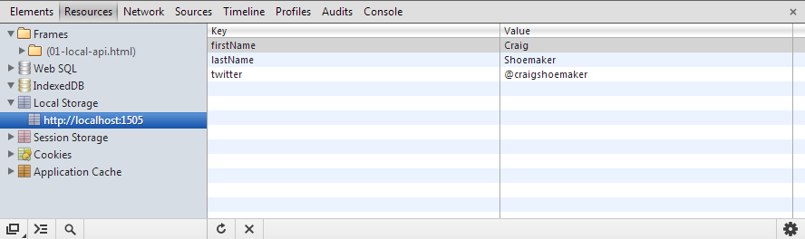
Local Storage

Slide 83
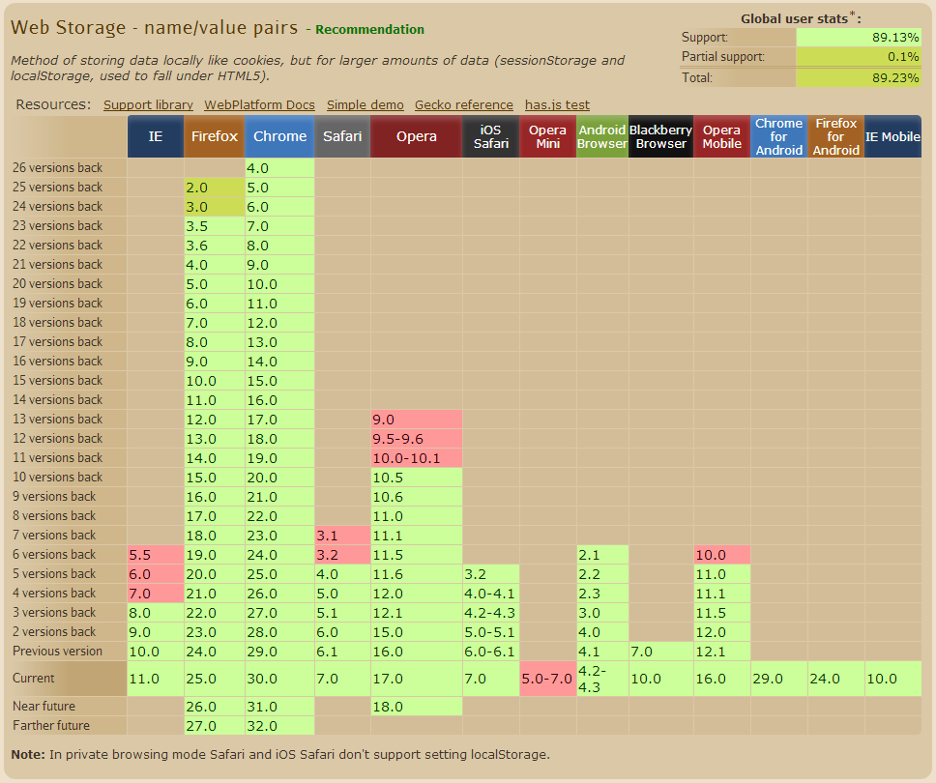
Local Storage

Slide 84
Data Storage : Indexed DB
Indexed DB
It is a web data base stored in the form of object store
A database index is a data structure that improves the speed of data retrieval.
Indexes are used to quickly locate data without having to search every row in a database every time it is accessed.

Slide 85
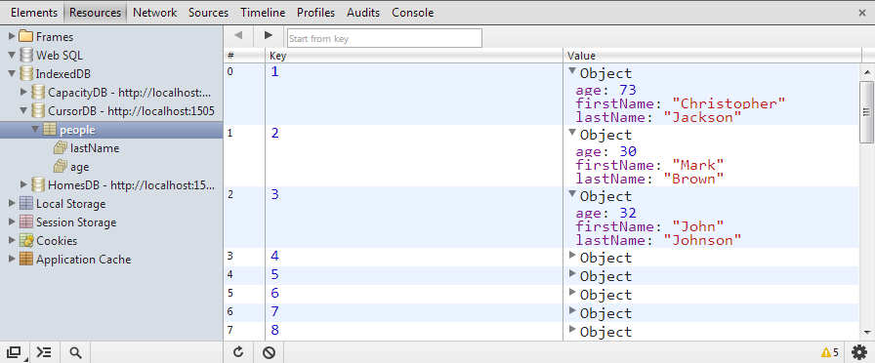
Data Storage : Indexed DB

Slide 86
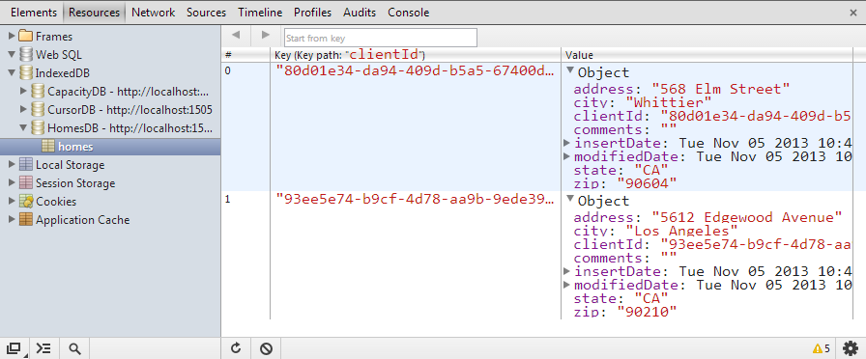
Data Storage : Indexed DB

Slide 87
Data Storage : Indexed DB
Features of IndexedDB API
Asynchronous API
Transactional
Versioning
Sandboxed data
Large capacity

Slide 88
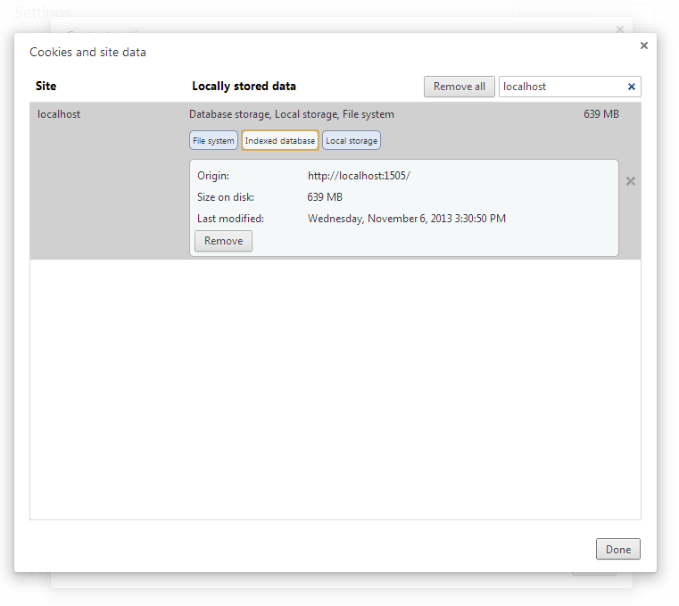
Data Storage : Indexed DB

Slide 89
Offline Application(Contd)
Web applications have a dependency on being able to connect to a network to fetch web pages and data.
However, in some environments a network connection may be intermittent. In these situations, it might
be useful to enable the application to continue functioning by using data cached on the user's device.
HTML5 provides a choice of new client-side storage options, including session storage and local storage,
and a resource caching mechanism called the Application Cache.

Slide 90
What is Application Cache?
HTML5 introduces application cache, which means that a web application is cached, and accessible without an internet connection.
Application cache gives an application three advantages:
Offline browsing - users can use the application when they're offline
Speed - cached resources load faster
Reduced server load - the browser will only download updated/changed resources from the server

Slide 91
Offline Applications
What is Application Cache?
HTML5 introduces application cache, which means that a web application is cached, and accessible without an internet connection.
Application cache gives an application three advantages:
Offline browsing - users can use the application when they're offline
Speed - cached resources load faster
Reduced server load - the browser will only download updated/changed resources from the server

