Slide 1
AZURE MANAGEMENT GROUPS

Slide 2
If there are only a few subscriptions in your organisation, then it's relatively simple to manage them independently. However, in an organisation there are usually many employees and may be, many applications. If all these employees are provided azure subscriptions and if they start creating azure resources at will, it may soon become difficult to control, manage and track who is creating what and eventually the costs may go out of control. So, Azure has four levels of management-scope to organize, secure, manage and track the costs. The following image from MSDN shows the four levels of management-scope and the relationship between them.

Slide 3
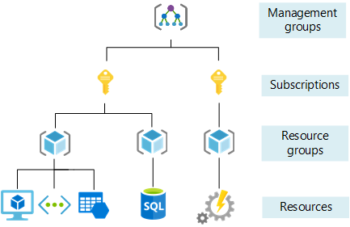

Slide 4
Management groups
Management group is at the top of the hierarchy. All subscriptions in a management group automatically inherit the conditions or settings specified at the management group level. So, a management group is like a container for all your subscriptions. Just like how there can be multiple subscriptions, there can also be multiple management groups in an organisation.
The following image is from MSDN, and it shows, how we can build a flexible structure of management groups and subscriptions to organize our resources into a hierarchy for unified policy and access management.

Slide 5
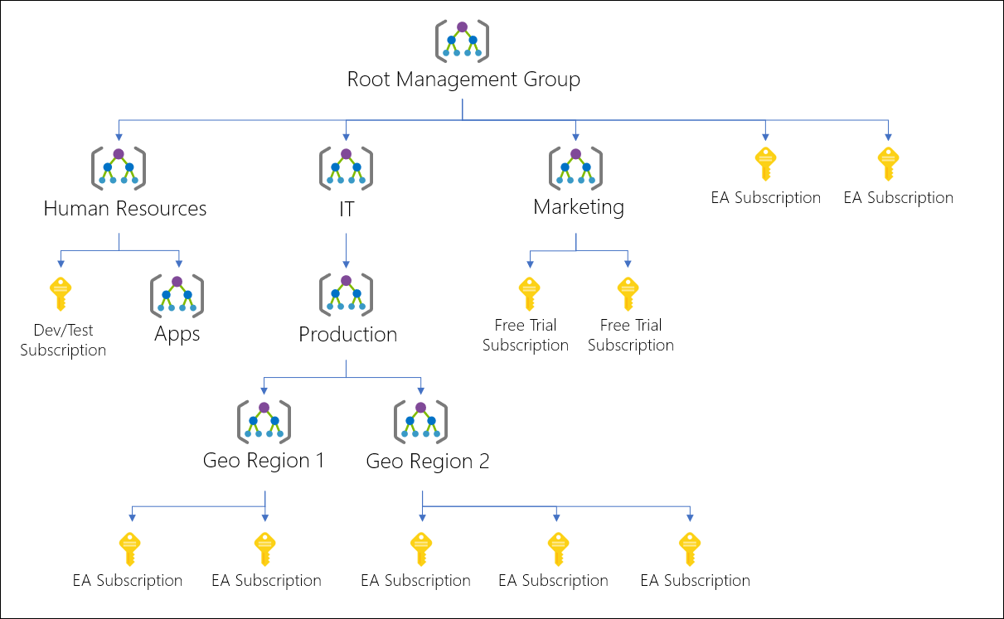

Slide 6
For whatever reason, let's say, in our organisation, we want to allow azure resources to be created only in the East US region. One easy way to do this is to create such a policy at the IT Management Group level. This policy is then automatically enforced on all the Management Groups and Subscriptions that are descendants of the IT management group. The descendants will not be able to alter this security policy in any way and it is also applicable to all resources under those subscriptions. So, obviously governance becomes much easier.

Slide 7
Management settings like policies and role-based access control can be applied at any of the management levels. The level you select determines how widely the setting is applied. Lower levels inherit settings from higher levels. For example, when you apply a policy to a subscription, that policy is also applied to all resource groups and resources in that subscription. In general, it makes sense to apply critical settings at higher levels and project-specific settings at lower levels.
Subscriptions
A subscription sits under a management group. It associates user accounts and the resources that were created by those user accounts. Each subscription has limits or quotas on the amount of resources you can create and use. Organizations can use subscriptions to manage costs and the resources that are created by users, teams, or projects.

Slide 8
Resource groups
A resource group, as the name implies, is a group of related azure resources. It is basically a logical container into which Azure resources like web apps, databases, and storage accounts are deployed and managed. We discussed resource groups in detail in Parts 5 and 6 of this azure tutorial.
Resources
An azure resource is any service instance that you create. For example, virtual machine, Azure sql database, storage account etc.

Slide 9
AVAILABILITY SETS

Slide 10
Azure Fault Domain
What does an azure dataceneter contain? Well, in simple terms, it contains several racks of servers. Each rack in turn, may contain several servers with it's own power supply and network switch. In reality, server racks are much complicated than this. They may be equipped with redundant power supplies and network switches. However, to keep this example simple, let's just say, a rack contains 15 to 20 physical servers with it's own power supply and network switch.

Slide 11
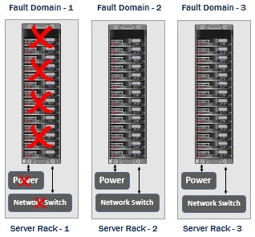
So you can think, each rack of servers as a separate fault domain. For example, if the power supply or network switch fails in a given rack, only the servers in that rack fails. The rest of the server racks are isolated and unaffected. So you may think of a fault domain as a group of resources that may fail at the same time due to the same root cause. It has a single point of failure. For example, if the power supply fails, all the servers in that rack fails. It is very important we understand the concept of fault domains, because, if we deploy our azure resources like virtual machines for example, in two or more fault domains, they remain available should a failure occur in one of the fault domains.

Slide 12
Azure Update Domain
The server hardware and supporting infrastructure in a datacenter is divided in to multiple fault domains and update domains. An update domain is a group of resources that can be updated and rebooted if required at the same time. From time to time, patches and software updates need to be applied. Some updates require servers to be rebooted. Only one update domain is rebooted at a time. A rebooted update domain is then given 30 minutes to recover before maintenance is initiated on a different update domain. This reduces the downtime to a great extent. So, if you want your azure resources, like virtual machines for example to be available even during the update process, have them deployed across multiple update domians.

Slide 13
Azure Availability Set
An Availability Set is a logical grouping for isolating virtual machine resources from each other. Azure makes sure that the VMs we place in an Availability Set run across multiple physical servers, compute racks, storage units, and network switches. If a hardware or software failure happens, only a subset of our VMs are impacted and our overall solution still stays operational. Availability Sets are essential for building reliable cloud solutions.

Slide 14
Let's say we have a simple two tier web application. On one of the virtual machines, we have a web server and on another virtual machine, we have our database server. Now, to be able to handle and process more requests we have 2 web servers and 2 database servers. In real-world, web applications that have lot of demand, for example Google.com, Gmail.com, and Amazon.com may have many many web servers and database servers. However, to keep our example simple, let's just stick to two web servers and two database servers. The load balancer obviously distributes the incoming traffic between the two web servers.

Slide 15
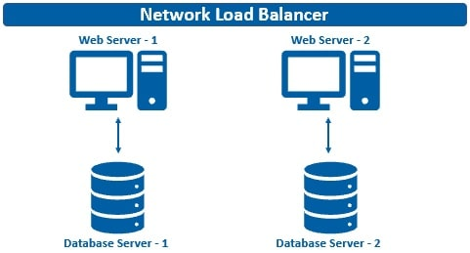
What may happen if availability sets are not used
Well, all the 4 VMs (i.e the two web servers and two database servers) may end up in the same fault domain or update domain. As a result if there is a software failure or hardware failure like power supply or network switch failure, all your web and databaser servers go down. End result your web application is no longer available. If it's an e-commerce application like amazon.com for example, just imagine the extent of loss to the business every second the system is down.

Slide 16
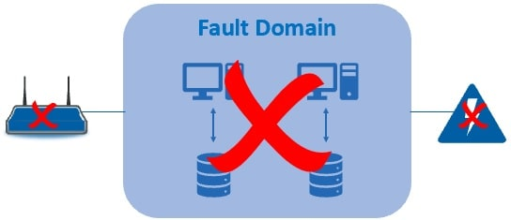
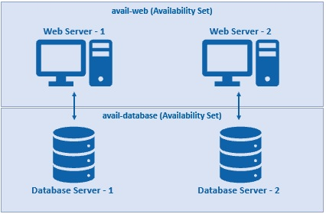
Use availability sets for high availability
Since we have two tiers - a web tier and a database tier, we create 2 availability sets - one for the web tier and the other for database tier.

Slide 17
In Azure, when creating an availability set, we specify the following:
Name
The name of the of the availaility set. It's a common convention to use the prefix "avail" for availability sets
Region
Azure region where we want the resources to be deployed
Fault domains
The number of fault domains you want in the availability set. For example, if you set the fault domains to 3 and you create 3 virtual machines, each of them will be placed in 3 separate fault domains. If there is a fault like a power failuer for example, only one of the server racks is affected. This means only one of you VM is down, but the other 2 vms from the other 2 fault domains are still available. This in turn means, your workload i.e in this case your web application is still available to end users.

Slide 18
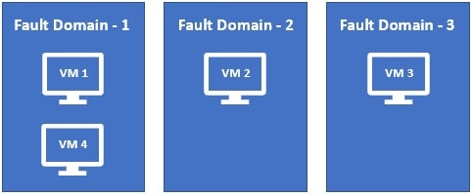
What happens if we create a fourth VM with 3 fault domains. Well, it will be placed in one of the 3 fault domains. This means, in one of the 3 fault domains, you will have 2 VMs and the rest 2 will have 1 each.

Slide 19
Update Domains
The number of update domains you want. Let's say, you have 3 VMs deployed across 3 update domains. If an update is installed and a restart is required, only one update domain is restarted at any given time. This means you have the other 2 VMs available from the rest of the 2 update domains.

Slide 20
Availability Sets and Virtual Machine SLA
For all Virtual Machines that have two or more instances deployed in the same Availability Set, Microsoft guarantees, you will have Virtual Machine Connectivity to at least one instance at least 99.95% of the time.
You can't add an existing Virtual Machine to an availability set after it's created. So, if you want a virtual machine in an availability set, it's a decision you have to make at the time of creation, not after it is created.

Slide 21
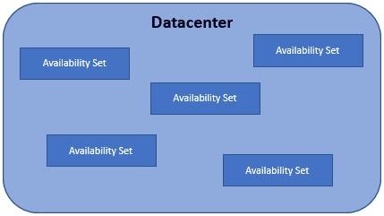
Update Domains and Fault Domains in an Availability Set
Availability set is a concept with in a datacenter.
The servers in a datacenter are divided into multiple physical and logical groups. The physical grouping is called fault domain and the logical grouping is called update domain.

Slide 22
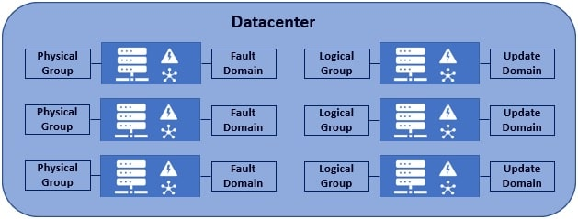
You can think of each rack of servers with it's own power supply and network switch as one fault domain. So, if there are 10 racks of server in a datacenter, it's like you have 10 different falut domains. Now, you may be thinking, why is such a grouping required. Well, to eliminate single point of failure.

Slide 23
For example, let's say in a datacenter, we have 100 servers and all these servers are connected by a single power supply and network switch. What if that single power supply or network switch fails? Well, all the 100 servers will fail as well.
So, to eliminate such a single point of failure, each rack of servers has it's own power supply and network switch. Let's say in each rack we have 10 servers. When the power supply or network switch in that rack fails, only the 10 servers in that rack are affected. The rest of the 9 racks i.e the other 90 servers are unaffected.
So, by grouping servers in a datacenter into multiple racks i.e multiple fault domains, we are able to eliminate a single point of failure.

Slide 24
Same idea with update domains. If there are 100 servers in a datacenter, they are logically grouped into 10, 15 or 20 update domains. So the important point to keep in mind is, an update domain is a logical grouping. Why are update domains required? Well, from time to time, server patches and software updates need to be applied. Some updates require servers to be rebooted. Now, we don't want all the servers to be rebooted at the sametime. Only one update domain is rebooted at a time. A rebooted update domain is then given 30 minutes to recover before maintenance is initiated on a different update domain. So, in short, an update domain is a group of servers that can be updated and rebooted at the same time.

Slide 25
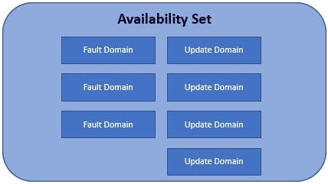
An availability set is a concept with in a datacenter and it is made up of multiple fault domains and update domains. In fact, when you create an availability set, you can specify how many fault domains and update domains you want in that availability set.

