Slide 1

2B9DBA
Women helping Women Worldwide

Slide 2
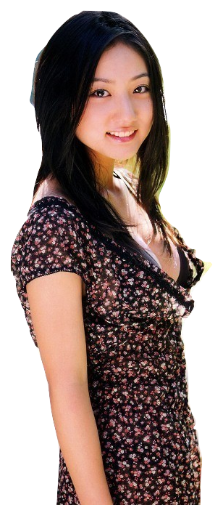
Min-seo Lee
Coming to live permanently in US to Berkeley, CA with husband and 2 year old daughter
25 years of age
Fluent in Korean and English
“How can I get a job here? I would like to teach Korean.”

Slide 3
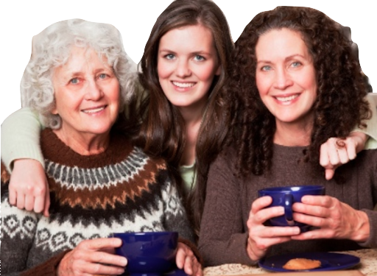
Yulia Baikov
Working at Apple as a product management lead
Her grandma and Mother came to visit her. They are only fluent in Russian
“I hope someone can travel them around during the time I am at work”

Slide 4
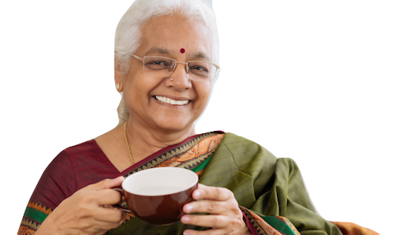
Sunita Patel
Traveling to US to attend the graduation ceremony of her daughter
62 years of age
Fluent in Hindi
“I want to find a place to do grocery and cook Indian authentic food for my daughter.”

Slide 5
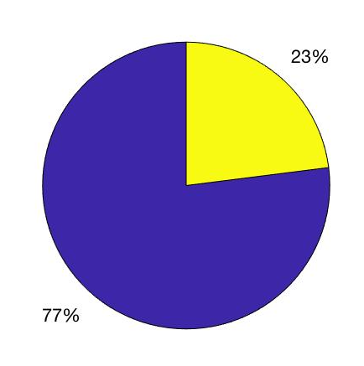
Women helping Women Worldwide
Women immigrants: students, professionals and other workers, spouses, parents, and caregivers.
Strong ties between social adaptation and depression in immigrant Women.
Percentage of immigrants are Limited English Proficient: In 2016, ~ 49 percent (21.3 million) of the 43.4 million immigrants ages 5 and older were LEP.

Slide 6
Implementation

Slide 7
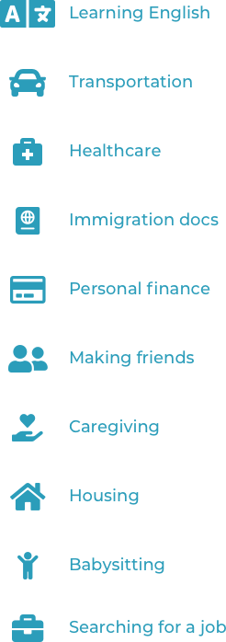

Slide 8
References
https://www.migrationpolicy.org/article/frequently-requested-statistics-immigrants-and-immigration-united-states#Demographic
https://www.globalcitizen.org/en/content/the-7-biggest-challenges-facing-refugees-and-immig/
https://europepmc.org/abstract/med/18080969

