Slide 1
PowerPoint 模板
黄湘云

Slide 2
Table of Contents
In the morning
Getting up
Breakfast
In the evening
Dinner
Going to sleep
壮士！我要模板
Python 块
matplotlib 绘图
软件信息

Slide 3
In the morning

Slide 4
Getting up
Turn off alarm
Get out of bed

Slide 5
Breakfast
Eat eggs
Drink coffee

Slide 6
In the evening

Slide 7
Dinner
Eat spaghetti
Drink wine

Slide 8
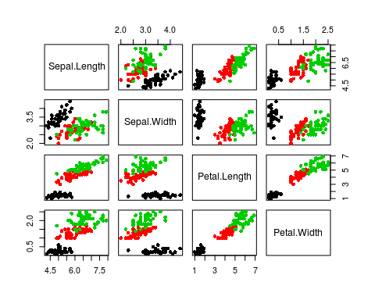
散点图

Slide 9
Going to sleep
Get in bed
Count sheep

Slide 10
壮士！我要模板
--- title: "Habits" output: powerpoint_presentation: reference_doc: my-styles.pptx ---

Slide 11
Python 块
import numpy as np import matplotlib.pyplot as plt plt.switch_backend('agg') # Very Important in R Markdown t = np.arange(0.0, 2.0, 0.01) s = np.sin(2*np.pi*t) plt.plot(t,s) plt.title(r'$\alpha_i > \beta_i$', fontsize=20) plt.text(1, -0.6, r'$\sum_{i=0}^\infty x_i$', fontsize=20) plt.text(0.6, 0.6, r'$\mathcal{A}\mathrm{sin}(2 \omega t)$', fontsize=20) plt.xlabel('time (s)') plt.ylabel('volts (mV)') plt.show() # plt.savefig('math-in-plot.png', bbox_inches='tight', dpi = 300) # plt.savefig('math-in-plot.pdf', bbox_inches='tight')

Slide 12
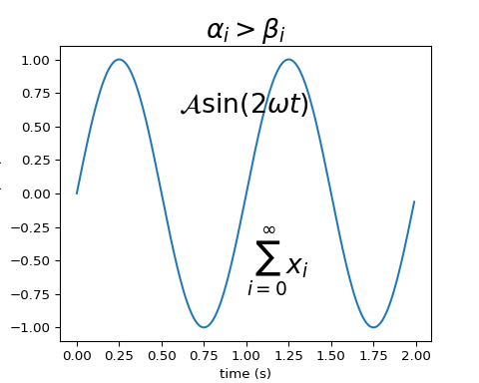
matplotlib 绘图
数学公式

Slide 13
软件信息
devtools::session_info("rmarkdown")
## ─ Session info ────────────────────────────────────────────────────────── ## setting value ## version R version 3.5.0 (2017-01-27) ## os Ubuntu 14.04.5 LTS ## system x86_64, linux-gnu ## ui X11 ## language (EN) ## collate en_US.UTF-8 ## ctype en_US.UTF-8 ## tz UTC ## date 2018-11-13 ## ## ─ Packages ────────────────────────────────────────────────────────────── ## package * version date lib source ## backports 1.1.2 2017-12-13 [1] CRAN (R 3.5.0) ## base64enc 0.1-3 2015-07-28 [1] CRAN (R 3.5.0) ## digest 0.6.18 2018-10-10 [1] CRAN (R 3.5.0) ## evaluate 0.12 2018-10-09 [1] CRAN (R 3.5.0) ## glue 1.3.0 2018-07-17 [1] CRAN (R 3.5.0) ## highr 0.7 2018-06-09 [1] CRAN (R 3.5.0) ## htmltools 0.3.6 2017-04-28 [1] CRAN (R 3.5.0) ## jsonlite 1.5 2017-06-01 [1] CRAN (R 3.5.0) ## knitr 1.20 2018-02-20 [1] CRAN (R 3.5.0) ## magrittr 1.5 2014-11-22 [1] CRAN (R 3.5.0) ## markdown 0.8 2017-04-20 [1] CRAN (R 3.5.0) ## mime 0.6 2018-10-05 [1] CRAN (R 3.5.0) ## Rcpp 1.0.0 2018-11-07 [1] CRAN (R 3.5.0) ## rmarkdown 1.10 2018-06-11 [1] CRAN (R 3.5.0) ## rprojroot 1.3-2 2018-01-03 [1] CRAN (R 3.5.0) ## stringi 1.2.4 2018-07-20 [1] CRAN (R 3.5.0) ## stringr 1.3.1 2018-05-10 [1] CRAN (R 3.5.0) ## tinytex 0.9 2018-10-23 [1] CRAN (R 3.5.0) ## xfun 0.4 2018-10-23 [1] CRAN (R 3.5.0) ## yaml 2.2.0 2018-07-25 [1] CRAN (R 3.5.0) ## ## [1] /home/travis/R/Library ## [2] /usr/local/lib/R/site-library ## [3] /home/travis/R-bin/lib/R/library

