Slide 1
MIDSUMMER MULTIMODAL AI HACKATHON
Exhale
The calls you've been dreading, handled in one tap.
Snap a photo of a confusing bill. Say what's wrong. Exhale reads it, makes the call, and handles the bureaucracy — while you breathe.

Slide 2
LET IT GO
Everyone has a call they're avoiding.
Disputing a medical bill. Reversing a wrong charge. Canceling a subscription that won't let you leave. We put these off for months — not because they're hard, but because they're dreadful.
40 min
$125B+
1 in 5
average hold time we'll do anything to avoid
in medical bills overpaid each year in the U.S.
bills contain an error people never dispute
It's not a knowledge problem. It's an avoidance problem.

Slide 3
THE IDEA
The magic is combining messy-document understanding with the phone call people avoid.
AI calling isn't new. Document readers aren't new. The product is the handoff — from understanding the confusing notice to taking real-world action on the phone, in one tap.

Slide 4




HOW IT WORKS
Four steps. One tap.
1
2
3
4
Snap the document
>
Exhale reads it
>
It makes the call
>
Resolved & saved
Photograph the confusing bill, notice, or statement.
Nebius extracts the real account, claim, and amount — and plans the call.
Vapi dials, navigates 'press 1 for billing', and speaks as you.
You get the outcome, reference number, and transcript — stored in Insforge.
Multimodal by design: voice and document vision are both load-bearing — not bolted on.

Slide 5
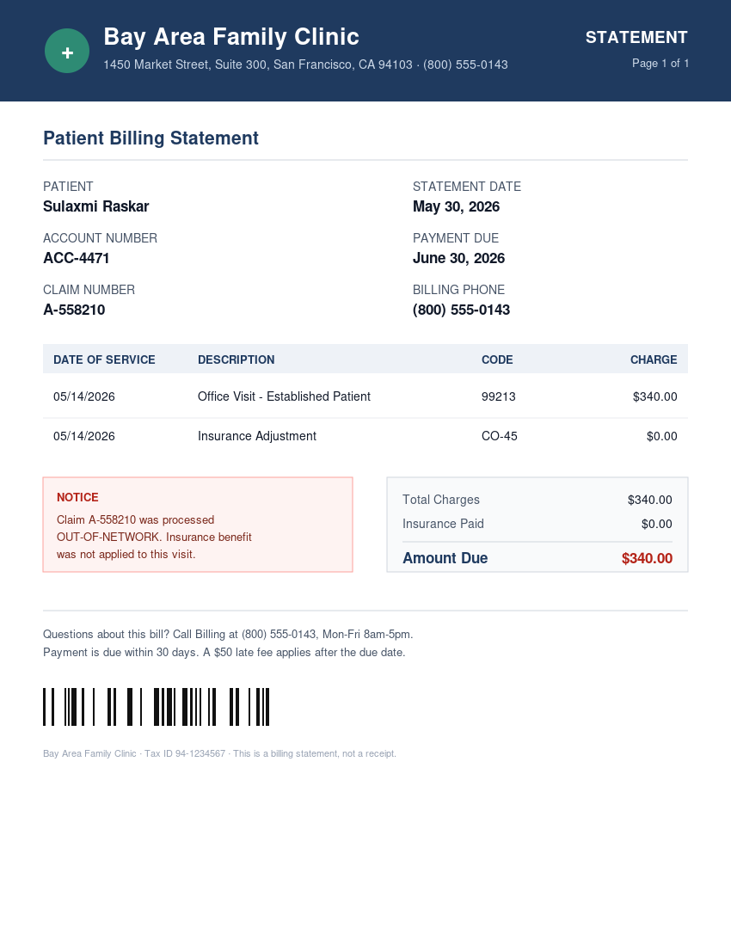
LIVE DEMO
A $340 medical bill, disputed live.
RESOLVED
Reads the bill
Claim A-558210, $340, processed out-of-network.
Calls billing
Navigates the menu, verifies the account as the patient.
Makes the case
Asks for the claim to be reprocessed in-network.
Returns the result
Flagged for review · ref RPC-99421 · deadline paused.

Slide 6





NOT JUST MEDICAL BILLS
Any dreaded call. Any document.
Dispute a medical bill
Cancel a subscription
Dispute a card charge
Out-of-network or coding errors, reprocessed.
The gym or service that forces you to call.
Quote the transaction; request a reversal.
Fight a parking ticket
Waive a late / overdraft fee
Reference the citation; contest or extend.
Ask for the one-time courtesy waiver.

Slide 7
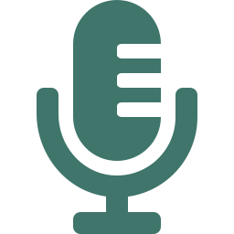

BUILT ON
Three sponsors, one demo.
Nebius
Vapi
Insforge
Multimodal LLM reads the document (OCR + reasoning) and writes the call plan.
Places the outbound call, navigates the phone menu, and talks to the rep.
Backend that stores every case — transcript, outcome, and history.

Slide 8
COMMERCIALLY VIABLE
A paid industry — done instantly.
25%
Exhale does it for a flat fee, instantly, for every kind of dreaded call.
of what they save you — what medical-bill advocates charge today, for the same phone calls.
Best Workflow Agent
Best Agent People Love
Best Overall Project

Slide 9
Exhale
Drop in the document. Say what's wrong. Exhale handles the bureaucracy.
Read the notice you've been dreading — and let it go.

