Slide 1
S. AUREUS MANUSCRIPT_03 My Preliminary Findings
Prepared by: Sulayman Sowe
Institution: MRCG at LSHTM
Submitted to: Dr. Abdoulie Bojang, Research Fellow & PI

Slide 2
Research Topic
Our hypothesis:
Is nasopharyngeal carriage of Staphylococcus aureus associated with invasive disease in the same patient? A genomic approach.
The data we have:
1. Our cohort was heavily skewed towards young infants (median age: 9.0 months) presenting during the high-transmission rainy season (62.9%) Table 2. i.e. 35 Pediatric patients.
2. Isolates were characterized using MLST and profiled for 30 distinct virulence genes and AMR markers.

Slide 3
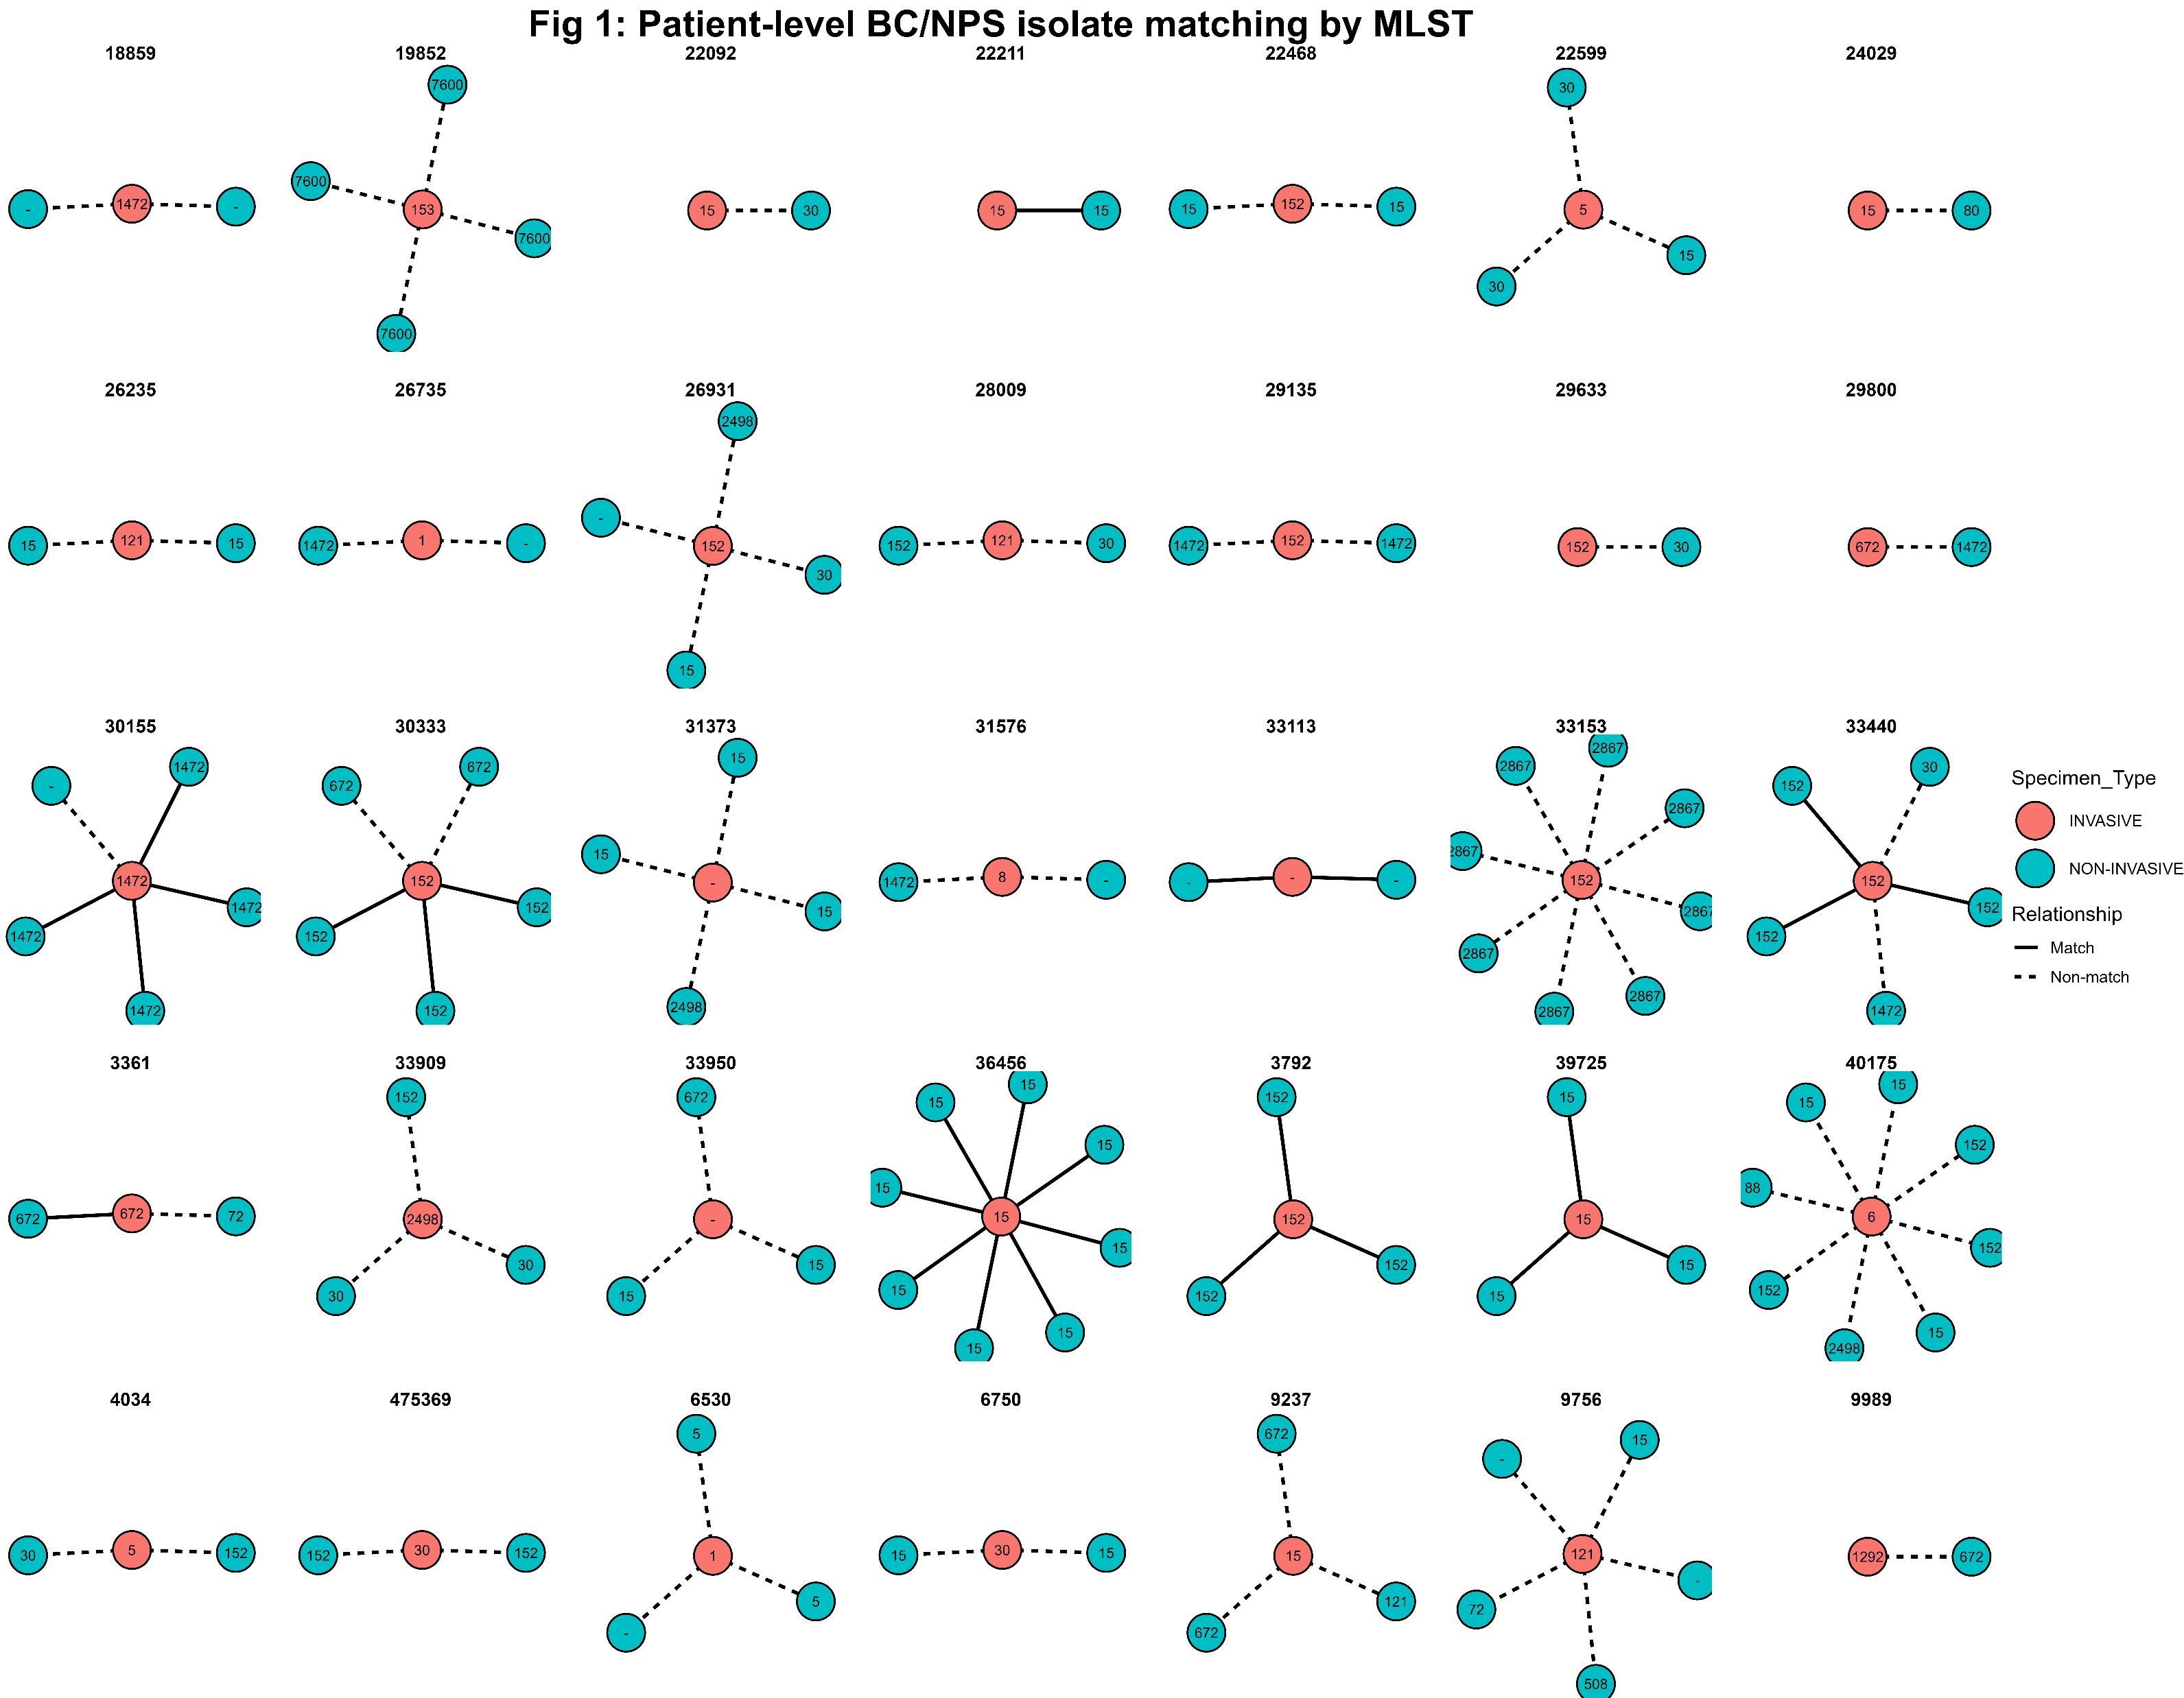
Figure 1: Visual representation of my core result
Question:
Which patients have matching vs non-matching BC/NPS isolates by genetic similarity?
Answer:
74% (26/35) of patients carried an invasive blood clone that did not match their sampled nasal clone.
See Table 3.

Slide 4
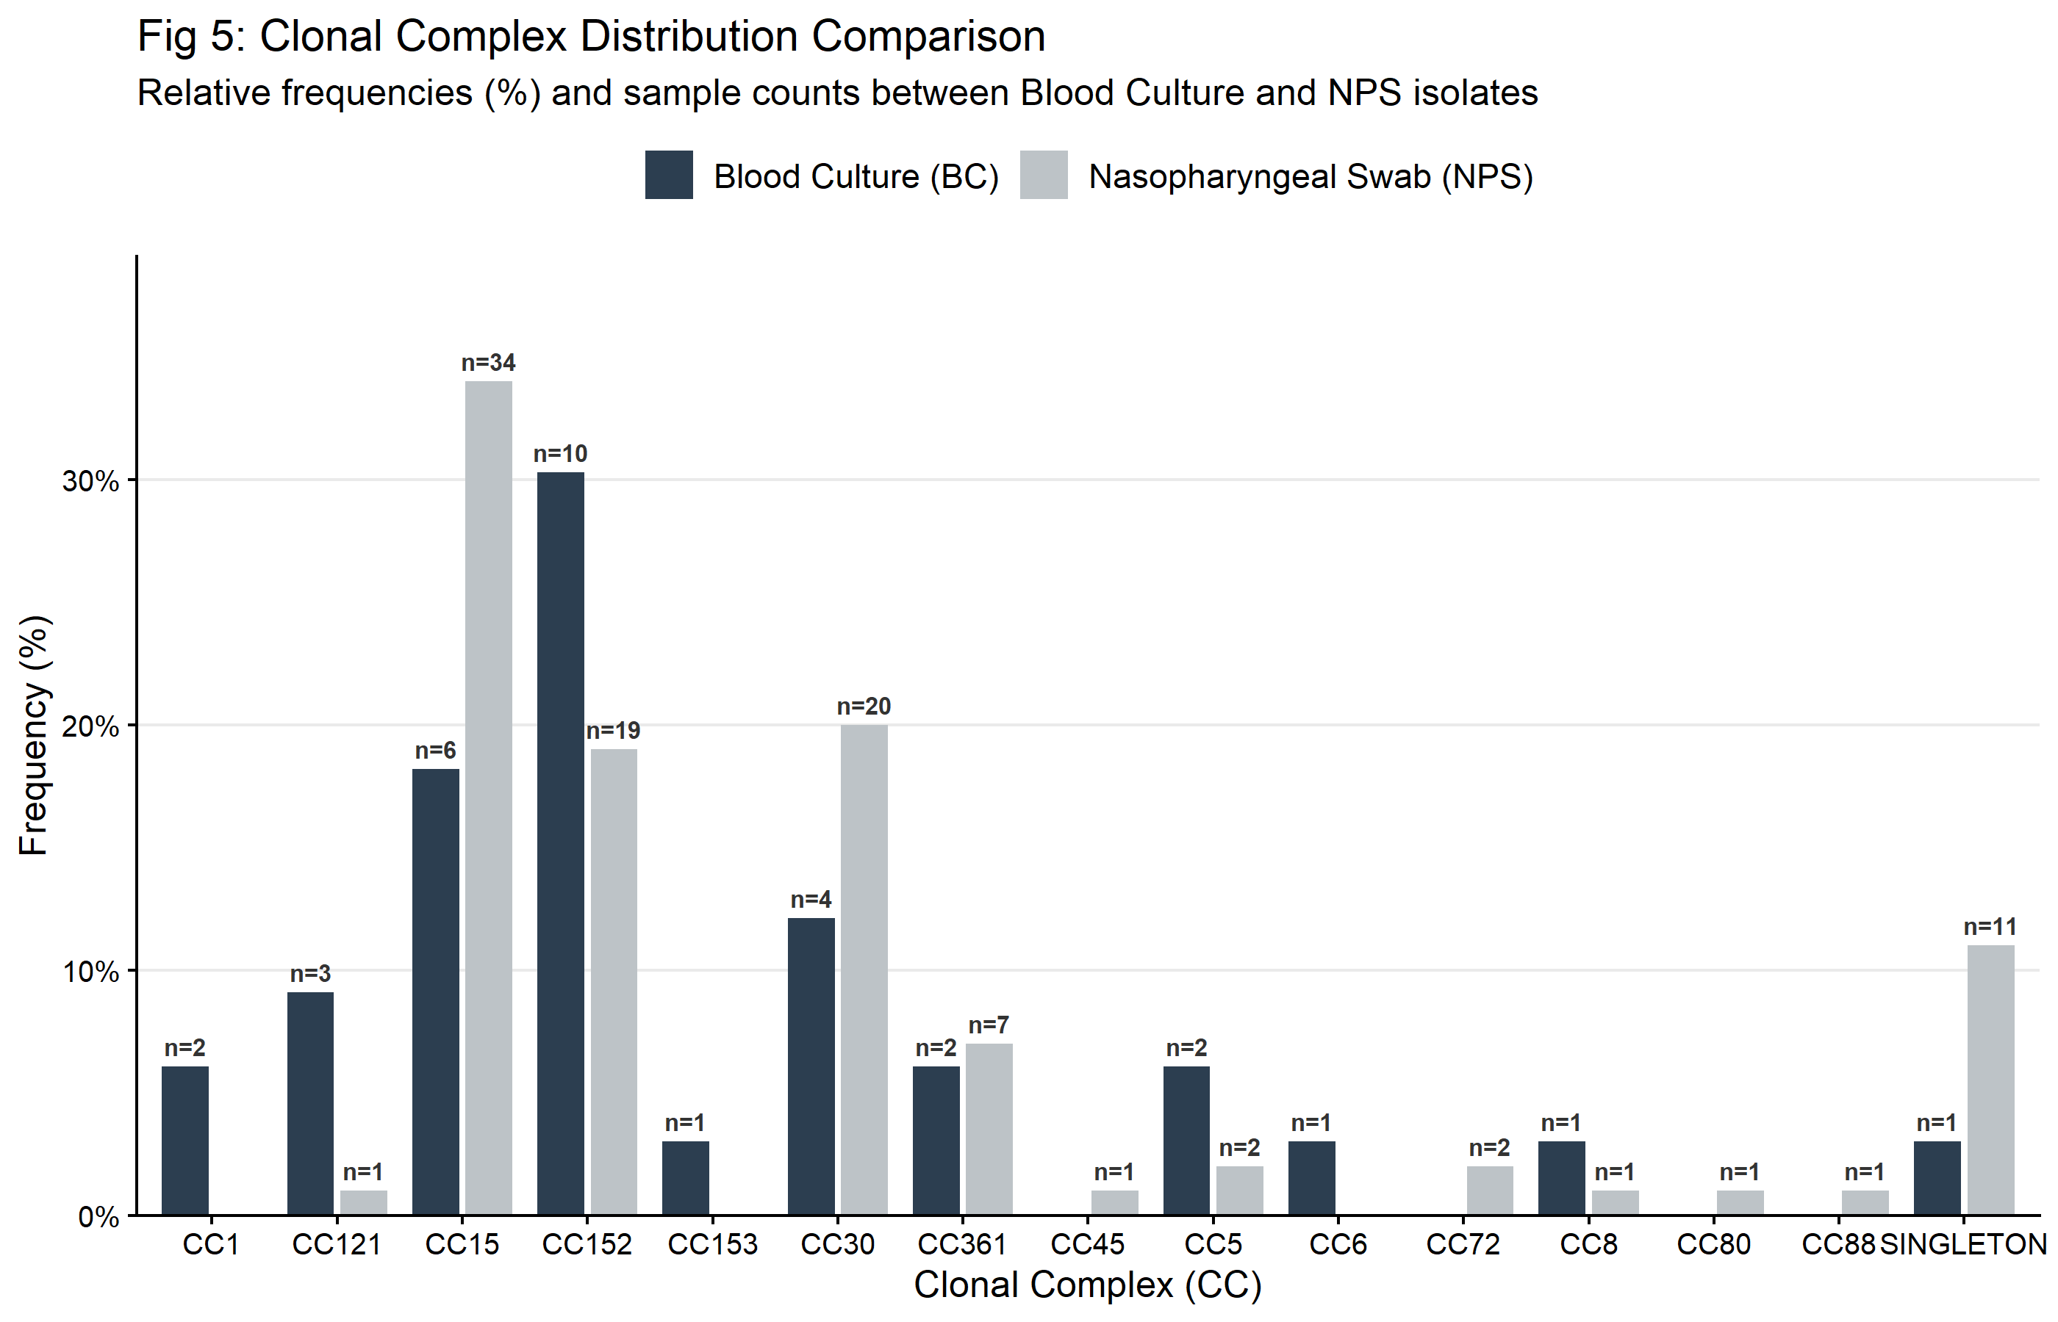
Figure 5: Different lineages?
Question:
Do BC and NPS isolates come from different lineages?
Answer:
No, the two groups look highly similar at the population level dominated by circulating regional clones including CC152 (22.9% vs 22.9%) and CC15 (17.1% vs 34.3%).
See table 4.

Slide 5
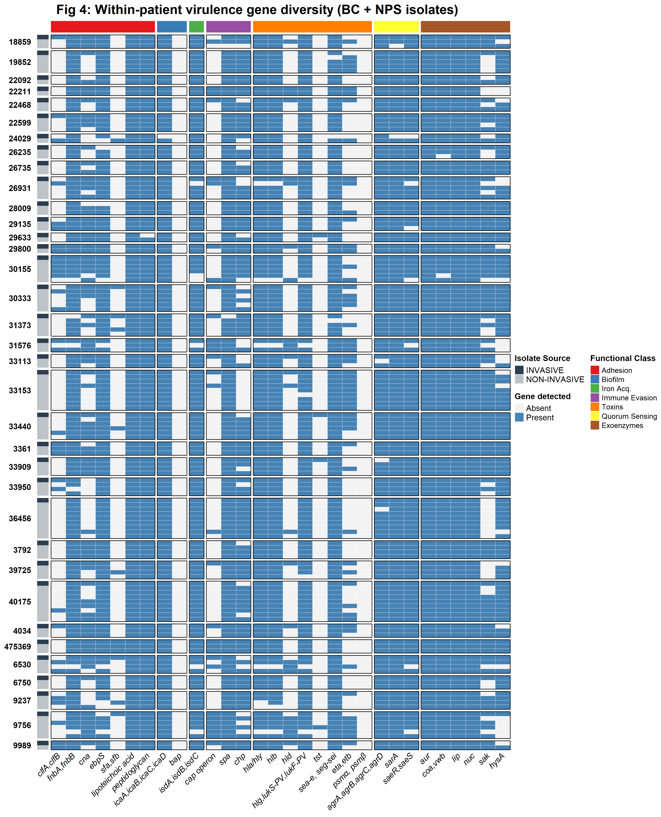
Figure 4: Virulence Heatmap
Why do we have low concordance (74% mismatch)?
The visual patterns in individual blocks for each patient, show that BC and NPS isolates are frequently not genetically identical.
However, there are similar virulence patterns between BC and some NPS isolates.

Slide 6
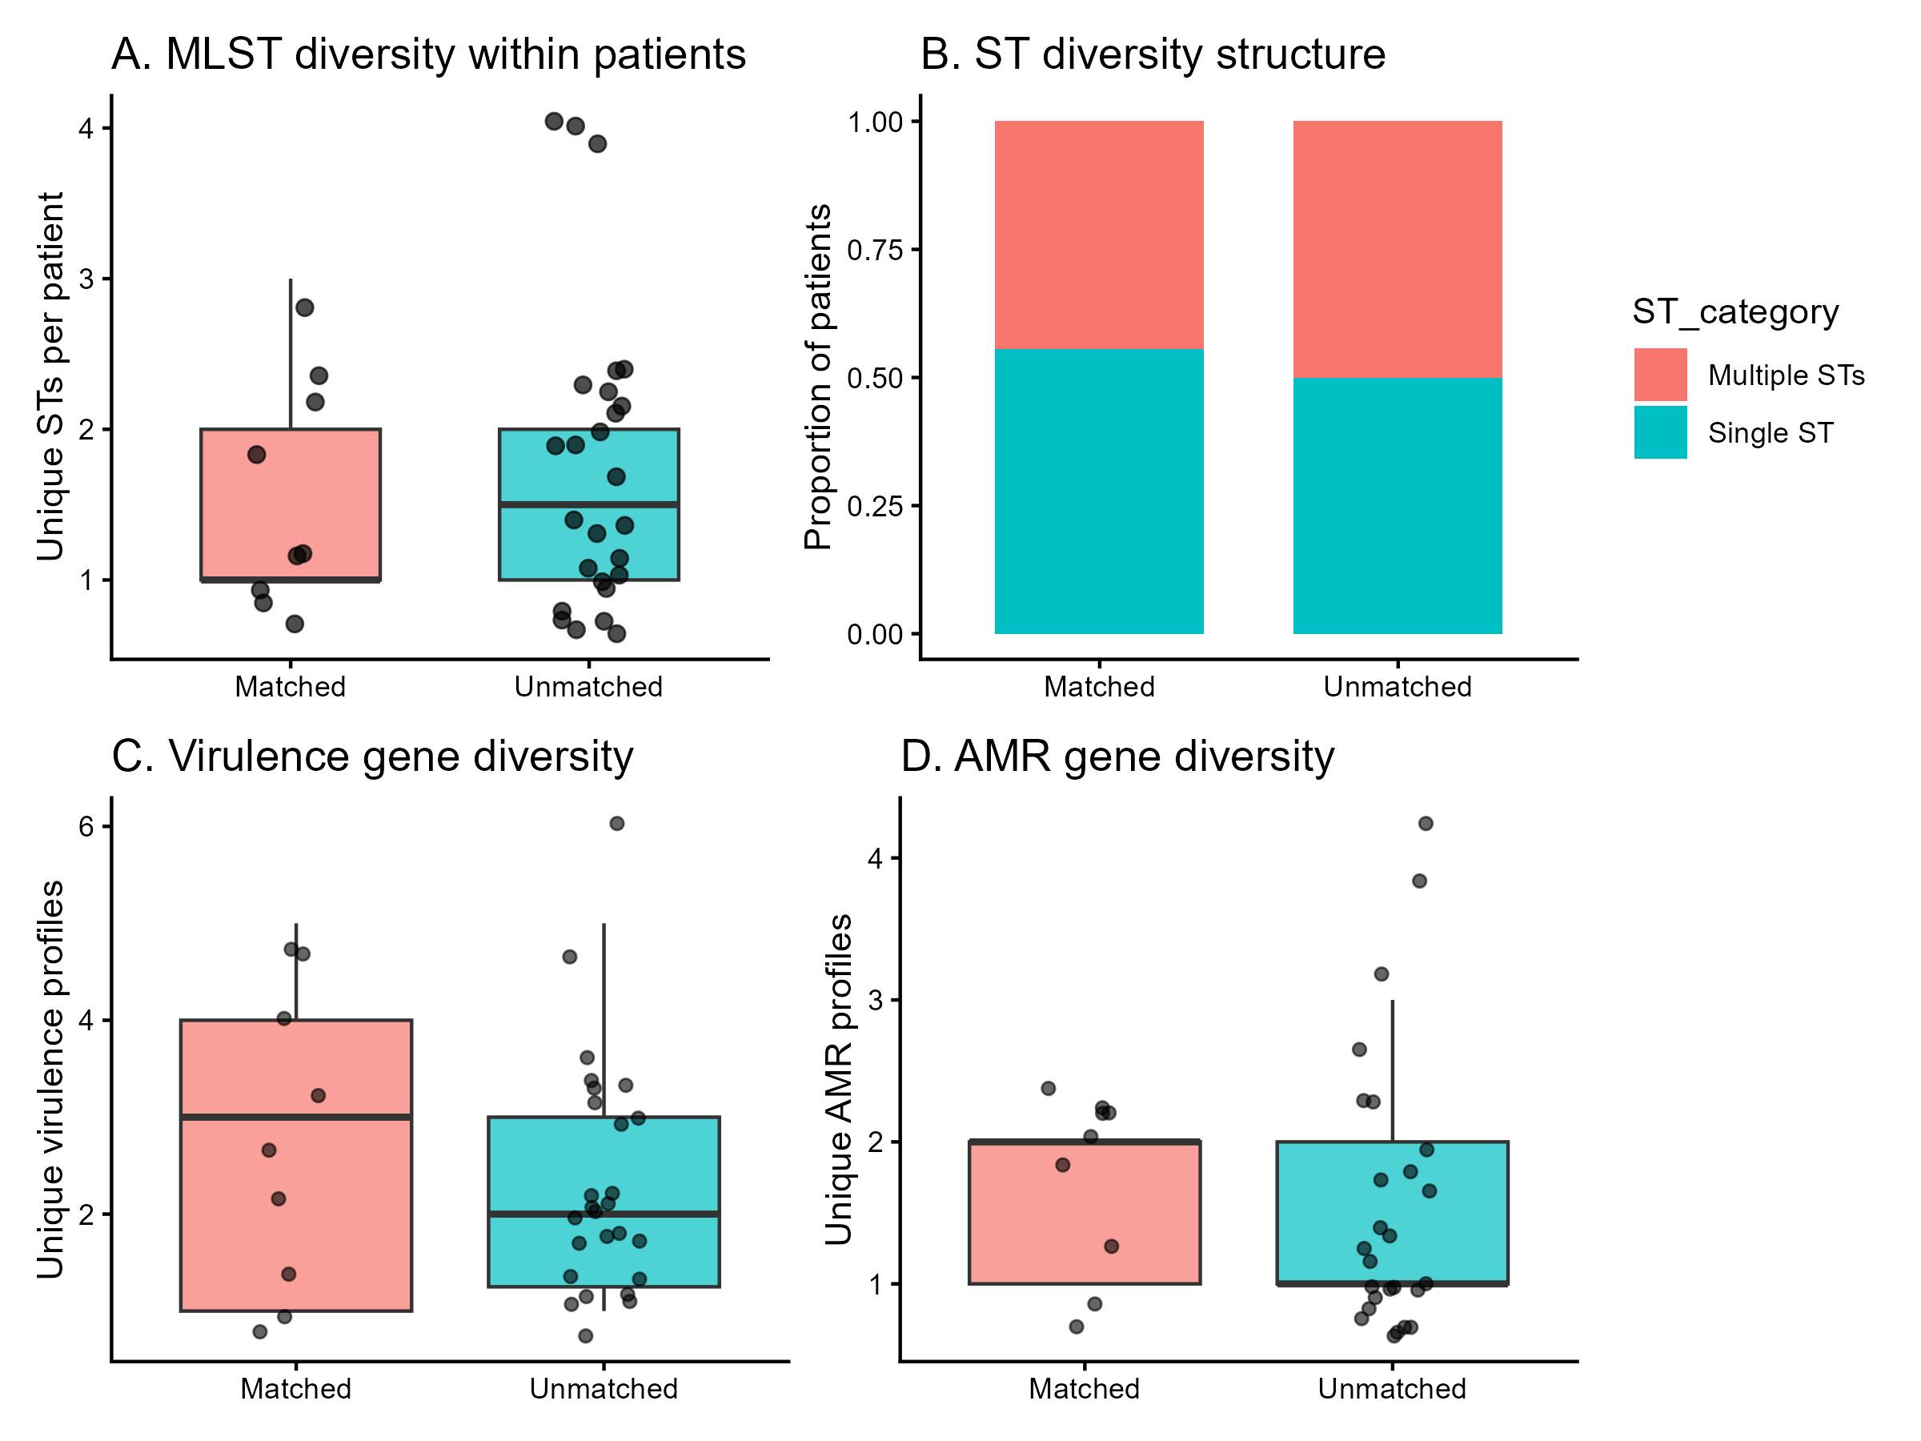
Figure 2: Sampling Limitations?
Does sampling limitations explain the low matches?
Yes! sampling limitations are a major reason for our low concordance matches.
Unmatched Patients:
Unmatched patients harbored highly diverse nasal environments with up to 4 unique STs and 6 distinct virulence profiles simultaneously.
Matched Patients:
matching was heavily restricted to patients with simplified, single-ST colonization profiles.

Slide 7
Conclusions…..
While the overall S. aureus population structure confirms that regional carriage lineages drive invasive sepsis, a standard nasal swab is a poor predictor of an individual child's disease strain.
Invasive clones frequently hide as low-abundance minority variants within hyper-diverse nasopharyngeal reservoirs, highlighting the profound impact of diagnostic sampling limitations on host-pathogen tracking.

Slide 8
Change of Research topic?
Based upon the analysis results, I will propose the following research topic to better reflect our unique context and dataset:
Navigating the Mismatch: High Intra-Host Diversity and Sampling Limitations Obscure the Nasopharyngeal Origin of Invasive Staphylococcus aureus Sepsis in Gambian Infants.

