Slide 1

County Labor Analysis and Salary Statistics (CLASS)
PI: Sulchan Yoon
Montgomery College
Data 205

Slide 2
Covid and the Economic Impacts
How did Montgomery County withstand the financial pressures of the Corona-Virus?
Did Montgomery County do better or worse than similar counties?
Has the economy of Montgomery County bounced back?

Slide 3
Covid-19 Major Events
First case of Novel Coronavirus in US
Restaurants, Movies, and Gyms close in MD
Maryland starts Stay At Home Orders
Dec ‘19
Mar ‘20
Mar ‘20
May ‘20
Jan ‘20
Mar ‘20
Mar ‘20
Outbreak is reported in Wuhan
Shutdowns start in the US
First Aid Package is Signed
Unemployment hits 14.7% in US, 9.3% in MD
Notes:
12/12/2019 outbreak of a virus in Wuhan
1/20/2020 first case of Novel Coronavirus in US
3/15/2020 shutdowns in the US start
3/16/2020 close of bars, restaurants, movies, gyms in Maryland
3/27/2020 Aid and Relief is signed
3/30 Maryland Stay at home
5/9/2020 Unemployment at record 14.7% since Great Depression (9.3% in Maryland)

Slide 4
Covid-19 Major Events
Inflation starts to significantly rise
Second Relief Bill Signed
Inflation hits recent highs at 9.1%
Jun ‘20
Mar ‘21
Jul ‘21
Apr ‘23
Dec ‘20
Jun ‘21
Jun ‘22
Montgomery County starts Social Distancing Orders
GDP returns to pre-pandemic levels
State of Emergency in Maryland Ends
State of Emergency in US Ends
Notes:
6/1 social distancing for Montgomery County
12/27/2020 Second Relief Bill signed
Q1 2021 GDP returned to pre-pandemic level
Q2 2021 significant rise of inflation begins with April hitting 4.2% compared to March 2.6
July 2021 state of emergency in Maryland ends by Gov. Hogan
June 2022 Inflation hits recent highs at 9.1%
April 10 2023 US Covid 19 emergency end
May 5 2023 WHO officially declares end of Covid 19 emergency

Slide 5

Montgomery County
Maryland
In 2020,
Population: 1,050,000
Employed: 559,029
Median Income: $111,812
Median Income Men: $63,611
Median Income Women: $50,242

Slide 6








Similar Counties
Washington DC
Douglas County
Fairfax County
Howard County
Loudoun County
Santa Clara County
Williamson County
Compare variety of metrics, such as income, population, and locality
Summary of Counties from 2020

Slide 7

Washington DC
Population: 701,974
Employed: 382,000
Median Income: $90,842
Median Income Men: $72,201
Median Income Women: $61,133

Slide 8

Douglas, Colorado
Population: 344,280
Employed: 188,155
Median Income: $121,393
Median Income Men: $79,055
Median Income Women: $46,163

Slide 9

Fairfax, Virginia
Population: 1,150,000
Employed: 611,782
Median Income: $127,866
Median Income Men: $74,391
Median Income Women: $52,422

Slide 10

Howard, Maryland
Population: 322,407
Employed: 170,492
Median Income: $124,042
Median Income Men: $84,366
Median Income Women: $55,539

Slide 11

Loudoun, Virginia
Population: 405,312
Employed: 220,064
Median Income: $147,111
Median Income Men: $93,579
Median Income Women: $52,860

Slide 12

Santa Clara, California
Population: 1,920,000
Employed: 992,202
Median Income: $130,890
Median Income Men: $79,036
Median Income Women: $50,802

Slide 13

Williamson, Tennessee
Population: 232,380
Employed: 117,937
Median Income: $111,196
Median Income Men: $76,666
Median Income Women: $41,063

Slide 14
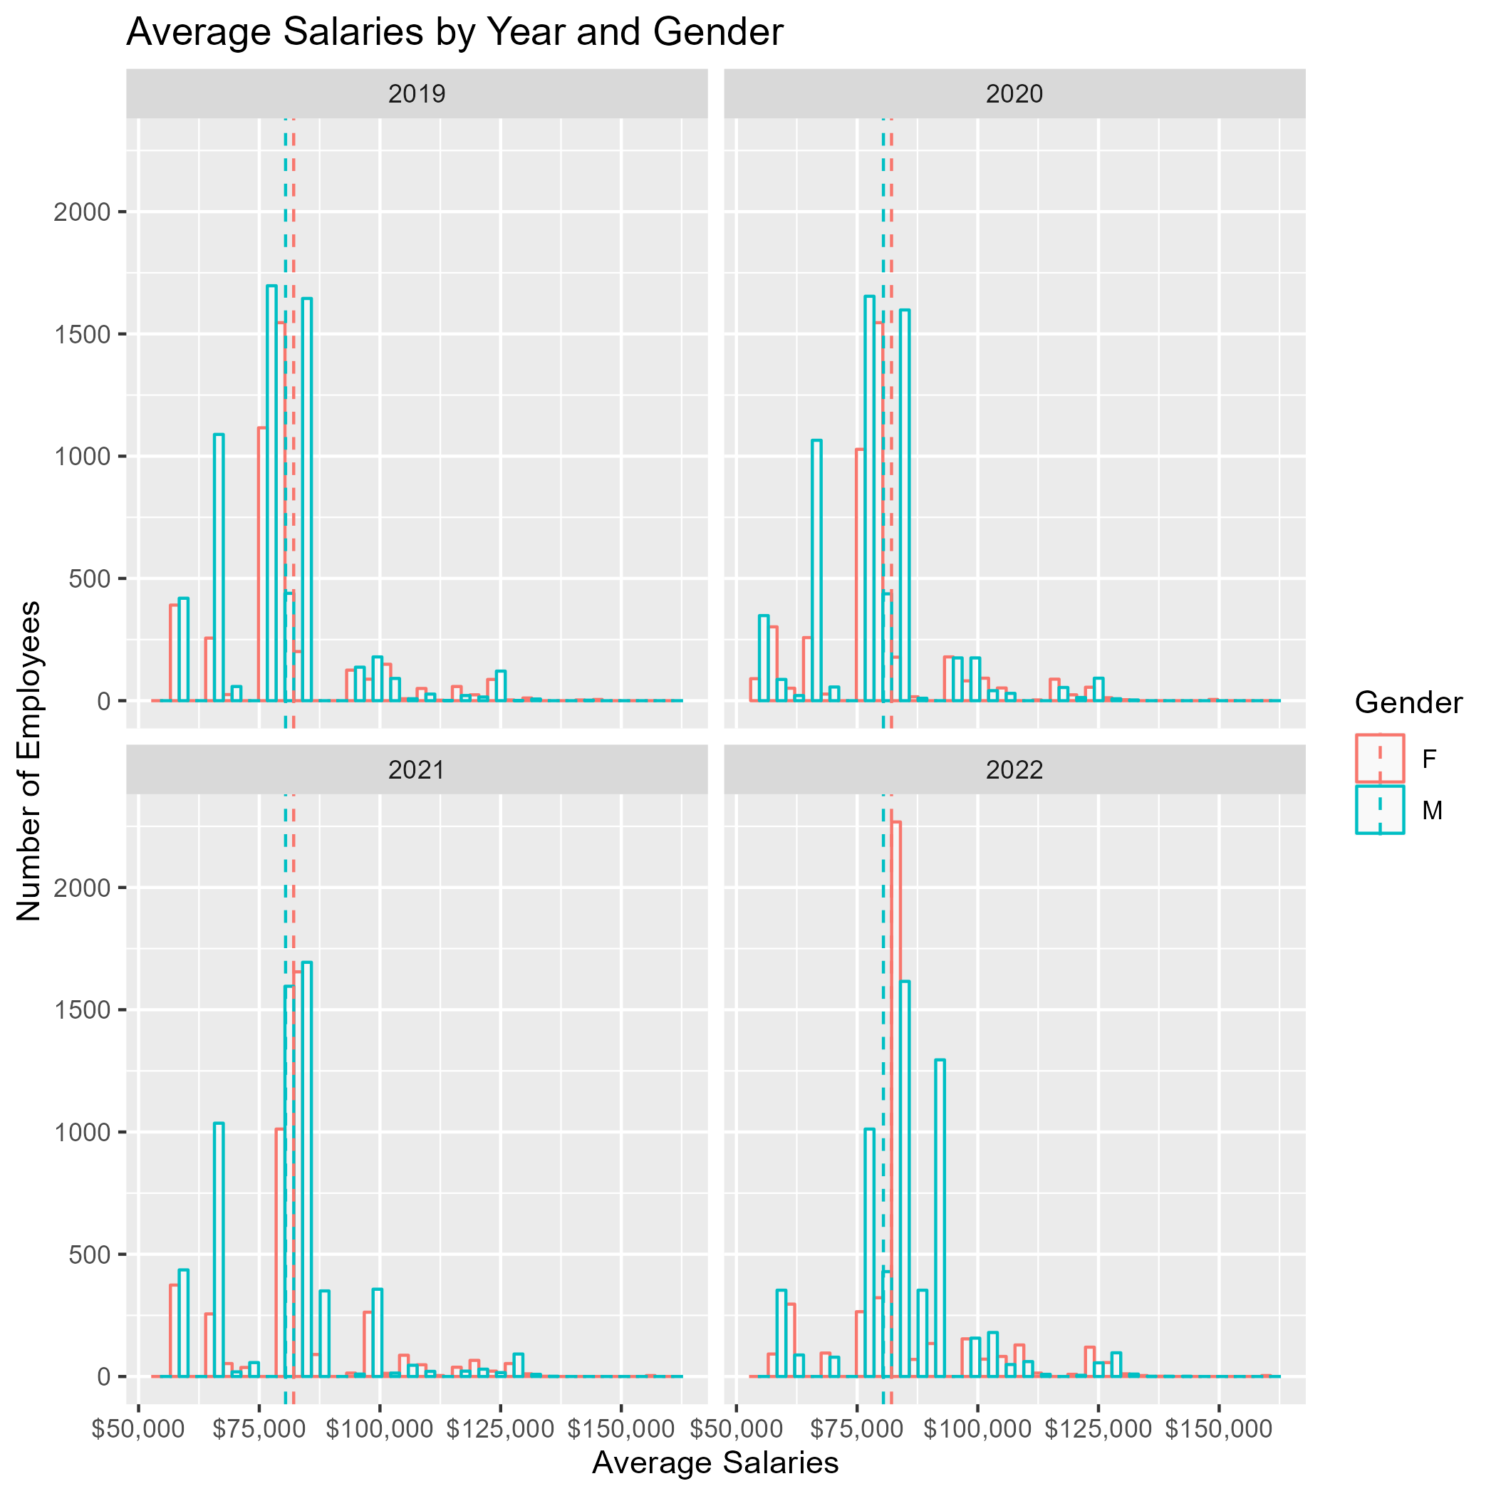
The Good
Montgomery County has been making strides to maintain equality with their public employees.
The Montgomery Public Sector has brought the average salary for Females to $82,124.28 as compared to their male counterparts at $80,445.82.
Overall, the salary gap within departments for all employees has been closing.

Slide 15
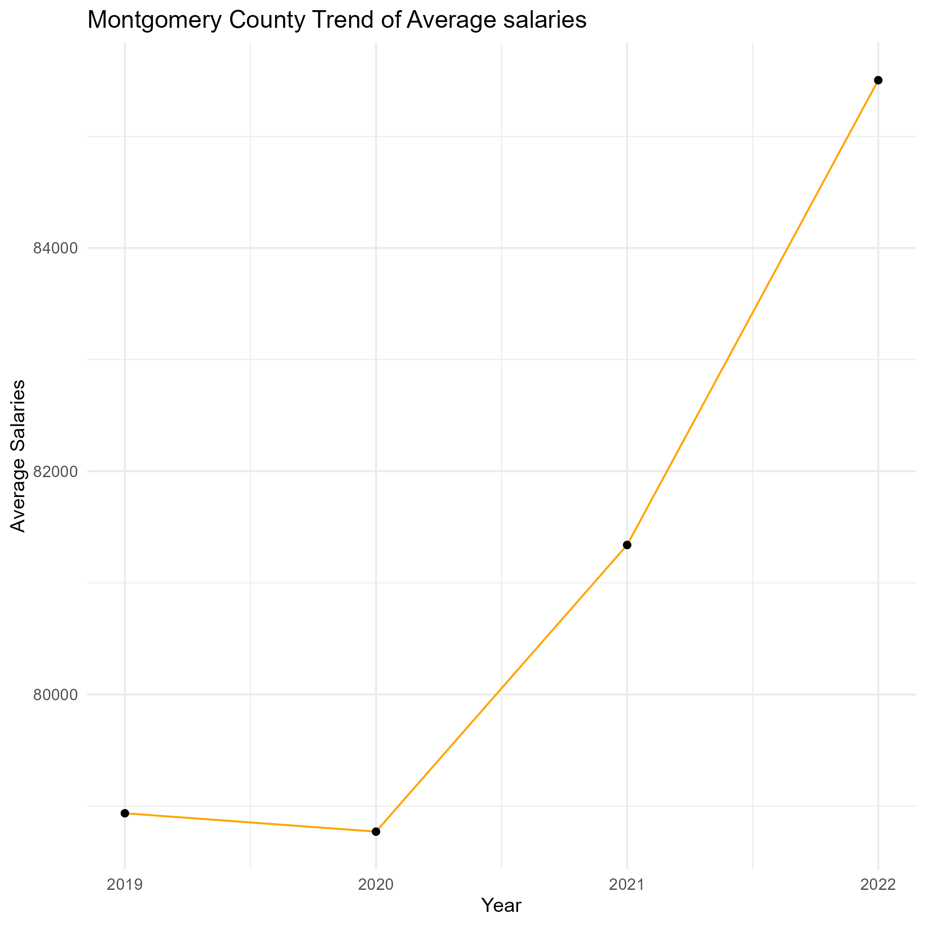
The Bad
Larger salary gaps among Montgomery public employees are commonly present in departments with lower average salaries.
The rapid growth of inflation has hit hard, and Montgomery County has lagged behind compared to similar counties.
Year | Rate of Change, MC | Inflation
2020 | -0.208 % | 1.4 %
2021 | 3.26 % | 7.0 %
2022 | 5.12 % | 6.5 %

Slide 16
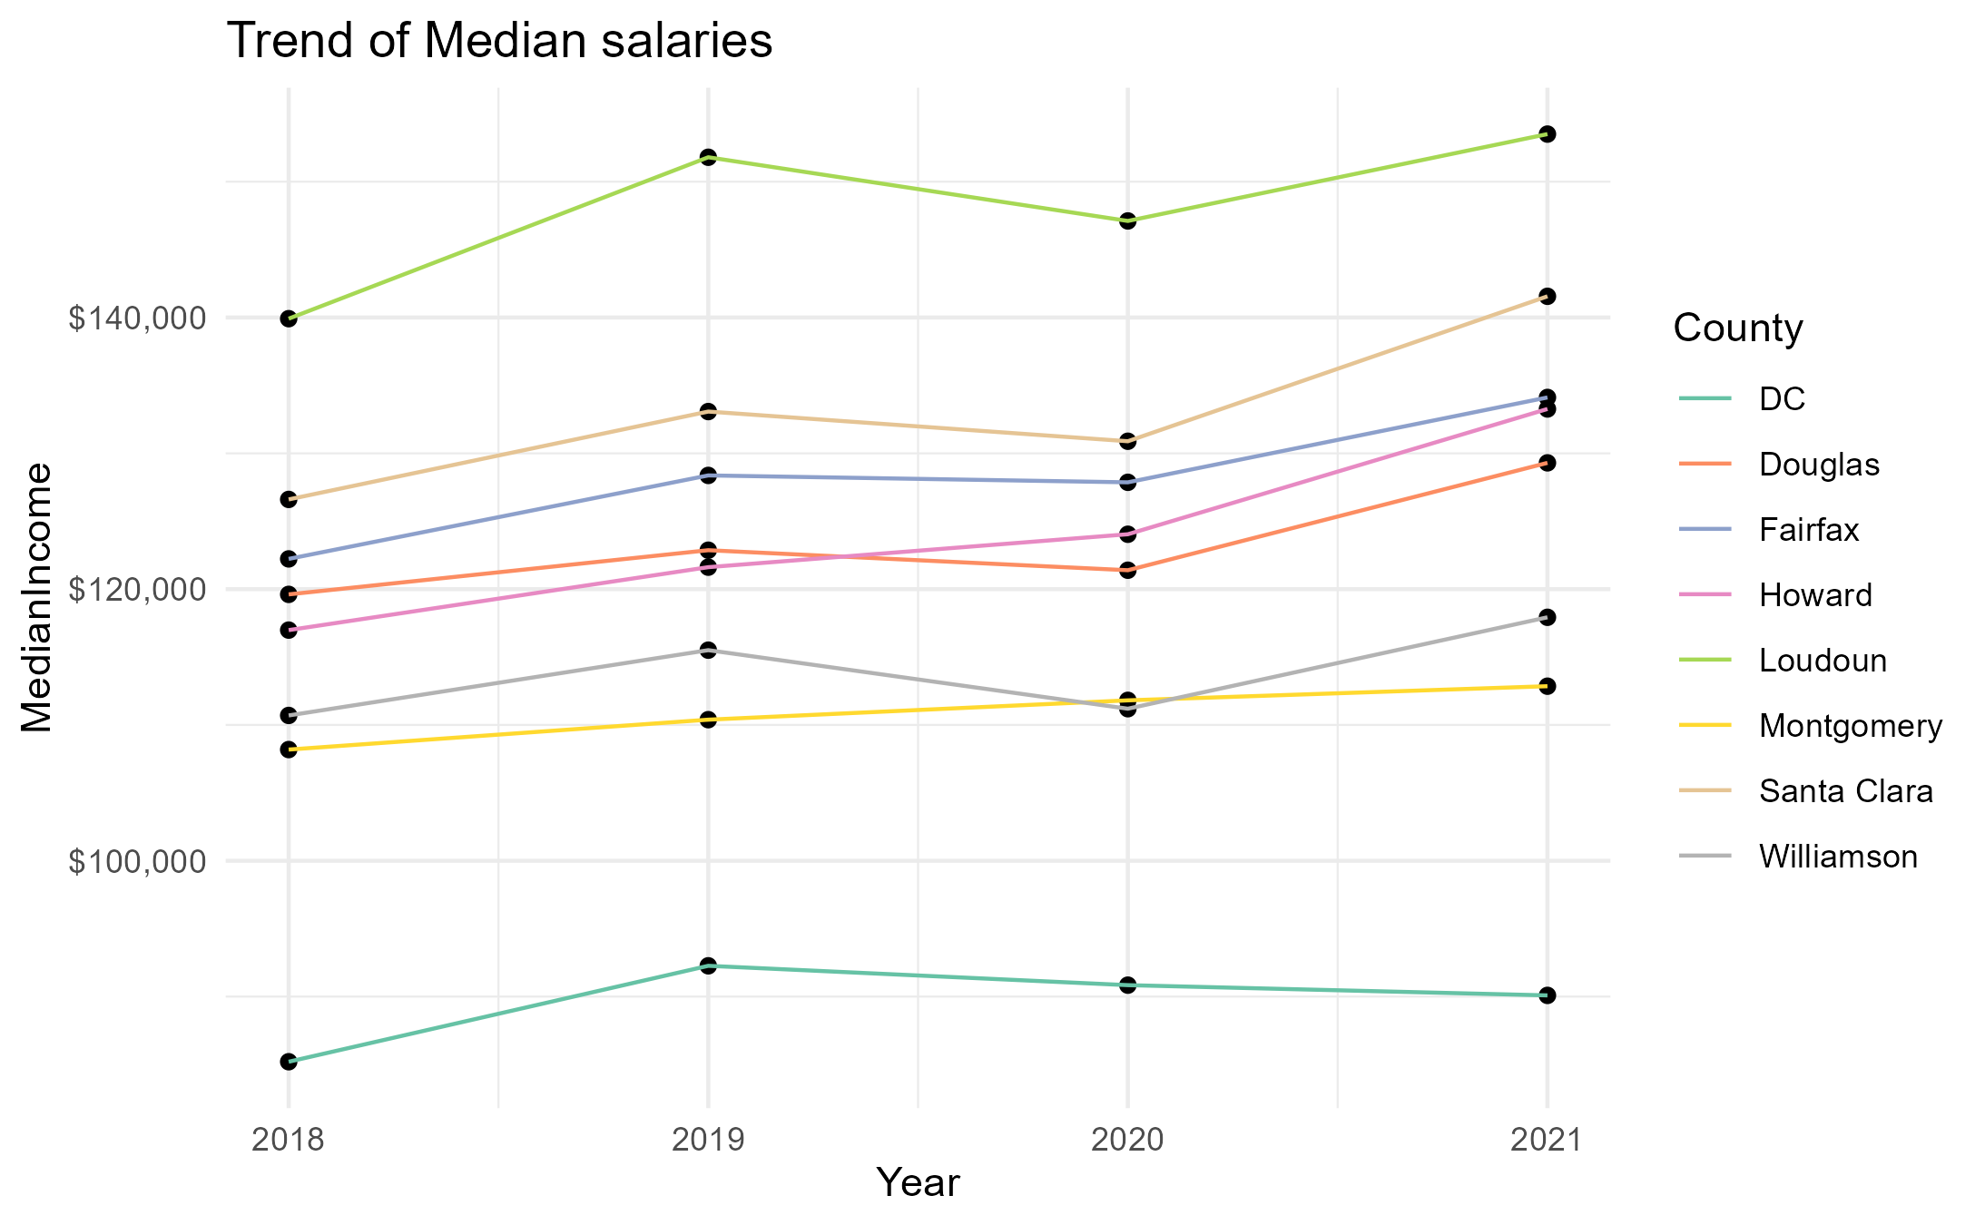
The Ugly
Montgomery County showed the slowest rate of recovery in 2018 to 2021 at 4.31%
Neighbors in DC increased at 5.73%, and Howard jumped at 13.92% from 2018 to 2021
Some of this slow growth may be due to minimum wage increases signed and not yet adjusted for significant economic impacts
2020 increased to $14.00
2021 increased to $15.00
2022 increased to $15.65
2023 increased to $16.70

Slide 17
Summary and Recommendations
Continue the employee equity movements put in place
Study the impacts of high wage gaps on employee morale
Find budget for support to those affected by inflation
Revisit the minimum wage schedule to adjust for the significant economic impacts

Slide 18

Thank You

