Slide 1

Student Information Systems
- Suleman Farooqi
- Joiney Nguyen
- Josh Parada
- Paulo Tuazon

Slide 2
Team Model
Life Cycle Model
Tools and Design
Workflow Analysis
Github Versions
UML Diagram

Slide 3

Team Model
Democratic
If a programmer sees a module as an extension of his/her ego, he/she is not going to try to find all the errors in “his”/”her” code
Encourage team members to find faults in code

Slide 4
Life Cycle Model
Iteration & Incrementation
Each successive version is intended to be closer to its target than its predecessor
To handle larger amounts of information, use stepwise refinement
Concentrate on the aspects that are currently the most important
Postpone aspects that are currently less critical
Every aspect is eventually handled, but in order of current importance

Slide 5
Tools and Design
Information derived from SQL displayed to GUI and allowing users to use the GUI to edit what is in the database (SQL). Allows the users to C.R.U.D (Create, Replace, Update, and Delete).
Users have the ability login to the user database system, register an account (admin/student). A table of the current semester, exam grades, and overall grade.

Slide 6
Workflow Analysis
Requirements phase
Learning management system that tracks the details of a student from the day one to the end of his/her course, completed semesters years, coming semester year curriculum details, exam details, project or any other assignment details, final exam result, etc.
Analysis Phase
As per the requirements, it's best approached by having a program to display the content depending on a specific student.

Slide 7

Github Versions
Github Repository

Slide 8
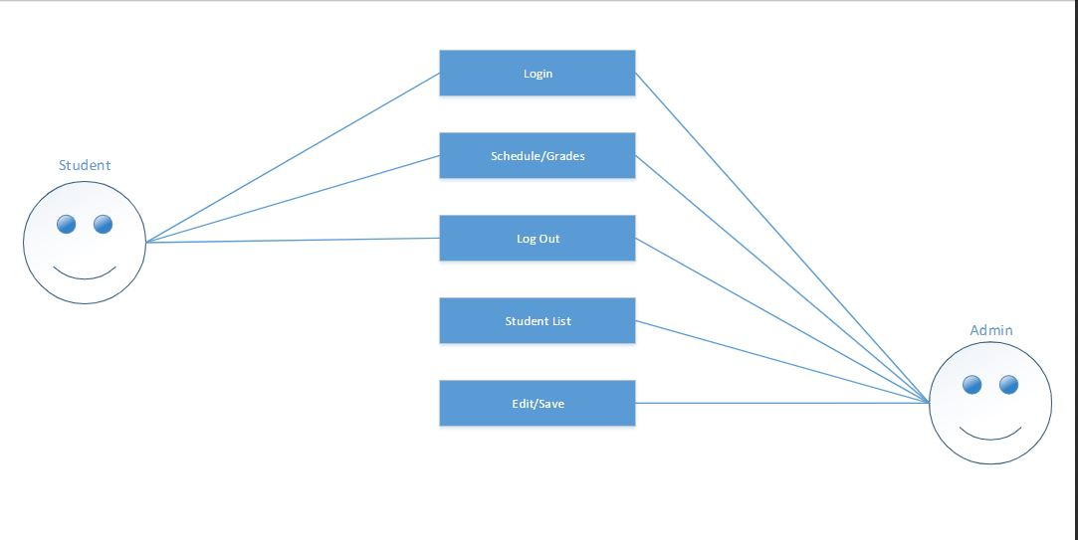
UML Diagram

Slide 9
End of Presentation

