Slide 1
Distributed Programming and Networking – AA 2022/2023
Project Topic: Medical Service Provider System
Authors: Daniel, Taofik, Hsham
(dtanyimadu@gmail.com , taofikahmed.suleiman@studentmail.unicas.it, ngim.hsham@gmail.com)

Slide 2
Outline
Abstract (500 words maximum)
Application modules
Model architecture
Server-side languages, client-side languages, environment and technologies

Slide 3
Abstract
The "Medical Service Provider System" is a scaled-down software solution designed to efficiently manage and deliver medical services to patients. The system aims to optimize the delivery of medical services to patients by doctors while ensuring effective financial management. The system consists of five essential modules: Users, Patients, Doctors, Services, and Transactions. Administrators act as intermediaries between doctors and patients, facilitating the delivery of services by doctors to patients. Transactions are carefully tracked and recorded for each service provided. The project incorporates a range of technologies, including HTML, CSS, JavaScript, Java Struts2, and MySQL, to ensure a robust and efficient application.

Slide 4
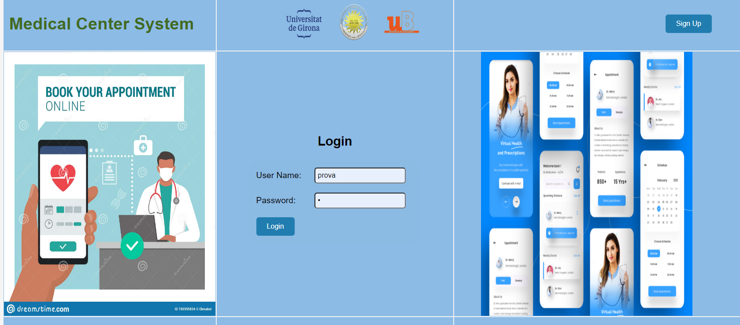
Application modules
The system consists of a login page and five essential modules: Users, Patients, Doctors, Services, and Transactions.
T

Slide 5
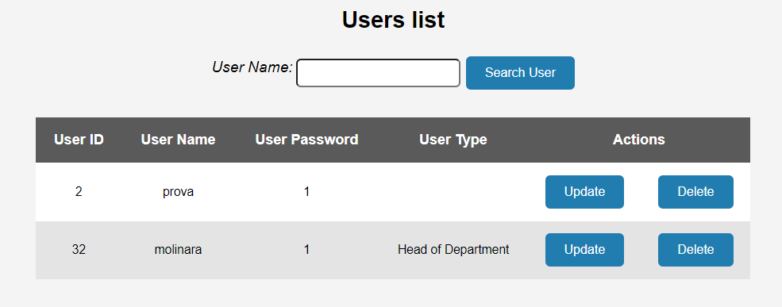
User Module
Users module: The Users module enables administrators to register and manage user accounts for authorized personnel. The Patients module allows for the registration and maintenance of patient records, ensuring accurate and up-to-date information.

Slide 6
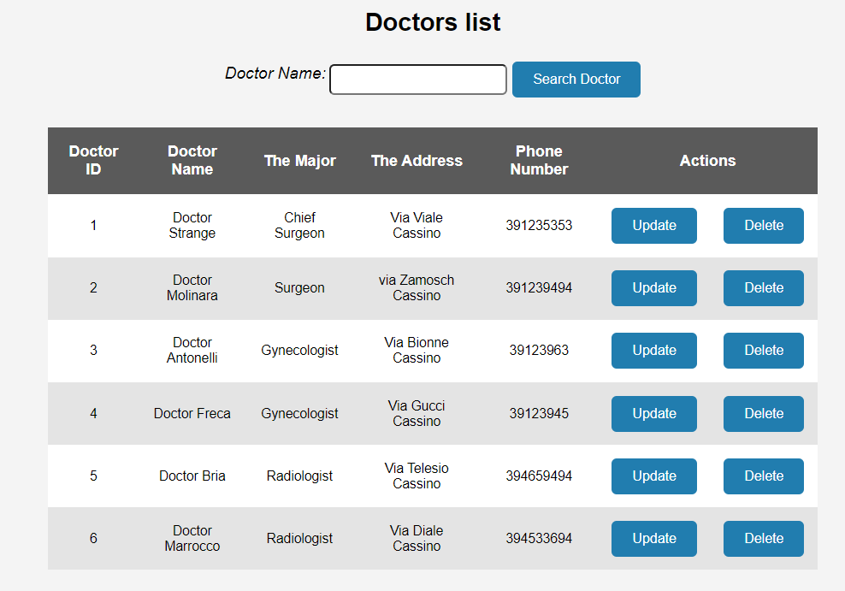
Doctor Module
Doctors module: In the Doctors module, administrators can manage doctor profiles, including specialization, contact details, and availability. Doctors can be associated with specific medical services offered by the center, facilitating seamless connections with patients.

Slide 7
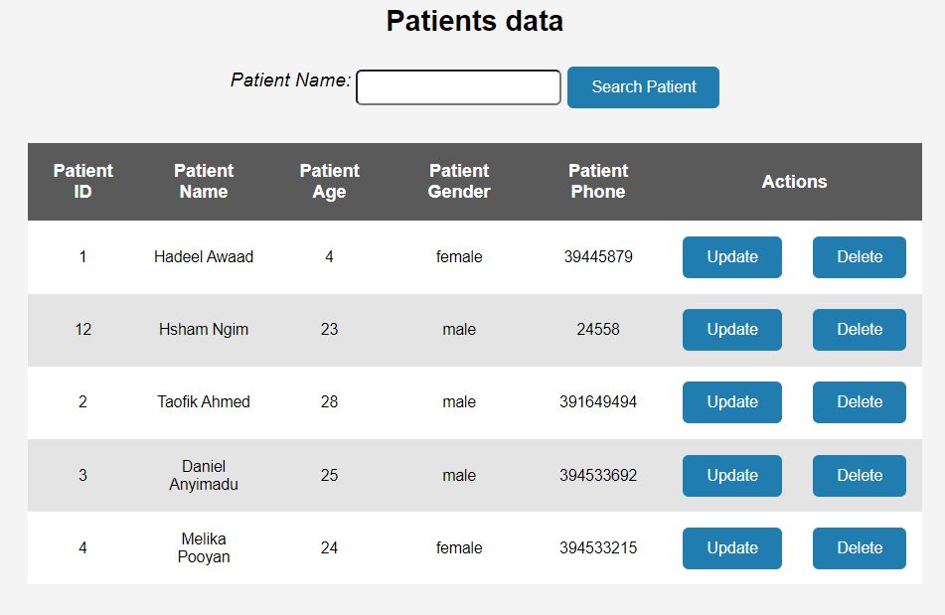
Patient Module
Patient module: In the patient module, administrators can manage patient profiles, including age, phone number and the type of services. Request made by the patient will appear at the transaction.

Slide 8
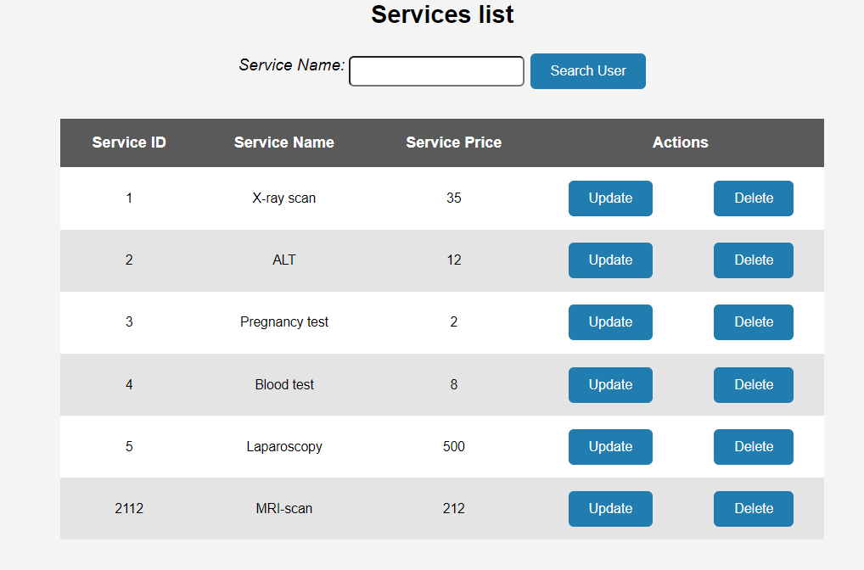
Service Module
Service module: The Services module enables administrators to define and maintain a catalog of medical services provided by the center. This includes various diagnostic tests, treatments, and procedures.

Slide 9
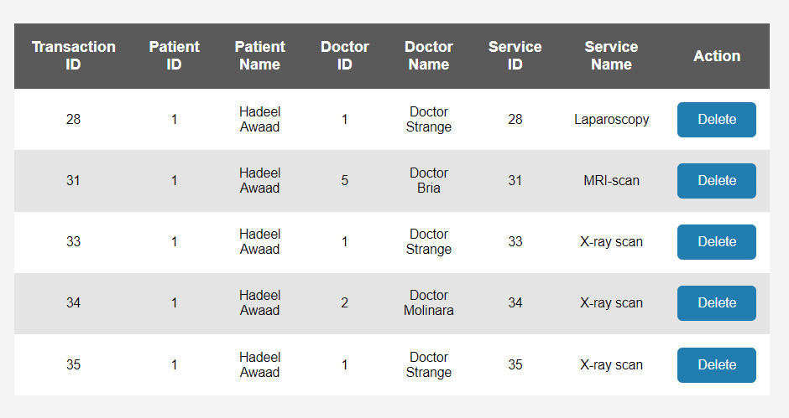
Transaction Module
Transaction module: The Transactions module is crucial for recording and tracking all medical transactions. Each transaction relies on unique identifiers, such as user ID, patient ID, doctor ID, and service ID, to establish relationships and accurately document services rendered..

Slide 10
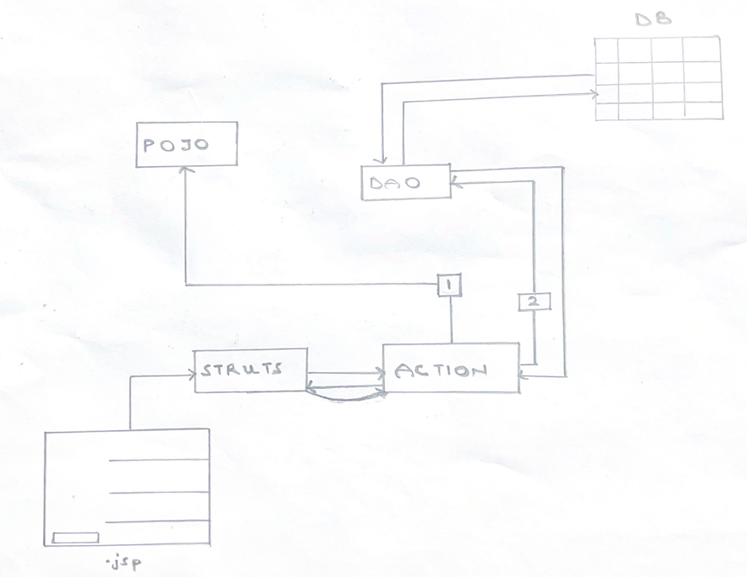
Model Architecture
Model Architecture: This follows the Model-View-Controller (MVC) design pattern within a client-server model.
The Model component encompasses the business logic and data management of the system. It includes actions, which represent the operations or functionalities of the system, data access objects (DAOs) that interact with the database, plain or Java objects (POJOs) that encapsulate data, and database utilities for efficient data retrieval and manipulation.
The Controller component utilizes the Struts framework, which acts as the intermediary between the user interface and the Model. It handles user requests, invokes the appropriate actions, and manages the flow of data between the View and the Model.
The View component defines the structure and layout of the web pages, allowing users to interact with the system's functionalities.

Slide 11
Client side
Languages, environment and technologies
The client-side of the application utilizes HTML, CSS, and JavaScript to create a dynamic and interactive user interface.
JavaScript: Enables client-side interactivity, form validation, and dynamic behavior.
JSON
HTML, CSS, Jquery: Provides the structure, layout and visually appealing layout of the web pages.

Slide 12
Server side
Languages, environment and technologies
The server-side of the application leverages Java Struts2 framework to handle server-side processing, facilitate communication between the front-end and back-end, and implement business logic.
MySQL: Serves as the database management system to store and manage appointment-related data, utilizing SQL queries to interact with the database.
Tomcat
Java: The primary language for server-side development, allowing for the implementation of robust business logic.
Struts2: Provides a framework for building web applications with support for MVC (Model-View-Controller) architecture, request handling, validation, and routing.

Slide 13
Conclusion
In conclusion, the system allows administrators to efficiently register and manage user accounts, maintain accurate patient records, facilitate seamless connections between doctors and patients, define and update a catalog of medical services, and accurately record and track all medical transactions.

Slide 14
Thank you
FOR YOUR ATTENTION

