Slide 1



ANALYSING NEIGHBOURHOODS IN DELHI TO START A NEW RESTAURENT.
SULEMAN Salmani
IBM applied data Science
11-09-2020

Slide 2
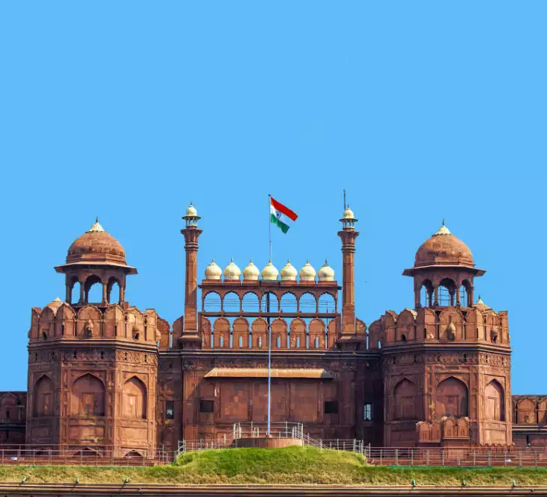
Introduction
Delhi: One of the biggest city in india
India is the second highest populated country in the world with the population of 138 crores.
Population of Delhi is 3 crores.

Slide 3
Business Problem
Recommend a place to start a restaurant in Delhi, India.
Neighbourhood that is most likely to give a great business.

Slide 4
Data
Neighbourhoods of Delhi:
-Entire Delhi localities from ceodelhi site through data scrapping.
Geographical coordinates of neighbourhoods
-Using GeoPy Library
Venues Data
-Using FourSquare API

Slide 5
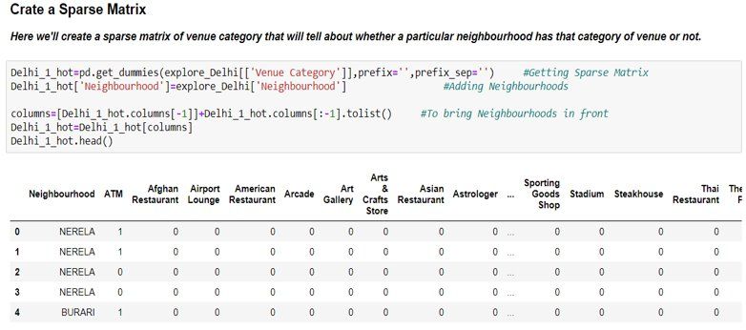
Methodologies
Feature Extraction
-One Hot Encoding

Slide 6
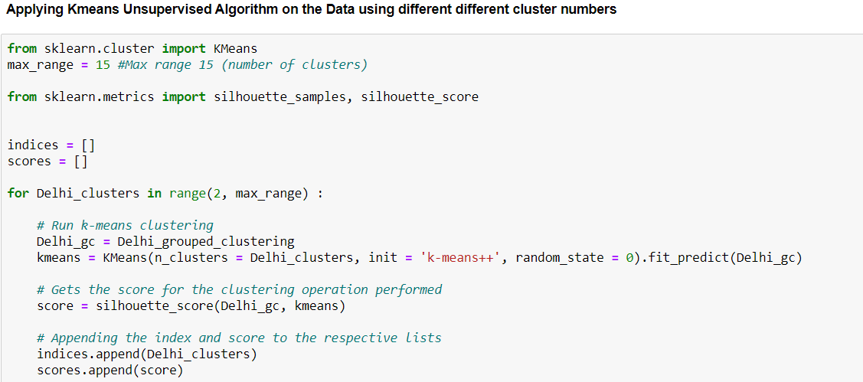
Unsupervised Learning -Kmeans clustering

Slide 7
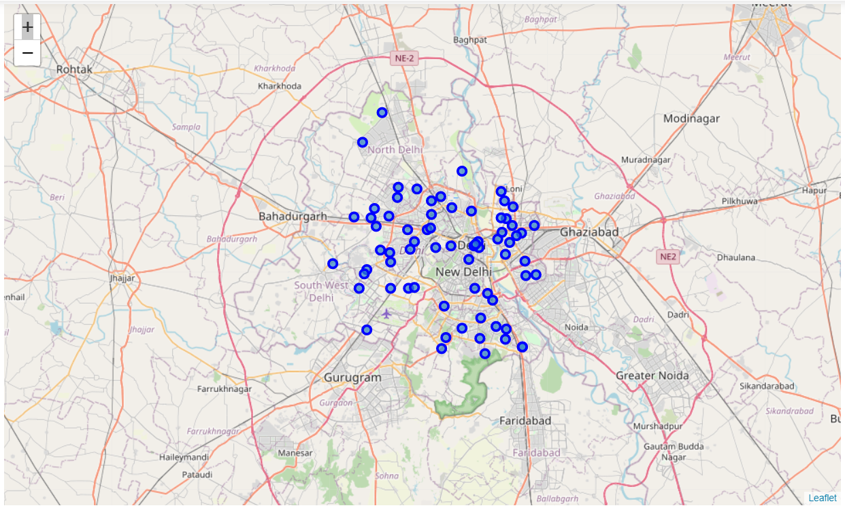
Plotting -Folium

Slide 8
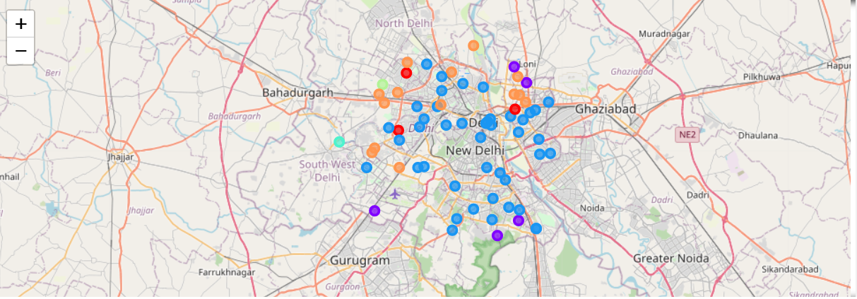
Result
Visualization of Clusters
After Visualizing all the clusters and studying them individualy some important conclusions were made. The neighbourhood that has the most number of restaurant was in cluster 3.

Slide 9
Discussion
Most suiatble neighbourhoods to start a new restaurant are present in cluster number 3.
Kmeans algorithm has successfully clustered the similer neighbourhoods together .
After studying all the clusters it is recommended to the client that neighbourhoods such as Rajouri Garden, Janak Puri are good locations to start a new restaurant.
Client can go ahead and make decisions based on other aspects that are out of the scope of this Project

Slide 10
Conclusions
Data Analysis and Machine Learning Techniques used in this project can be very helpful in determining solution of certain business problems.
Python inbuilt libraries such as Geopy, Folium and Beautiful Soup are good to analyze the geographical Data.
In this Project we studied about the neighbourhoods in Delhi, India and come up with a solution of recommendation of Neighbourhoods where client can start the restaurant.

Slide 11

Thank You !
Salmanisuleman804@gmail.com

