Slide 1
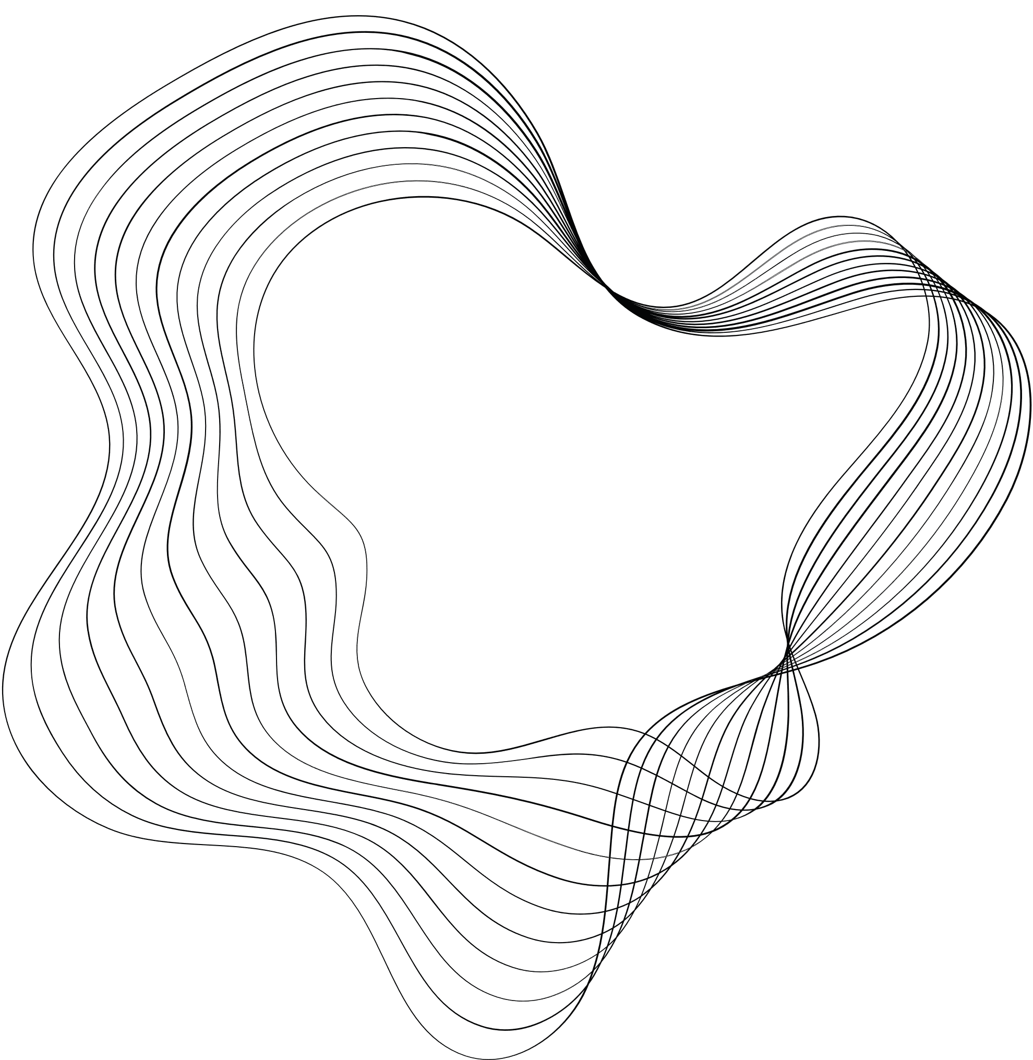

464 DIGITAL IMAGE PROCESSING
BALL
TRACKING
SÜLEYMAN KORAMAZ

Slide 2
Detection and Tracking Multiple Balls using image processing.
PROJECT DESCRIPTION

Slide 3
Project design has three main parts.
1- Filtering
2- Noise cleaning
3- Ball detection and tracking
PROJECT DESIGN

Slide 4
FIRST PART
In this step, purpose is basically applying Gaussian Blur, using HSV transformation and get binary image.

Slide 5
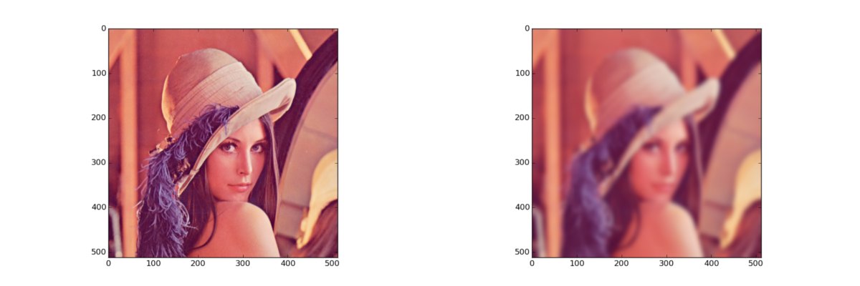
GAUSSIAN BLUR
The Gaussian blur is a type of image-blurring filter that uses a Gaussian function (which is also used for the normal distribution in statistics) for calculating the transformation to apply to each pixel in the image. It is a widely used effect, typically to reduce image noise and reduce detail.

Slide 6
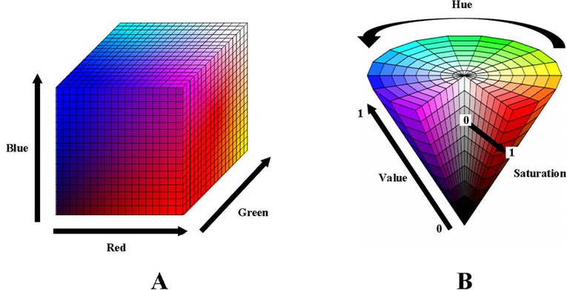
HSV TRANSFORMATION
HSV color space is the most suitable color space for color based image segmentation.
HSV is a cylindrical color model that remaps the RGB primary colors into dimensions that are easier for humans to understand.These dimensions are hue, saturation, and value

Slide 7
SECOND PART
In this step, purpose is clear noise with applying opening and closing using circular kernel for better image segmentation.
Morphological opening is useful for removing small objects and noises.
Morphological closing is useful for filling small holes.

Slide 8
FINAL PART
At the end, noise free frame that transformed to HSV format is used for finding contours.
Contours are very usefull for shape analysing, they are simply curve joining all continuous points.
After that, circumcircle of all contours found. They are objects which extracted with filtering process.
For finding circular objects in frame, their circularity is calculated and passed through the trashhold (for perfect circle, circularity is 1).

Slide 9
END
Thank you for listening

