Slide 1



TADAWUL Saudi Stock Market
BIG-HERO 6
AMJAD AISHA IBTISAM
MANAR NAWAL SULIMAN

Slide 2

Table of Content
INTRO
01
02
03
04
DATASET
PRE-PROCESSING
DASHBOARD
05
06
07
08
EDA
PIG INVESTIGATIONS
DEEP LEARNING
CONCLUSION

Slide 3
01. INTRO
What is Tadawul ?

Slide 4
Tadawul Definition
The Saudi Exchange is a fully owned subsidiary by Saudi Tadawul Group and was established in March 2021 following the transformation of the Saudi Stock Exchange Tadawul into a holding company, Saudi Tadawul Group.

Slide 5
Tadawul Stock Exchange Crisis
2006
2008
2020
2022
Black February
Housing Bubble
COVID-19
Russia & Ukraine War

Slide 6
02. DATASET

Slide 7
Dataset Dimention
COLUMNS
RECORDS
14
600k

Slide 8
Dataset Sample
symbol | name | trading_name | sector | date | open | high
2010 | Saudi Basic Industries Co. | SABIC | Materials | 4/16/2020 | 80 | 80.2
4240 | Fawaz Abdulaziz Alhokair Co. | ALHOKAIR | Consumer Discretionary | 3/5/2020 | 27 | 27.25
…
low | close | change | perc_change | volume_traded | value_traded | no_trades
79.4 | 79.6 | 0.4 | 0.51 | 1756828 | 140323271.7 | 3326
25.45 | 25.8 | -2.45 | -8.67 | 1513238 | 39283946.6 | 1377

Slide 9

Dataset Sample
symbol | ID or reference number of the company
name | The name of the company
trading_name | The trading name of the company
sector | Sector in which the company operates
date | The date of the stock price
open | The opening price
high | Highest price of the stock in a specific day
low | Lowest price of the stock in a specific day
close | The closing price
change | Difference between open & close price
perc_change | The difference but in percentage
volume_traded | Number of shares traded in that day
value_traded | Value of shares traded in that day
no_trades | Number of transactions in that day

Slide 10
Difference Between No. of Trades vs Volume vs Value
No. of Trades
Volume
Value
Number of transactions (buying and selling stocks) in a specific day
Number of stocks that were sold and bought in that day
The value of the stocks that were sold and bought in that day

Slide 11
Difference between Name vs Trade Name
Name
Trading Name
The name of the
main company
The brand name owned by the main company

Slide 12
03. PRE-PROCESSING

Slide 13
04. DASHBOARD

Slide 14
05. EDA

Slide 15
06. PIG INVESTIGATIONS

Slide 16
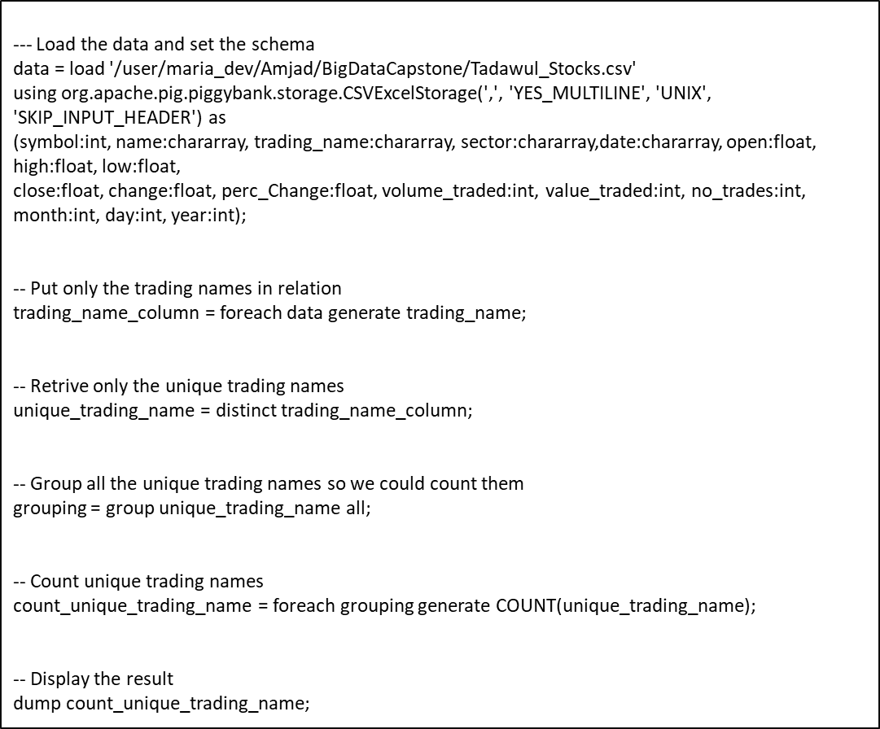
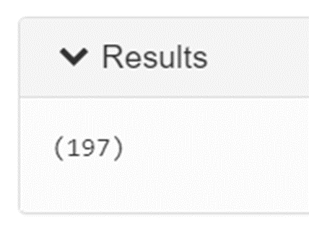
Q1: How many trading names do we have in the dataset ?
PIG SCRIPTS

Slide 17
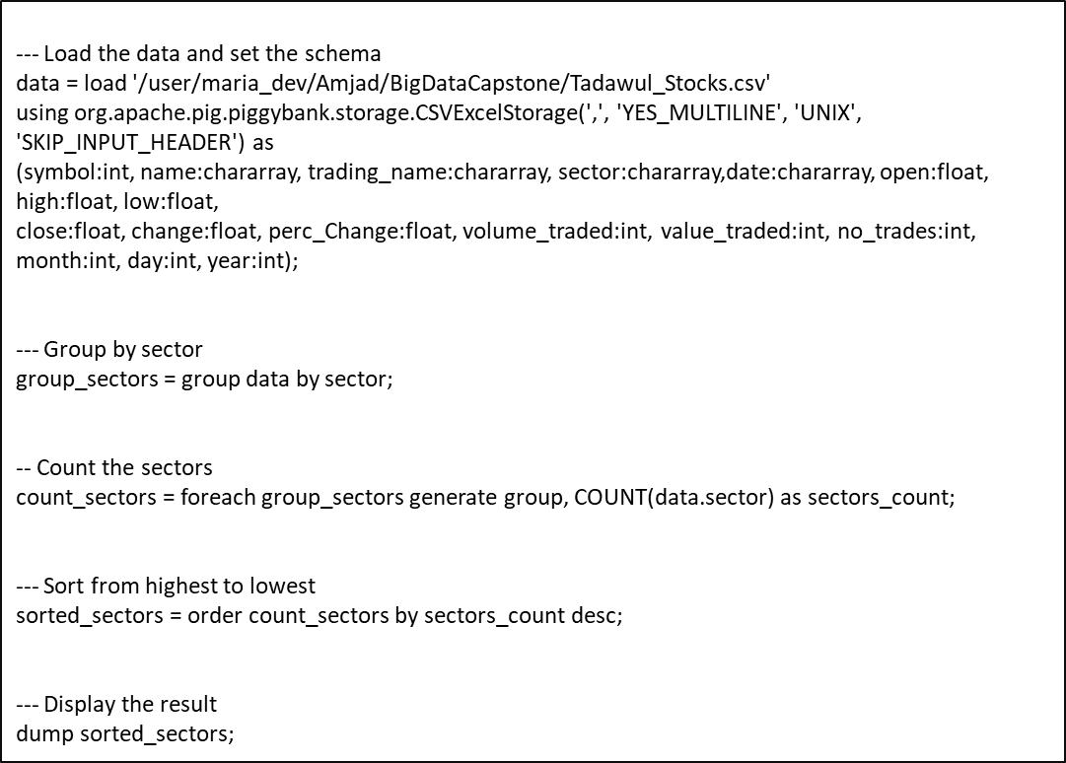
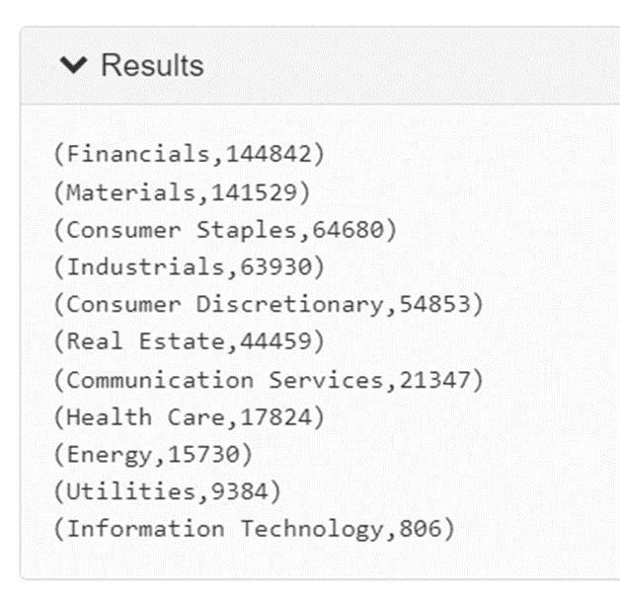
PIG SCRIPTS
Q2: What is the frequency of all the sectors in the dataset?

Slide 18

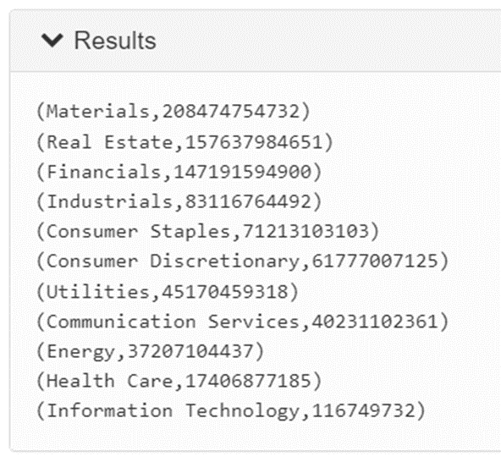
PIG SCRIPTS
Q3: What is the total traded volume for each sector?

Slide 19
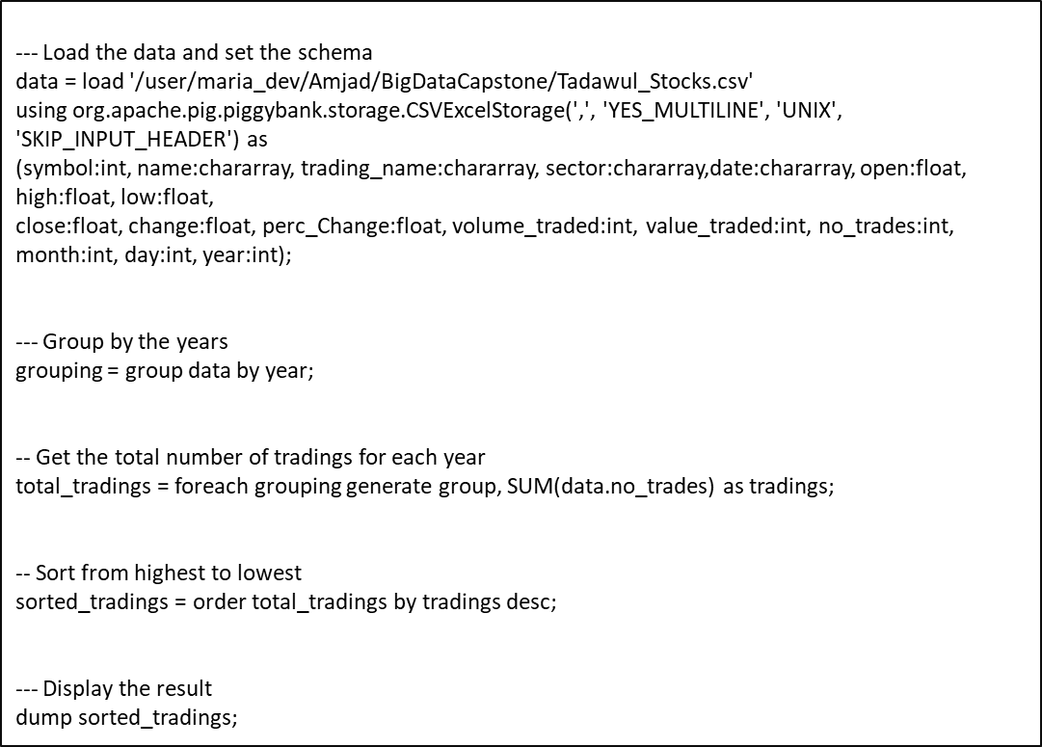
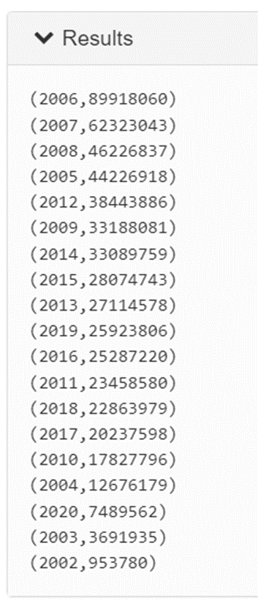
PIG SCRIPTS
Q4: What is the total number of trades in each year?

Slide 20

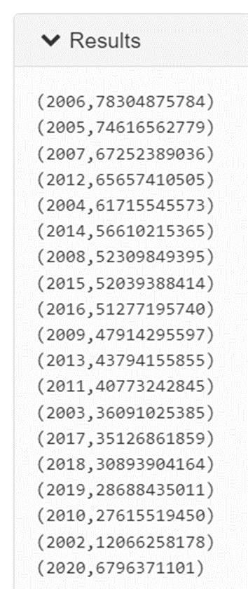
PIG SCRIPTS
Q5: What is the total traded volume in every year?

Slide 21

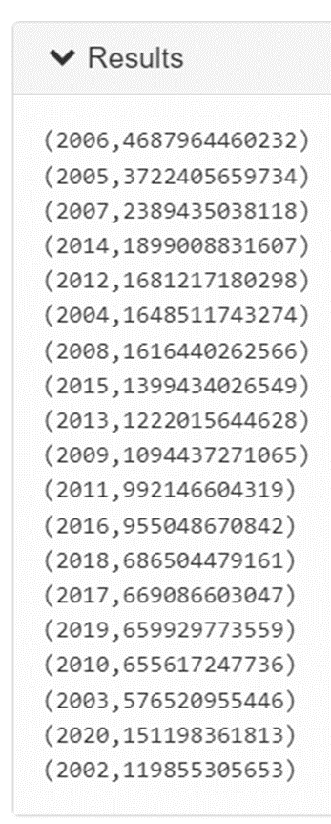
PIG SCRIPTS
Q6: What is the total traded value in every year?

Slide 22

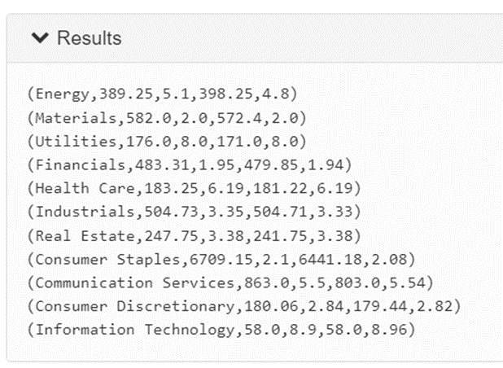
PIG SCRIPTS
Q7: What was the highest and lowest opening and closing price in every sector?

Slide 23

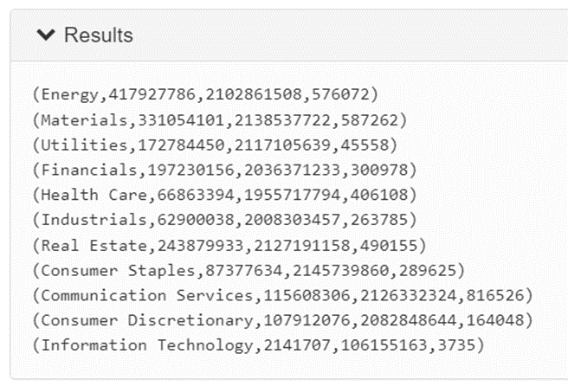
PIG SCRIPTS
Q8: What was the highest volume, value and number of trades in every sector?

Slide 24

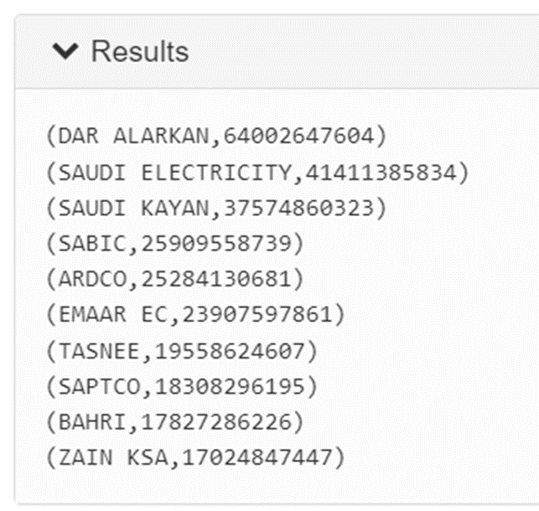
PIG SCRIPTS
Q9: What are the top 10 companies with the highest volume trades?

Slide 25

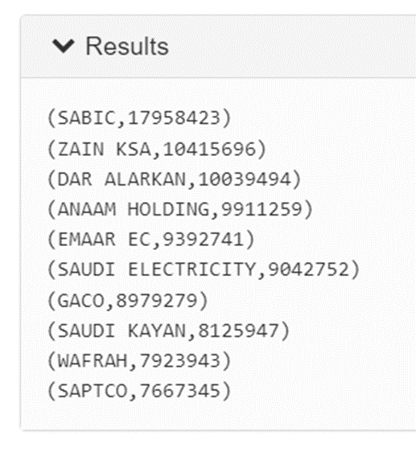
PIG SCRIPTS
Q10: What are the top 10 companies with the highest number of trades?

Slide 26

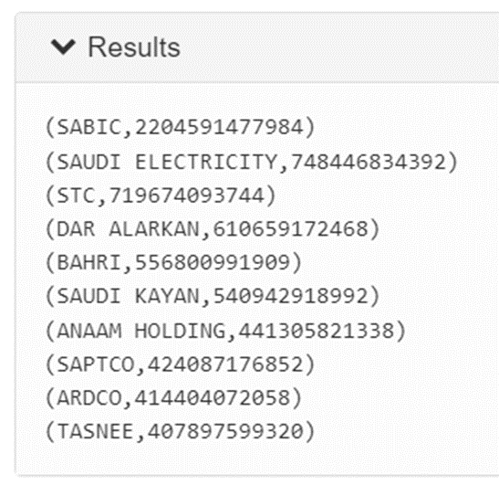
PIG SCRIPTS
Q11: What are the top 10 companies with the highest value of trades?

Slide 27
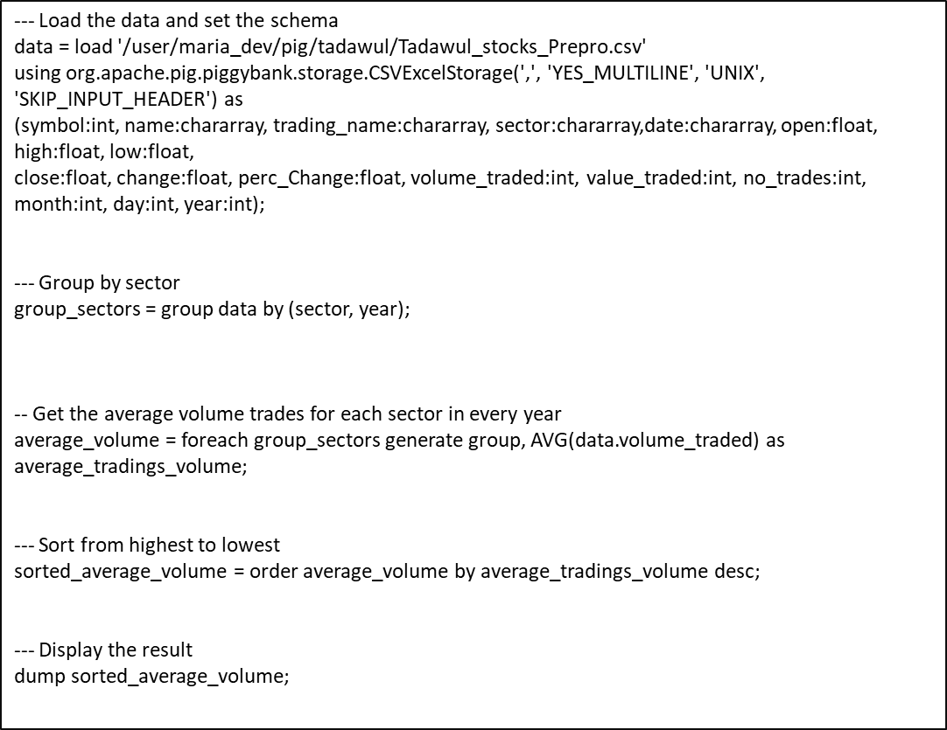
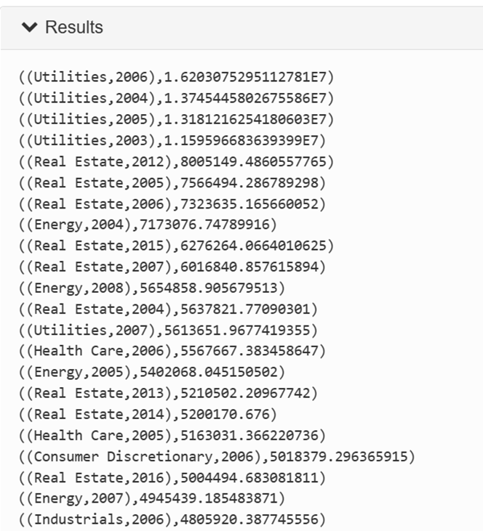
PIG SCRIPTS
Q12: What is the average traded volume for each sector in every year ?

Slide 28
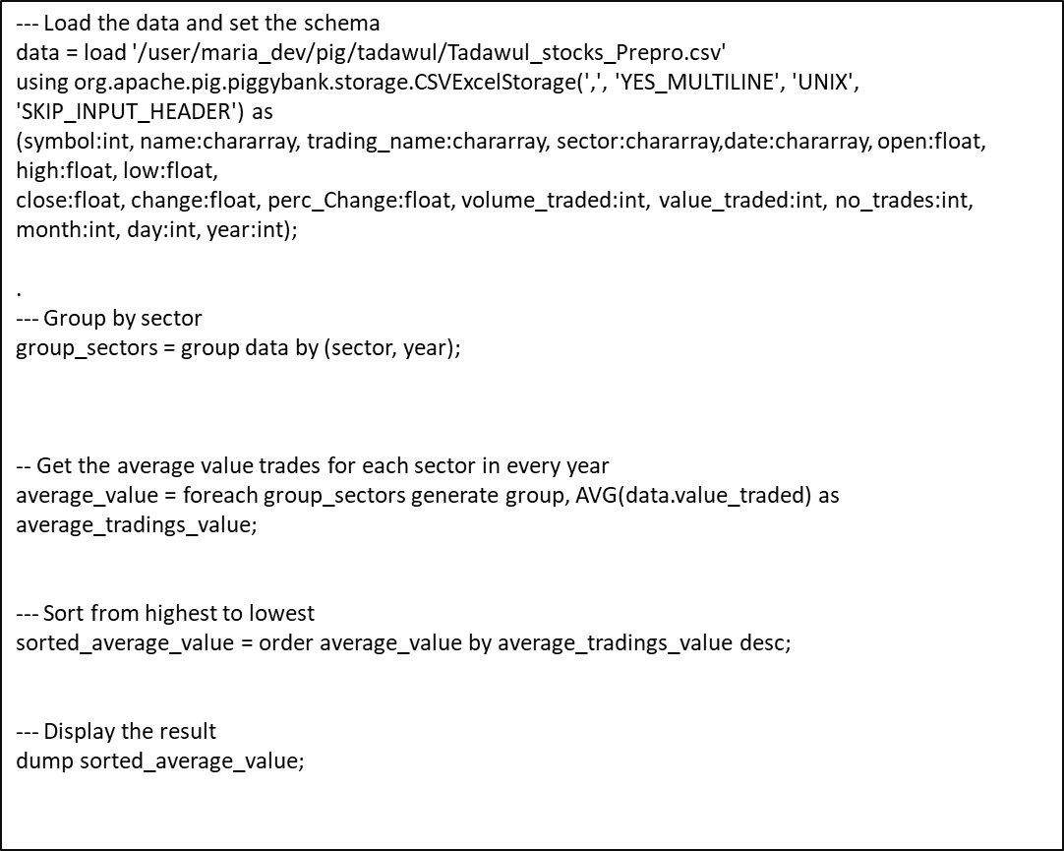
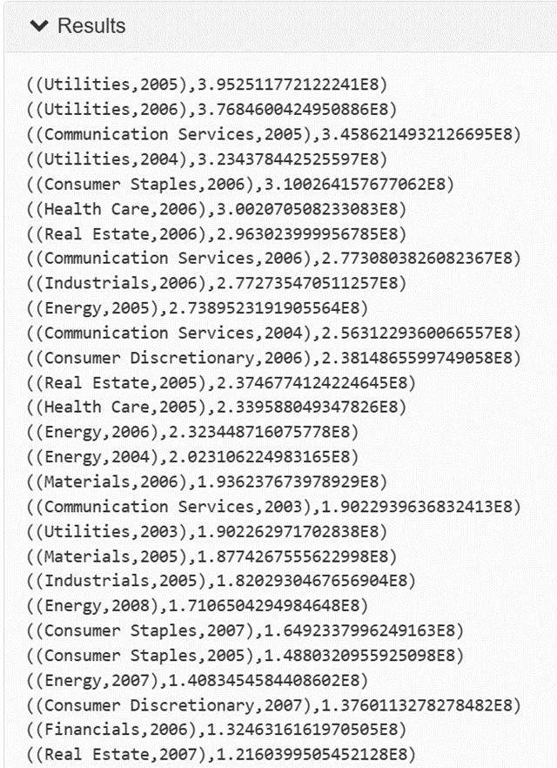
PIG SCRIPTS
Q13:What is the average traded value for each sector in every year ?

Slide 29
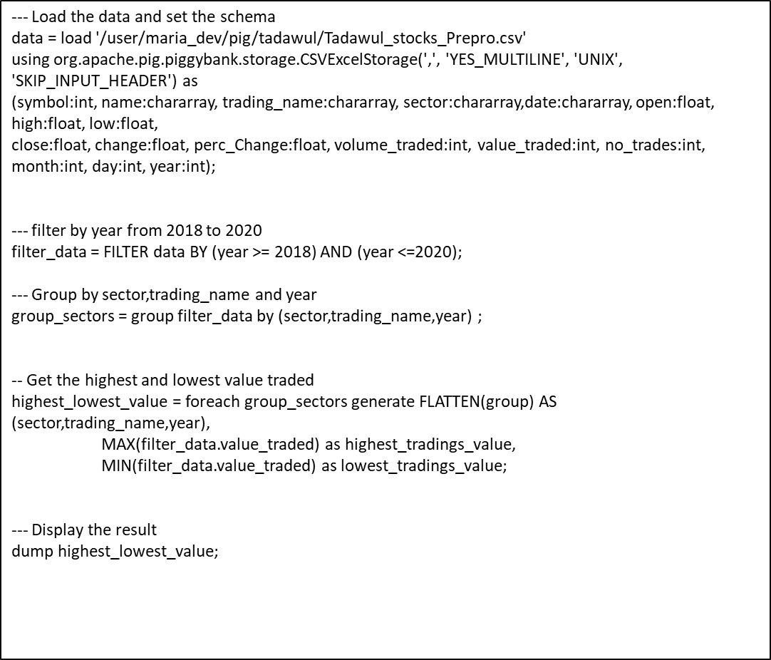
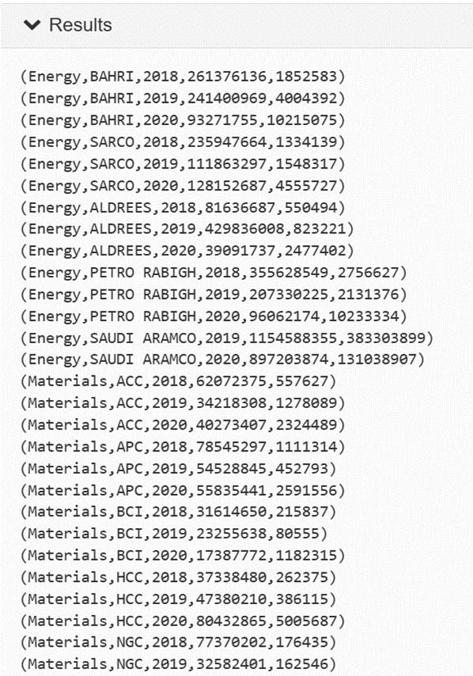
PIG SCRIPTS
Q14:What is the highest and lowest value traded for companies
in each sector from 2018 to 2020 ?

Slide 30
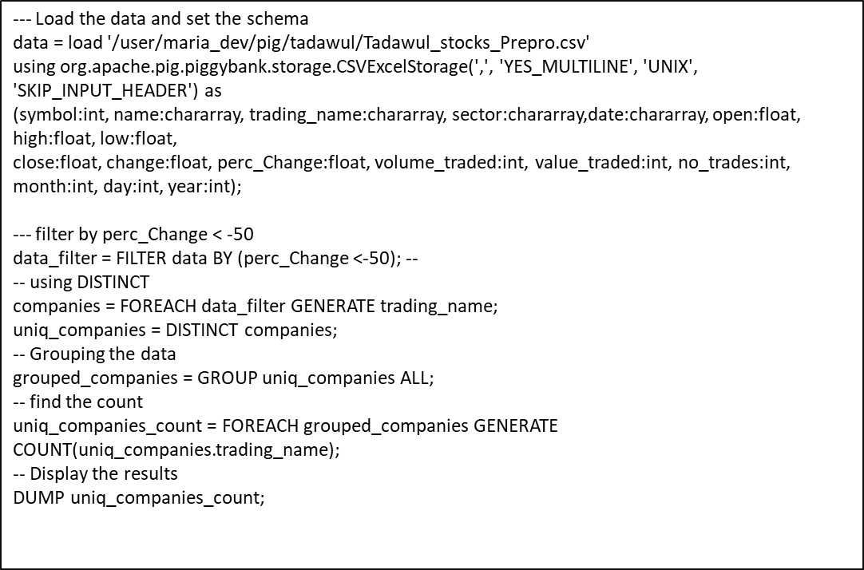
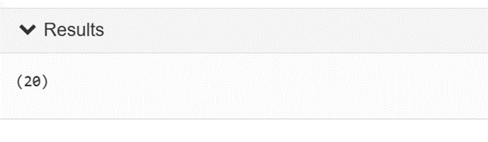
PIG SCRIPTS
Q15: find count of companies lost more than fifty percent of the
price of their shares (perc Change is more than -50)

Slide 31

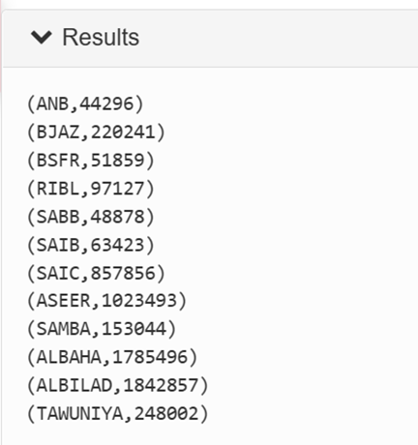
PIG SCRIPTS
Q16: What is the total traded number for each company in the Financials sector of the year 2006 ?

Slide 32
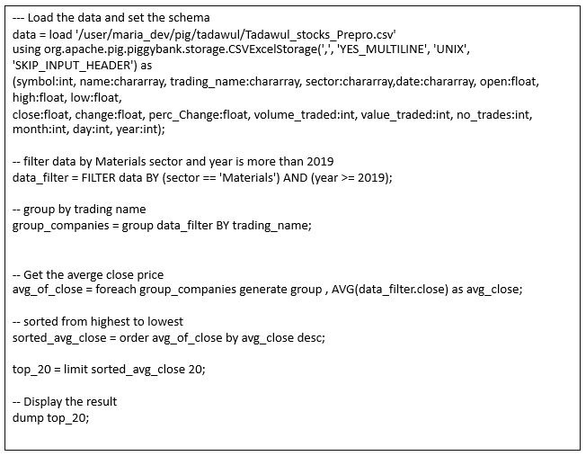
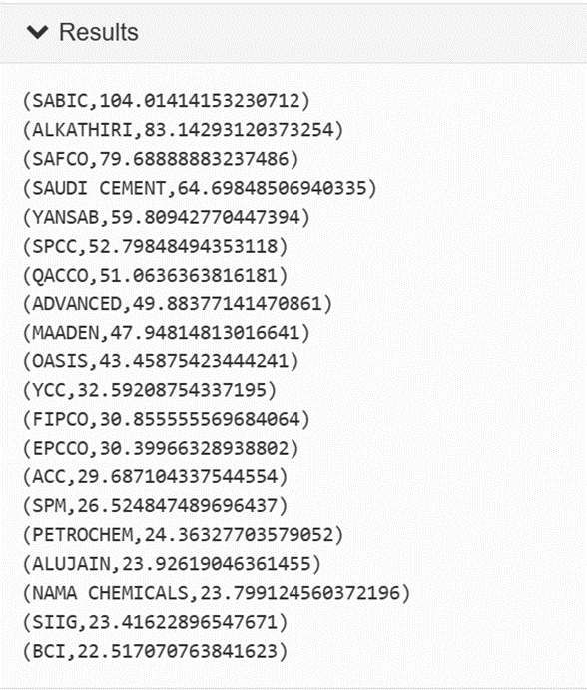
PIG SCRIPTS
Q17: what is the average close price for the companies in Materials sector last 2 years in data set, find top 20 companies ?

Slide 33

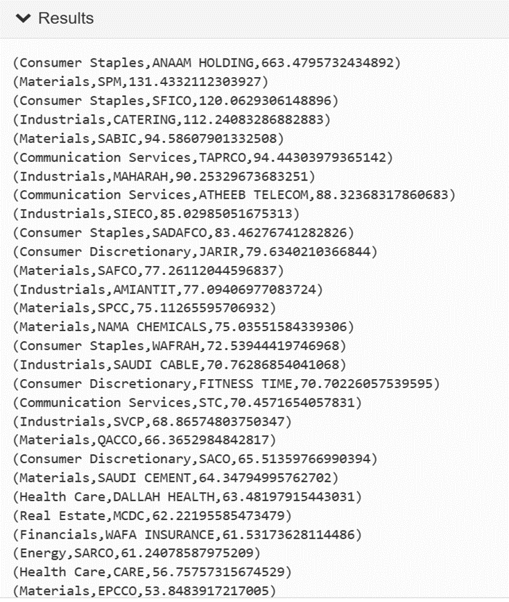
PIG SCRIPTS
Q18: Find the average of high price of shares for companies in
each sector, and sort them from highest to lowest

Slide 34
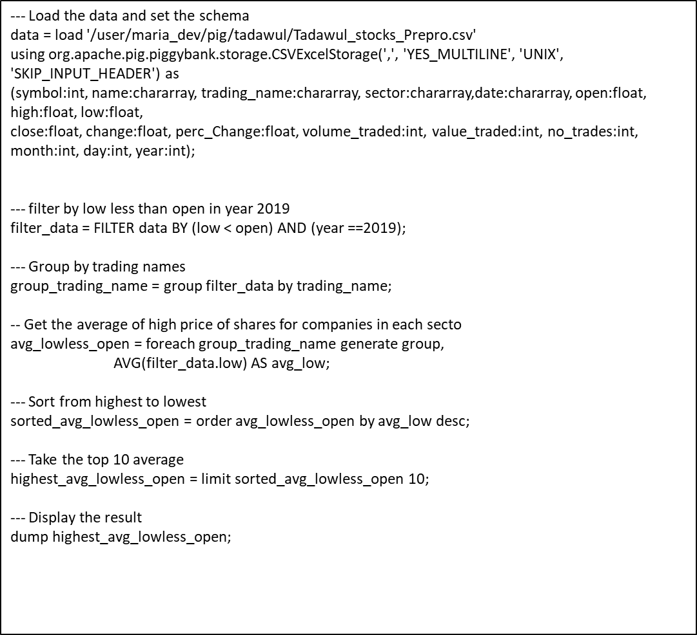
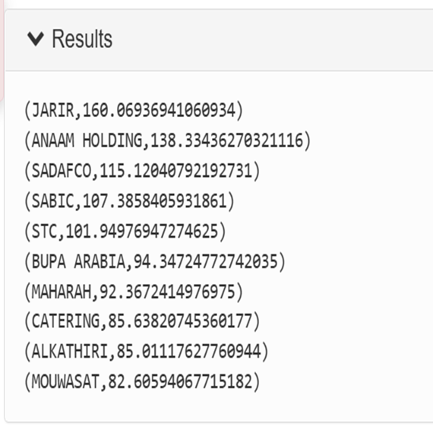
PIG SCRIPTS
Q19: what is the top ten companies that their low price is less than open in year 2019.find the average of low price of shares for those companies in that year ?

Slide 35

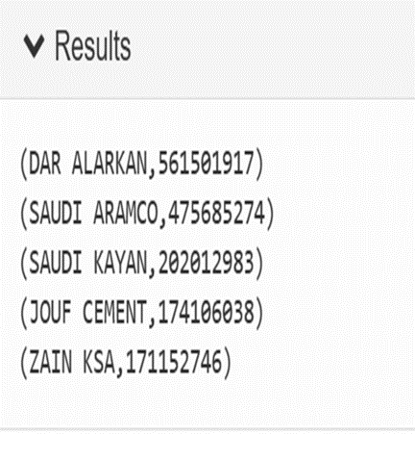
PIG SCRIPTS
Q20: what is the total volume traded for the companies in 2020,sort from highest to lowest, limit to first 5 highest volume ?

Slide 36
07. DEEP LEARNING

Slide 37
DEEP LEARNING OBJECTIVE
Stock Trend Prediction:
Determine the future movement of the stock value for specific company in the stock market.
Investigate technical analysis prediction vs AI model prediction.
Build web app for the stock prediction.

Slide 38
08. CONCLUSION

Slide 39

THANKS
Do you have any questions?
تم بحمد الله

