Slide 1
San Diego's safe night out program
Scan at any partner bar for a safe ride home.
Drink well.
Leave better.
drinkwellleavebetter.com
IN PARTNERSHIP WITH UBER | LYFT | SD SAFETY | CA OTS

Slide 2
Agenda
01
02
The Problem
Our Solution
Why San Diego needs a new approach to DUI prevention
15 self-service breathalyzer kiosks at decision points
03
04
Project Methodology
Financial Strategy
Stakeholder analysis, WBS, phases & risk planning
Budget, revenue model & investor return
05
06
Risk & Mitigation
Recommendations
Key risks and contingency plans
Key findings and next steps
drinkwellleavebetter.com
UBER | LYFT | SD SAFETY | CA OTS

Slide 3
Drink well.
Powered by
Leave better.
SafeNight SD
Smart kiosk technology that
encourages safe ride decisions
at San Diego's top venues.
15 kiosk locations
across San Diego's
top bar districts.
SCANNING...
15
Kiosk locations
Face-scan check-in
3.75%
Cost of 1 DUI
Instant ride booking
DUI prevention tech
21×
Minimum ROI
Real-time data capture
drinkwellleavebetter.com
UBER | LYFT | SD SAFETY | CA OTS

Slide 4
The Problem
WHY SAN DIEGO NEEDS A NEW APPROACH
2,100+
$487M
30%
DUI arrests annually
Annual economic cost
Of crashes alcohol-related
in San Diego County
medical, legal & lost productivity
preventable with intervention
The gap in the system
Problem - Current DUI prevention relies on enforcement after the fact — arrests, fines, and tragedies. There is no infrastructure that intervenes at the decision point: when someone is leaving a bar and deciding whether to drive.
Every hour that passes without an intervention infrastructure costs San Diego approximately $55,600 in DUI-related economic damage.
drinkwellleavebetter.com
UBER | LYFT | SD SAFETY | CA OTS

Slide 5
Our Solution
BEHAVIORAL INTERVENTION AT THE MOMENT OF DECISION · 15 SELF-SERVICE KIOSKS
Behavioral economics in action: 15 kiosks at bar exits, transit hubs, and entertainment districts modify the choice environment at the moment of decision — real-time BAC feedback converts impaired intent into a safe ride home.
How It Works
1
Patron approaches kiosk
🍺
Bar Exits
Single-use breathalyzer mouthpiece — results in under 10 seconds
Gaslamp, North Park, Pacific Beach — posted at departure points
2
BAC result displayed
Clear color-coded output: green (safe), amber (caution), red (do not drive)
🚌
Transit Centers
Downtown stations, trolley stops, bus terminals
Rideshare option presented
3
QR code links directly to Uber/Lyft app with co-branded promo code
🎉
Entertainment Districts
Event venues, stadiums, concert halls
4
Data captured anonymously
Usage, BAC ranges, and rideshare conversions logged for KPI reporting
drinkwellleavebetter.com
UBER | LYFT | SD SAFETY | CA OTS

Slide 6
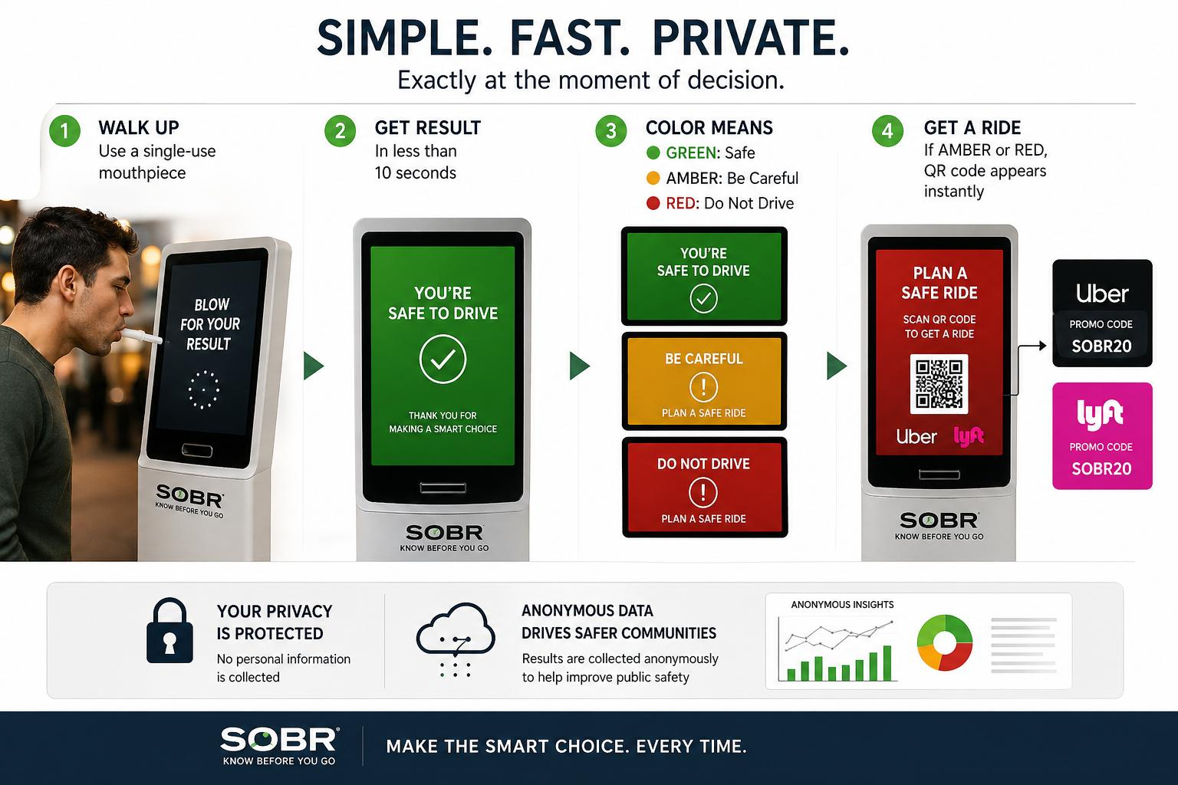

Slide 7
Project Plan & Methodology
5 PHASES · 9-MONTH PILOT · KPI-DRIVEN EVALUATION · BEHAVIORAL ECONOMICS FRAMEWORK
1
Vendor Procurement
2
Site Development
3
Install & Deploy
4
Pilot Operations
5
Evaluation
RFP, select, contract
Identify locations, finalize agreements
All 15 units operational
Training, launch marketing, monitor performance
Analyze data, measure results
Month 1
Month 2
Month 3
Months 4–9
Month 9
Key Performance Indicators
25+
95%+
>0.5mi
100%
BAC tests/kiosk/day
Device uptime
Rideshare pickup radius
Data collection rate
drinkwellleavebetter.com
UBER | LYFT | SD SAFETY | CA OTS

Slide 8
Kiosk Pilot Program — Project Timeline
◆ CRITICAL PATH
Apr 2026 — Apr 2027
Task
Start
End
May '26
Jun '26
Jul '26
Aug '26
Sep '26
Oct '26
Nov '26
Dec '26
Jan '27
Feb '27
Mar '27
Apr '27
PHASE 1 — VENDOR PROCUREMENT
▶ Develop & Issue RFP
4/27
5/1
▶ Vendor Review Period
5/4
5/15
▶ Bid Evaluation & Scoring
5/18
5/22
▶ Compliance Verification
5/25
5/29
▶ Vendor Selection & Award
6/1
6/1
◆ ★ Vendor Selected
6/1
6/1
▶ Contract Negotiation
6/2
6/8
PHASE 2 — SITE DEVELOPMENT
Candidate Location Scoring
5/4
5/15
▶ Physical Site Walkthroughs
5/18
5/29
Venue Outreach & MOU Drafting
6/1
6/26
▶ MOU Review & Negotiation
6/29
7/10
▶ Finalize 15 Signed MOUs
7/13
7/13
◆ ★ All MOUs Signed
7/13
7/13
PHASE 3 — INSTALLATION & DEPLOYMENT
▶ Equipment Delivery
7/14
7/20
▶ Install Units 1–5
7/21
7/27
▶ Install Units 6–10
7/28
8/3
▶ Install Units 11–15
8/4
8/10
▶ Connectivity & Function Check
8/11
8/17
◆ ★ All Kiosks Operational
8/17
8/17
PHASE 4 — PILOT OPERATIONS
▶ Venue Staff Training
8/18
8/31
Marketing Materials Design
5/4
5/22
Signage Deployment
5/25
6/5
◆ ★ Awareness Campaign Launch
8/31
8/31
Rideshare Partnership Outreach
5/4
6/12
▶ Kiosk Operations & Monitoring
9/1
3/1
PHASE 5 — EVALUATION
▶ Weekly Data Quality Checks
8/18
2/15
DUI Baseline Data Request
5/4
5/29
Mid-Pilot KPI Review
11/17
11/23
▶ Final Data Aggregation
3/2
3/29
▶ Final Report Compilation
Procurement
3/30
4/26
Site Dev
Installation
Operations
Evaluation
Critical Path
Today
drinkwellleavebetter.com
Critical path = tasks with zero float that control project end date
Apr 23, 2026
◆ ★ Final Report Delivered
4/26
4/26

Slide 9
WBS Milestones & Acceptance Criteria
STRUCTURED DELIVERABLES · MEASURABLE ACCEPTANCE CRITERIA · 9-MONTH TIMELINE
Milestone
Target Date
Acceptance Criteria
Vendor Selected
Month 1
Vendor meets cost, compliance, and data-capability targets; contract executed
15 Site MOUs Signed
Month 2
All 15 venue agreements fully executed; site walkthroughs confirmed
All Kiosks Operational
Month 3
100% unit functionality confirmed across all locations; connectivity verified
Awareness Campaign Live
Month 3
Marketing materials deployed at all 15 sites; rideshare promo codes active
Pilot Monitoring Complete
Month 9
Six-month data collected consistently; 95%+ device uptime maintained
Final Evaluation Report
Month 9
KPI analysis delivered to sponsor; DUI baseline delta documented
drinkwellleavebetter.com
UBER | LYFT | SD SAFETY | CA OTS

Slide 10
Stakeholder Analysis
POWER · INTEREST · PRIORITY · KEY CONCERN
Stakeholder
Type
Power
Interest
Priority
Key Concern / Cadence
Project Sponsor
Internal
95%
90%
HIGH
Budget efficiency & pilot success | Weekly
Venue Owners
Internal/Ext
80%
85%
HIGH
Liability reduction & customer safety | Weekly
Operations Team
Internal
85%
95%
HIGH
System uptime & data quality | Weekly
Safety Advocates
External
50%
90%
MED
Public safety outcomes | Monthly
Rideshare Providers
External
55%
70%
MED
Increased demand signals | Monthly
Public Health Orgs
External
40%
65%
MON
Behavioral intervention data | Quarterly
drinkwellleavebetter.com
UBER | LYFT | SD SAFETY | CA OTS

Slide 11
Financial Strategy
THE INVESTMENT CASE — COSTS · REVENUE · RETURN
Total Investment
$65,000 / year
Social ROI by Scenario
15 kiosks × $3,500 installation & maintenance
$52,500
Conservative
1 fatal DUI prevented
Part-time coordinator (recommended)
$12,500
$1.4M
21× ROI
$432K est.
Realistic
3 incidents prevented
Revenue Streams
$4.2M
64× ROI
Kiosk screen advertising (15 kiosks)
$180,000
Government grants (CA OTS / NHTSA)
$150,000
Optimistic
10 incidents prevented
B2B data licensing
$60,000
$14M+
215× ROI
Bar venue subscriptions (SaaS)
$35,880
Rideshare referral commissions
$7,000
Investor Breakeven
Estimated Year 1 Net Profit
$367,880
Bar owners (liability avoidance)
Week 1
after all operating costs · 5.7× revenue-to-cost ratio
Corporate / brand sponsors
Immediate
Govt / grant funders
Month 1–2
Uber / Lyft rideshare
Month 2–3
drinkwellleavebetter.com
UBER | LYFT | SD SAFETY | CA OTS

Slide 12
Risk Analysis
KEY RISKS · LIKELIHOOD · MITIGATION
Risk
Likelihood
Impact
Owner
Mitigation
Vendor Delays
Procurement Lead
Secondary vendor shortlist; 2 backups pre-qualified during RFP phase.
Medium
High
Venue Withdrawal
Partnership Lead
Maintain 5 alternate backup locations; flexible MOU exit clauses.
Low-Med
Medium
Low Public Adoption
Marketing Lead
Pre-launch awareness campaign; rideshare promo codes as incentive.
Medium
High
Equipment Malfunction
Operations Lead
Vendor SLA with 48-hr response; spare units held in inventory.
Medium
High
drinkwellleavebetter.com
UBER | LYFT | SD SAFETY | CA OTS

Slide 13
Quality Plan & Evaluation Standards
DEVICE UPTIME · DATA INTEGRITY · VENDOR COMPLIANCE · SCALABLE EVALUATION
01
02
Device Uptime Target
Weekly Data Integrity Checks
95% uptime across all 15 kiosks, enforced via vendor SLA with 48-hr response requirement. Spare units held in inventory to prevent service gaps at high-traffic sites.
Systematic review of usage logs, BAC ranges, and rideshare conversion rates. Anomalies trigger immediate vendor escalation. 100% data collection rate required for evaluation validity.
03
04
Vendor Compliance Standards
Scalable Evaluation Framework
Vendor agreements mandate real-time uptime dashboards, API-accessible usage data, and proven maintenance history. Compliance verification is a zero-float critical path task.
Pilot results feed a structured KPI report delivered Month 9. The framework is designed to support evidence-based expansion decisions and replication across other metro markets.
drinkwellleavebetter.com
UBER | LYFT | SD SAFETY | CA OTS

Slide 14
Key Findings & Recommendations
WHAT WE KNOW · WHAT WE RECOMMEND
01
Cost Case Is Unusually Clear
02
Location Selection Is Everything
$52,500 vs. $1.4M — a 97% cost advantage per prevented DUI tragedy. The social ROI model uses accepted NHTSA cost-of-crash valuation methodology, giving this figure institutional credibility. Lead with it in every investor and grant conversation.
A kiosk at a bar exit outperforms one in a parking garage by 5× in BAC interactions — consistent with nudge theory: interventions closest to the decision point drive the highest behavioral change. Score all 15 sites on foot traffic, rideshare proximity, and BAC interaction potential.
03
Prioritize Vendor Data Capability
04
Launch Awareness Campaign on Day 1
Hardware is commoditized. The program differentiator is real-time uptime dashboards, API data access, and rigorous data collection integrity — the evaluation framework only holds if the data infrastructure supports it. Vendor compliance verification is a critical path task, not an afterthought.
The behavioral economics model only works if patrons know kiosks exist before their first encounter. Marketing must precede deployment — baseline DUI data is only valid when the choice environment is fully established from day one of operations.
drinkwellleavebetter.com
UBER | LYFT | SD SAFETY | CA OTS

Slide 15
The Question Isn't Whether
We Can Afford This.
It's Whether We Can Afford
Another Year Without It.
90-day
15
$65K
$367K
21×
97%
launch target
kiosks deployed
total investment
net profit Y1
min social ROI
cost advantage
Total investment: $65,000 · 97% less than one preventable tragedy · Fully scalable model
SafeNight SD · drinkwellleavebetter.com · San Diego, California
drinkwellleavebetter.com
UBER | LYFT | SD SAFETY | CA OTS

