Slide 1
Statically Checking Web API Requests in JavaScript
报告人：曹雨露
Notes:
ICSE 2017

Slide 2
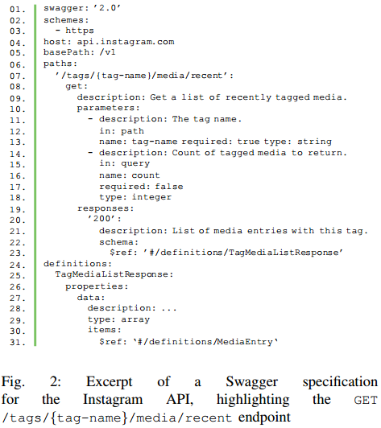
INTRODUCTION
Request
URL string, HTTP method, and the corresponding data（payload and query data）
The work is to check whether the request conforms to publicly available web API specifications
Notes:
该篇论文主要做的就是通过静态分析识别出代码中的Web API调用，检查是否符合API规范
The work is to check whether the request conforms to publicly available web API specifications
创新点：一是静态的分析（区别于动态执行需要验证和覆盖率较低的问题），二是从客户端调用的角度
Endpoint
a URL and HTTP method
Swagger

Slide 3
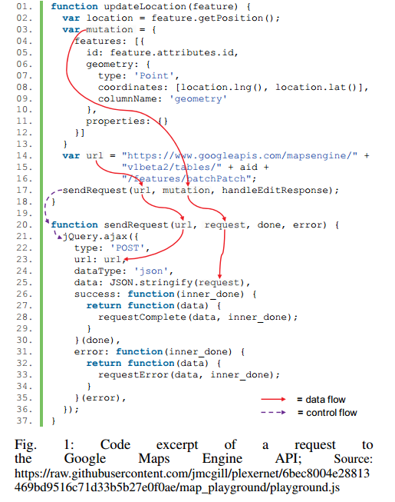
Overview
Our approach employs an inter-procedural static analysis to extract URL and input strings from a web API request in JavaScript code.
The second step of our approach checks whether the
extracted information from the web API requests conforms with web API specifications.
Notes:
Inter-procedural static analysis指的是控制流分析和数据流分析
Checking a request against a web API Specification：首先检查在API规范中是否有这样的端点（endpoint），然后在确定端点之后检查参数格式是否一致，最后检查写入请求体中的数据是否正确

Slide 4
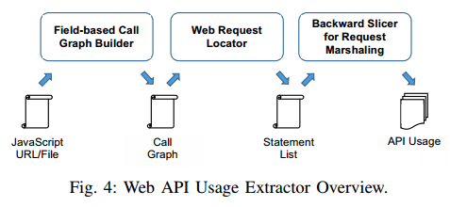
WEB API USAGE EXTRACTION
Field-based Call Graph Builder
In our implementation, we used the field-based call graph construction available in WALA .We take all functions in the script as entry points for the call graph
Web Request Locator
To identify API invocations, we look for framework-specific patterns in the call graph. For jQuery, we handle the most common patterns, i.e., function calls to $.ajax, $.get, and $.post。
Backward Slicer for Request Marshaling
Using WALA backward slicer, we recover all possible data flows that lead to the request.
Notes:
Field-based Call Graph Builder
In our implementation, we used the field-based call graph construction available in WALA .We take all functions in the script as entry points for the call graph
Web Request Locator
To identify API invocations, we look for framework-specific patterns in the call graph. For jQuery, we handle the most common patterns, i.e., function calls to $.ajax, $.get, and $.post。
Backward Slicer for Request Marshaling
Using WALA backward slicer, we recover all possible data flows that lead to the request.

Slide 5
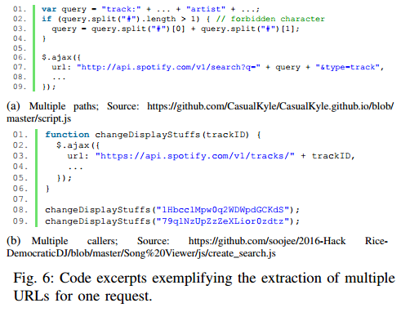
Perform path-insensitive data flow analysis.

Slide 6
CHECKING PROCEDURE
Checking endpoints
  whether any of the URLs for a given request begins with any of the base URLs of the known API specifications
  Path
  the procedure attempts to match a request’s URLs to paths defined in the API specifications
  Any method determined by the static analysis is checked against all methods defined in all matched specifications and all matched paths.
Notes:
The goal of the checking procedure is to match the information produced by the static analysis against formal web API specifications.
这个地方还要重写

Slide 7
  Checking request data
    Payload data
    If any of the matched specifications defines a payload schema
    in any of the matched endpoints, the procedures determines if
    the payload data reported in the request information adheres
    to that schema or not
    Query data
  To check the query parameters, the procedure parses the query strings of all URLs reported for a request. It then checks whether any of the found parameter
  sets matches the parameter definitions found in any of the endpoint definitions matched for the request

Slide 8
Evaluation
RQ1: Given JavaScript code describing a web API request, to what degree can the analysis correctly determine whether the request is consistent with an endpoint in given Swagger specifications?
RQ2: For a request consistent with an endpoint in the Swagger specifications, to what degree can the analysis correctly determine whether the request data (the payload and the query parameters) is consistent with specifications?

Slide 9
Data Collection
API specifications from APIs Guru
These specifications act as a source of ground truth to indicate whether requests in the source code invoke the API correctly.
JavaScript files from GitHub
From these queries, we obtained 6746 JavaScript files, from which we extracted 19668 web API requests.
For this evaluation, we focused on the 6575 requests that matched a specification (i.e., a request URL matching the base URL of a specification, including matching the schemes, domain, and the basepath) .
Notes:
收集数据具体是怎么操作的？
Guru repository
The repository contains specifications either provided by API providers or third-parties, or generated using dedicated scripts
Search the files
We obtained such a set by querying GitHub using its search capabilities . extension:js "$.ajax" "{domainName}"
Each search query targets the domain name of an available Swagger specification from APIs Guru and JavaScript instances that send requests using the jQuery function
Filter data
For this evaluation, we focused on the 6575 requests that matched a specification (i.e., a request URL matching the base URL of a specification, including matching the schemes, domain, and the basepath)
9915 (Remove 13093 requests) 4926个是不包含API calls，3178是静态分析不能解析的urls（比如在base url中有不能确定的符号，还有动态执行才会赋值的符号）

Slide 10
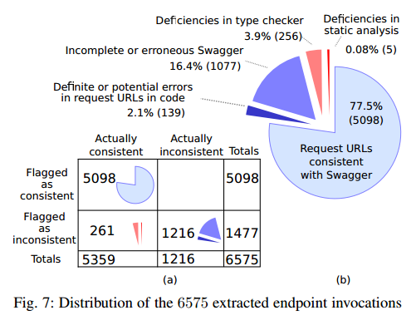
Endpoint Results
Method：a request is a valid endpoint when it satisfies two conditions: (1) the URL matches an endpoint path, which can contain path variables(e.g., /repos/{owner}/{repo}) and (2) the HTTP method matches (e.g., GET).
96.0% for endpoint checking
Notes:
Precision for endpoint checking :96%

Slide 11
True Negatives
  definite or potential errors in the code
    Deprecated APIs
    Documented Programming Errors
    Typographical errors
  Erroneous and incomplete Swagger specification
    Errors in Swagger specifications
    Missing endpoints in Swagger specifications
    Missing authorization URLs in Swagger specifications
False Positives
  Static analysis
    Limitation of the analysis scope
    Handling string library functions
  Checking procedure
    Conservative Matching
    Missing authorization URLs
Notes:
1
代码问题
规范的缺失和错误
2
静态分析
检查步骤

Slide 12
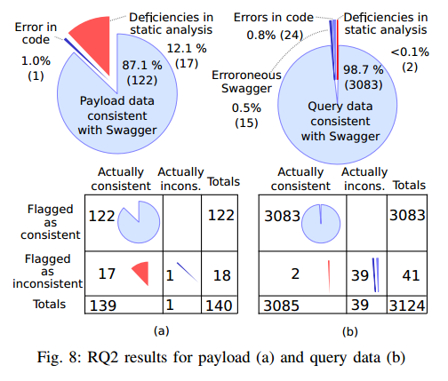
Payload Data Results
87.9% for payload data checking
True Negatives
False Positives
Notes:
Precision for payload data checking :87.9%
While the analysis reports a required data property to be sent in a query parameter, the specification requires it to be sent in the payload body 查询数据和有效数据位置放错了
False positives
The 17 false positive cases are explained by deficiencies in the static analysis. 静态分析出错
In 13 cases, the static analysis does actually report data that, upon manual inspection, does match with the data schema in the specification. However, in these cases, the data is present as a JSON-encoded string in the request source code (rather than a JSON object) 解码出问题

Slide 13
Query Parameter Results
99.9% for query parameter checking
True Negatives
  Errors in the specification
  Errors in the code
False Positives
Notes:
Precision for query parameter checking :99.9%
39 reported query parameter mismatches
15 cases are explained by errors in the specification – required parameters are actually not necessary for a successful request （规范有问题）
In 24 cases, query parameters that are required according to the specification are sent in the payload body of the request instead, which is, in most of these cases, in conflict with both,
the API specification and online documentation。（代码中将查询数据被放到有效载荷payload中，因为缺失查询数据，该模型判为错，而规范认为是对的）
Only in two cases do we find mismatches due to our approach’s failure to report needed information （解析url出错，）
We observe two cases where the static analysis misses to report an inconsistency because the extracted URLs end with a variable

Slide 14
Future work
this approach can be integrated with existing tools that support developers in using web APIs.
Notes:
可能的问题：
API规范可能存在问题

Slide 15
Revamping JavaScript Static Analysis via Localization and Remediation of Root Causes of Imprecision
Notes:
FSE 2016

Slide 16
Introduction
A diagnosis algorithm is applied to trace this “bad”behavior back to its root causes linked to specific functions. By applying a well-chosen context sensitivity policy to use on these functions during a fresh analysis pass, the anomalous behavior may be circumventable .
Notes:
静态分析需要考虑精度和性能两个方面，然后该论文使用动态运行信息来找到关键的上下文信息，对这些代码进行上下文敏感分析，会提高精度而不会影响性能。
A diagnosis algorithm is applied to trace this “bad”behavior back to its root causes linked to specific functions. By applying a well-chosen context sensitivity policy to use on these functions during a fresh analysis pass, the anomalous behavior may be circumventable .

Slide 17
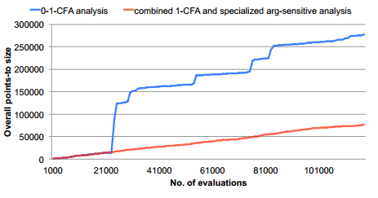
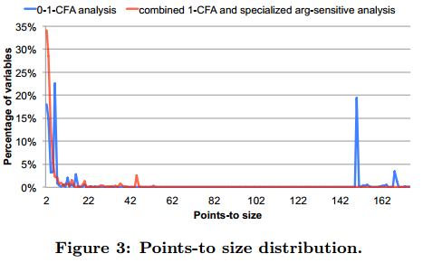
Motivation
The existence of such “jumps” indicates that the overly-approximated results are frequently
propagated, resulting in significant overall precision loss.
These results motivated us to design an automated approach to identify root causes of imprecision via the differences in static analysis behavior
Notes:
实证分析说明对于Javascript静态分析，有些变量的上下文信息比较重要，这些是影响静态分析精度的root causes，所以需要设计方法来定位这些root causes
The existence of such “jumps” indicates that the overly-approximated results are frequently propagated, resulting in significant overall precision loss
This result also indicates that overly-approximated results of specific program constructs may pollute many places in the program due to copying during the points-to propagations
Motivation：These results motivated us to design an automated approach to identify root causes of imprecision via the differences in static analysis behavior

Slide 18
Overview
Notes:
Root cause的定位和补救：面临的问题有两个(i) the program
construct has a wide reach within the propagation system(e.g., the values of the property access source[name] are assigned to target[name] at line 5 and are transitively propagated to about 500 other program variables or reference properties), and (ii) the impact of its wide reach is significant (e.g., looking up the property name of source at line 5 produces the points-to size of 150)
we design an improvement suggestion algorithm that uses dynamic information to suggest appropriate context sensitivity to improve the analysis precision on the identified root causes

Slide 19
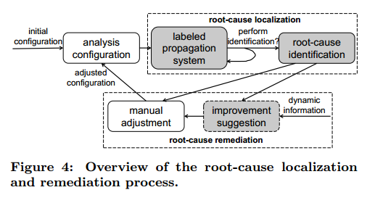
Overview
Intuitively, an anomaly is flagged if a given variable or reference property, collectively referred to as a program pointer, is associated with a large points-to set,and the label corresponding to the pointer propagates to many other pointers within a small number of evaluations of the propagation system.

Slide 20
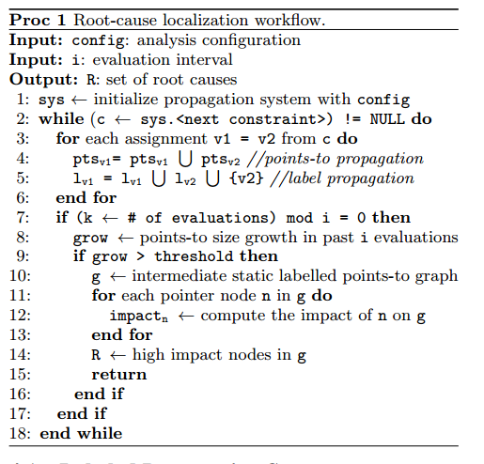
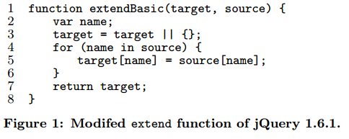
Root-cause location
Labeled Propagation System
Notes:
Root cause定位被分成两部分：解释标签传播系统和使用指向图和对应的标签去确定对应的root cause
Labeled Propagation System ：the system solves a constraint that assigns a program pointer v2 to another pointer v1 by adding the points-to set of v2 to that of v1
Moreover, a label v2 is associated with the points-to set of v1 that indicates (some of) the points-to relations of v1 were propagated through v2
我的理解：如果v1被赋值给了v2，则label v2将被赋值v1的指向集，We retain all these reference properties (e.g., psource_i.pname_j) as labels attached to the points-to set of vtmp
对一个变量的指向集（point-to set）举例：the propagation-history graph for the points-to set of vtmp consists of all the reference properties of source[name] as entry points. vtmp is
the entry point of the propagation-history graph for the points-to set of each reference property of target[name] (e.g., ptarget_i.pname_j), while there also are edges from vtmp
to the properties of source[name]

Slide 21
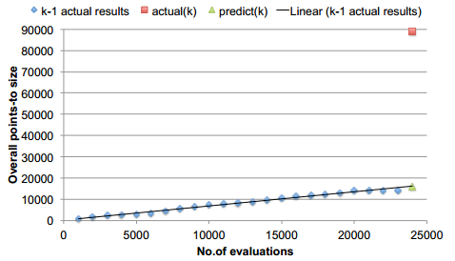
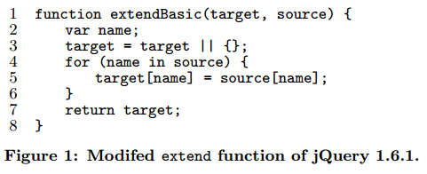
predict(k) = intercept + slope × kn. If actual(k) > threshold × predict(k)
Notes:
首先建立了一个预测模型，This prediction model can capture the “jump” phase of the points-to analysis shown in Figure 2
认为指向规模应该是个线性的过程，有斜率有截距，唯一的问题是这个evaluation是啥意思？

Slide 22
Identifying Root Causes for Divergence
For each variable or reference property v, we count
its points-to size, |Pv|
its number of occurrences as labels in the points-to sets of other variables and/or reference properties, |Lv|.
We therefore use the scoring heuristic Sv=|Pv|×|Lv| as a measurement of the possibility of v being a root cause.
Notes:
|Lv| measures how widely v reaches within the propagation system, and |Pv| measures if the impact of its wide reach is significant

Slide 23
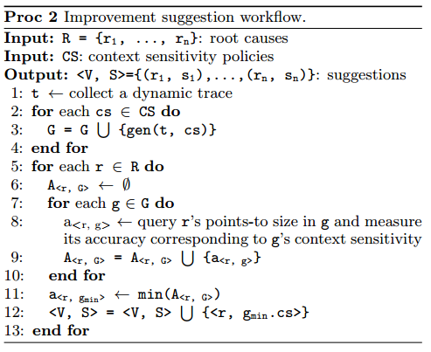
Improvement Suggestion
First, the target program is executed to collect a dynamic
function entries and exits
invocations
  the location of the call site
  the location of the target function
  The allocation site of the receiver object
property reads and writes.
  the instruction location in the program;
  the allocation site of the base object (as its program location)
  the property name
  the allocation site of the value, if it is a reference object, or the type of the value, if it is a primitive value
Notes:
首先收集一个动态执行的trace，对每一种类型的对象记录对应的信息

Slide 24
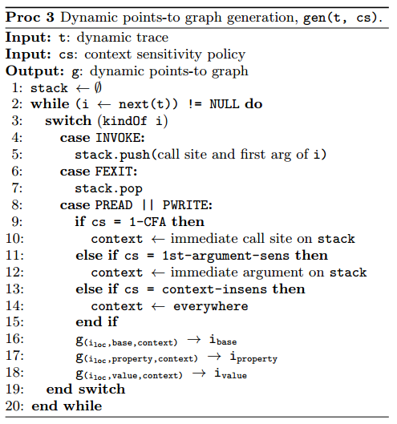
Improvement Suggestion
For a program pointer r that is identified as a root
cause, we locate its corresponding nodes via its program
location in each dynamic points-to graph, and collect
the number of calling contexts associated with r, ccr
the sum of points-to sizes under all calling contexts
The context sensitivity with the smallest ar is chosen for the function that contains r as the improvement suggestion
Notes:
因为获得了不同的上下文敏感的动态指向图，可以确定哪个policy是有用的。（policy包括call site、argument、everywhere）去确定哪种calling context是
the target program is executed to collect a dynamic trace
function entries and exits; (ii) invocations; and (iii) property reads and writes 动态的指向图
此模块是通过动态的方法去确定选择哪种calling context是最好的。
问题在于此项目适用，并不代表这里得到的结论可以用于其它项目

Slide 25
Evaluation
一：先对benchmark执行1-CFA分析，然后执行定位方法找到包含根本原因的函数，对这些函数applied additional argument sensitivity on the first arguments ，剩下的函数执行1-CFA分析。
二：we applied the root-cause localization as well as improvement suggestion algorithms on the baseline 0-1-CFA analysis.
  Possible suggestions for root-cause functions include:
    a context-insensitive analysis
    a single context-sensitive analysis (i.e., 1-CFA or argument sensitivity on any argument of the function)
    a combined context-sensitive analysis (e.g., 1-CFA + 1st-argument sensitivity)
Notes:
两组实验：
实验一：先对benchmark执行1-CFA分析，然后执行定位方法找到包含根本原因的函数，对这些函数applied additional argument sensitivity on the first arguments ，剩下的函数执行1-CFA分析。
the whole-program 1-CFA and 1st-argument-sensitive analysis, and the selective analysis
实验二：we applied the root-cause localization as well as improvement suggestion algorithms on the baseline 0-1-CFA analysis.
Possible suggestions for root-cause functions include:
a context-insensitive analysis,
a single context-sensitive analysis (i.e., 1-CFA or argument sensitivity on any argument of the function5)
a combined context-sensitive analysis (e.g., 1-CFA + 1st-argument sensitivity)

Slide 26
Evaluation
Hypothesis I: The root-cause localization algorithm can accurately identify a small set of program constructs as the root causes of imprecision.
Hypothesis II: Guided by the root causes identified by the localization algorithm, the improvement suggestion algorithm can recommend appropriate kinds of context sensitivity to significantly improve the analysis precision.
Notes:
两个实验分别验证了这两个假设

Slide 27
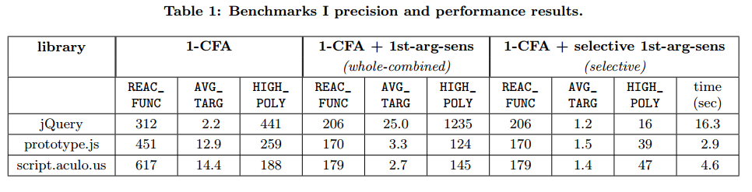
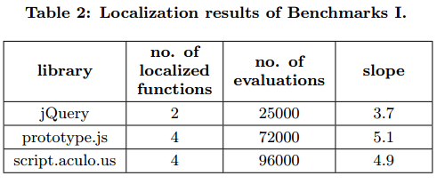
Benchmarks I Results
Notes:
This result suggests that
(i) 1-CFA analysis is imprecise to resolve the call targets in many cases, and
(ii) because the whole-combined analysis applies 1st-argument sensitivity over all the program, it may create many calling contexts for the functions that are not identified as root causes which may not significantly increase the analysis precision (e.g., in terms of the REAC_FUNC metric)

Slide 28
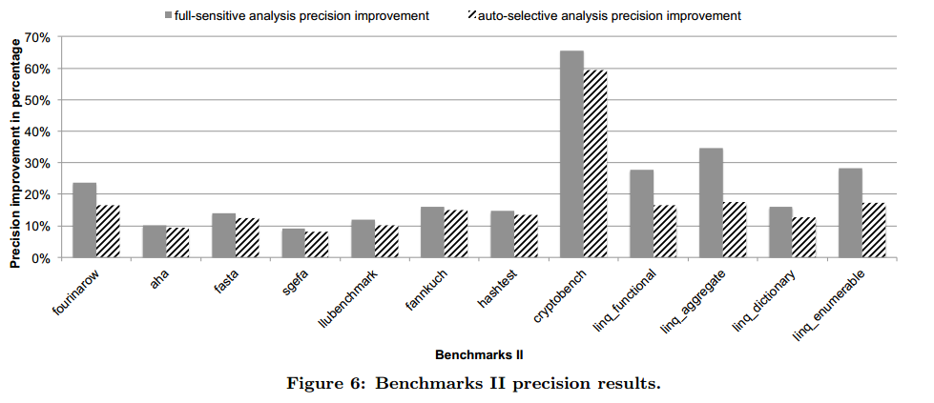
Benchmarks II Results

Slide 29
Question
是否可以推广使用（即该项目得到的结论可以推广到其它项目吗？）
Notes:
论文的创新点：
1、第一个定位静态分析精度不准的根本原因的工作
2、第一个使用动态信息自动建议上下文敏感类型
3、认为找到使得初始静态分析性能不好的原因

Slide 30
Efficient Static Checking of Library Updates
Notes:
FSE 2018

Slide 31
INTRODUCTION
a static analysis for automatically and effciently checking if a library upgrade introduces an API compatibility (colloquially termed a breaking change)
Notes:
研究背景：第三方库更新导致下游应用不兼容，语义版本控制（SemVer（主版本号、次版本号、修订号））作为一种解决办法，库作者会在版本号上标明是否有breaking change，存在必须人工处理和不能捕捉细粒度的代码变更的问题。
And unsurprisingly, it's impossible for that single number to contain enough meaningful information
本文提出一种自动检查库更新是否保证API兼容性的静态分析工具。与语义版本控制不同的是，不使用版本信息，而是直接对源代码计算difference。
涉及到三种语言：Java、Python、Ruby
创新点
1、静态分析用于提醒库更新
2、diff查询可以在线性时间内完成
3、做了个实证分析证明了有版本违反了SemVer

Slide 32
APPROACH
Basic diffs（基础的，由代码得到的）
Transitively-changed Methods（间接改变的，通过调用图）
Fast Queries（构建了相邻版本的调用图）
Diﬀ Composition（diff复合）
Conflating Operations（合并不改变和丢失两种情况）
Suggesting Upgrades（推荐更改）

Slide 33
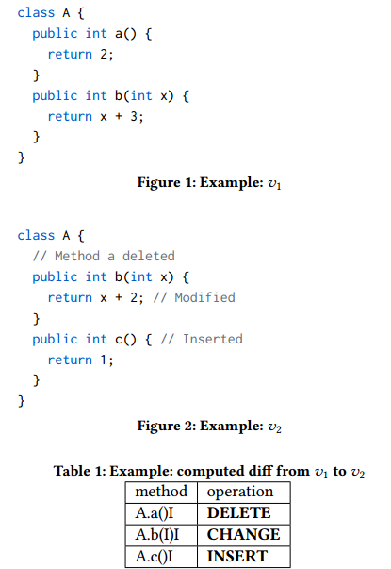
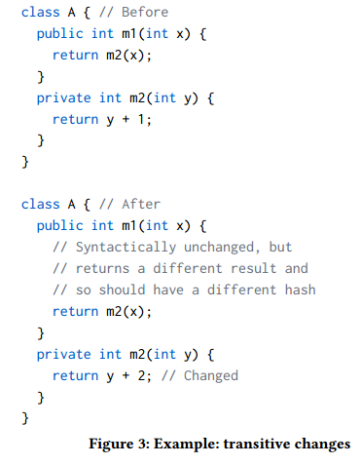
将变化分类为INSERT, DELETE, CHANGE，UNCHANGED，MISSING
build call graphs of library programs
our call graph construction algorithm uses standard techniques of CHA and VTA
Get diff
We then use the call graphs to improve diﬀs: given a method m whose identifer is present in a diﬀ, we also include all public methods that call m.
Notes:
在计算diff的过程中，每次都需要构建一个调用图

Slide 34
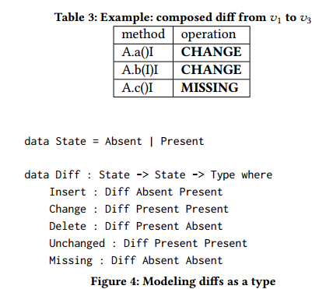
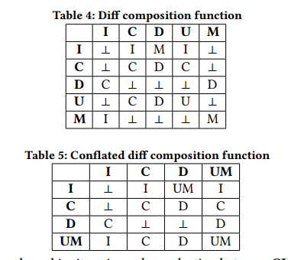
Notes:
我们的方法是在仅连续的库版本之间预先计算diffs，然后组合各个diffs以导出任意版本间的diffs。 这实现了良好的平衡，需要线性的空间并且在实践中足够快地运行。
Diff复合，例如
compose Insert Delete = Missing
compose Delete Insert = Change
这种形式（粒度是method）

Slide 35
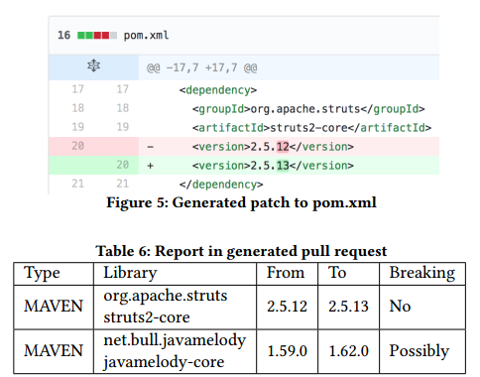
Suggesting Upgrades
Notes:
We then use diﬀs to suggest upgrades and determine if they induce breaking changes
从专有漏洞数据库中获取一个库中脆弱的版本，然后提醒更新库（找到不会造成漏洞的库）
如果我没有理解错，意思就是通过（用户的调用图）来检查一个库的更新是否存在问题，最后生成一个类似于此的补丁文件，标记涉及到的版本等信息

Slide 36
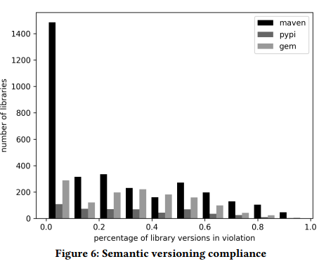
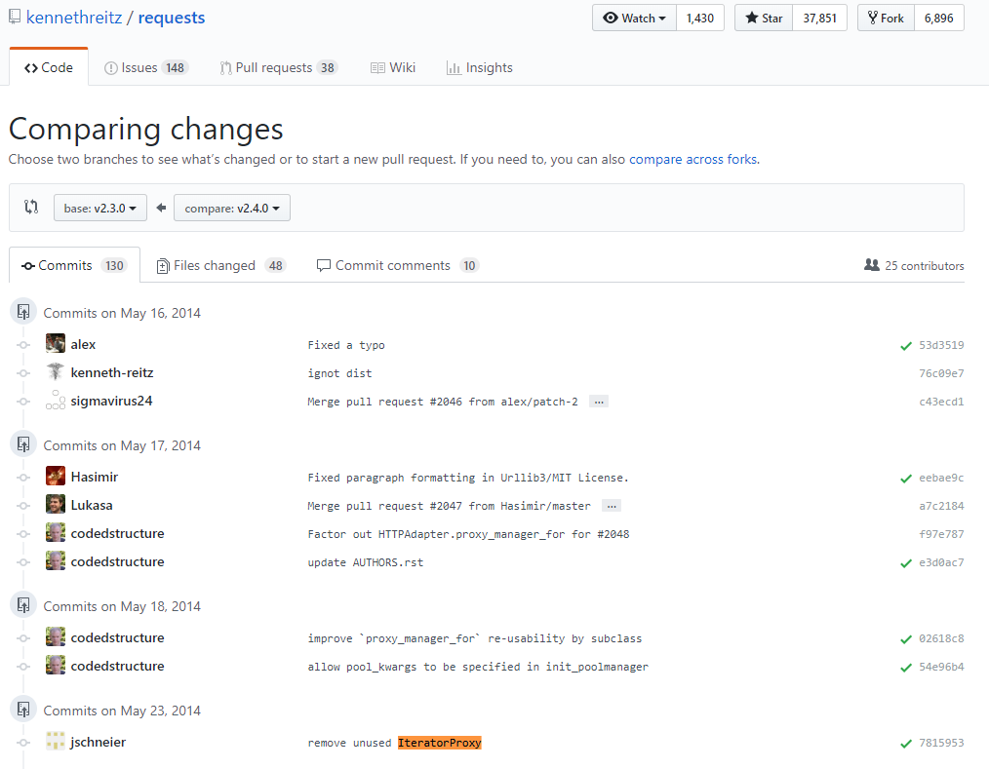
Evaluation
Maven Central (3273 libraries), RubyGems (1332), and PyPI (501)
https://github.com/requests/requests/compare/v2.3.0...v2.4.0#diﬀ-
2bdbe7e19f5215e8c319573cdd114f01L16
Notes:
72% of libraries violate SemVer in some version: the actual numbers are 80% (RubyGems), 67% (Maven Central), and 82% (PyPI). In addition, on average, 26% of all library versions are in violation, actual numbers being 31% (RubyGems), 24% (Maven Central), and 31% (PyPI)
首先讨论了语义版本控制被违反的情况，指出了未表明breaking API的版本
如在2.3.0和2.4.0版本之间被删掉了一个request.structures.Iteratorxy

Slide 37
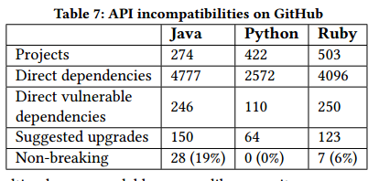
实验方法：
we identifed 4777 unique direct dependencies, of which 246 had known vulnerabilities in our database.
We were then able to suggest upgrades for 150 of those; 36 had no safe versions to upgrade to, and 60 failed due to the errors in an earlier part of the pipeline
Notes:
然后检查了开源项目的API 不兼容问题，Java中28 (18.7%) are non-breaking， 其它语言的结果不一定可信，因为调用图的构建有问题
它的用处和不足：作为漏洞修复工具，仅仅静态可能是不够的，可以加上动态的方法
Limitations of Static Analysis
Unsupported Language Features.
Computing Diﬀs in Isolation
Insuﬀicient Semantic Information

