Slide 1
Automating Test Environments With Chef
QA Camp 2018
Corey Sullivan

Slide 2
About Me
Software Consultant since 2006
Joined Centare in 2015
Worked in the CI/CD/DevOps space since 2015
Experience with Chef since 2016

Slide 3
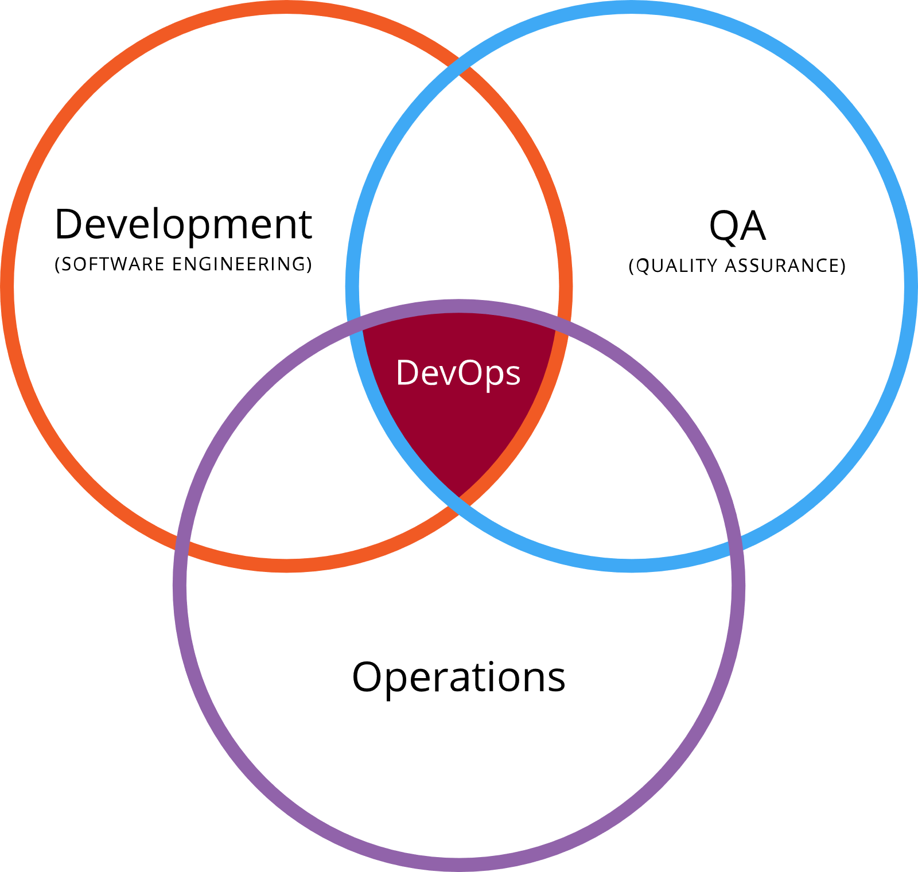
DevOPS
Development
Seeks change
QA
Seeks risk reduction
Operations
Seeks organizational stability

Slide 4
What is Chef?
Infrastructure as Code
Automated Infrastructure Configuration
Includes Testing Framework
Test Kitchen
Compliance with InSpec
Written in Ruby
Notes:
Chef is an infrastructure configuration automation tool.
Infrastructure as code treats configuration as a first-class citizen. Better organization than custom scripts.
Testable code using ChefSpec for unit testing and InSpec for integration testing and compliance. Test Kitchen is the test harness provided with Chef. Automated testing for the automation.
Compliance means ensuring that nodes with the same configuration are identical.
Chef code extends Ruby. Chef code can contain normal Ruby structures.

Slide 5
Why Chef?
Increases productivity
Increases consistency
Increases confidence
Notes:
Increases productivity by removing manual instance setup. Chef allows for scalable deployments.
Increases consistency by automating the configuration process.
Increases confidence by removing manual error. Did I remember to install dependencies? Self-documenting and reduces tribal knowledge.

Slide 6
Chef Basics
Nodes – final result of a Chef run
Run list
Attributes – data
Resources – fine-grained configuration
Recipes – collection of resources
Cookbooks – collection of recipes and attributes
Roles – collections of recipes and attributes
Environments – collection of nodes, attributes, and version constraints
Notes:
Nodes are the “output” of a Chef run. The final
Attributes are the “variables”. Attributes can defined at the cookbook, recipe, role, and environment levels. Values are determined by a precedence system.
Resources are the fine-grained configuration objects. Represents a physical object on a node. Examples including downloading files, installing packages, and configuring services.
Recipes determine the order in which resources are executed. Changing the order of resources will change the order of execution. Normal Ruby files.
Cookbooks store attribute defaults, recipes, and any support files such as files and templates.
Roles are a context-specific collection of attributes and recipes (pseudo-run list). Roles are composable and can be used as a way to organize related recipes that configure a specific function. A node can have any number of roles and recipes.
Environments represents a collection of nodes. Attribute values can be defaulted at this level and cookbooks version constraints can be set here. A node can only be in one environment.

Slide 7
Chef and AWS
AWS OpsWorks
Chef Automate
Chef Server
AWS EC2
Registers with Chef Server
User-data script installs chef-client
Notes:
AWS OpsWorks is a service that creates and configures a Chef Automate and Server environment. Backed by EC2, it alleviates the need for an on-premises set up.
Chef Server is a centralized repository for all of the Chef objects. Chef-client communicates with Chef Server for managing nodes, cookbooks, roles, and environments.
AWS OpsWorks with Chef Automate provides default configuration for auto-registering nodes with the Chef Server.

Slide 8
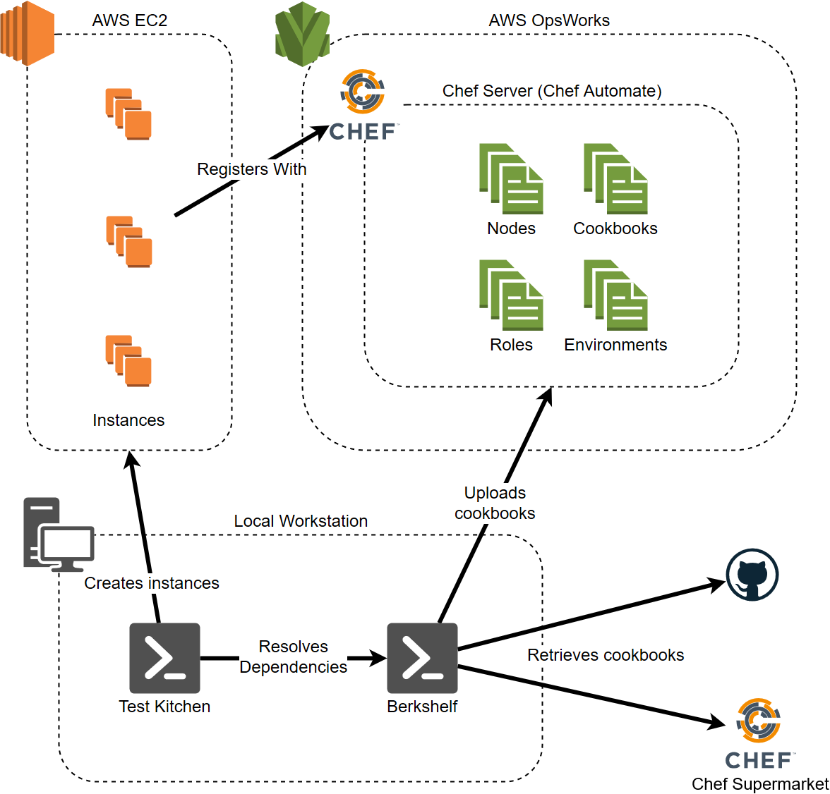
Demo Overview

Slide 9
Next Steps
Chef Automate
Compliance Pipeline
InSpec
Habitat
Application lifecycle configuration
Alternative to Chef
Notes:
Chef Automate is a compliance pipeline. Beyond managing configuration with Chef Server, it provides monitoring for node compliance. Compliance tests are executed periodically against nodes. These nodes can be corrected with further automation with Chef.
The compliance tests are InSpec tests as shown in the demo.
Habitat is an alternative to Chef that focuses on automating the whole application lifecycle. Build, packaging (as containers), and deployment. Brand-new offering.

Slide 10
Questions?
https://chef.io
https://learn.chef.io
corey.sullivan@centare.com
Notes:
Chef Automate is a compliance pipeline. Beyond managing configuration with Chef Server, it provides monitoring for node compliance. Compliance tests are executed periodically against nodes. These nodes can be corrected with further automation with Chef.
The compliance tests are InSpec tests as shown in the demo.
Habitat is an alternative to Chef that focuses on automating the whole application lifecycle. Build, packaging (as containers), and deployment. Brand-new offering.

Slide 11
Thank you!

