Slide 1
2020 하반기 설리번 프로젝트
스스로 만들어보는
지도 웹 어플리케이션
[4차시] HTML
설리번 프로젝트 Web2팀 l 윤새연 김민주

Slide 2

학습목표
HTML, CSS, JS를 이용하여 회원가입 폼을 만들 수 있다.

Slide 3
1. HTML
<!doctype html>
<html>
<head>
<meta charset="utf-8">
<title>회원가입</title>
<link rel='stylesheet' href='style.css'/>
</head>
<body>
<form action="what.html" method="post">
<div class="form">
<div class="title">
<h2>회원가입</h2>
</div>
<div class="content">

Slide 4
1. HTML
<!--id 입력-->
<div>
<span class="txtbox int_id">
<input type="text" id="id" class="int" placeholder="아이디를 입력해주세요.">
<span data-placeholder="id"></span>
</span>
</div>
<!--pw 입력-->
<div>
<span class="txtbox int_pw">
<input type="password" id="pw" class="int" placeholder="비밀번호를 입력해주세요.">
<span data-placeholder="pw"></span>
</span>
</div>
<!--name 입력-->
<div>
<span class="txtbox int_name">
<input type="text" id="name" class="int" placeholder="이름을 입력해주세요.">
<span data-placeholder="name"></span>
</span>
</div>

Slide 5
1. HTML
<!-- month 입력 -->
<div id="month">
<span class="txtbox">
<select id="mm">
<option>월</option>
<option value="01">1</option>
<option value="02">2</option>
<option value="03">3</option>
<option value="04">4</option>
<option value="05">5</option>
<option value="06">6</option>
<option value="07">7</option>
<option value="08">8</option>
<option value="09">9</option>
<option value="10">10</option>
<option value="11">11</option>
<option value="12">12</option>
</select>
</span>
</div>
<!--birth 입력-->
<div class="birth">
<!--year 입력-->
<div id="year">
<span class="txtbox">
<input type="text" id="yy" class="int" placeholder="년(4자)">
</span>
</div>
<!-- date 입력 -->
<div id="day">
<span class="txtbox">
<input type="text" id="dd" class="int" placeholder="일">
</span>
</div>
</div>

Slide 6
1. HTML
<!--phonenumber 입력 -->
<div>
<span class="txtbox int_number">
<input type="text" id="number" class="int" placeholder="전화번호을 입력해주세요.">
<span data-placeholder="number"></span>
</span>
</div>
<div class="btn_area">
<button type="button" id="btnJoin">
<span>가입하기</span>
</button>
</div>
</div>
</div>
</form>
</body>
</html>

Slide 7
2. CSS
<style>
body {
background: #A0E5FF;
margin: 0;
height: 100px;
text-decoration: none;
}
.form {
width : 400px;
background-color : #F4F9FF;
height : 300px;
padding : 100px 40px;
border-radius: 10px;
position : absolute;
left : 50%;
top: 50%;
transform : translate(-50%,-50%);
text-align:center;
}

Slide 8
2. CSS
.title{
position: absolute;
left : 10%;
top: 5%;
right: 10%;
font-family: Dotum,'돋움',Helvetica,sans-serif;
color: #494B4C;
}
.txtbox{
display: block;
width:100%;
height: 30px;
padding: 5px 10px 5px 10px;
box-sizing: border-box;
background: #ffffff;
position : relative;
margin : 20px 0;
border-bottom: 2px solid #E5E5E5;
}
.int {
display: block;
height: 20px;
font-size : 13px;
color : #333;
width : 100%;
border : none;
outline : none;
}

Slide 9
2. CSS
#month, #day {
padding-left: 10px;
}
.btn_area {
margin: 30px 0 91px;
}
#btnJoin {
width: 50%;
padding: 15px 0 15px;
border: 0;
cursor: pointer;
color: #ffffff;
background-color: #3EDBA7;
font-size: 16px;
font-family: Dotum,'돋움',Helvetica,sans-serif;
}
</style>
#birth {
display: table;
width: 100%;
}
#year {
display: table-cell;
width: 126px;
}
#month {
display: table-cell;
width: 126px;
vertical-align: middle;
}
#day {
display: table-cell;
width: 126px;
}

Slide 10
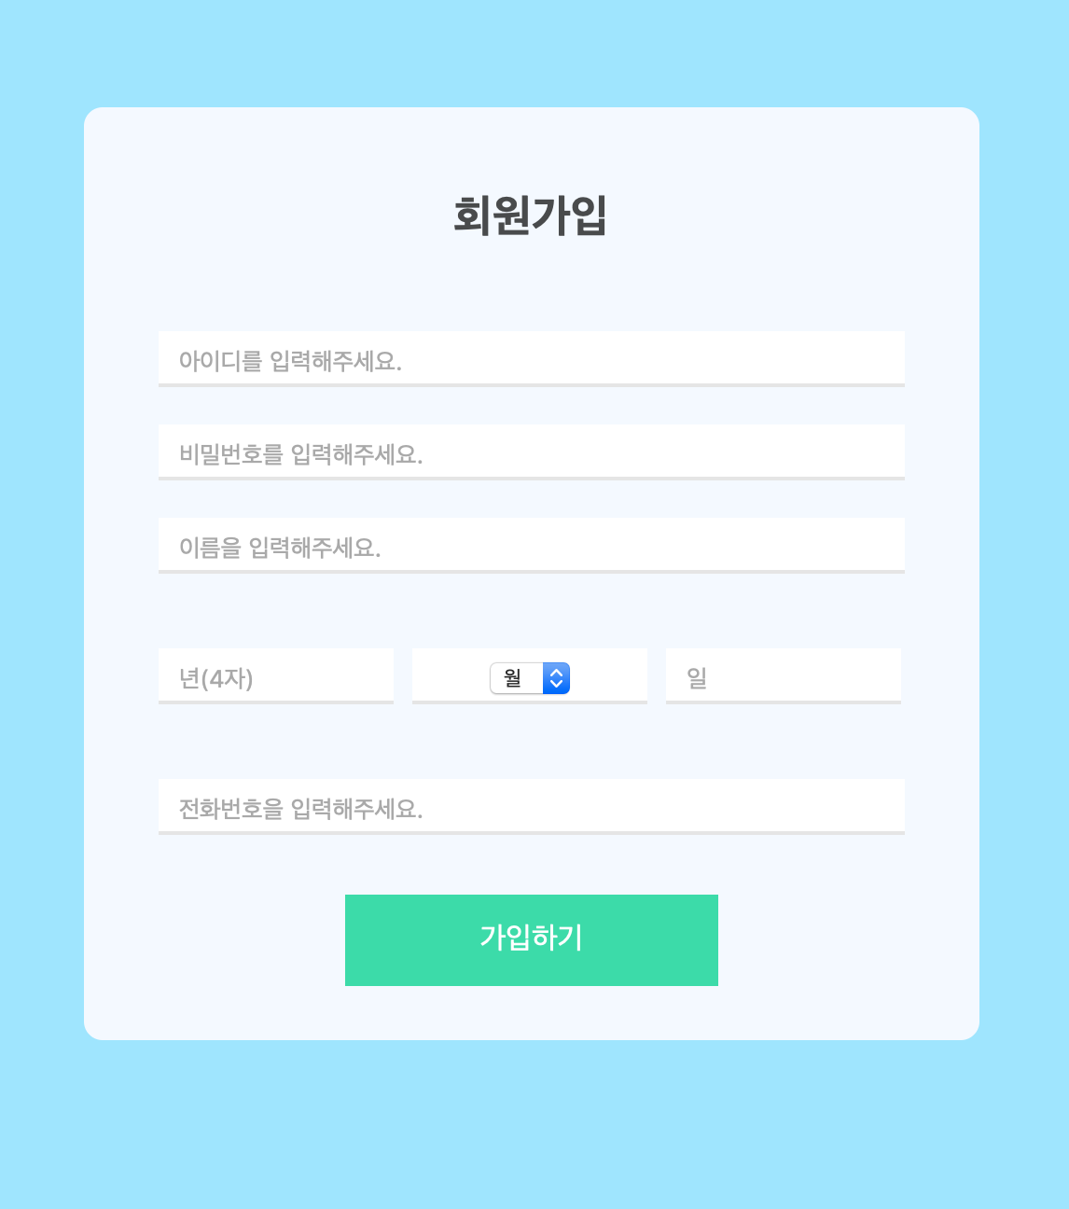
2. CSS

Slide 11
3. JS
// 함수 선언법 : function a() {}
// 조건문 : if ~ else if ~ else
// console.log() : 콘솔창 로그 입력 함수
function checkform(){
let id = document.getElementById('id').value;
let pw = document.getElementById('pw').value;
let mname = document.getElementById('name').value;
let birth_yy = document.getElementById('yy').value;
let birth_mm = document.getElementById('mm').value;
let birth_dd = document.getElementById('dd').value;
let number = document.getElementById('number').value;
//let : 변수 선언법 const : 상수 선언법(추후 값 변경 불가)
//document.getElementById('id') : html요소에서 id라는 아이디를 가진 태그를 지칭함

Slide 12
3. JS
if(id==''){
alert("아이디를 입력하지 않았습니다.");
}
else if(pw==''){
alert("비밀번호를 입력하지 않았습니다.");
}
else if(mname==''){
alert("이름을 입력하지 않았습니다.");
}
else if(birth_yy=='' || birth_dd=='' || birth_mm==false){
alert("생일을 입력하지 않았습니다.");
}
else if(number==''){
alert("전화번호를 입력하지 않았습니다.");
}
else {
console.log(id);
console.log(pw);
console.log(mname);
console.log(birth_yy + '년' + birth_mm + '월' + birth_dd + '일');
console.log(number);
}
}

Slide 13
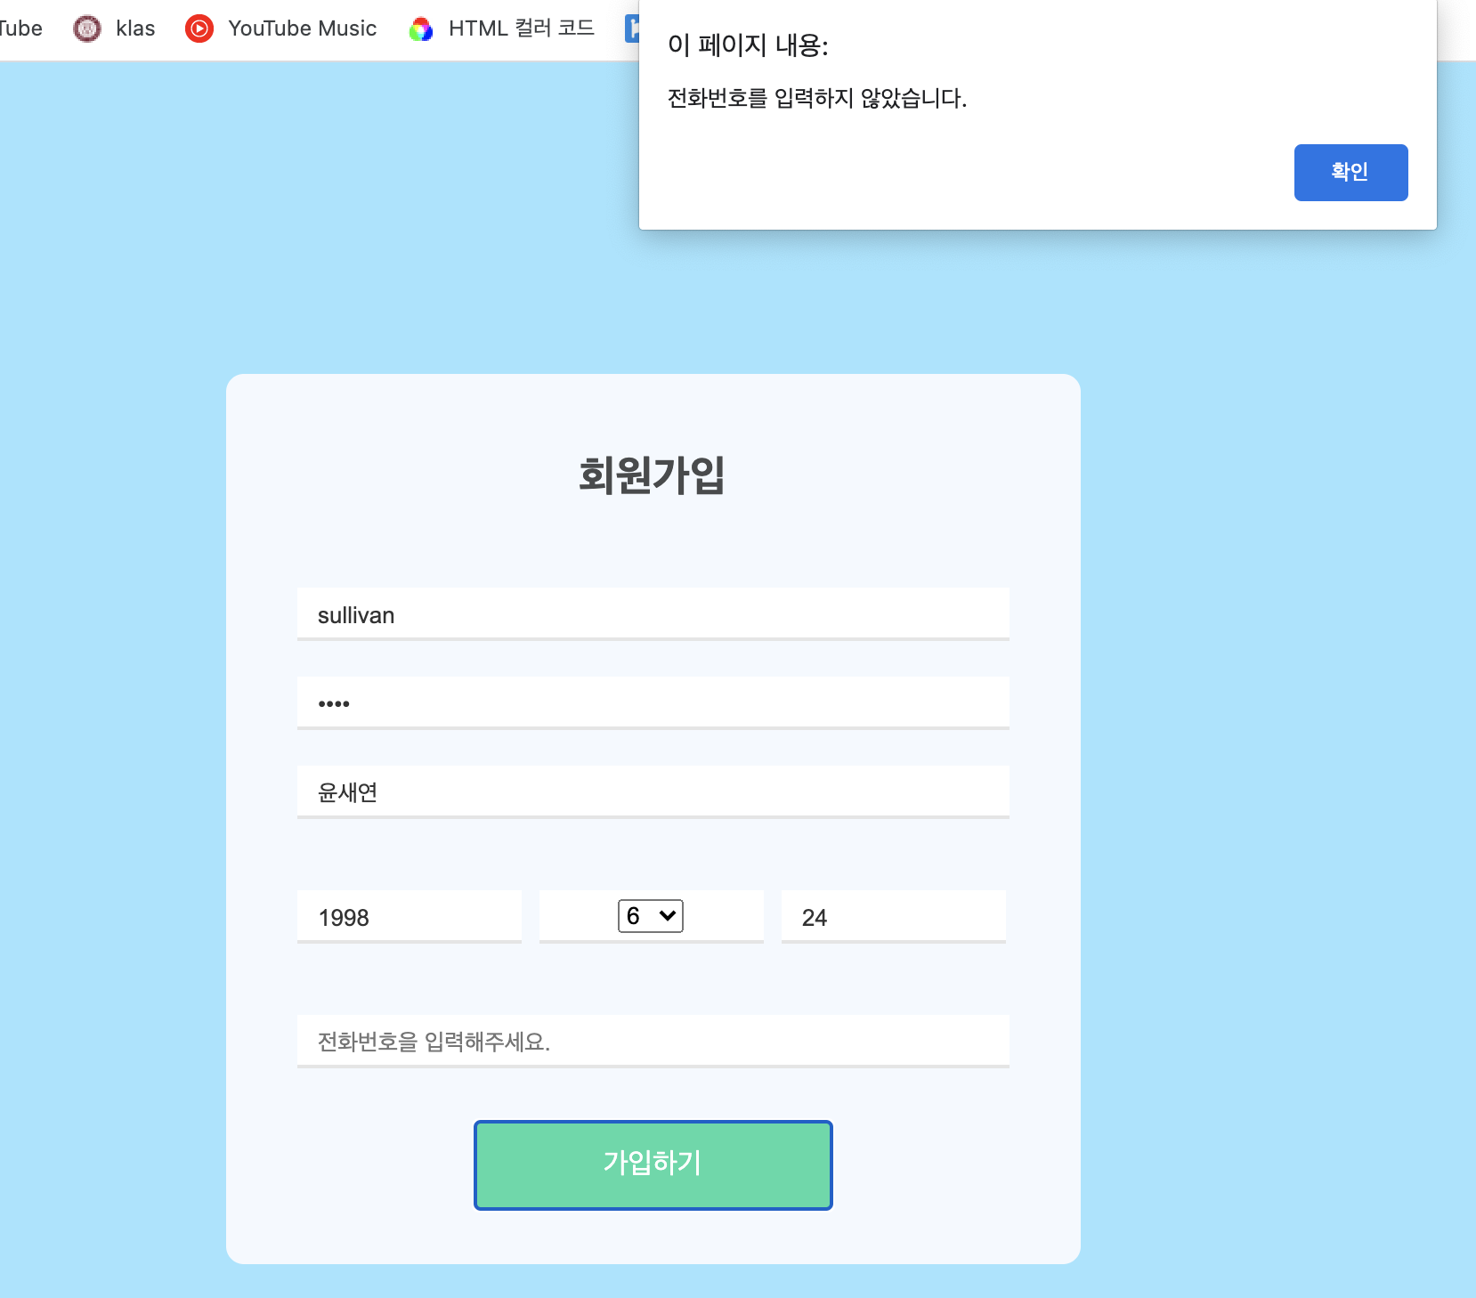

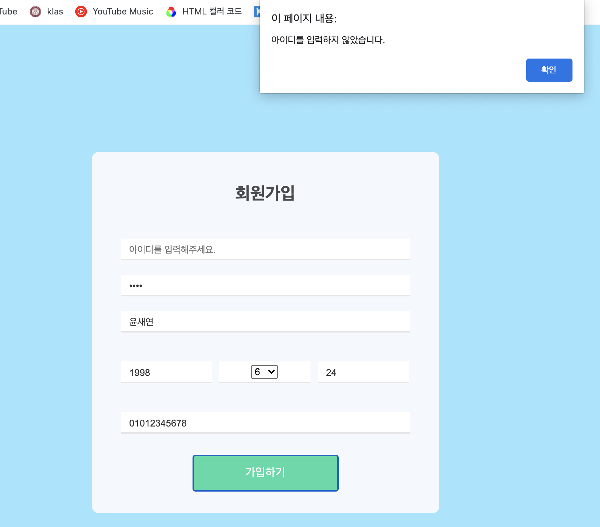

3. JS

Slide 14
다음 시간에 만나요!
▶︎ [5차시] API

