Slide 1
Studying machine learning optimization

Slide 2
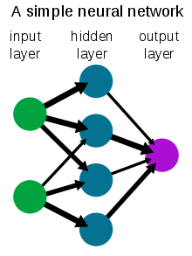
What is machine learning?
Computer algorithms that can get better (“learn”) with more data.
Deep learning is a type of ML, based on making artificial neural networks.
Are used for a variety of problems:
Speech recognition
Image recognition
Translation
Protein folding
Games (Chess, Go, etc.)

Slide 3
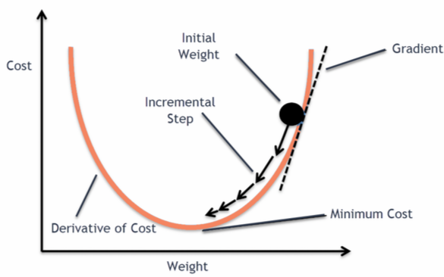
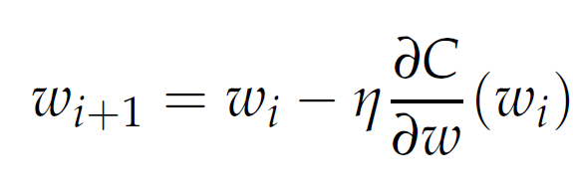
What is optimization? (in machine learning)
Training a model is iterative
Uses minibatch gradient descent
Vocab:
Minibatch = randomly selected subset of dataset
Epoch = iteration through entire dataset
Updated weights
Learning rate
Old weights
Minibatch gradient

Slide 4
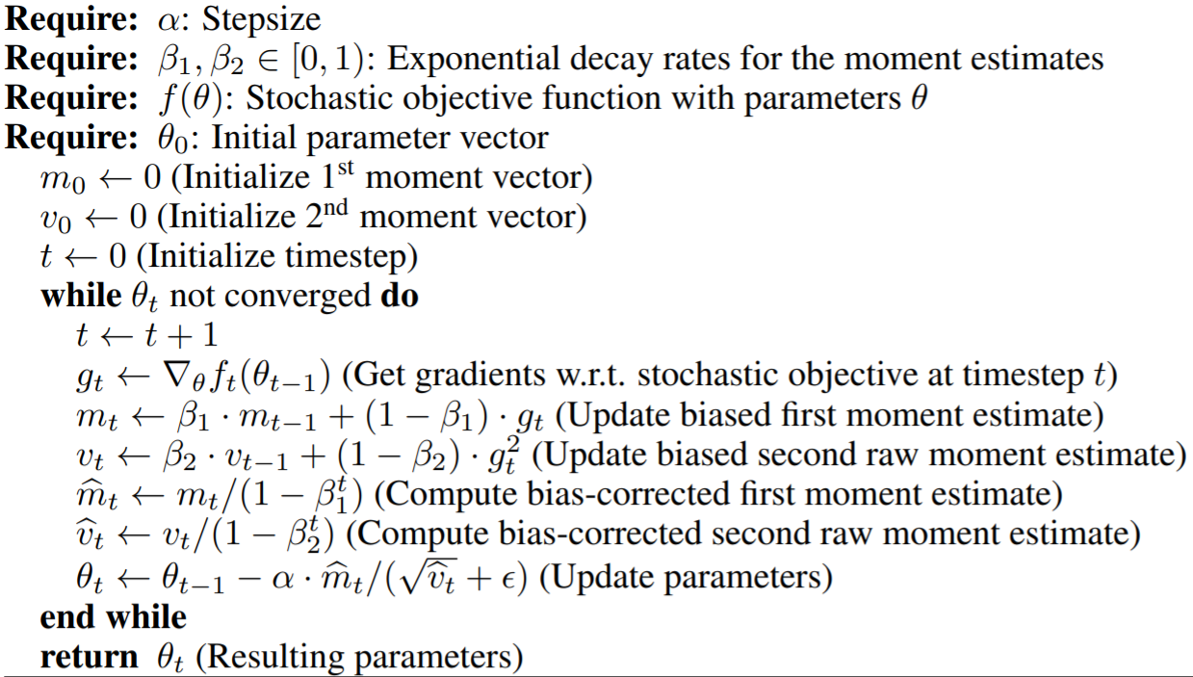
What is Adam? (“Adaptive moment estimation”)
Commonly used optimization algorithm developed in 2014
Instead of using just the gradient, calculates momentum variables
Uses these to take a smarter path and train faster and better

Slide 5
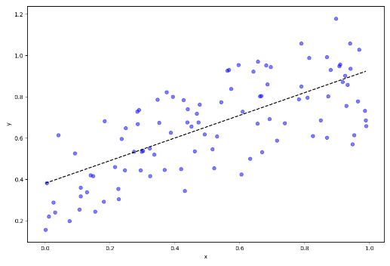
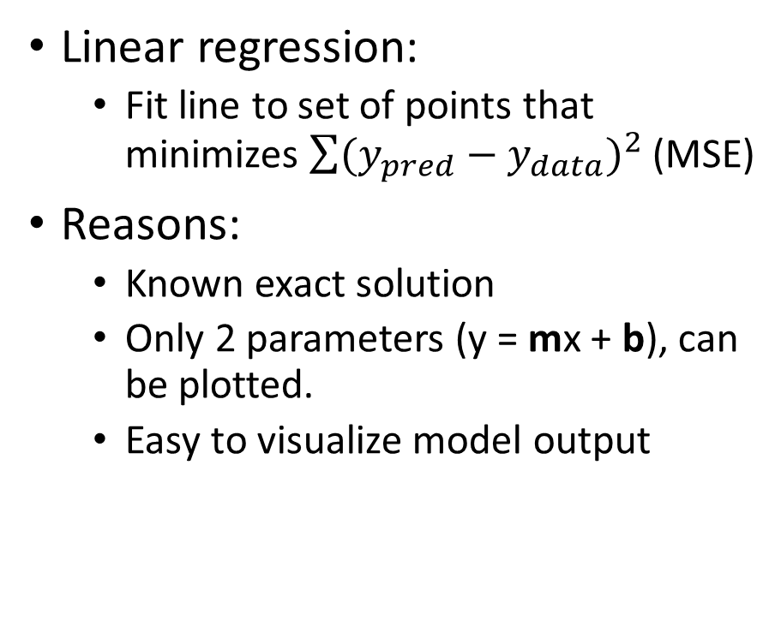
Visualizing a simple example
Linear regression:
Fit line to set of points that minimizes $\sum{{(y_{pred}−y_{data})}^{2}}$ (MSE)
Reasons:
Known exact solution
Only 2 parameters (y = mx + b), can be plotted.
Easy to visualize model output

Slide 6
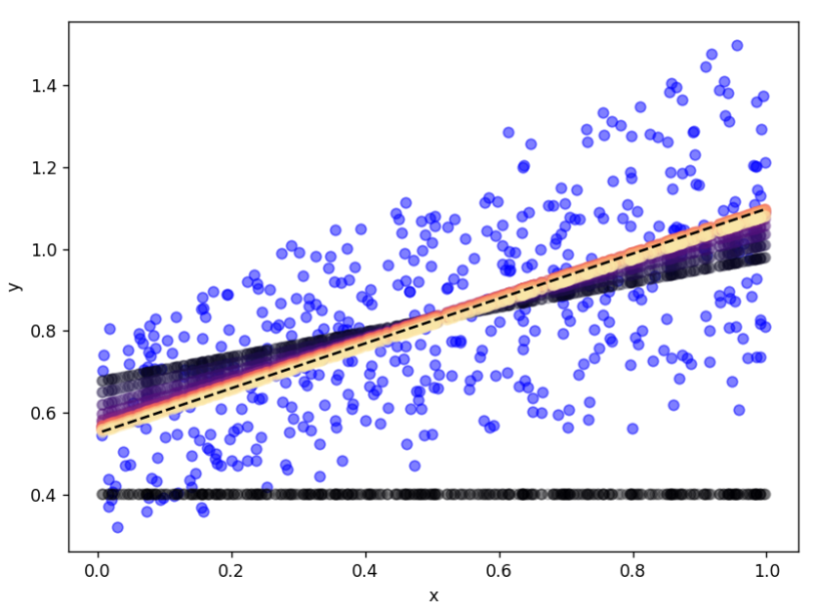
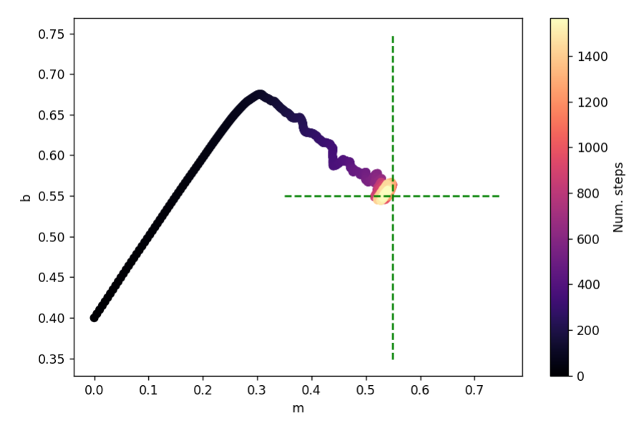
y = mx + b
Model predictions over training
Model parameters over training

Slide 7
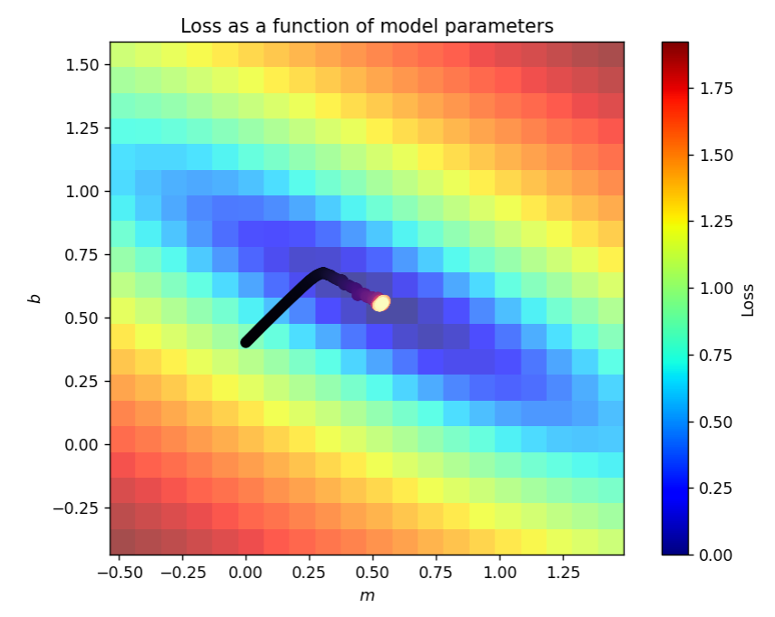
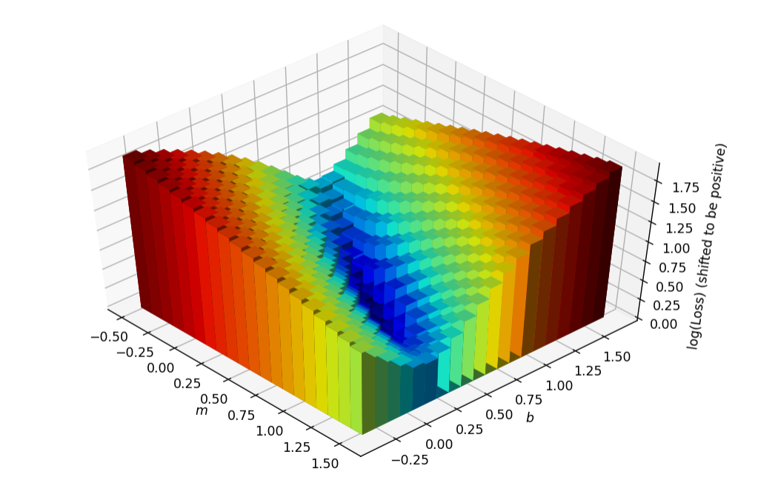

Slide 8
Building tools for analyzing larger models
Cannot plot model’s parameters over training
The previous method could be extended with moderate success (for small enough models).
For larger models, with thousands or millions of parameters, it is not feasible.
Cannot plot model’s parameters each step
For larger datasets and larger models, the number of steps the model takes is huge.
Over each epoch, look at the amount and “direction” of the change in parameters.

Slide 9
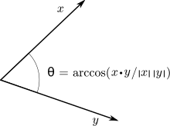
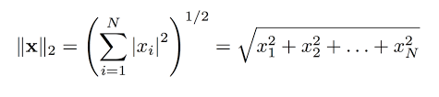
Epoch step size
Epoch step direction

Slide 10
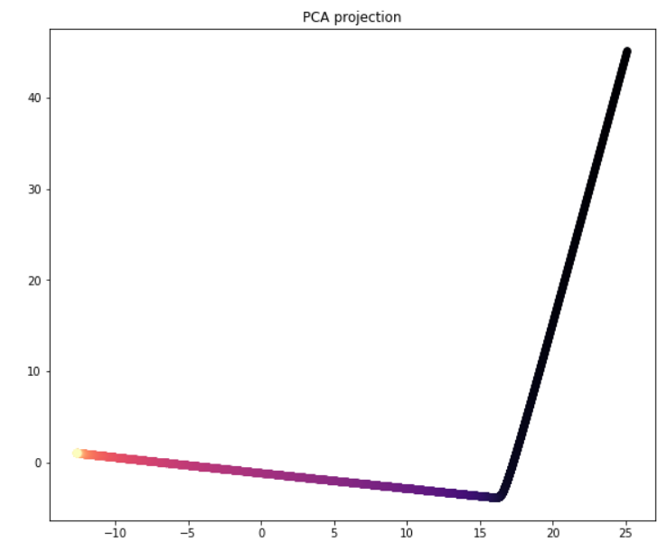
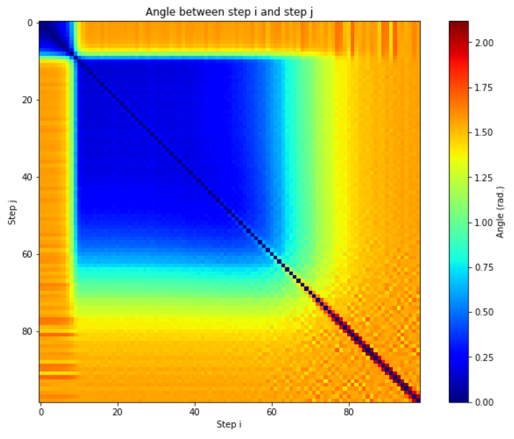
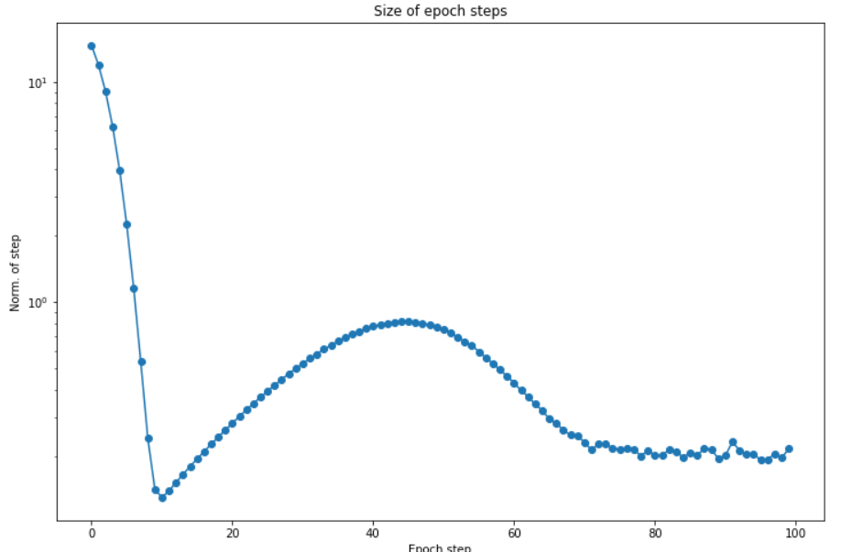
For linear regression
Relative direction of steps
Size of steps

Slide 11
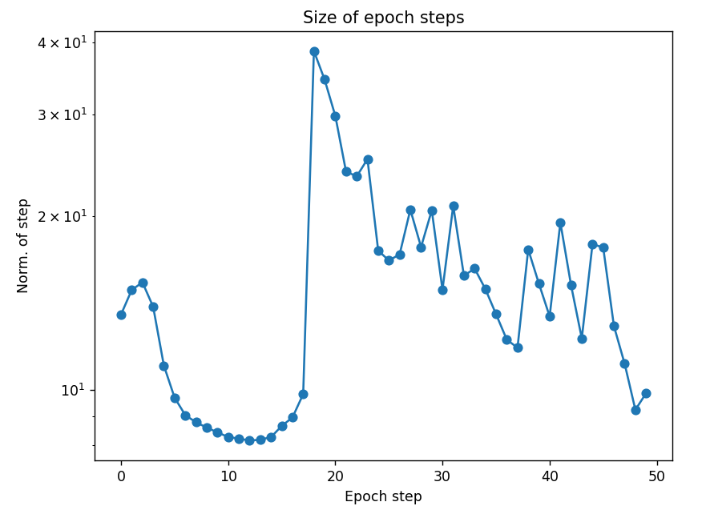
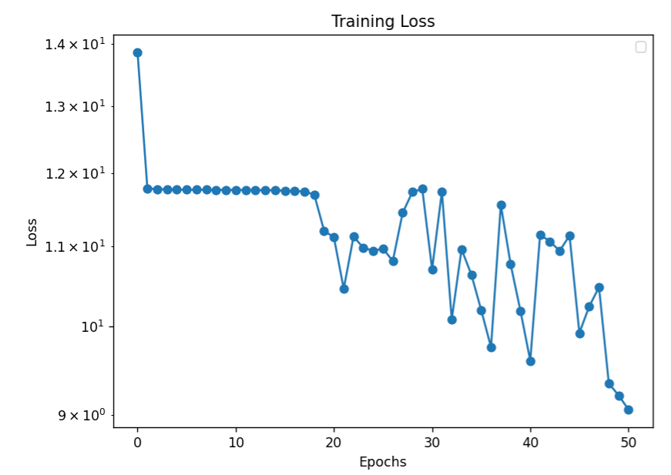
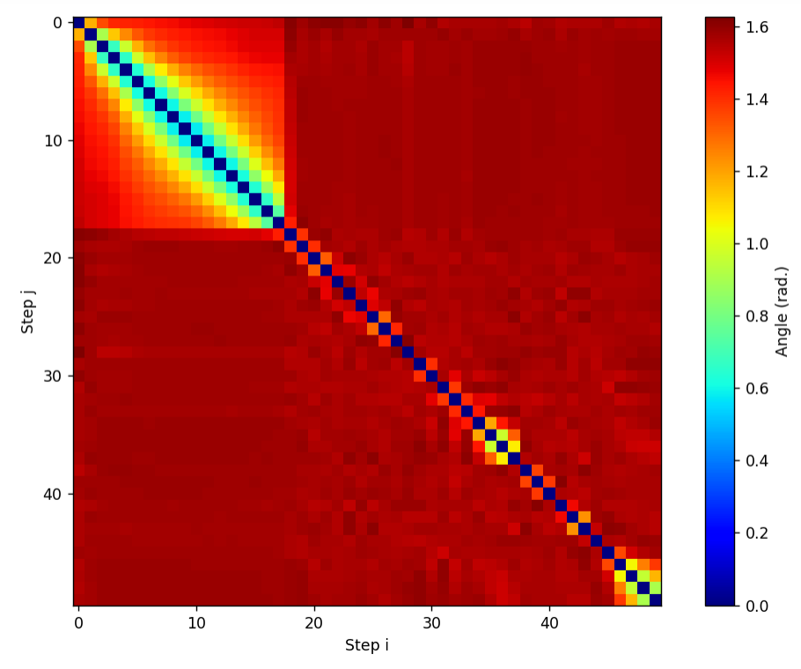
Real application: DDplus model

Slide 12
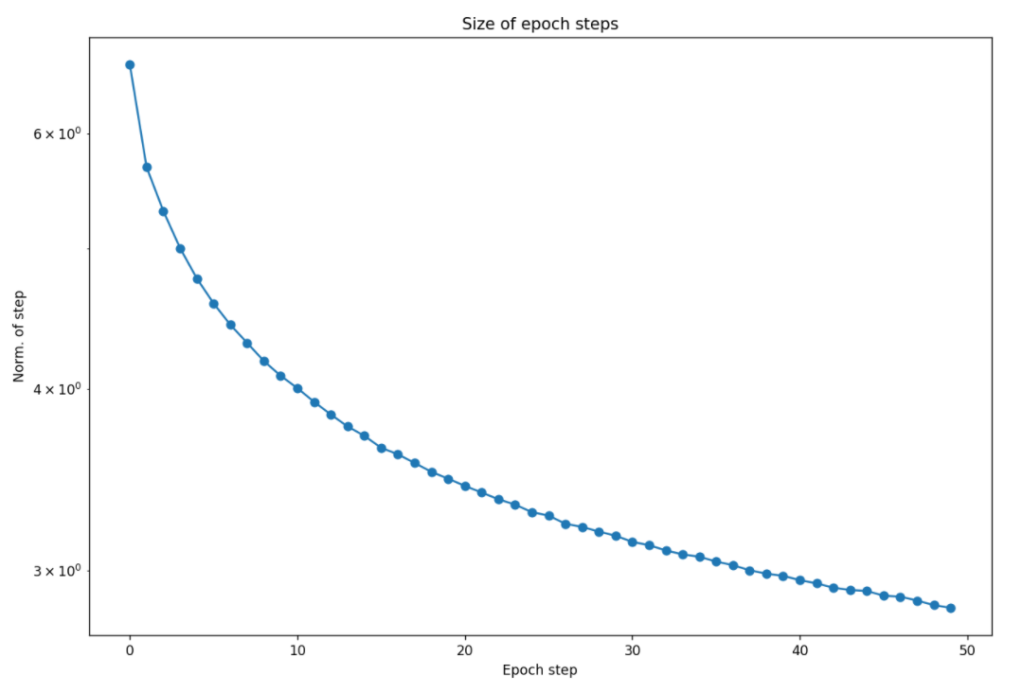
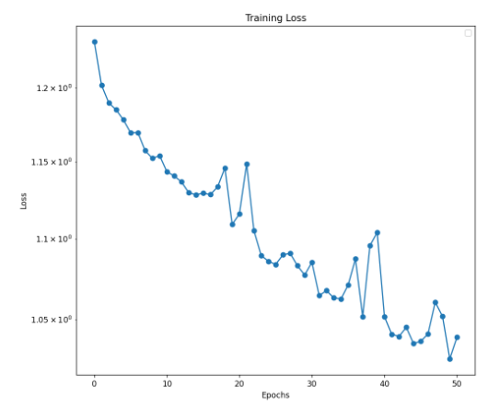
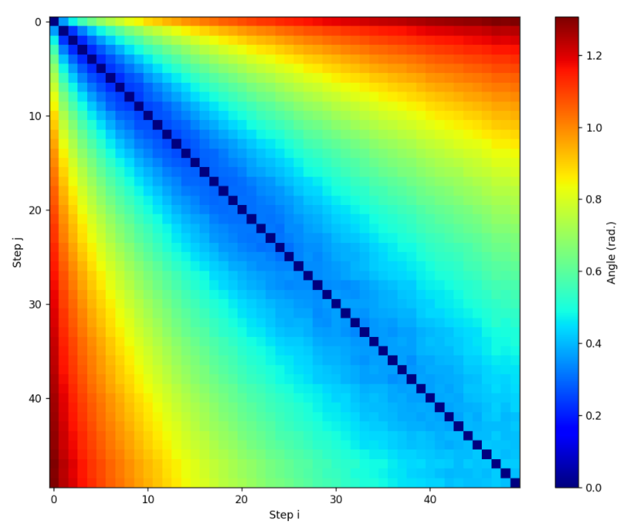
Real application: trained DDplus model

Slide 13
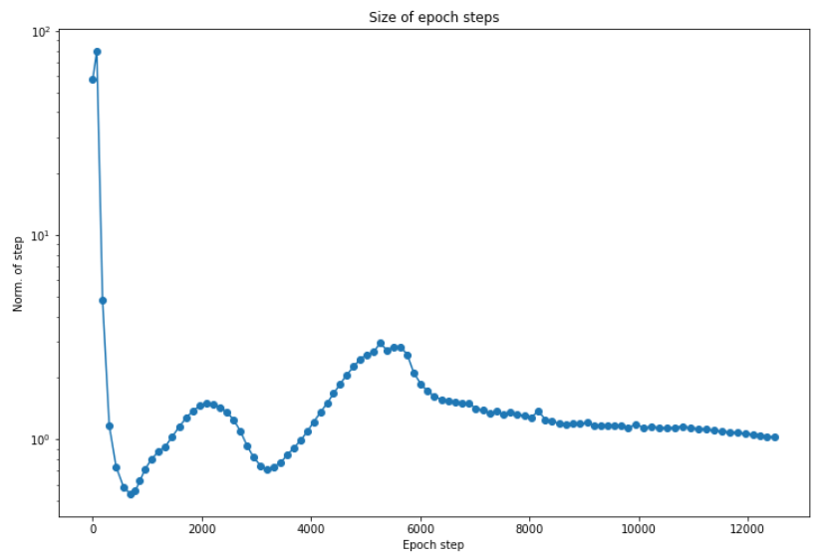
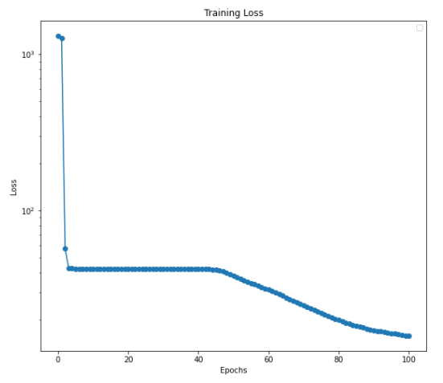
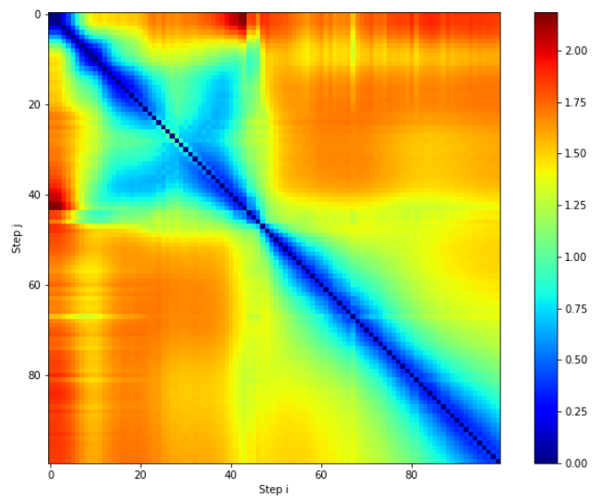
Real application: AllCNN model

Slide 14
Speeding up optimization?
Adaptive learning rate
Increase the learning rate if epochs are in the same direction
If consecutive steps are in the same direction, can you take larger steps?
EVE algorithm
Evaluate loss in epoch direction, and if the loss continues decreasing take a larger step
If the loss repeatedly jumps up, should you take smaller steps?
Careful learning rate
If the loss jumps up, decrease the learning rate

Slide 15
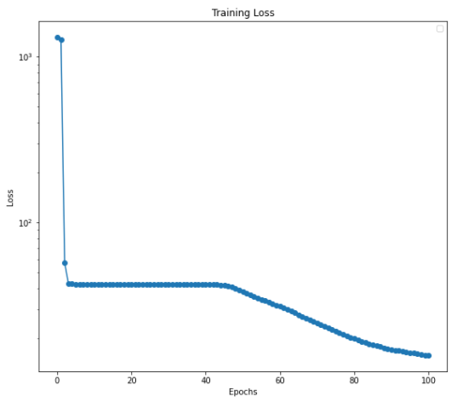
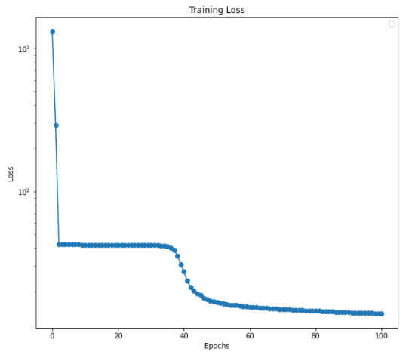

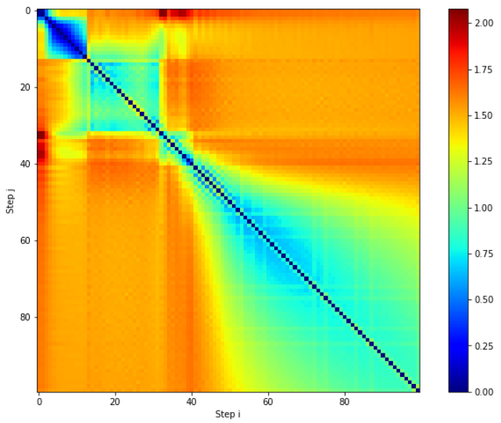
Adaptive learning rate with the AllCNN model
Without adaptive learning rate
With adaptive learning rate

Slide 16
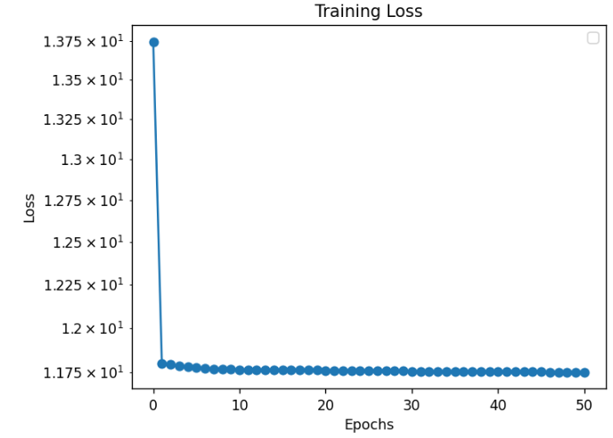
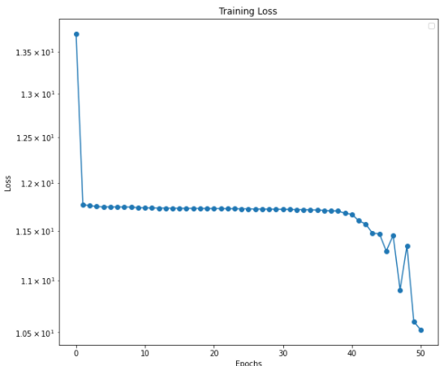
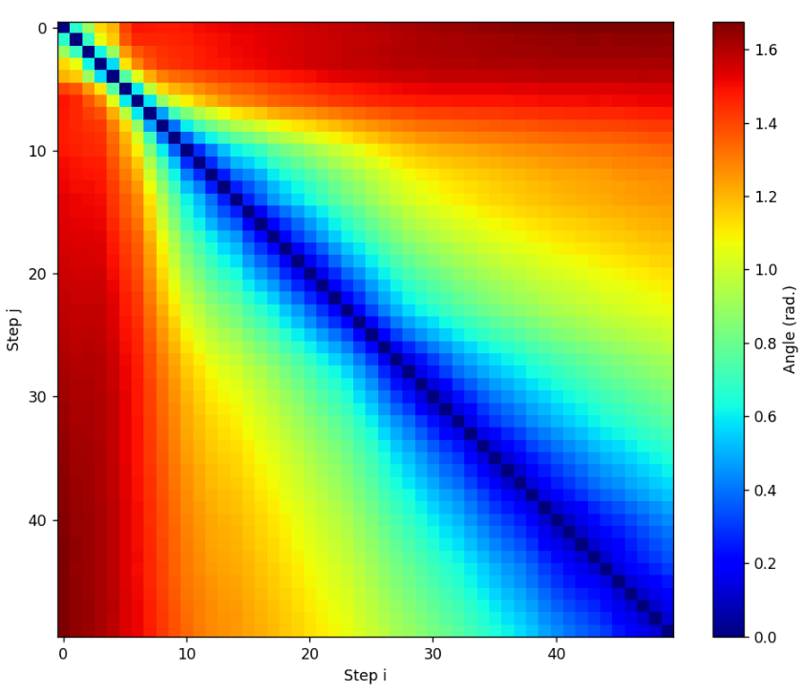
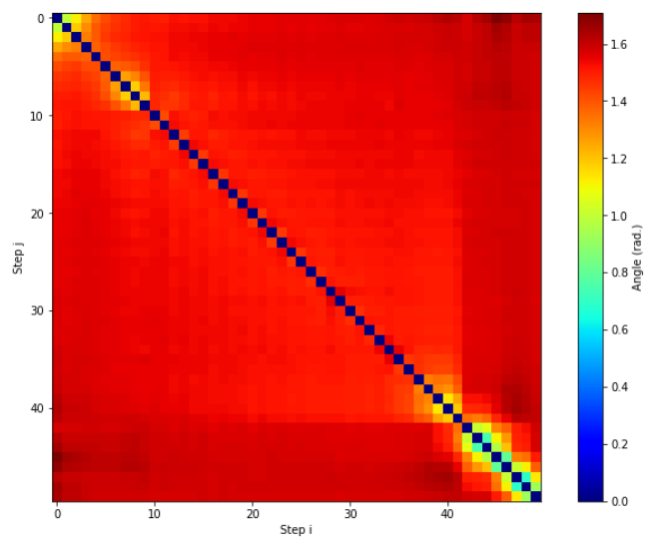
EVE algorithm with the DDplus model
Without EVE
With EVE

Slide 17
Current conclusions
How model’s train seems to be unique to the model and problem.
Some evidence that these methods can be used to speed up the training of models.
Hopefully, the methods of visualizing training can help create better deep learning models.

