Slide 1
MRA – MILESTONE PROJECT 1
SUBMITTED BY
SULOCHANA
12-O3-2023

Slide 2
Agenda & Executive Summary of the data
Contents of the presentation
Problem statement
About Data (Info, Shape, Summary Stats, your assumptions about data)
Exploratory Analysis and Inferences
Univariate, Bivariate, and multivariate analysis using data visualization
Weekly, Monthly, Quarterly, Yearly Trends in Sales
Sales Across different Categories of different features in the given data
Summarize the inferences from the above analysis
Customer Segmentation using RFM analysis (make 4 segments)
What is RFM?
What all parameters used and assumptions made
Output table head
KNIME used, Workflow image to be put
Inferences from RFM Analysis and identified segments
Who are your best customers?
Which customers are on the verge of churning?
Who are your lost customers?
Who are your loyal customers?

Slide 3
PROBLEM STATEMENT
An automobile parts manufacturing company has collected data of transactions for 3 years. They do not have any in-house data science team, thus they have hired you as their consultant. Your job is to use your magical data science skills to provide them with suitable insights about their data and their customers.
Auto Sales Data: Sales_Data.xlsx

Slide 4
Data Dictionary
ORDERNUMBER : | Order Number | CUSTOMERNAME : | customer
QUANTITYORDERED : | Quantity ordered | PHONE : | Phone of the customer
PRICEEACH : | Price of Each item | ADDRESSLINE1 : | Address of customer
ORDERLINENUMBER : | order line | CITY : | City of customer
SALES : | Sales amount | POSTALCODE : | Postal Code of customer
ORDERDATE : | Order Date | COUNTRY : | Country customer
DAYS_SINCE_LASTORDER : | Days_ Since_Lastorder | CONTACTLASTNAME : | Contact person customer
STATUS : | Status of order like Shipped or not | CONTACTFIRSTNAME : | Contact person customer
PRODUCTLINE : | Product line – CATEGORY | DEALSIZE : | Size of the deal based on Quantity and Item Price
MSRP : | Manufacturer's Suggested Retail Price
PRODUCTCODE : | Code of Product

Slide 5
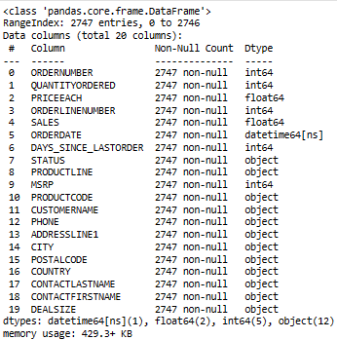
ABOUT THE DATA
INFO
This dataset has 20 variables out of which 12 are categorical, 7 numerical and 1 datetime64.
There is no missing values and duplicate values found.
Total number of observations are 2747.

Slide 6
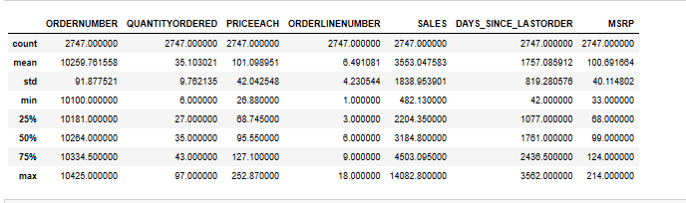
About the data - continued
Data shape:
(2747, 20)
Data summary:

Slide 7
About the data - continued
Data shape:
(2747, 20)
Data summary:
This dataset is measured using central measures for all the columns with integer values.
It tells how the data is been distributed, deviated and aligned.

Slide 8
UNIVARIATE ANALYSIS
The numeric columns of the data set are represented in graphically.
After exploration of data it is found that there are outliers in few of the columns.
Most of the data is normally distributed.

Slide 9
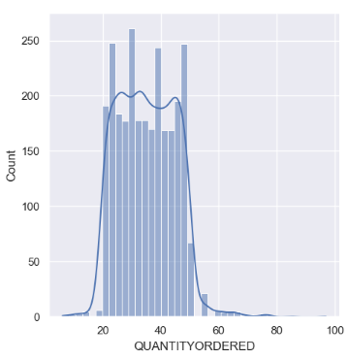
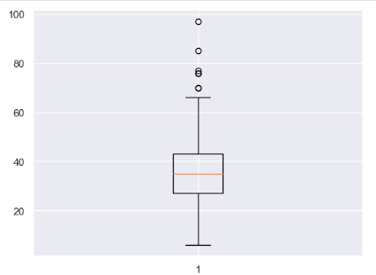
Order quantity After univariate anlysis of the data it is found that there are outliers present in this variable.

Slide 10
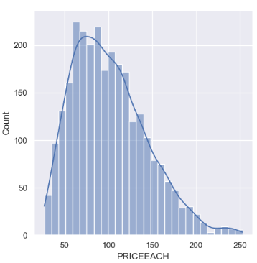
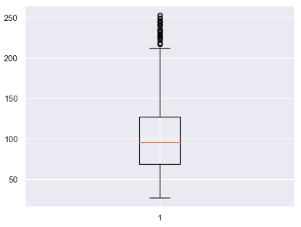
Price of each item This variable is seems to be normaly distributed and also slightly right skewed.

Slide 11
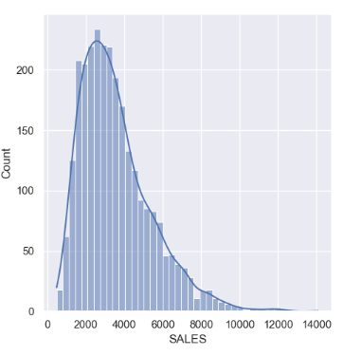
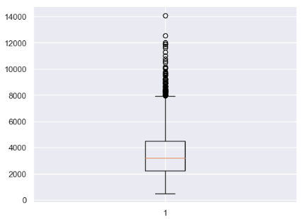
Sales This variable has outliers and right skewed.

Slide 12
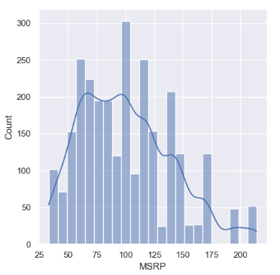
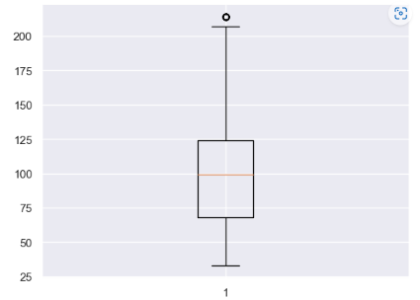
MSRP(manufactur’s suggested retail price) This variable has few outliers and it look like normal distribution.

Slide 13
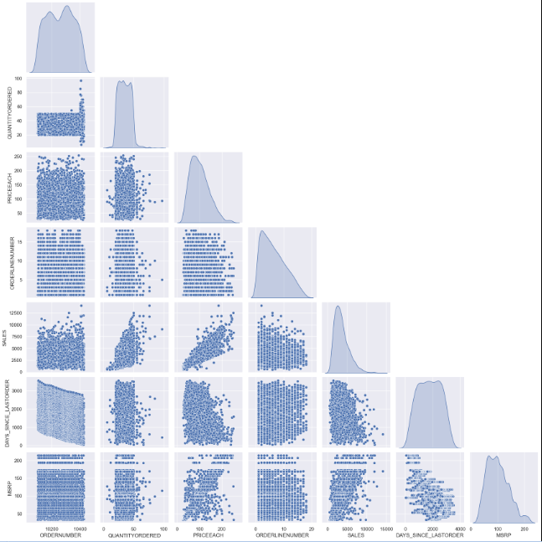
BIVARIATE ANALYSIS
For bivariate analysis we perform pairwise analysis relationship.

Slide 14
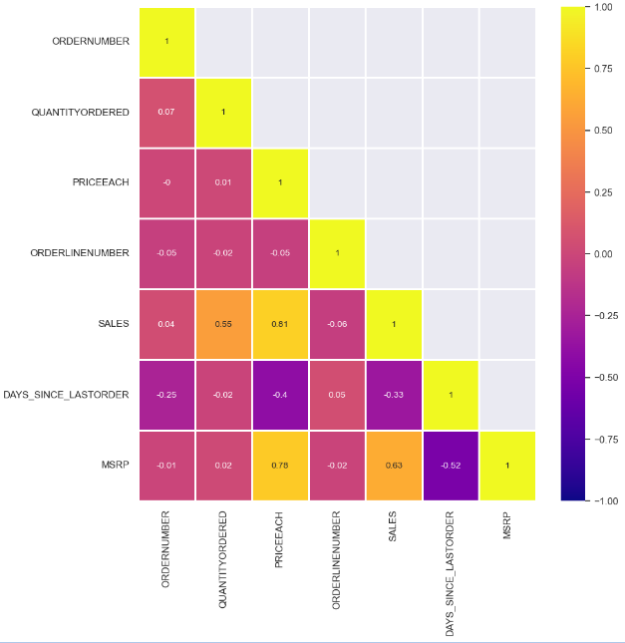
MULTIVARIATE ANALYSIS
For multivariate analyasis we perform heatmap for the different columns.
Sales is highly correlated to PRICEEACH.
PRICEEACH is highly correlated to MSRP.

Slide 15
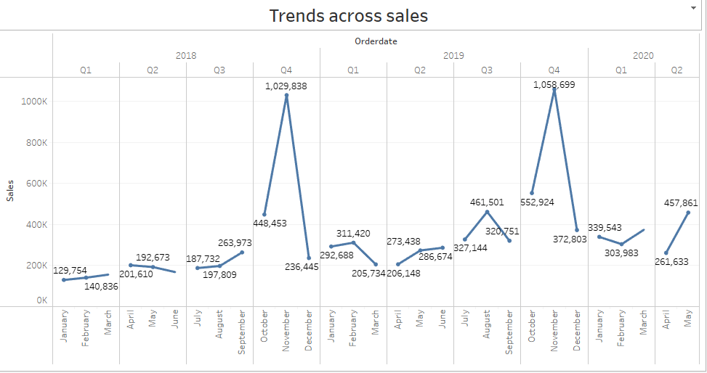
TRENDS IN SALE
In this graph we can observe yearly, quarterly and monthly trend in data.
Sale is highest in the 4th quarter for the year 2018 and the for the 2019 when compared to other quarters.
For the year 2020 sale is highest in the 2nd quarter.
For the rest of the quarter sale is increasing and decreasing trend.

Slide 16
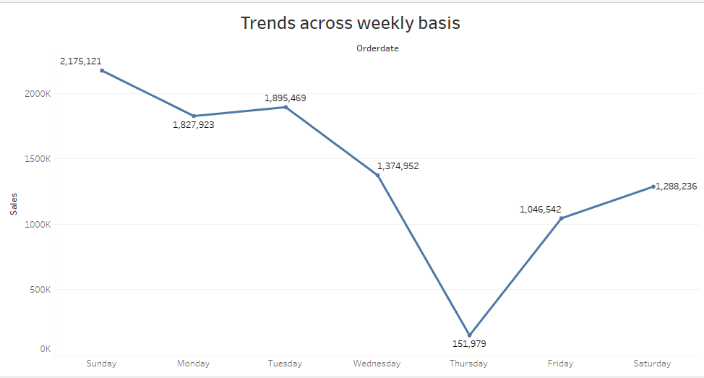
In this graph we can see weekly basis trend.
We see that on day basis, Sunday has the highest sales followed by Tuesday.
But Thursday has the least sale compared to other week days.

Slide 17
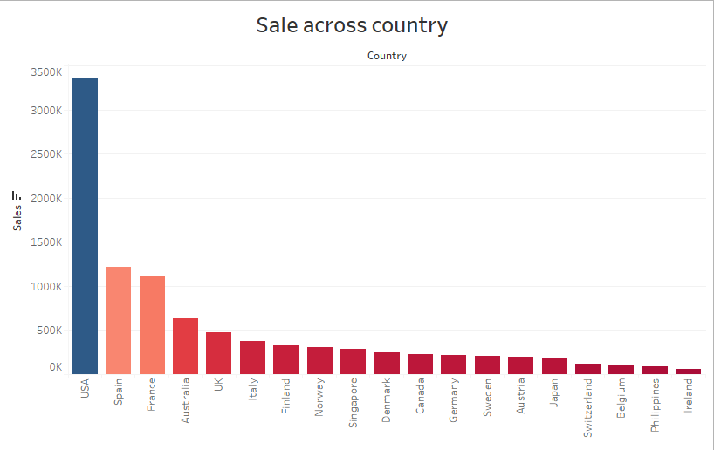
Sales Across different Categories of different features in the given data
We can see that in sales across the country, USA has the maximum sales followed by Spain.
The country with lowest sales is Ireland.

Slide 18
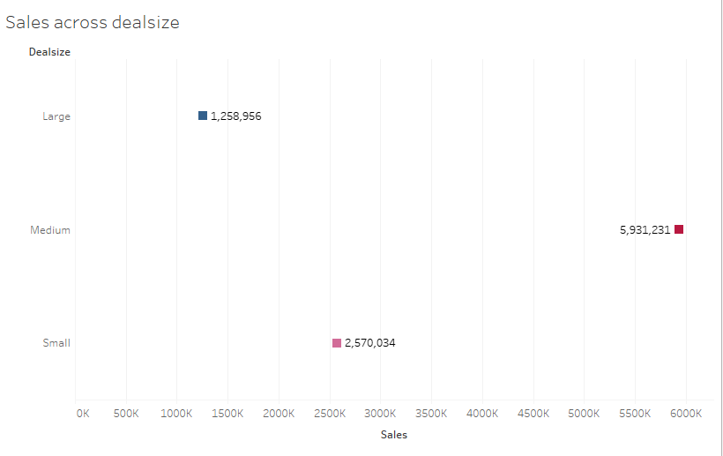
Most of the sales is happening in medium deal size. This means that most of the orders are of medium size and not too large or small.
The least orders are of large deal size.

Slide 19
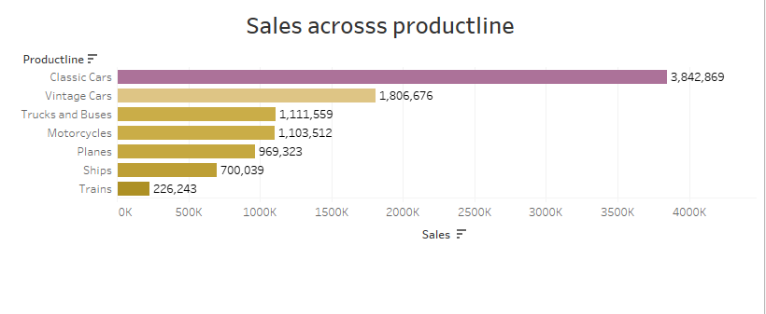
In this graph we can see most of the sale is happening in classic cars.
Least orders are of trains .

Slide 20
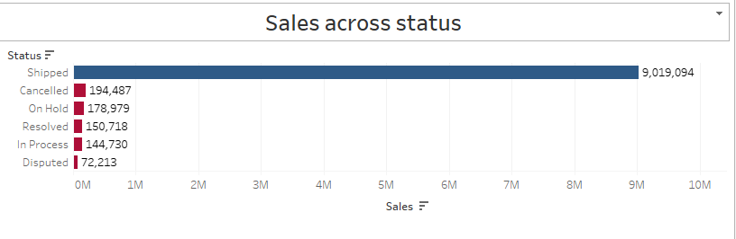
From this graph we see most of the orders are shipped.
Few orders have been cancelled where as few are in process.
Some orders which are under dispute are been resolved but still some are yet to be resolved.

Slide 21
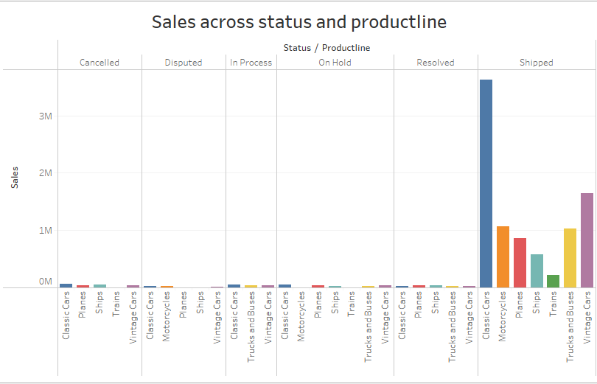

Slide 22
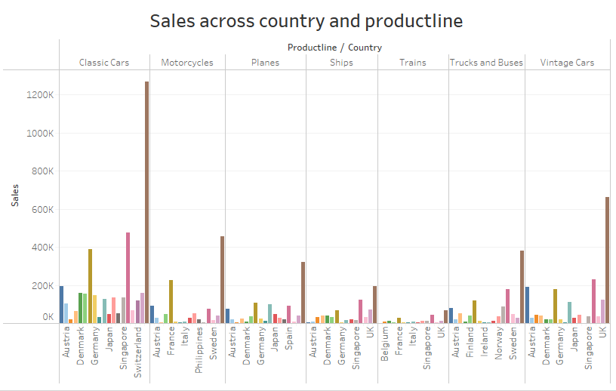
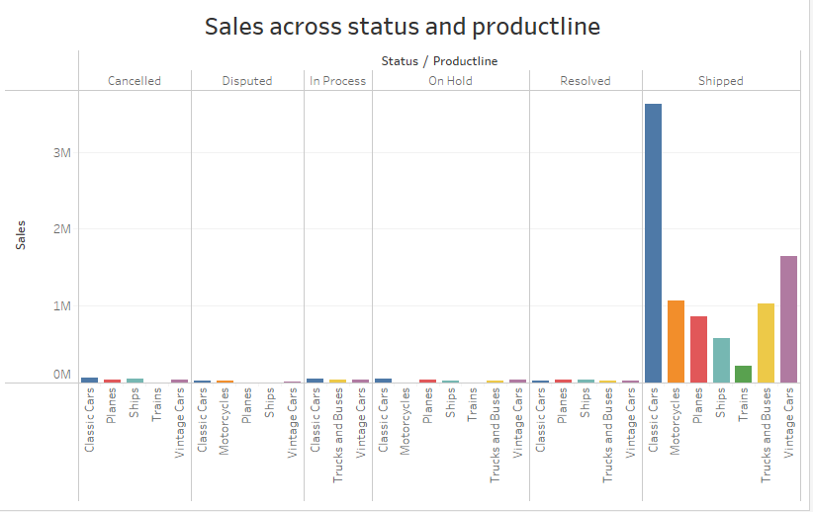

Slide 23
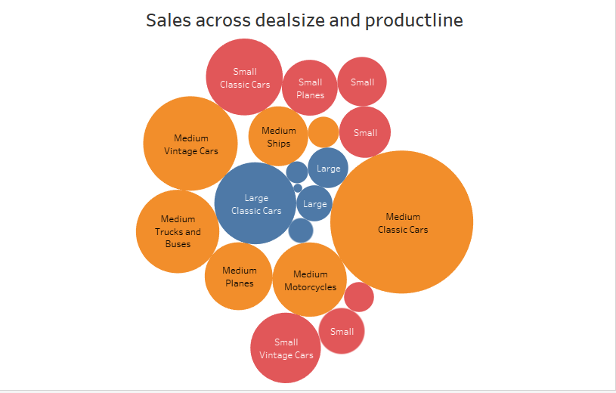

Slide 24
INFERENCES FROM THE ABOVE ANALYSIS
To increase the sales in countries with least sales, we should provide offers with low EMI facilities to promote the sales.
From the trends graph we identified that the sales are maximum during the 4th quarter, to increase over all sales across all the quarters offers or discounts can be given to the customers.
The large size deals are lowest when compared to other deals. Steps to be taken to attract the customers to buy more of large size deals.
Classic cars have majority sales whereas trucks and buses sales can be expanded.
Should focus on cancelled orders to check why it was cancelled and work on it.
Pending disputed orders should be resolved at the earliest so it doesn’t gives a negative feel to the customers.

Slide 25
EDA done in python and tableau.
Tabeau link is provided below.
https://public.tableau.com/views/MRAmilestoneproject1/Trendsacrosssales?:language=en-US&:display_count=n&:origin=viz_share_link

Slide 26
Customer Segmentation using RFM analysis
What is RFM?
The “RFM” in RFM analysis stands for recency, frequency and monetary value. RFM analysis is a way to use data based on existing customer behavior to predict how a new customer is likely to act in the future. An RFM model is built using three key factors:
how recently a customer has transacted with a brand
how frequently they’ve engaged with a brand
how much money they’ve spent on a brand’s products and services
RFM analysis enables marketers to increase revenue by targeting specific groups of existing customers (i.e., customer segmentation) with messages and offers that are more likely to be relevant based on data about a particular set of behaviors. This leads to increased response rates, customer retention, customer satisfaction, and customer lifetime value (CLTV).

Slide 27
What all parameters used and assumptions made?
As per your suggestion about ignoring the column ‘days since last order’ and create new column name recency as “[max(order date) – order date)]”
We have assumed “01-06-2020” as a reference date and created Recency column.
We can assume count of each order number as frequency of an order number.
In sales column we get sales amount for each transaction. We can use sales parameter and using an assumption of sum of aggregation we created a new column as Monetary.
then created four different bin for each Recency, frequency and Monetary using percentile range (0,0.10,0.40,0.70,100).
Based on above 4 bin assumption we have considered 4 segments like High, medium, low and churn.

Slide 28
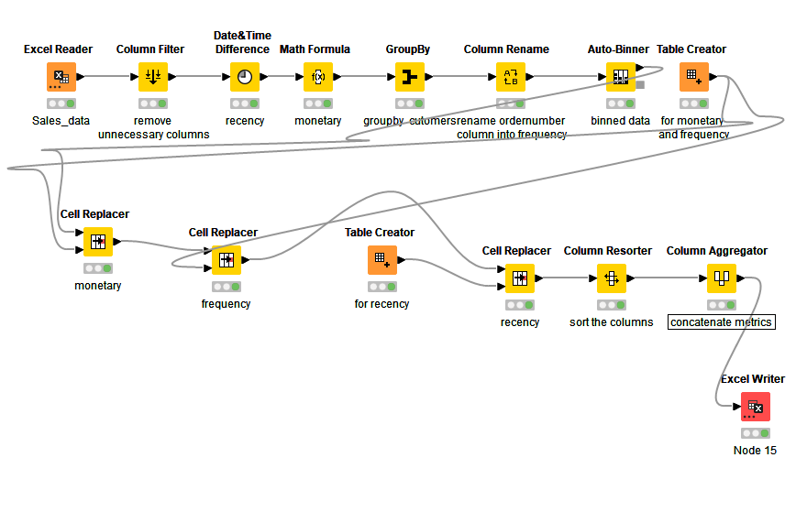
KNIME WORKFLOW IMAGE

Slide 29
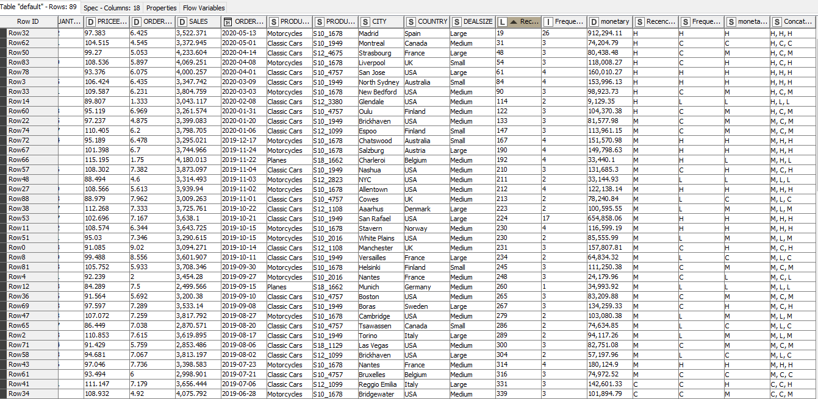
OUT PUT TABLE HEAD FOR RFM ANALYSIS

Slide 30
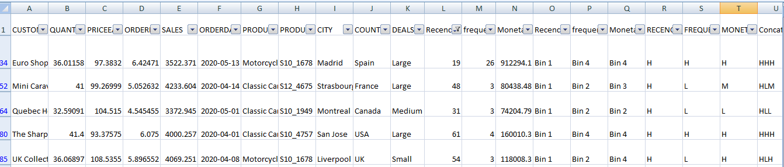
Inferences from RFM analysis and identified segments 1. BEST CUSTOMERS

Slide 31
On the basis on recency, frequency and monetary grouped top customers.
These customers has recently purchased our products.
Also according to RFM model the most importance is given to recency.
Hence we have kept it as our first parameter for selecting top customers.
Reward these customers. They can become early adopters for new products and will help promote your brand.

Slide 32
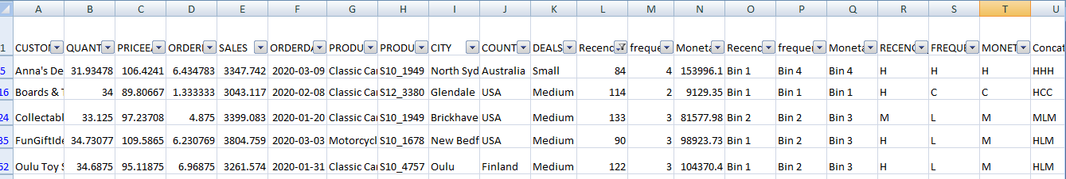
2. LOYAL CUSTOMERS

Slide 33
On the basis on recency, frequency and monetary grouped top customers.
These are recent customers with average frequency and who spent a good amount .
Offer membership or loyalty programs or recommend related products to upsell them and help them become top customers.

Slide 34
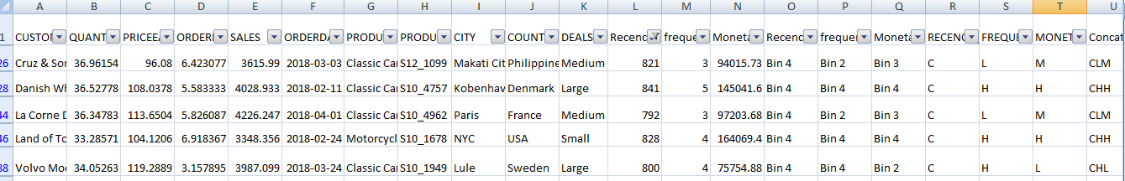
3. CUSTOMERS ON VERGE OF CHURNING

Slide 35
These customers are risk customers who purchased often and spent big amounts, but haven’t purchased recently.
Send them personalizes reactivation campaigns to reconnect, and offer renewals and helpful products to encourage another purchase.

Slide 36
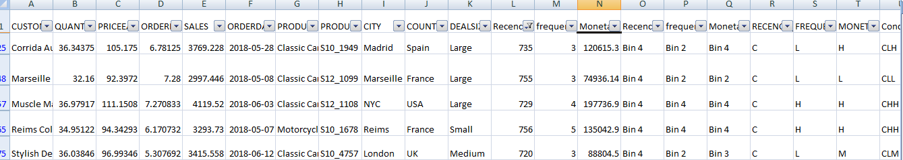
4. LOST CUSTOMERS

Slide 37
On the basis on recency, frequency and monetary grouped top customers.
These customers who used to vist and purchase quite often, but haven’t been visiting recently.
Bring them back with relevent promotions, and run surveys to find out what went wrong and avoid losing them to a competitor.

Slide 38
RECOMENDATIONS
RFM model is used for deriving the customers types like top ,loyal, on verge of churning and lost customers.
This model is helpful to the company to maintain the sales and promote the business.
It is vital for the company to convert customers who are on verge of churning into a regular customers.

Slide 39
THANK YOU

