Slide 1
MRA – MILESTONE PROJECT 2
SUBMITTED BY
SULOCHANA
12-O3-2023

Slide 2
SUMMARY
Exploratory Analysis
Exploratory Analysis of data
trends across months/years/quarters/days
Use of Market Basket Analysis (Association Rules)
Write Something about the association rules and their relevance in this case
Add KNIME workflow Image , as that is the only tool to be used for MBA.
Write about threshold values of Support and Confidence
Associations Identified
Put the associations in a tabular manner
Explain about support, confidence, & lift values that are calculated
A suggestion of Possible Combos with Lucrative Offers
Write recommendations
Make discount offers or combos (or buy two get one free) based on the associations and your experience

Slide 3
PROBLEM STATEMENT
A Grocery Store shared the transactional data with you. Your job is to identify the most popular combos that can be suggested to the Grocery Store chain after a thorough analysis of the most commonly occurring sets of menu items in the customer orders. The Store doesn’t have any combo meals. Can you suggest the best combo meals?
Data: dataset_group.csv

Slide 4
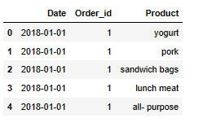
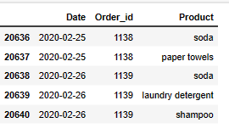
EXPLORATORY DATA ANALYSIS
Data shape:
(20641, 3)

Slide 5
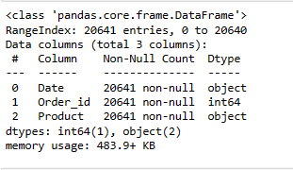
Continued…
INFO
This dataset has 3 variables out of which 2 are categorical and 1 int64
There is no missing values.
Total number of observations are 20641.
There are 4730 duplicate values present in the dataset.

Slide 6
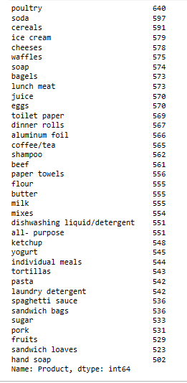
Product value counts
In this graph we can identified Poultry product has highest number sale followed by soda and cereals.

Slide 7
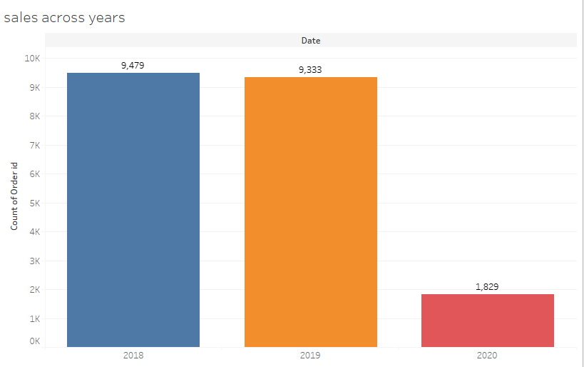
EDA
In this chart we can see in 2018 the number of the orders are highest followed by 2019.
The number of orders are lowest in 2020 but this year we have 2 months of data.

Slide 8
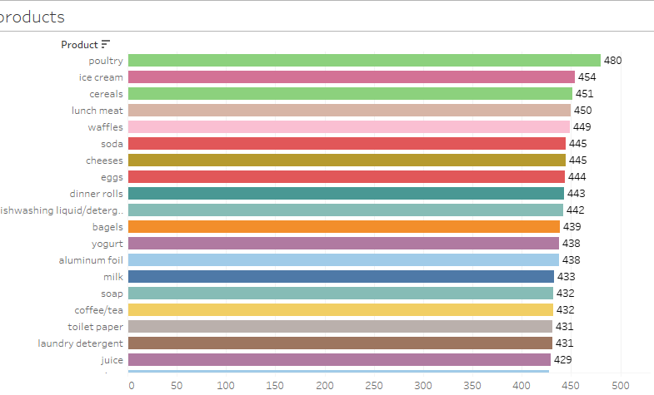
EDA- product count
The total 1139 orders are ordered.
Based on above graph, the poultry product ordered highest orders followed by ice cream and cereals.

Slide 9
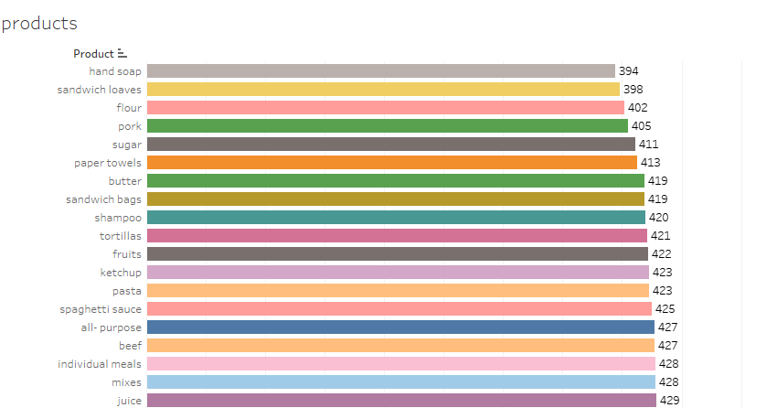
Cont..
Hand soap is a product that ordered least among the product list and is part of 394 orders out of 1139 orders, followed by sandwich leaves and flour.

Slide 10
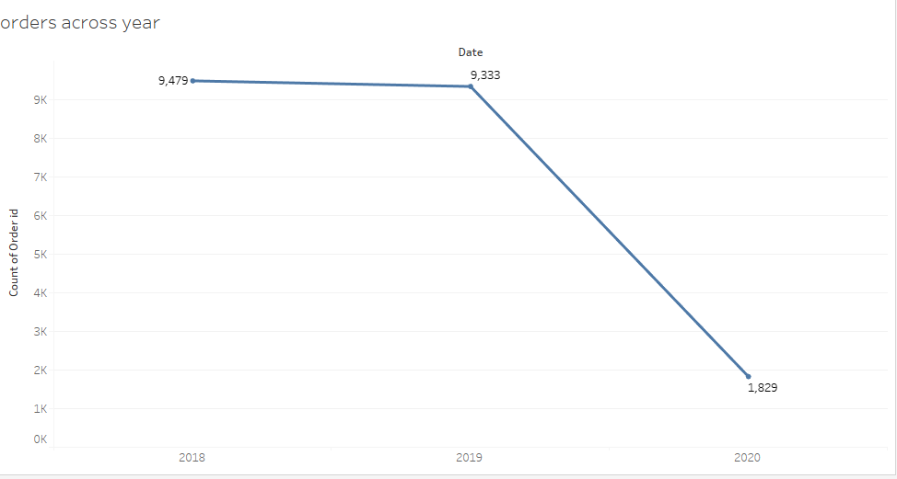
Orders Trend over the year
In this graph we can recognize the orders trend for this data is decreasing over the years with 2018 having highest orders and then followed closely by 2019 and then 2020 with the lowest number.
We don’t need to consider about 2020 because, for this year we have only 2 months data.

Slide 11
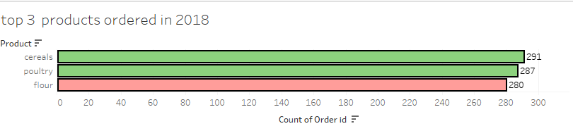
Top 3 products ordered in 2018
Top 3 products ordered in 2018 are cereals, poultry and flour.

Slide 12
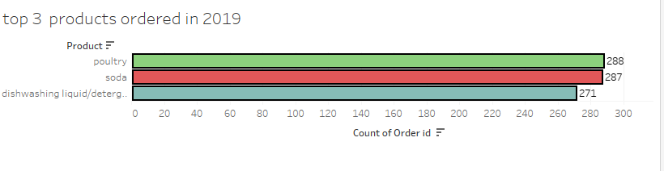
Top 3 products ordered in 2019
Top 3 products ordered in 2019 are poultry, soda and dish washing liquid/detergent.

Slide 13
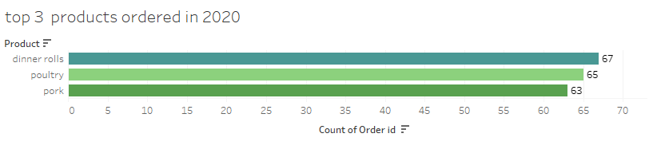
Top 3 products ordered in 2020
Top 3 products ordered in 2020 are dinner rolls, poultry and pork.

Slide 14
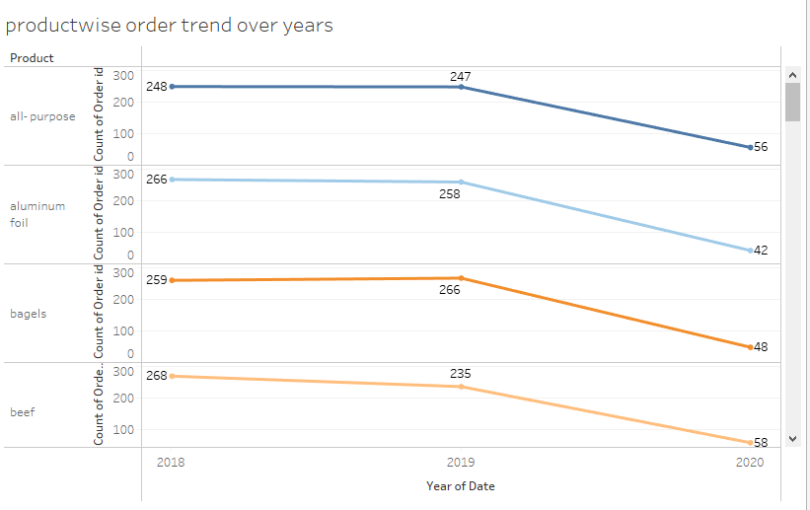
Product wise order trend across the year
In this graph also we can observe the product wise trend across years also in decreasing manner.

Slide 15
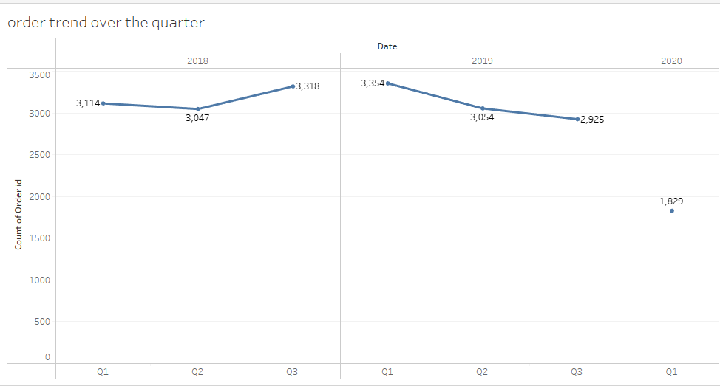
Orders trend over the quarter
The orders trend for this data over the quarters indicate 2019 with highest number of orders followed by Q3 of 2018.
In 2018 the orders are slightly decreased from Q1 to Q2 and increased from Q2 to Q3. but in 2019 the tend is decreased from Q1 to Q3.

Slide 16
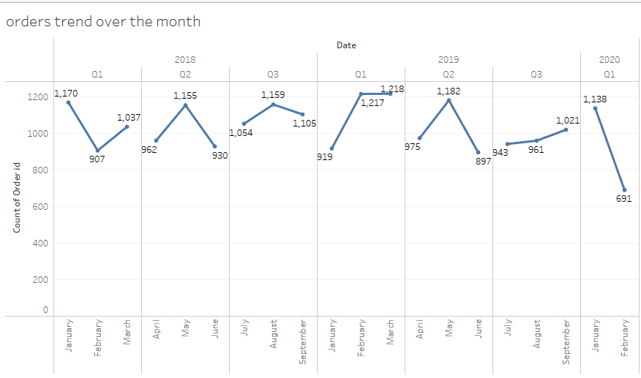
Orders trend over the month
The orders trend for the given data over the months, However indicate Jan, march, may and august being months where high orders are placed in 2018.
In 2019 , Feb, march, may and sep being months where high orders are placed.
In 2020 we have only 2 months data.

Slide 17
EDA is done in python and tableau.
Tableau solution link:
https://public.tableau.com/views/MRAmilestoneproject2_16786254789230/ordertrendoverthequarter?:language=en-US&:display_count=n&:origin=viz_share_link

Slide 18
Market basket analysis
Market basket analysis is a data mining technique used by retailers to increase sales by better understanding customer purchasing patterns.
Market basket analysis also called association analysis or frequent item set mining.
It involves analyzing large data sets, such as purchase history, to reveal product groupings, as well as products that are likely to be purchased together.
In market basket analysis, association rules are used to predict the likelihood of products being purchased together.
Support, confidence and lift are the most commonly known metrics for this analysis.
Market basket analysis can increase sales and customer satisfaction.

Slide 19
MBA- Association rules
Association rules are the set of rules where the likelihood of buying a product is greater with a set of product.
Key metrics for association rules:
Support: Percentage of orders that contain the item set. In the example above, there are 11 orders in total, and (bread, butter) occurs in 3 of them.
Support = Freq(X,Y)/N
Support = 3/11 = 0.27
Confidence: Given two items, X and Y, confidence measures the percentage of times that item Y is purchased, given that item X was purchased. This is expressed as:

Slide 20
Cont..
Looking back to the example, percentage of times that butter(X) is purchased, given that bread(Y) was bought:
Confidence (butter -> bread) = 3/3 = 1
Lift: Unlike the confidence metric whose value may vary depending on direction (e.g: confidence(X ->Y) may be different from confidence(Y ->X), lift has no direction.
This means that the lift (X,Y) is always equal to the lift(Y,X):
Lift(X,Y) = lift(Y,X) = support (X,Y) / (support(X) * support(Y)
Lift(butter, bread) = lift(bread, butter) = support(butter, bread) / (support(butter) * support(bread))

Slide 21
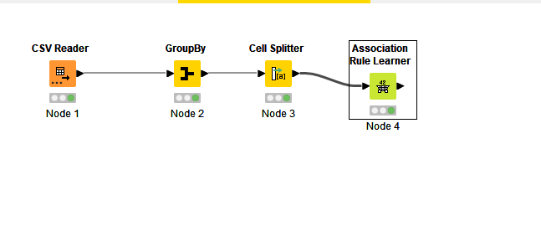
KNIME WORKFLOW

Slide 22
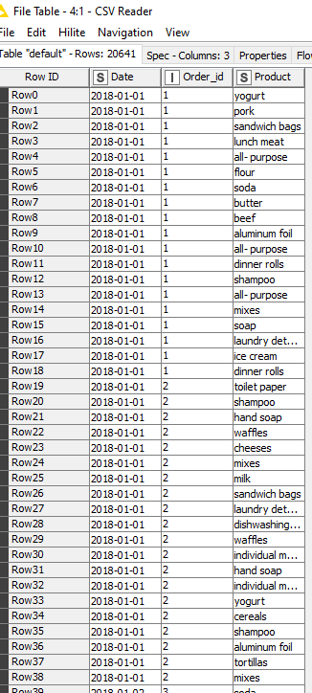
MBA – data output

Slide 23
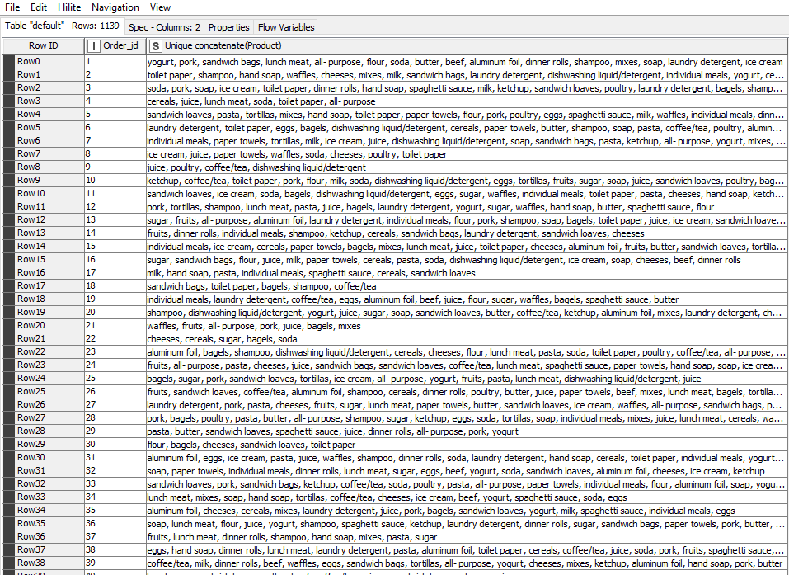
MBA
After loading the data in knime , data grouped with order_id and concatenated product column.
We can observe here that no. of rows are now 1,139 as compared to our dataset it was 20,641.
This will help us classify the products for our further market basket analysis.

Slide 24
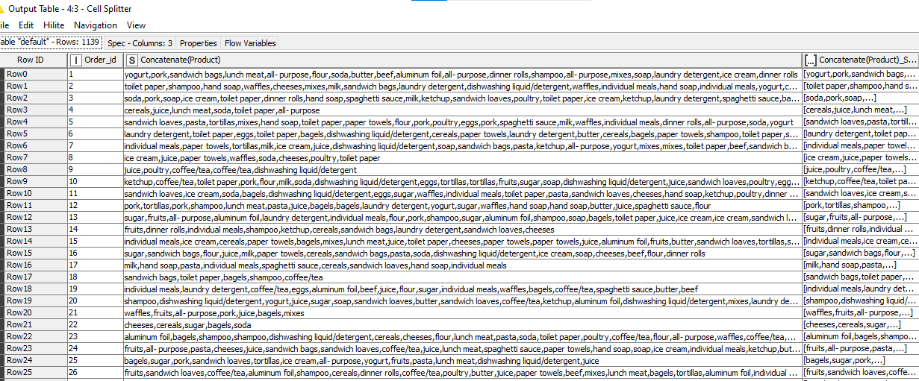
MBA
By using cell splitter node we removed the duplicated products and concatenated them in a single group as per the order id.
This again helped us to classify the items in the set format which is in square bracket.

Slide 25
MBA
After that by using association rule learner node we created association rules. these rules are action able in that they can be used to target customers for marketing or product placing or more generally to inform decision making.
This is the most important node for our market basket analysis. We have here the three metrics that are support , confidence and lift, we added a value to our support which is between 0-1.

Slide 26
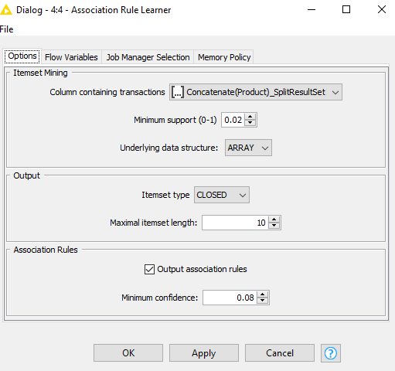
MBA
We added value of 0.02 that is 5 % sell of a product from overall transactions and we also selected the association rule for the minimum confidence as 0.08. so as you can see the values of support and confidence will help us to get threshold.

Slide 27
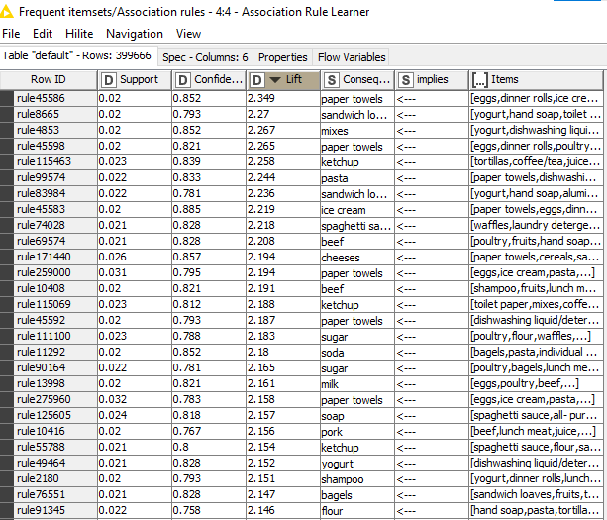
MBA

Slide 28
MBA
So as we can see in the previous slide the table shows 399666 records in which each row contains a different rules.
It has created multiple rules on the basis of threshold limit that we have set earlier in the association rule learner node and whichever has a higher lift value we recommend that product to the customer.
Consequent column contains recommended products and we have sorted the lift values from higher to lower for the better recommendations.
So generally we recommend the products that are listed in consequent feature which has a higher lift.

Slide 29
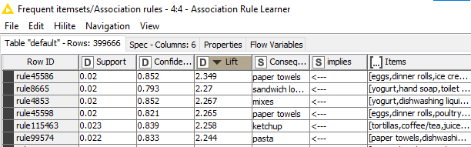
MBA – suggestions and recommendations
Poultry could be suggested as a combo offer with most of the food and snacks items such as dinner rolls and spaghetti sauce.
soda could be another item which can be offered in a combo.
Top combo’s with good confidence are:

Slide 30
MBA – suggestions and recommendations
We can keep frequent sale offers on the least sold products to increase its sales.
And also we can offer discount coupon on the least sold products.
Since poultry and soda are the most sold items and hand soap and sandwich loaves are the least- a combo offer of theses two would eventually increase a sale of hand soap and sandwich loaves.

Slide 31
THANK YOU

