Slide 1
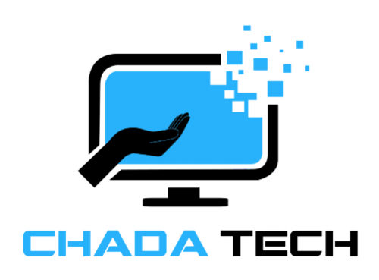
Agile Development
Sulochana Pradhan

Slide 2


Agenda
Agile Roles
SDLC Phases in Agile
Waterfall vs Agile
Choice: Waterfall or Agile

Slide 3
Agile Roles
Product Owner:
Acts as a bridge between the stakeholders and the development team.
Responsible for maximizing the product value and the development team efficiency.
Scrum Master:
Acts as a bridge between the product owner and the development team.
Facilitates different agile scrum events.
Development Team
Developers – Responsible for writing the software based on the user stories.
Testers – Responsible for creating test cases and test.

Slide 4
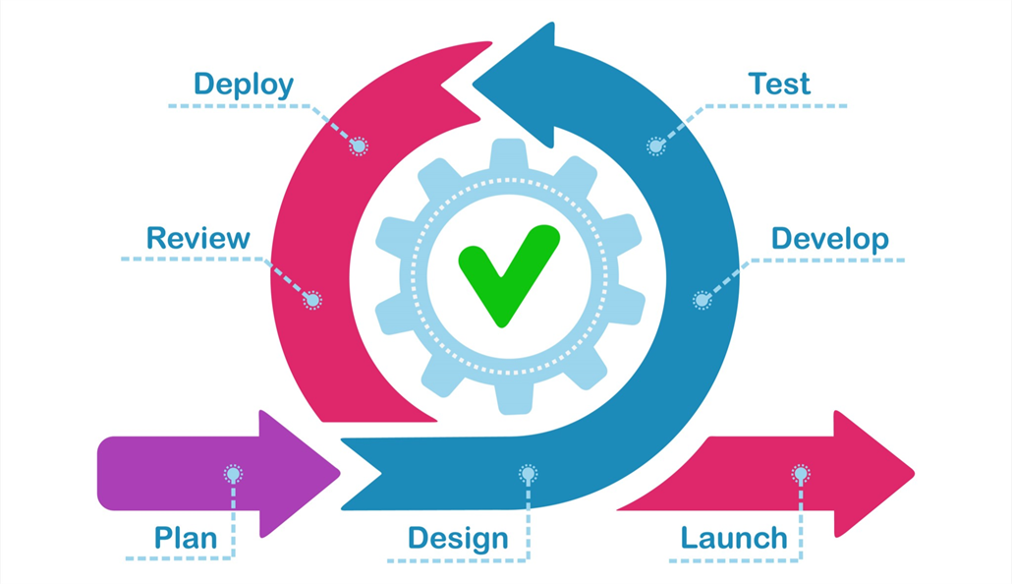
SDLC Phase in Agile
Plan/Requirements:
Used to plan for the next sprint.
This includes new or modified requirements, backlog refinements to create new user stories/tasks for new sprint, and overall sprint planning.
Design:
Prototype design, research, sketch, refinement
Development team discusses about technology details, time limits, and frameworks needed.
Develop:
Developers write the software to add new features or fixing the bug.
Test
Tester uses their test cases to test against the completed work items by developers.
Any bugs are immediately reported to developers and developers fixed that.
Deploy
Software gets deployed after all the testing is done and approved by the product owner.
Development team continue to support to keep the software working.
Any new bugs get fixed.
Review
The development team presents the completed work to the product owner.
This doesn’t need to be working software but any completed features or part of the software or even the research findings.
Launch
Product is released
Team gets ready for the new sprint.
Photo: Retrieved from SNHU

Slide 5
Waterfall vs Agile
Waterfall | Agile
Requirements are expected to be known earlier. Changes in requirements lead to major redoing. | Core requirements remain unchanged but changes are expected. Idea is to deliver the product iteratively.
Less coordination between the team and lacks transparency. | Assumes collaborative team approach and supports transparency.
More customer satisfaction with iterative deliverable product. New technology can be easily integrated. | Customer needs to wait until the end of the project. At the time technology can changes or even becomes obsolete.
The cost of the product can be estimated after the requirements are defined. | The product estimation fluctuates based on the future requirement changes, research, and blockers.
Team can easily follow the model. | There is a learning curve.

Slide 6
Choice: Waterfall vs Agile
For the SNHU Travel, agile is better choice than the waterfall.
From the SNHU Travel consumers-product owner meeting, there was already a major requirement changes. Moreover, there can be unexpected surprises from the stakeholders waiting in the future.
The waterfall methodology couldn’t handle such uncertainty and increases the project deadline as the entire project needs reevaluation.
In contrast, the agile approach expects such uncertainty and work through with minimum or no changes in the timeline.
Furthermore, with the agile approach, we can get frequent customer feedback and accordingly develop the product to make it successful. This is not possible in the waterfall model.

Slide 7
References
CS250-Module One: SDLC Methodologies. (n.d.-b). Retrieved December 6, 2022, from http://snhu-media.snhu.edu/files/course_repository/undergraduate/cs/cs250/storyline/mod1/story_html5.html
Minhas, S. (2021, December 7). Agile design process - UX Collective. Medium. Retrieved December 6, 2022, from https://uxdesign.cc/agile-design-process-24be92018ad2
Dziuba, A. (2022, May 20). Agile Software Development Lifecycle Phases Explained. Relevant Software. Retrieved December 6, 2022, from https://relevant.software/blog/agile-software-development-lifecycle-phases-explained/

Slide 8
Thank you
Sulochana Pradhan
sulochana.pradhan@snhu.edu

