Slide 1
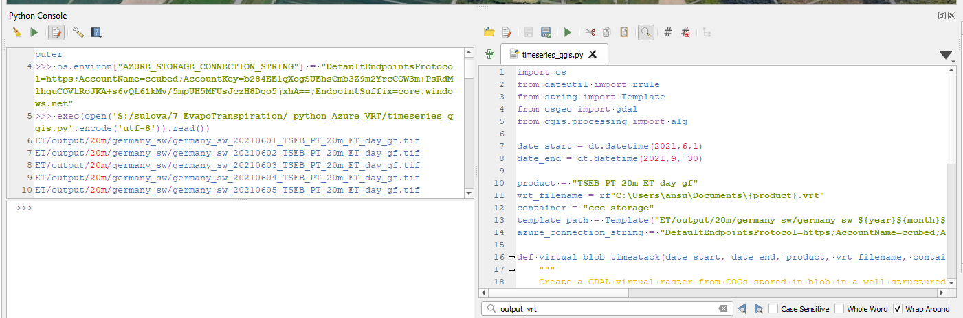
os.environ["AZURE_STORAGE_CONNECTION_STRING"] = "DefaultEndpointsProtocol=https;AccountName=ccubed;AccountKey=b284EE1qXogSUEhsCmb3Z9m2YrcCGW3m+PsRdMlhguCOVLRoJKA+s6vQL61kMv/5mpUH5MFUsJczH8Dgo5jxhA==;EndpointSuffix=core.windows.net"

Slide 2
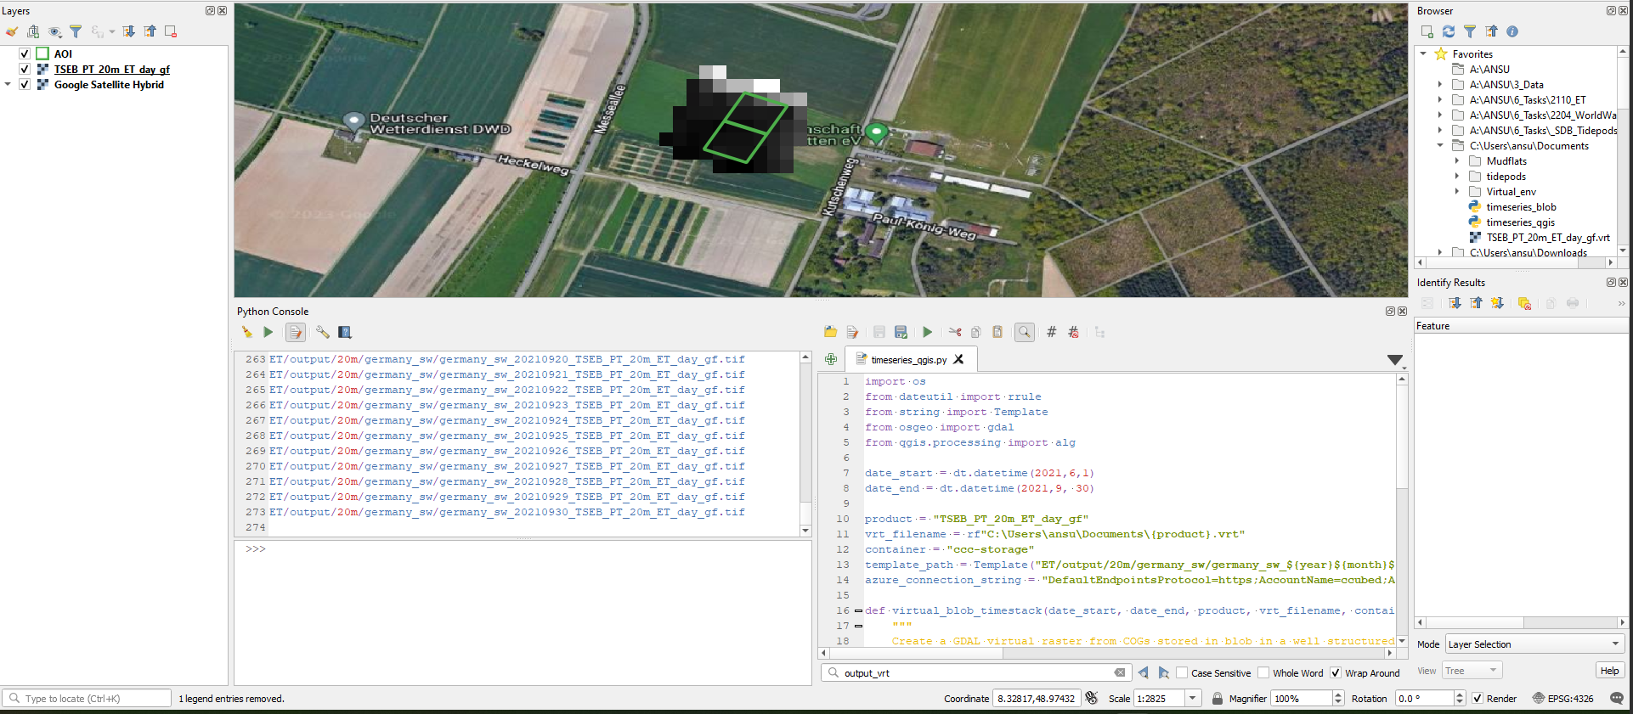

Slide 3
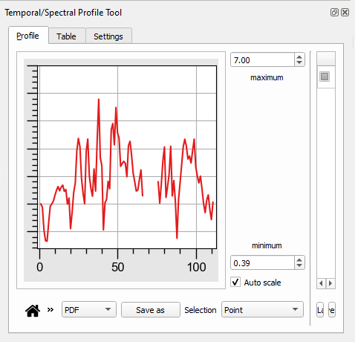
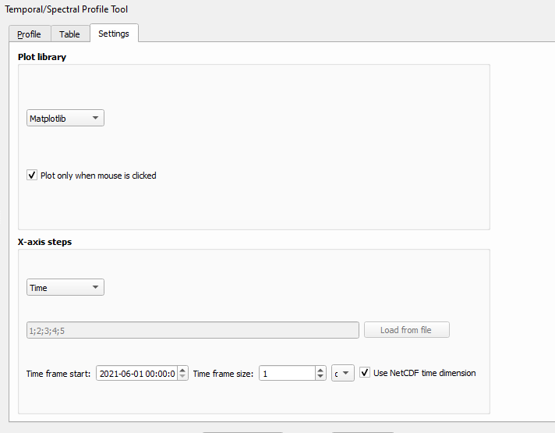
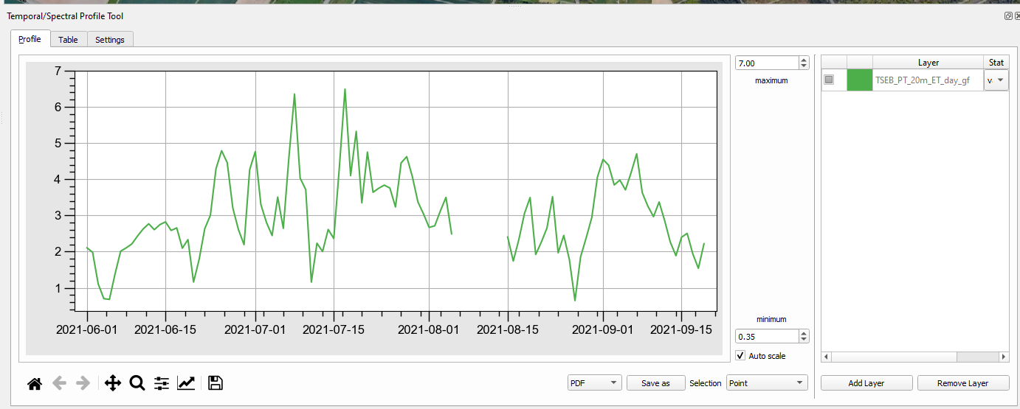
Change dates
Click on map again

