Slide 1
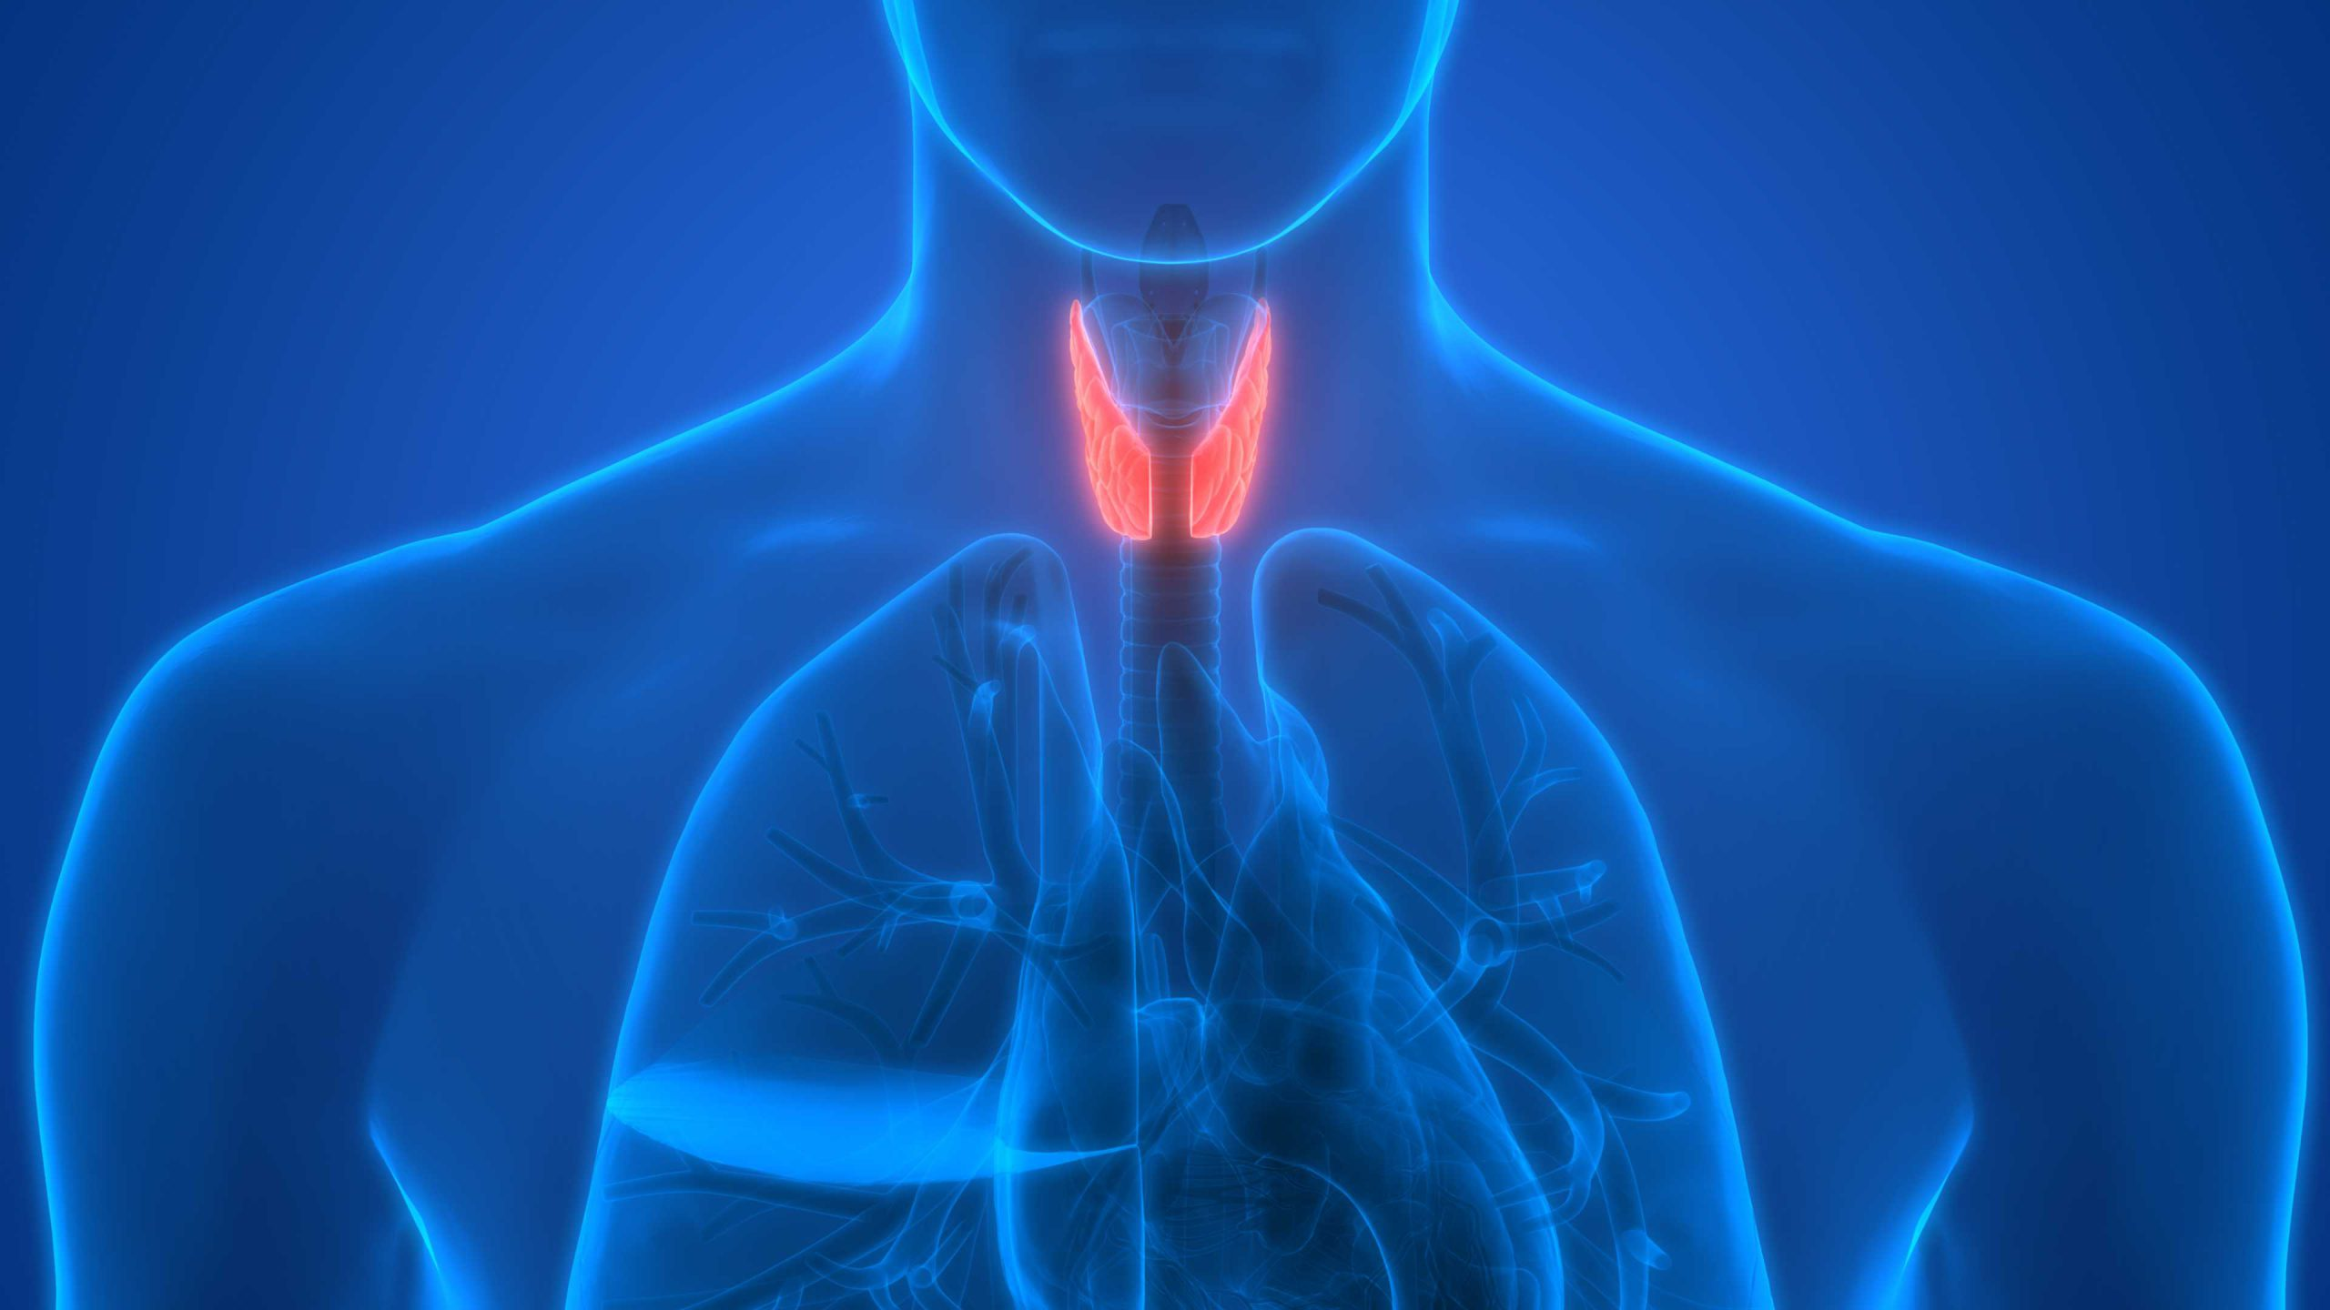
Thyroid Disease Analysis
Andrea Sulova
22 Feb 2021

Slide 2
Task description
Attached is a data set dealing with Thyroid Disease. It has a TSV file (thyroid.tsv) with the data (7200 instances of 21 attributes and a class variable). The variable descriptions are in the text file (variable_description.txt).
We are asking that you demonstrate how you would approach the following tasks:
Data wrangling
Explorative Data Analysis
Feature Engineering
Modeling. Please build a model that allows you to predict the Class feature. The test data should be taken from the full data set.
Data Visualisation. Please demonstrate how you would share your findings back to a group of stakeholders outside the data science team.
You are free to use R or Python (or even Julia or your tool of choice) to complete the tasks.
You have free choice of how to present your work back to us and will be given 45 minutes (including our questions) in the interview to do so.
Notes:
Introduction to the task
I have approached the task by solving it in python by using jupyter notebooks and have the process and the results summarized in this presentation.
The 5 points are forming the agenda of this presentation

Slide 3
Agenda:
Data wrangling
Explorative Data Analysis (EDA)
Feature Engineering
Modeling
Data visualisation

Slide 4
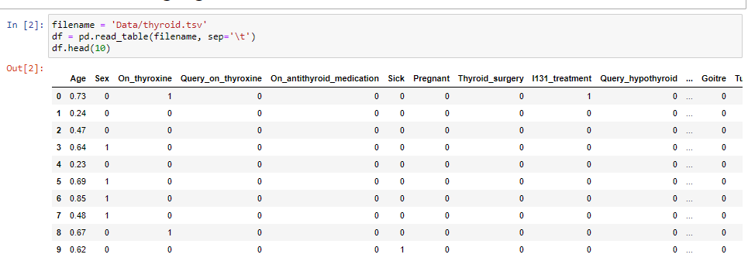
1. Data wrangling
Notes:
High level to data wrangling – the 80-20 rule, where data scientist spents 80% time on cleaning the data and 20% on analysing.
In this case the data we nicely prepared and were imported the data in pandas dataframe to enable easy manipulation with the data. The data were nicely prepared in tsv format and should the file type or format of the input file change, it can again be converted to Pandas dataframe for the analysis.
Check if all data were loaded 7200 rows with 22 variables.

Slide 5
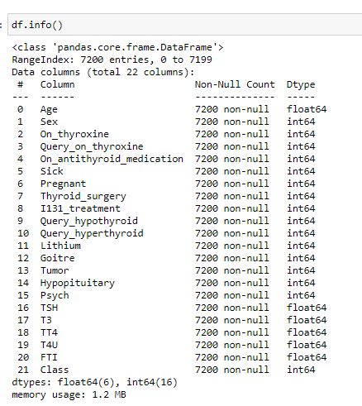

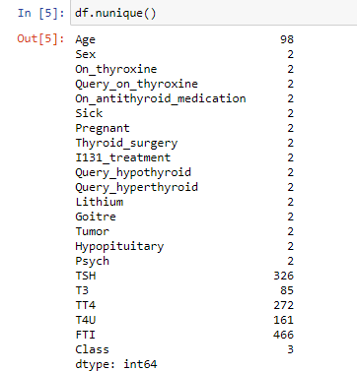
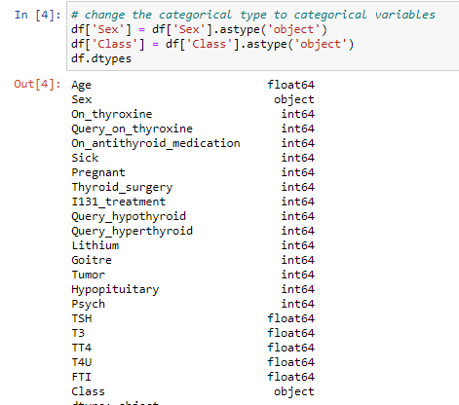
1. Data wrangling
Notes:
Check if the data type of variable is correctly classified by python
I could see that the binary and categorical variable are classified as different integer type by python. I just decided to change categorial data classified into to ‘object’ type due to the better graphic visualization. The binary variable stayed classified as different integer type by python.
I check for the data characters mistakes so if range values thus, the binary values should have a range from 1-2 and class variable should have a range from 1-3

Slide 6
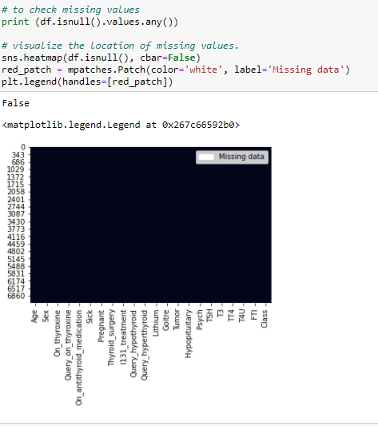
1. Data wrangling
Notes:
Next, I will check for missing values and visualize the missing values using seaborn library for showing also graph of missing values // Seaborn is a library for making statistical graphics
(if would be missing values Replace the NaN with median.)
Palko: Should I check for duplicate rows? Does it have any influence on SVM?

Slide 7
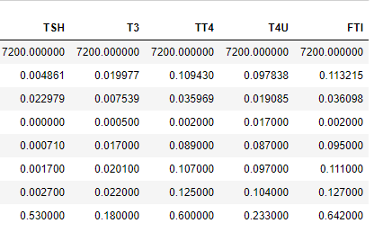
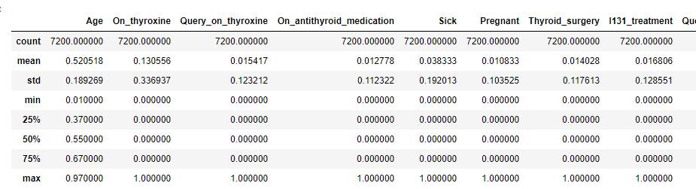
1. Data wrangling
Continuous variables : Age, TSH (0.0–0.53), T3 (0.0005–0.18), TT4 - (0.002–0.6), T4U (0.017–0.233) and FTI (0.002–0.642)
Notes:
Statistics summary - Basically, with df.describe(), I check on the min and max value for the categorical variable (1-3) another binary values Sex (0–1), Pregancy (0–3). We should also observe the mean, std, 25% and 75% on the continuous variables:
Age, amount of TSH (0.0–0.53). Continuous variable.T3 - amount of T3 (0.0005–0.18). Continuous variable.TT4 - amount of TT4 (0.002–0.6). Continuous variable.T4U - amount of T4U (0.017–0.233). Continuous variable.FTI - amount of FTI (0.002–0.642). Continuous variable.)
Note: quartile breaks down the data into quarter - 75% of the data lie below that value.
50th Percentile - Also known as the Median, The median cuts the data set in half.

Slide 8
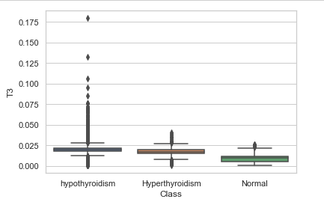
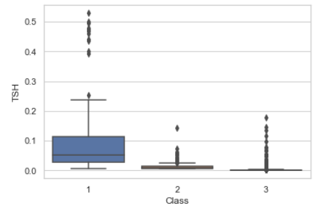
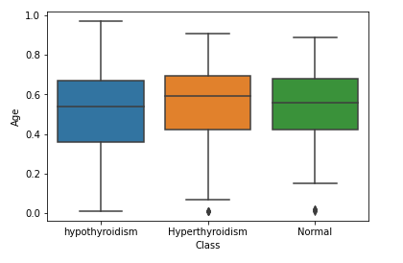

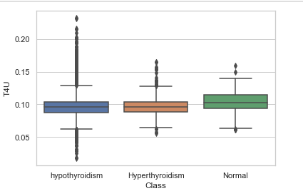
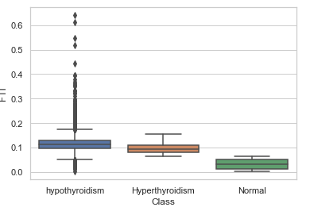
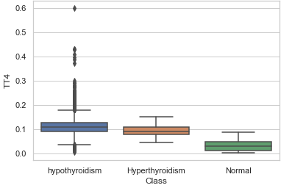
1. Data wrangling
TSH (0.0–0.53), T3 (0.0005–0.18), TT4 - (0.002–0.6), T4U (0.017–0.233) and FTI (0.002–0.642)
Notes:
below the lower quartile.
An outlier is an observation that lies outside the overall pattern of a distribution.
A convenient definition of an outlier is a point which falls more than 1.5 times the interquartile range ( middle 50%,, IQR = Q₃ − Q₁.) above the third quartile or below the first quartile.
Outliers With Boxplot: Z-Score or Extreme Value Analysis (parametric)
Probabilistic and Statistical Modeling (parametric)
Linear Regression Models (PCA, LMS)
Proximity Based Models (non-parametric)
Information Theory Models.

Slide 9
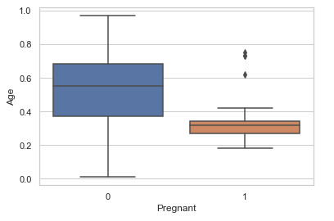
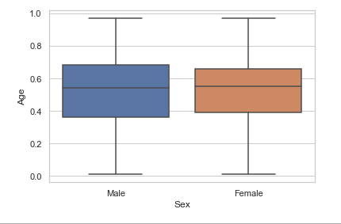
1. Data wrangling
Notes:
below the lower quartile.
An outlier is an observation that lies outside the overall pattern of a distribution.
A convenient definition of an outlier is a point which falls more than 1.5 times the interquartile range ( middle 50%,, IQR = Q₃ − Q₁.) above the third quartile or below the first quartile.
Outliers With Boxplot: Z-Score or Extreme Value Analysis (parametric)
Probabilistic and Statistical Modeling (parametric)
Linear Regression Models (PCA, LMS)
Proximity Based Models (non-parametric)
Information Theory Models.

Slide 10
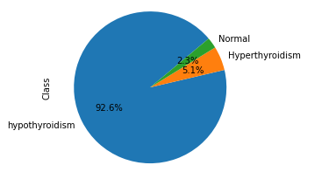
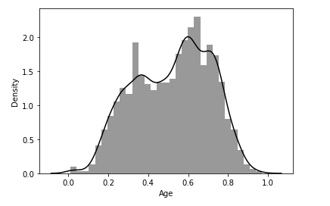
2. Explorative Data Analysis (EDA)
Normal | 128
Hyperthyroidism | 294
hypothyroidism | 5338
Notes:
Explorative data analysis is the initial familiarization with the provided dataset.
For this task I decided to visualize the main attributes of the dataset.
First plot – distribution of class attribute across the dataset. It is clear that class no. 3 is the most common and has almost 93% majority compared to class no. 1 and 2.
Second plot – density distribution across population. This is almost a normal distribution curve but shifted towards mid-upper age range.

Slide 11
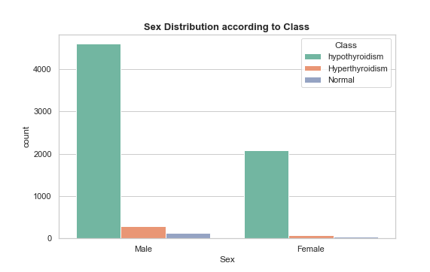
2. Explorative Data Analysis (EDA)
Notes:
Sex distribution according to class.
We see that roughly 2 times more males are suffering by the diseases compared to females. However there is not a clear difference between the different disease classes across different sexes.

Slide 12
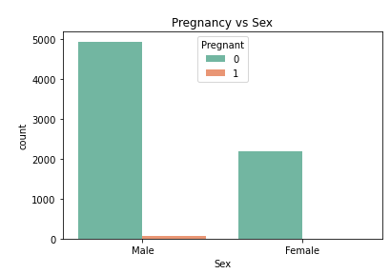
2. Explorative Data Analysis (EDA)
Notes:
We found no pregnant subjects in the provided dataset, only one pregnant male in the dataset – this is an LGBT inclusive dataset.

Slide 13
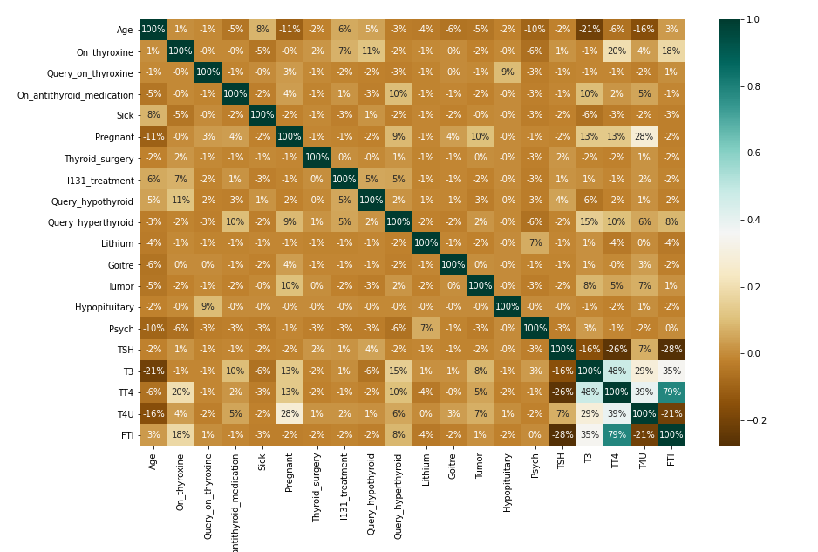
2. Explorative Data Analysis (EDA)

Slide 14
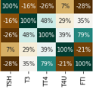
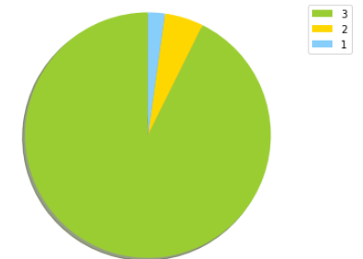
3. Feature Engineering
Data Enrichment
Include aggregating or combining attributes to create new features → Age variable to discrete data represented as categorical
Feature Selection → A class strongly correlated with the
variable may be important to the model
PCA → to the shape of the data, where there is the greatest variation
Data augmentation → o increase the amount of data by adding slightly modified copies of already existing data
Notes:
Data Enrichment - introducing data from external sources
Feature selection aims to reduce the dimensionality →if it is highly correlated with another feature
PCA - unsupervised dimensionality reduction method, to the shape of the data,
where there is the greatest variation,
and therefore, the most information unsupervised dimensionality reduction method,

Slide 15
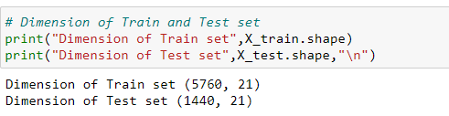


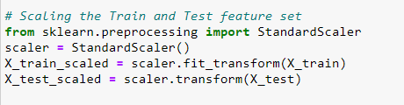
4. Modeling
SVM - classification or regression problems, be applied to both linear and nonlinear problems.
Notes:
SVM (Support Vector Machine)
distinguishing several classes and obtaining a mathematical model to predict classes
z = (x - u) / s

Slide 16
4. Modeling
SVM - classification or regression problems, be applied to both linear and nonlinear problems.
Notes:
SVM (Support Vector Machine)
distinguishing several classes and obtaining a mathematical model to predict classes
z = (x - u) / s

Slide 17
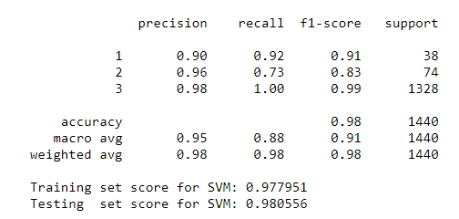
4. Modeling
35 | 0 | 3
1 | 54 | 19
3 | 2 | 1323

Slide 18
5. Data Visualisation
Notes:
In order to share my findings with stakeholders outside the data science team I would prepare a presentation similar to this. I would tailor the level of technical detail according to the stakeholders background and interest.

