Slide 1
Mobile Application Development Project
Submitted By
Submitted To
Md Sultanul Arefin
15-0-52-020-002
4th year 2nd semester
B.Sc in CSE
Bangladesh Open University
Md. Omar Faruque
Associate Professor
Department of CSE
Dhaka University of
Engineering & Technology

Slide 2

About Financial Status Analysis App
Personal Financial Status Analysis is a daily income and expense management system or a mobile application, which helps a person for keeping track of their finance like daily expenditure, income and budgeting with easy and effective way through computerized system which tends to eliminate manual paper works.

Slide 3
The motivation behind this project is actually our real-life experience.
In our daily life money is the most important portion, we face many difficulties in our daily life according to management and analysis, but if we keep on track all financial data then we can be overcome this problem.
Motivation

Slide 4
Many organizations are record their income and expenses, which they feel is the main key point of their business progress.
Problem Statement
Due to lack of a complete analysis and tracking system, there is a constant overload to rely on the daily entry of the expenditure and total budget till the end of the month.

Slide 5
The aim and objective of the project is to analysis and fully manage and keep tracking the expenses and income based on users budget.
Objectives
The main goal of the project is to make the application offline based and perform more tasks in short period of time and also very simple to used.

Slide 6
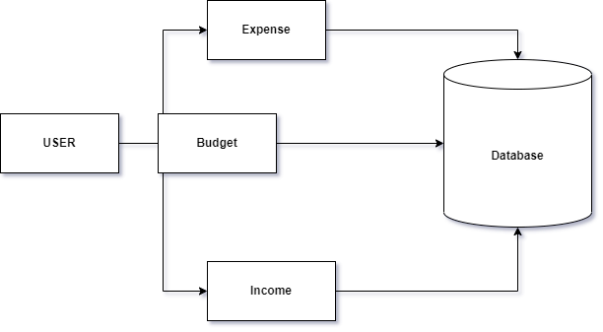
Block Diagram
This application user is provided with three options for data entry namely – Income, Expense and Budget for income & Expense.

Slide 7
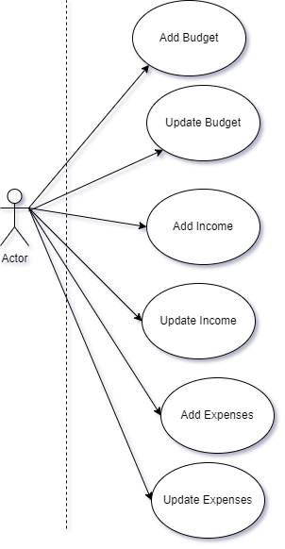
A actor can operate the application with various type of function like add and update for the transection they have made in every day to day life.
Use case Diagram

Slide 8
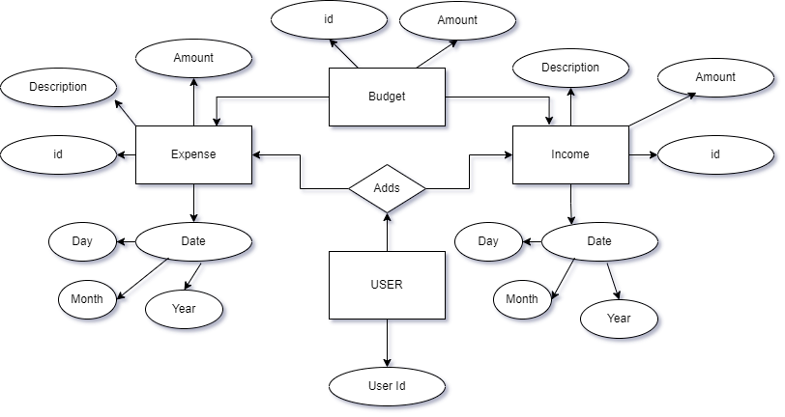
Entity Relationship
Diagram
The modeling about how the data stored in database, and main functionality of them.

Slide 9
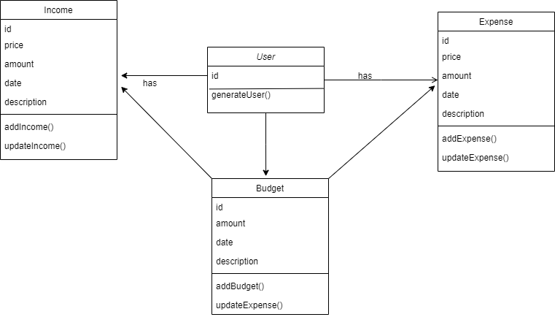
Design Class Diagram
The specifications for software classes and interfaces which we have done to develop the application.

Slide 10

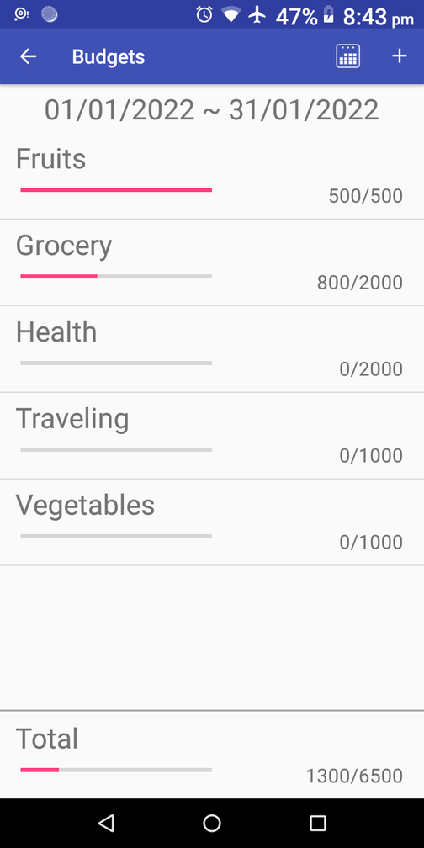
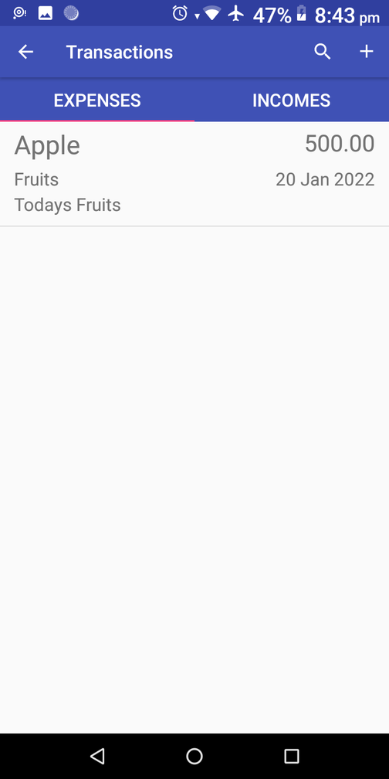
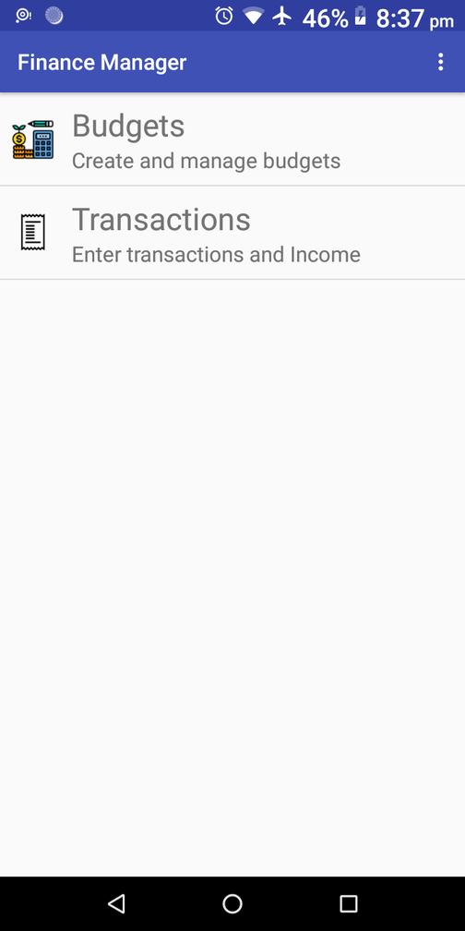
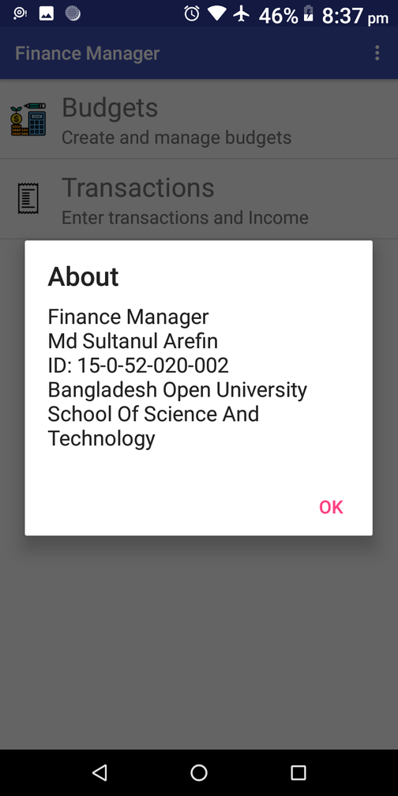
Finance Manager App Preview

Slide 11
LIMITATIONS
This android application has some limitations:
• The application is unable to maintain the backup of data once it is uninstalled.
• This application does not provide any decision capability.
Discussion
FUTURE SCOPE
This features also to be incorporated:
• Bengali language interface.
• Provide backup and recovery of data.
• Online data storage capability

Slide 12

Any Question ?
ABOUT THE APPLICATION !

