Slide 1
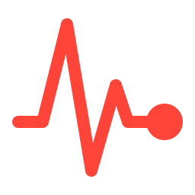
RSNA-STR PULMONARY EMBOLISM CT
Pulmonary Embolism SDA Project:
Catching pulmonary embolism before it's missed
Notes:
Opening line: our project builds a model that looks at a patient's chest CT and flags whether they have a pulmonary embolism. The whole design is built around one idea: a sick patient should not be missed. We trained three models, compared them fairly, and deployed the best one as a Gradio app.

Slide 2



A missed clot can be fatal
01 · THE PROBLEM
What PE is
Why it's hard
Our goal
A blood clot blocking the arteries of the lungs. It is common and can kill quickly if it is not treated.
Doctors find it by scrolling through hundreds of CT slices per patient. Small clots are easy to overlook, especially when radiologists are busy.
A model that flags which patients have PE, tuned so that almost no sick patient is missed. Flagged scans get a careful second look.
Notes:
Explain PE simply: a clot travels to the lung arteries and blocks blood flow. It can be fatal, so missing it is the worst outcome. The diagnosis comes from CT pulmonary angiography: a scan with hundreds of thin slices, and the radiologist must check each one. That is slow and tiring, which is exactly where a screening model helps. Our model is not replacing the doctor; it flags patients so nobody slips through.

Slide 3

RSPECT: expert-labeled chest CT scans
02 · THE DATA
7,279
1,500
32.5%
~6%
CT studies in the full Kaggle dataset
patients in our subset
of patients are sick: we kept the real ratio
of slices actually show a clot
From the 2020 RSNA-STR Kaggle competition. Radiologists labeled every slice as clot / no clot, and every patient as PE / no PE. Patient-level imbalance is mild (about 2 : 1), but slice-level imbalance is strong (about 16 : 1).
Notes:
Key numbers: the full dataset has 7,279 studies; we used 1,500 to fit Kaggle's time and memory limits. About 32.5% of patients have PE, and we kept that ratio when sampling. But only around 6% of slices show a clot, because even in a sick patient most slices look normal. That slice imbalance is why we weight the loss later. Also mention: 34 scans first failed to load because they were compressed DICOMs; we installed the right decoders instead of dropping them, because dropping them could bias the splits.

Slide 4




Turning each scan into model input
03 · PREPARATION
1
2
3
4
Read DICOM
Keep 64 slices
Window
Resize
Load the slices and convert pixels to Hounsfield units (HU), the CT density scale.
Pick 64 evenly spaced slices along the scan, so every patient has the same size input.
Clip the HU range so blood vessels and clots stand out, and scale to 0–1.
Shrink every slice to 256 × 256 to save memory and time. Saved once as .npz files.
Notes:
Walk through the pipeline left to right. HU: raw CT pixels are converted with RescaleSlope and RescaleIntercept so values mean real densities (air about -1000, water 0, contrast-filled blood high). 64 slices: full scans have hundreds of slices, which is too much for our budget, so we sample evenly. The cost of this is on the limitations slide. Windowing: we clip to the range where contrast-filled vessels and clots differ, so the model sees the useful contrast. Resize to 256 x 256 and save everything once, so training doesn't redo the slow DICOM reading. Preprocessing ran in parallel with 4 workers.

Slide 5
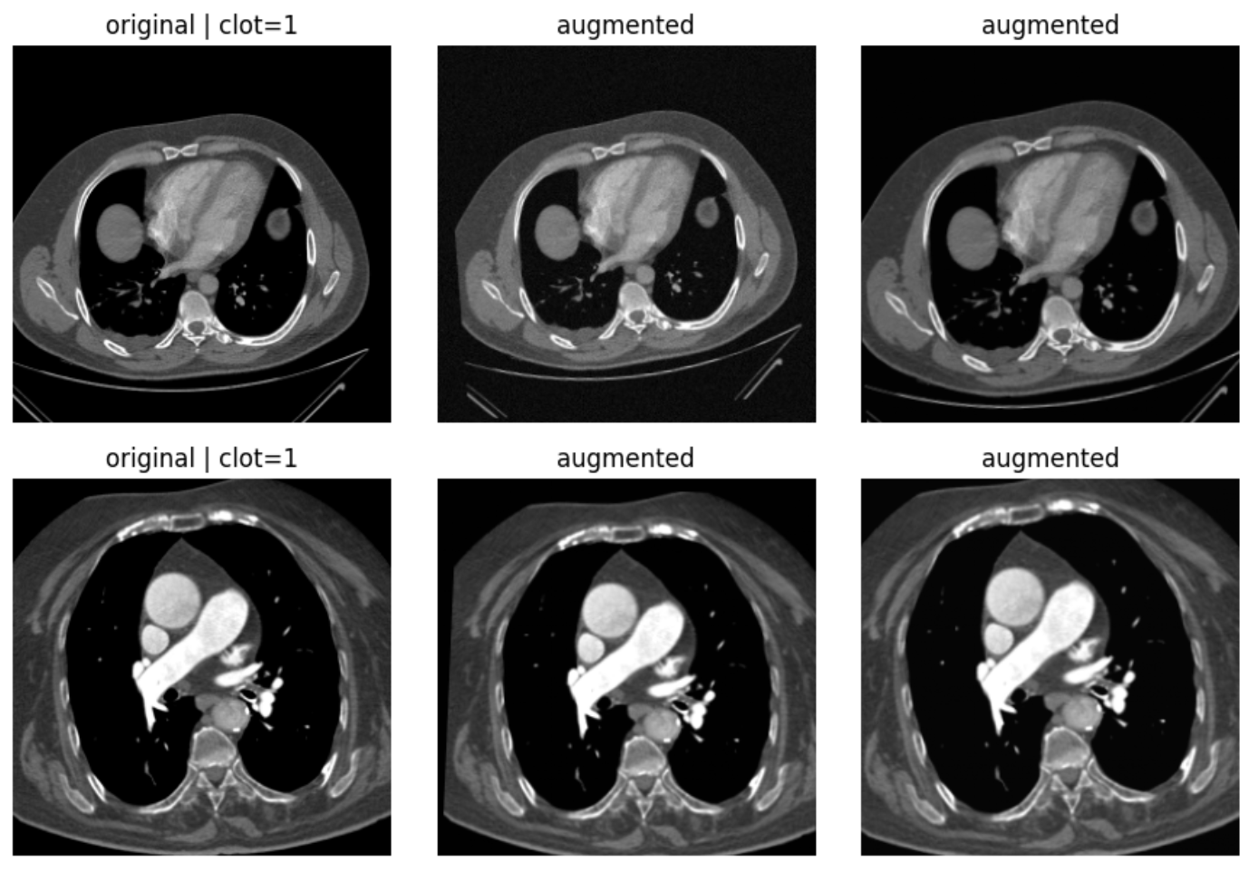
The Augmentation Methods We chose
03 · PREPARATION
Notes:
Walk through the pipeline left to right. HU: raw CT pixels are converted with RescaleSlope and RescaleIntercept so values mean real densities (air about -1000, water 0, contrast-filled blood high). 64 slices: full scans have hundreds of slices, which is too much for our budget, so we sample evenly. The cost of this is on the limitations slide. Windowing: we clip to the range where contrast-filled vessels and clots differ, so the model sees the useful contrast. Resize to 256 x 256 and save everything once, so training doesn't redo the slow DICOM reading. Preprocessing ran in parallel with 4 workers.

Slide 6
ResNet18 reads one slice at a time
04 · MODEL 1
1
Look at one slice plus its neighbors
The slices just above and below help it tell a clot (which continues across slices) from noise.
2
Predict a clot score for that slice
ResNet18 pretrained on ImageNet, final layer replaced with one output: the chance of a clot, 0 to 1.
slice i
3
Patient score = highest slice score
If any slice looks like a clot, the patient is flagged. One clear clot is enough for PE.
neighbors above and below give 2.5D context
Notes:
2.5D means: not a full 3D model, but more than one flat slice. The model sees a slice with its neighbors, so it gets a bit of depth cheaply. ResNet18 expects a 3-channel image, normalized with ImageNet mean and std; we replaced its 1000-class head with a single output and train with BCEWithLogitsLoss. To go from slices to a patient, we take the maximum slice score. Why max: PE is present if there is a clot anywhere, so one confident slice should be enough. The downside: one noisy slice can also flag a healthy patient, which costs precision.

Slide 7
Same data, same rules, three approaches
05 · THREE MODELS
Baseline, 2D CNN
2D CNN
2D CNN
pe_ct_cnn
ResNet18
EfficientNet-B0
A small 4-block CNN (~100k parameters) with no pretraining, trained only on our CT slices.
2.5D slices, slice labels
Pretrained on ImageNet
~11M parameters
Same pipeline, new backbone
Pretrained on ImageNet
~5M parameters
Tests: does a better 2D feature extractor help?
Notes:
The instructor asked for three models. We change one thing at a time so the comparison means something. ResNet18 is the baseline. EfficientNet-B0 keeps everything identical and only swaps the backbone, so any difference comes from the network. COLIPRI is different in kind: a 3D vision-language model from Microsoft, pretrained on tens of thousands of chest CTs and their reports. We keep it frozen, extract one 768-number embedding per patient, and train a logistic regression on top. Caveat to mention: COLIPRI resamples to 2 mm, which may blur small clots, and it was not built specifically for PE.

Slide 8




Missing a sick patient costs the most
06 · WHY RECALL
Missed PE
Weighted loss
Can be fatal. This is the error we fight hardest.
Clot slices count about 16.6× more in the loss (pos_weight = negatives ÷ positives), so the rare clot slices aren't drowned out.
False alarm
Lower threshold
A doctor double-checks the scan. Costs time, not a life.
Instead of 0.5, we pick the cutoff on the validation set that catches about 95% of sick patients, then apply it unchanged to test.
Notes:
The two errors are not equal. A false negative means a sick patient goes home untreated; a false positive means a doctor looks again. So we optimize recall: of all sick patients, how many did we catch. Two tools: first, pos_weight in BCEWithLogitsLoss, about 16.6 for our training set, because clot slices are only about 6%. Second, threshold tuning: the default 0.5 cutoff is arbitrary, so we lower it until about 95% of sick validation patients are caught. Important: the threshold is chosen on validation only, never on test, otherwise the test numbers would be cheating.

Slide 9
Split by patient, judged on four metrics
07 · EVALUATION
Train · 1,050 patients
Val · 225
Test · 225
No patient appears in two sets, and each split keeps the ~32.5% sick ratio.
Main goal
Trust
Calm
Overall
Recall
Precision
Specificity
AUC
Of all sick patients, how many we caught
Of flagged patients, how many were really sick
Of healthy patients, how many we left alone
How well scores rank sick above healthy
Notes:
Why split by patient: slices from the same patient look almost identical. If one patient's slices were in both train and test, the model could just recognize the patient, and the scores would be fake. So the split is done on patients: 1,050 train, 225 validation, 225 test, stratified so each keeps about a third sick. Why not accuracy: a model that calls everyone healthy already gets about 67.5% accuracy and catches nobody. Recall is the main goal; precision and specificity show we are not just flagging everyone; AUC is threshold-free and summarizes ranking quality. All metrics are patient-level.

Slide 10
Test set results
08 · RESULTS
Model | Recall | Precision | F1 | AUC
pe_ct_cnn | 0.90 | 0.33 | 0.48 | 0.590
ResNet18 | 0.90 | 0.34 | 0.50 | 0.705
EfficientNet-B0 | 0.91 | 0.37 | 0.53 | 0.729
Best AUC
72.9 %
EfficientNet-B0
Recall-tuned threshold chosen on validation, applied once to the 225 test patients.
Notes:
Fill in the numbers before presenting. How to read them: first say recall for each model, since that's the goal. Then show that precision and specificity aren't near zero, which proves the model isn't just flagging everyone. Use AUC to compare models independent of the threshold. Remember the test set is small (about 73 sick patients), so one missed patient changes recall by about 1.4 points; small differences between models may just be noise.

Slide 11


Try it live with Gradio
09 · DEPLOYMENT
What the app shows
The image is preprocessed the same way as in training
The model returns a clot probability
A PE / no PE flag using our recall-tuned threshold
Camera photos lack real CT density values, so treat that mode as a demo
Upload an image
Use the camera
Pick a CT image, get a PE score and a flag
Point the camera at a scan, get a score live
Notes:
The instructor required Gradio with two interfaces: one where you upload an image, one using the camera. Both run the same model and the same threshold. Be honest if asked: the camera mode sees a photo of a screen, not real DICOM data with Hounsfield units, so its predictions are less reliable. It shows the pipeline works end to end; the upload mode is the meaningful one. Have the demo open before the talk in case the network is slow.

Slide 12



What to keep in mind
10 · LIMITATIONS
Small subset
64 slices can skip clots
Research only
1,500 of 7,279 studies. The test set has 225 patients, so results will vary from run to run.
38 of 488 sick patients (7.8%) had no clot in any kept slice, which caps recall at about 92% for slice-based models.
Not validated for clinical use. Data comes from a few hospitals, so performance elsewhere is unknown.
Notes:
Most important limitation, and it's measured, not guessed: with only 64 evenly spaced slices, 38 of the 488 sick patients had no clot visible in any kept slice. Those patients are labeled sick but every slice they show the model is labeled clean, so a slice model will very likely miss them. That's why recall is capped near 92% even with a perfect model. Fix for future work: keep more slices (96 or 128). Small test set: with about 73 sick test patients, each miss moves recall by about 1.4 points.

Slide 13
Thank you
Catch every clot we can, and let doctors handle the double-checks.
Questions?
Notes:
Close with the one-sentence takeaway, then open for questions. Review the Q&A slide before presenting.

