Slide 1
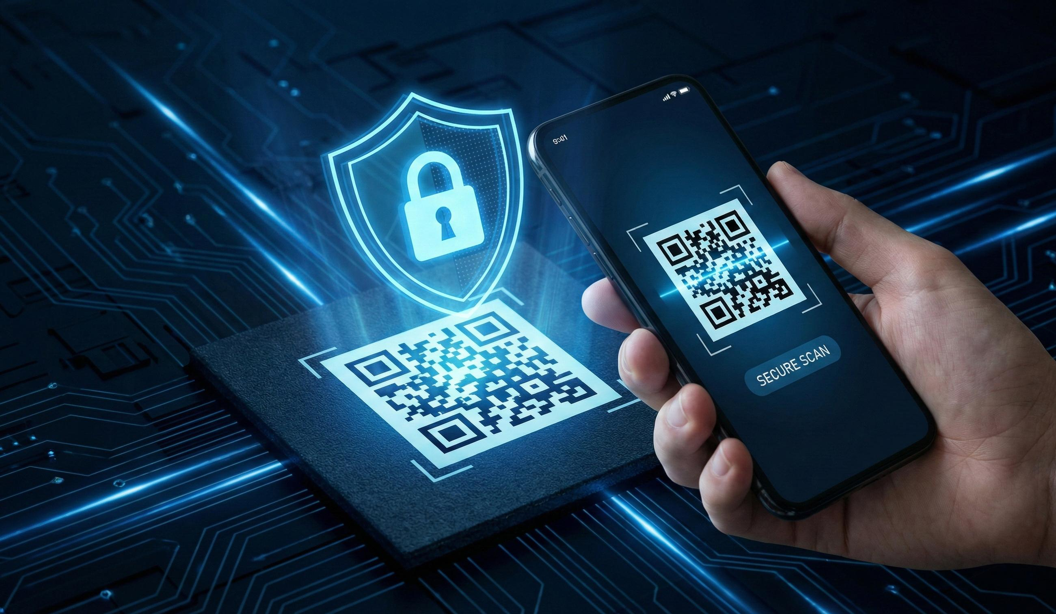
QR-Based Smart Health Information Access
HL
HEALTHLENS AI
The Right Health Information. When Every Second Matters
Turning a working QR health-profile demo into a safer, clearer, judge-ready prototype.
QR-BASED ACCESS
CONSENT –FIRST PRIVACY
RESPONSIBLE AI
Illustrative visuals • Synthetic demo only

Slide 2
01 / STARTING POINT
From Working Prototype to Hackathon-Ready Solution
A QR-based health information demo with a clear path toward stronger reliability, privacy, and user trust..
WHAT WORKS
PRIORITY IMPROVEMENTS
WHAT JUDGES SHOULD SEE
• QR-code generation and download
• Camera capture and image upload
• Two fictional health-profile examples
• Consent step and rule-based summary
• Validate missing, invalid, or unreadable QR inputs
• Separate consent from identity verification
• Define session clearing and data-retention behaviour
• Add clear error messages and recovery steps
• A clean, intuitive user interface
• A successful scan and a failed-scan demonstration
• Transparent explanation of current AI capabilities
• Clear privacy safeguards and demo-only boundaries
A reliable demo workflow with clear consent, safe error handling, and transparent limitations.
Illustrative visuals • Synthetic demo only
02

Slide 3
02 / RELIABLE BY DESIGN
A Transparent Workflow. Safe at Every Step.
Validate inputs, obtain consent, control access, and handle failures without exposing stale data.
01
02
03
04
05
CAPTURE
→
VALIDATE
→
CONSENT
→
DISPLAY PROFILE
→
REVIEW & CLEAR
Scan a QR code or upload an image.
Check QR format, token validity, and expiry where supported.
Record consent and verify access permissions where implemented.
Show only the permitted synthetic health information.
Let the user review details and clear the displayed profile when finished.
FAIL-SAFE DESIGN
Invalid QR → Clear error → Safe reset → Retry
Never leave a previous patient's profile visible after a failed scan.
Illustrative visuals • Synthetic demo only
03

Slide 4
03 / RELIABILITY
Expect Failure. Recover Safely.
Validate every input, handle errors clearly, and prevent stale health information from remaining on screen.
INPUT DEFENSE
EDGE-CASE TESTING
• Accept only supported image formats.
• Enforce a maximum upload size.
• Handle corrupt or unreadable images gracefully.
• Reject empty scans and unknown QR tokens.
• Show safe error messages without exposing technical details.
• Valid QR ,invalid QR ,blurry images.
• Camera permission denied or unavailable
• Consent unchecked or revoked
• Page refresh, repeated scans, and session reset.
• Slow connection and mobile-browser behaviour.
RELIABILITY SUCCESS CRITERION
Every test produces a correct outcome or a clear recovery path.
No silent failures • No stale profiles • No sensitive error details
Illustrative visuals • Synthetic demo only
04

Slide 5
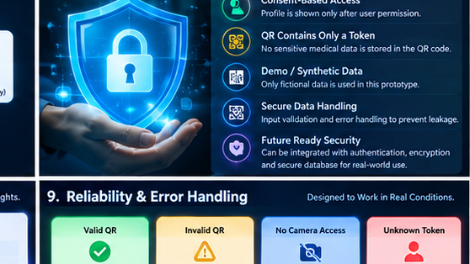
04 / PRIVACY
A QR Code Should Identify—Not Expose
Minimize exposed data, respect user consent, and protect access to health information.
CURRENT · DEMO SAFE
NEXT · SECURE ACCESS
BEFORE REAL PATIENTS
• Use synthetic health data only
• Keep medical details out of QR code
• Clear displayed profile on revoke
•Avoid embedding profile contents in QR tokens.
• Authenticated users and verify their permissions
•Enforce authorization on the server for each record
•Add consent expiry and revocation
• Protect data in transit and at rest
• Use short-lived, revocable QR access tokens
• Threat model and security review
• Implement access logs and retention policies
• Review applicable privacy and legal requirements
• Clinical validation and incident plan
PRIVACY PRINCIPLE
A QR code is a pointer — not proof of identity or permission.
Illustrative visuals • Synthetic demo only
05

Slide 6
05 / TRUST MODEL
Consent Is Essential. Authorization Is Mandatory.
Consent expresses permission; identity verification and access control determine who can view a health record.
CURRENT DEMO
BEFORE REAL-WORLD DEPLOYMENT
• Fictional patient records only
• QR Token allowlist for demo profiles
• Consent checked before displaying a profile
• Clear or reset action
• Generic errors messages without sensitive debug output
• Verified identity and appropriate user roles
•Server-side authorization for every record request
•Clear, specific, time-limited consent
•Enforced consent revocation and access expiry
•Auditable access logs and secure data storage
NON-NEGOTIABLE TRUST PRINCIPLE
A QR code or consent checkbox alone does not provide production-grade healthcare security
security
Illustrative visuals • Synthetic demo only
06

Slide 7
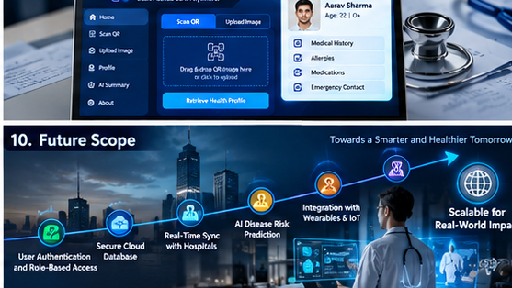
06 / PREMIUM UI
A clinical-tech look: calm, sharp, and readable
Navy surfaces + electric blue accents + clear information cards.
HEALTHLENS AI / DEMO MODE
DESIGN PRINCIPLES
Health profile overview
• One primary action per step
• Readable labels and strong contrast
• Consistent spacing and card style
• Loading, success, warning, error states
• Mobile-first responsive layout
PROFILE
CONSENT
QR STATUS
Synthetic
Confirmed
Validated
INFORMATION SUMMARY
Reported information
Human review required. This demo does not diagnose diseases.
DESIGN GOAL
Make essential health information easy to understand without overstating what the system knows.
Illustrative visuals • Synthetic demo only
07

Slide 8
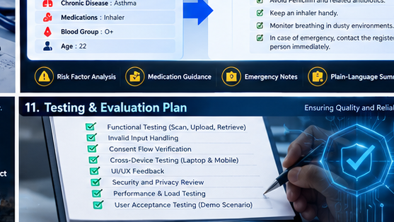
07 / RESPONSIBLE AI
AI With Transparency. Healthcare With Trust
Clearly distinguish demonstrated capabilities from future AI features and unvalidated medical claims.
WHAT HEALTHLENS AI DOES
WHAT IT DOES NOT CLAIM
• Retrieves QR-linked synthetic health profiles.
• Presents profile information in a clear format.
• Generates rule-based summaries, if implemented.
• Supports human review of displayed information.
• Demonstrates a privacy-conscious healthcare workflow.
• Disease detection from a QR code
• Clinical accuracy without validation
• Live hospital-record integration unless implemented
• Treatment recommendations or autonomous medical decisions.
• Proven clinical accuracy without
proper evaluation
OUR AI PRINCIPLE
Make health information easier to understand—not pretend to replace a clinician.
Illustrative visuals • Synthetic demo only
08

Slide 9
08 /IMPLEMENTATION ROADMAP
From Prototype to Secure Pilot
Improve reliability first, verify every change, and introduce real health data only after security and privacy requirements are met.
PHASE 1
PHASE 2
PHASE 3
HARDEN THE MVP
TEST & VERIFY
PLAN A SECURE PILOT
• Validate QR inputs and uploaded images
• Improve consent and profile-reset behaviour
• Add clear error messages and recovery
• Refine mobile layout and accessibility
• Test valid, invalid, and unreadable QR codes
• Check mobile browsers and session resets
• Verify privacy behaviour and error handling
• Record test results and fix defects
• Design identity verification and record-level authorization
• Define consent expiry, revocation, and audit logging
• Complete privacy, security, and legal reviews
• Plan clinical workflow validation with qualified professionals
SAFETY GATE
No real patient records until security, privacy, authorization, and governance requirements are reviewed
Illustrative visuals • Synthetic demo only
09

Slide 10
09 / VERIFICATION
Prove It Works. Verify It Is Safe.
A structured pre-demo checklist for functionality, privacy, accessibility, and responsible AI claims.
FUNCTIONAL TESTS
PRIVACY & PRESENTATION
• Valid demo QR retrieves correct fictional profile
• Unknown token is rejected
• Blurry or corrupt image gives recovery message
• Consent off blocks profile
• Clear or revoke hides prior profile
• Synthetic data only; no real patient records
• No API keys or secrets committed to the repository
• Mobile and desktop layouts checked
• AI capabilities and limitations labelled accurately
• Safety disclaimer visible
• Error messages do not expose sensitive details
DEMO ACCEPTANCE CRITERION
Every defined test has a recorded result, and no unresolved critical issue remains
Illustrative visuals • Synthetic demo only
10

Slide 11
10 / EVALUATION & IMPACT
Define Success. Measure It. Prove It.
Proposed acceptance criteria for reliability, usability, consent, and data protection in the HealthLens AI prototype.
100%
< 2 taps
0
100%
Known test cases end safely
Clear / revoke path
Real patient records in MVP
Consent-negative tests blocked
EVIDENCE OVER CLAIMS
Targets are proposed. Report actual results only after testing.
Illustrative visuals • Synthetic demo only
11

Slide 12
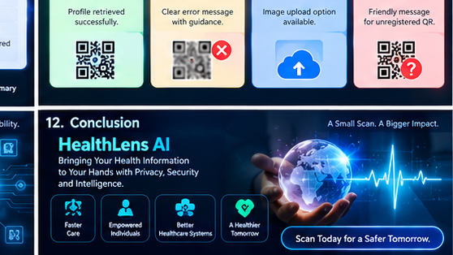

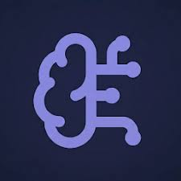
HEALTHLENS AI
Smarter Access. Safer Health Information
HL
HEALTHLENS AI
A QR-based health information access prototype designed around privacy, consent, and responsible technology.
🛡️
SIMPLE ACCESS
PRIVACY FIRST
RESPONSIBLE AI
our vision is simple: make essential health information easier to access, while keeping privacy, consent, and human judgment at the centre
Technology should connect people to information—
not compromise their trust
Illustrative visuals • Synthetic demo only
12

