Slide 1
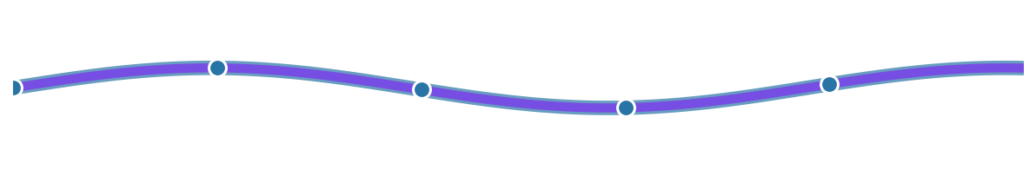
Polster
Build Reliable Data Pipelines with Enforced Architecture
Data Analytics Meetup • January 2026

Slide 2
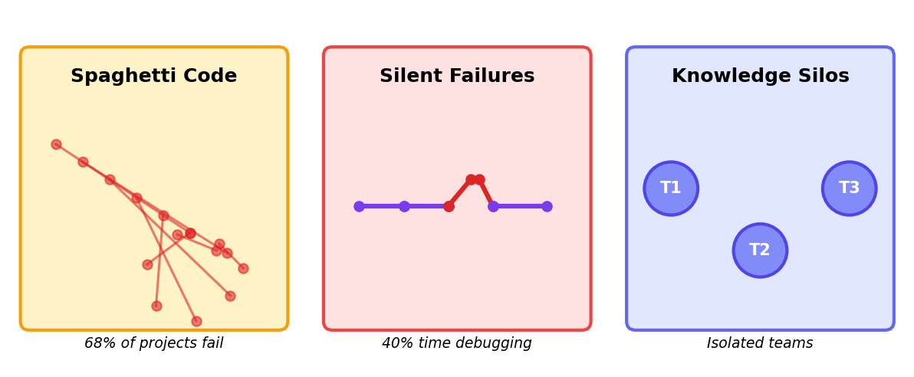
Why Do Data Projects Fail?
💡 The root cause: Lack of enforced architecture leads to technical debt

Slide 3
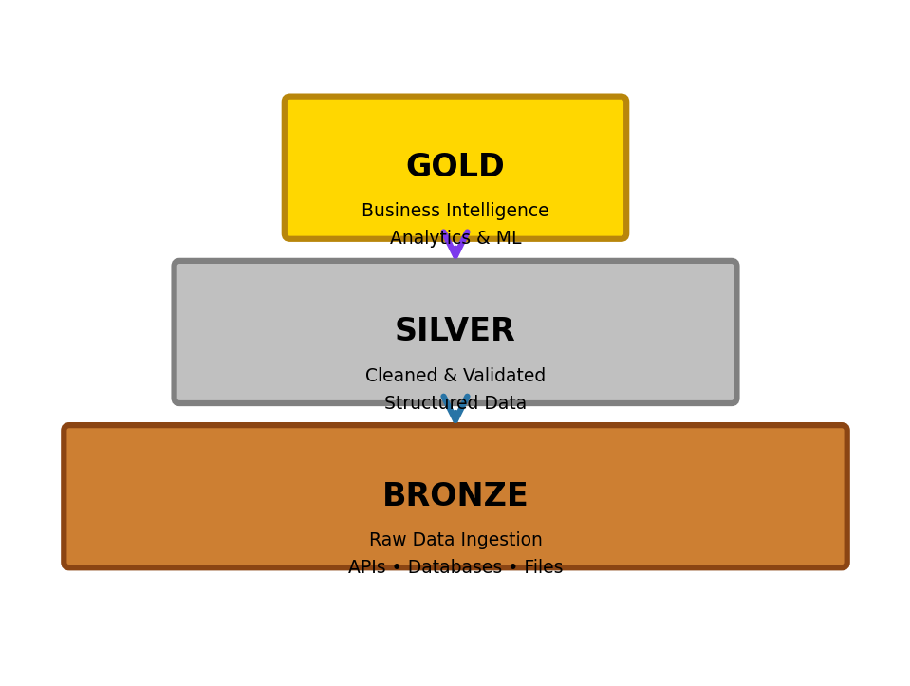
The Solution: Medallion Architecture
✓ Quality improves at each layer
✓ Clear data lineage & debugging
✓ Consistent structure across teams
✓ Enforced best practices
✓ Separate concerns by layer
Like refining ore:
Raw → Purified → Valuable

Slide 4
Meet Polster: Architecture as Code
BEFORE:
AFTER:
• Manual project setup (2-3 days)
• One command setup (5 minutes)
• Inconsistent structure
• Enforced Medallion layers
• Complex dependency management
• Automatic dependencies
• No enforced patterns
• Built-in best practices
• Production surprises
• Catch errors early
$ polster init my_pipeline
✓ Bronze layer created ✓ Silver layer created ✓ Gold layer created ✓ Ready to build

Slide 5
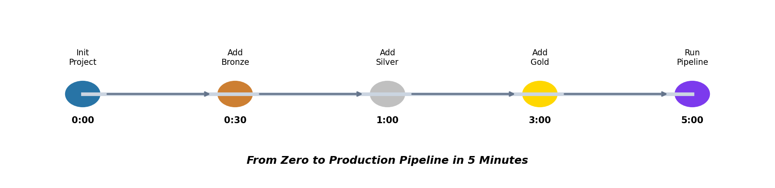
5 Minutes to Production
1. Initialize
$ polster init my_project
2. Add Bronze Asset
$ polster add-asset --layer bronze --name raw_sales
3. Add Silver Asset
$ polster add-asset --layer silver --name clean_sales --dependencies raw_sales
4. Add Gold Asset
$ polster add-asset --layer gold --name sales_metrics --dependencies clean_sales
5. Run Pipeline
$ python run_polster.py --ui

Slide 6
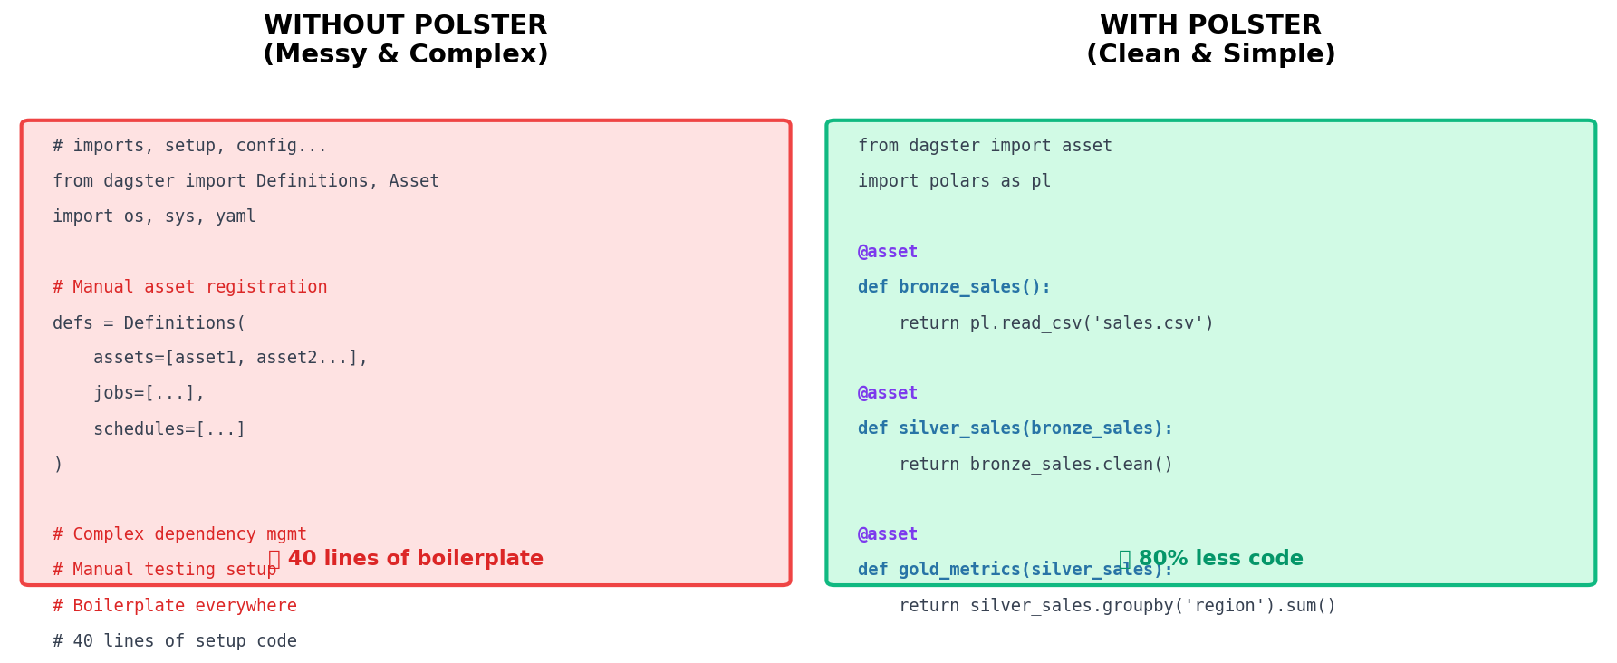
Less Boilerplate, More Business Logic

Slide 7
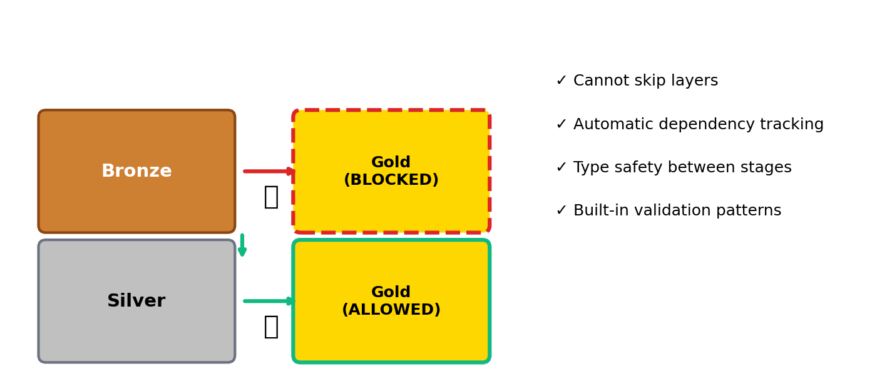
Guardrails, Not Gates

Slide 8
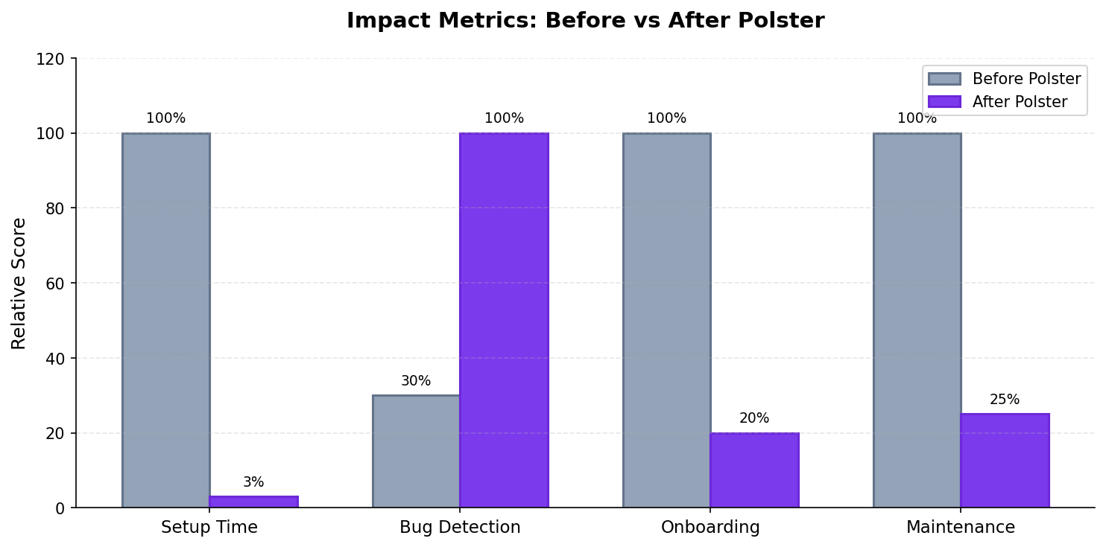
Results That Matter

Slide 9
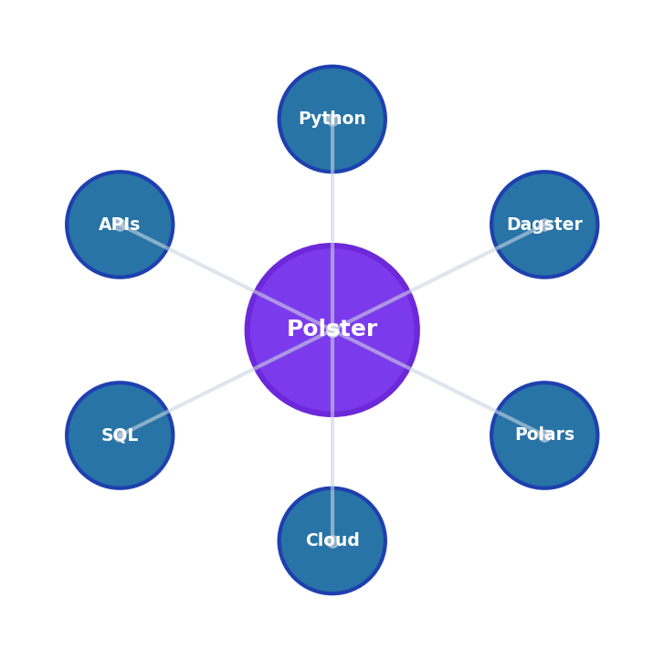
Works With Your Stack
Languages & Frameworks
🐍 Python • ⚡ Polars • 🐼 Pandas
Orchestration
🔄 Dagster • ☁️ Cloud-native • 🚀 Scalable
Data Sources
🐘 PostgreSQL • 📊 MySQL • 🔌 REST APIs • 📁 Files
Destinations
☁️ AWS • ☁️ Azure • ☁️ GCP • 📈 BI Tools

Slide 10
Who Is Polster For?
💻
📊
🚀
Data Engineer
Analytics Manager
Startup CTO
"Finally, a standardized way to build pipelines that my team can actually maintain."
"My team ships faster with fewer bugs. New hires get productive in days, not weeks."
"Enterprise-grade data infrastructure without the enterprise timeline or budget."

Slide 11
Start Building Today
1
$ pip install polster
Install from PyPI
2
$ polster init my_project
Create your first pipeline
3
$ python run_polster.py --ui
Launch the UI
📦 pip install polster • 🐙 github.com/sultanaltair96/polster-cli • 📚 polster.rtfd.io

Slide 12
Polster
Architecture that scales with your data
🚀 pip install polster | 💻 github.com/sultanaltair96/polster-cli
Questions? Let's talk!

