Slide 1
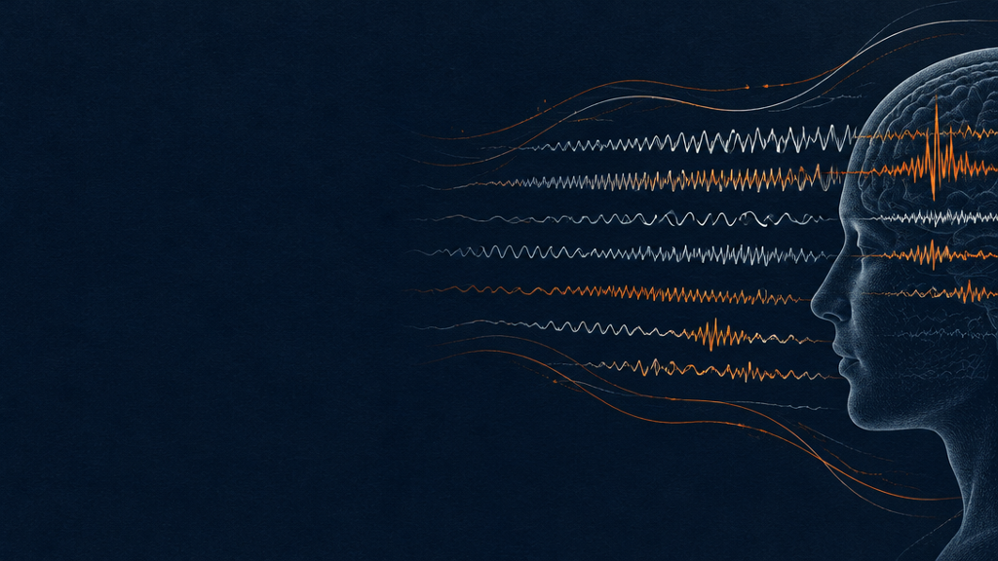
Session-to-session drift
in motor-imagery decoding
Does a BCI decoder trained on one day still work on the next?
BNCI2014-004 · BCI Competition IV 2b · Graz
ROBT613 MIDTERM PROJECT
Sultanbek · Aruzhan · Daniela · Aidarkhan
Notes:
Our question: does a motor-imagery decoder trained on one day still work on later days? We test it on BNCI2014-004 (BCI Competition IV 2b, Graz): 9 subjects, 5 sessions on different days, left vs right hand imagery. Spoiler: once the comparison is fair, we find no measurable drift in left/right separation - a well-tested negative result - but a small shift of the decision threshold.

Slide 2
A BCI is calibrated once — then used for days
CALIBRATE
Day 1
USE
Day 2
USE
Day 3
Between days electrodes sit differently, impedance and fatigue change, people learn. If the EEG features move, a decoder from an earlier day should do worse than one trained on the same day.
Notes:
A BCI is calibrated on one day and then used on later days. Between days the electrodes sit slightly differently, impedance and fatigue change, and people learn - so the EEG features a decoder relies on can shift. That is session-to-session drift. If it is real, a decoder trained on an earlier day should perform worse on a new day than a decoder trained on that same day.
Full disclosure: our first version (v1) used MOABB's ready-made epochs, an EOG correction fitted on task data, no trial cleaning and imprecise band edges, and found no drift from day 1 to day 2. The hypotheses were written before v1's results and kept unchanged; this version fixes the data preparation and adds H1b.

Slide 3
Hypotheses and decision rules
Fixed in advance · drift cost = within-session AUC − cross-session AUC · one-sided Wilcoxon · n = 9 · α = 0.05
H1a
H1b
H2
AUC drops on day 2
AUC drops with feedback
Label-free fixes help
Primary. Train on S1, score S2 (both screening). Cross-session AUC lower than within-session CV on S2, same number of training trials.
Secondary, new. Same test inside the feedback paradigm: train on S3, score S4 and S5 (averaged).
C: baseline-relative power. D: per-session z-scoring. Lower drift cost, Holm-corrected; cross-session AUC must not drop.
Notes:
All three hypotheses and decision rules were fixed before running the analysis.
H1a (primary): trained on session 1, tested on session 2 - both screening, different days. ROC AUC is lower than within-session cross-validation on session 2, with the same number of training trials.
H1b (secondary, added and fixed before its first run): the same inside the feedback paradigm - trained on session 3, tested on sessions 4 and 5, averaged.
H2: two label-free fixes reduce the drift cost. C is baseline-relative power: log power 3.5-5.5 s minus 0.5-1.5 s. D is per-session z-scoring of the features - the hypothesis from our README. Drift cost is averaged over both transfers, one-sided Wilcoxon per fix, Holm-corrected, and cross-session AUC must not drop significantly.
Drift cost = within-session AUC minus cross-session AUC. Secondary metric everywhere: balanced accuracy at the default threshold. AUC only asks whether right-hand trials score higher than left-hand trials; if a new day shifts all scores together, AUC stays the same but accuracy drops. Comparing the two tells us which kind of drift we see.

Slide 4
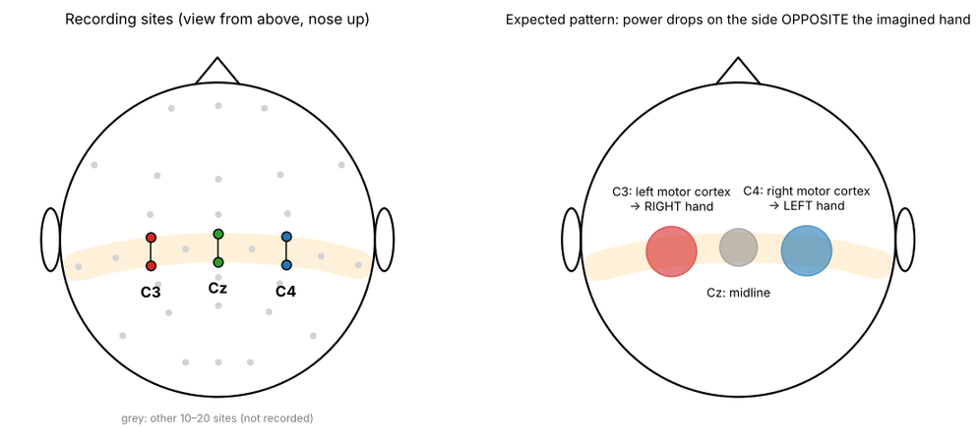
Dataset: BNCI2014-004
9 subjects · 5 sessions on different days
S1–S2 screening · S3–S5 smiley feedback
Left vs right hand motor imagery, balanced
3 bipolar EEG (C3, Cz, C4) + 3 EOG · 250 Hz
6,520 trials · 19.2% flagged by the authors
Read from the original .mat files: signal, onsets, labels, expert artifact flags. Each session starts with a ~3.6-min eye-movement calibration recording.
Notes:
BNCI2014-004 is BCI Competition IV dataset 2b from Graz. 9 subjects, 5 sessions each on different days: sessions 1-2 are screening without feedback, sessions 3-5 have smiley feedback. Task: left vs right hand motor imagery, classes balanced in every session.
We read the competition .mat files ourselves instead of MOABB's ready-made epochs, so we keep every field: signal, trial onsets, labels, expert artifact flags, age and gender. Checks passed: 250 Hz everywhere, classes balanced. Most sessions have 120 (screening) or 160 (feedback) trials; four differ and we use what the files contain.
Each EEG channel is a bipolar pair ~2.5 cm apart around C3, Cz or C4. C3 and C4 sit over the left and right hand area of primary motor cortex; imagining the right hand should reduce mu/beta power at C3, the left hand at C4.
Most important audit finding: the ~3.6 minutes before the first trial are a recording of deliberate eye movements and blinks - we use it for EOG correction. 1,253 of 6,520 trials (19.2%) are flagged as artifacts by the dataset authors.

Slide 5
One preprocessing pipeline for every session
Same steps for every session and both arms; nothing uses class labels.
1
Load .mat + audit
2
FIR 1–40 Hz
3
EOG regression
4
Epochs 0–7.5 s
5
Clean training trials
6
Log band power
EOG weights come from the pre-trial calibration recording (43 of 45 sessions). Expert-flagged and >5 robust-SD outlier trials — 1,272 (19.5%) — are left out of training only. Every trial is still scored.
Notes:
Same steps for every session.
1. Units and MNE object: files store microvolts, MNE works in volts. Channels are bipolar, so no re-referencing.
2. Zero-phase FIR band-pass 1-40 Hz on the continuous signal: removes slow drift, keeps everything up to the highest band edge (30 Hz). 50 Hz line noise was already notched by the amplifier.
3. EOG regression (notebook 04): we estimate how much each EOG channel leaks into each EEG channel from the pre-trial calibration recording, where the person moved the eyes on purpose, and subtract that leak from the whole session. A separate recording is cleaner than fitting on task data and uses no labels. 43 of 45 sessions had at least 60 s of calibration; the other 2 fall back to the whole session, also label-free.
4. Epochs 0-7.5 s from trial start; cue at ~3 s; feature window 3.5-5.5 s.
5. Cleaning rule, applied only to trials used for training: a trial is left out if the authors flagged it, or its log-variance is more than 5 robust SDs from the session median on any channel. That is 1,272 of 6,520 trials (19.5%): 1,253 expert-flagged plus 19 extra outliers. Scored trials are never removed - an online BCI must classify every trial, and both comparisons are scored on the same trials.
6. Log Welch band power features (next slides).

Slide 6
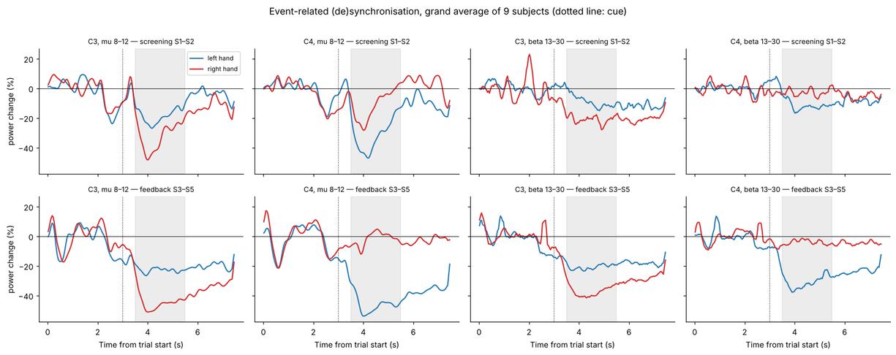
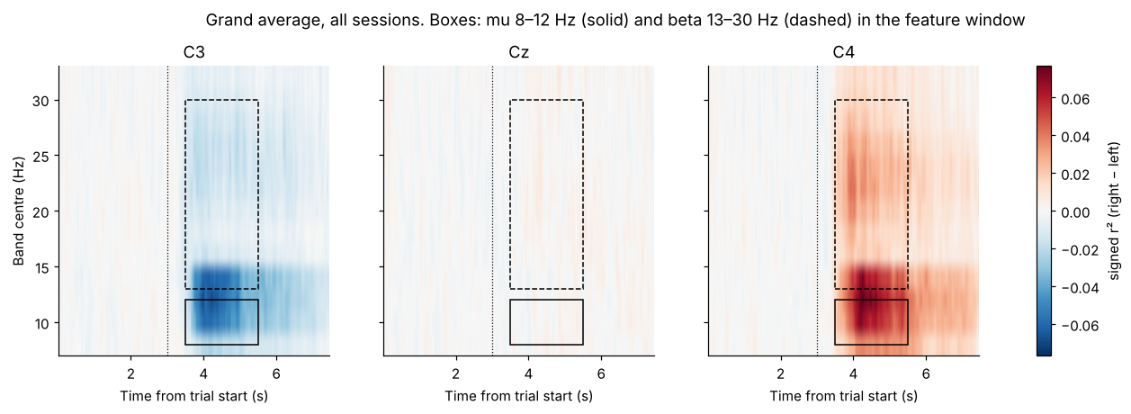
The expected brain response is there
Before decoding, we checked for event-related desynchronisation (ERD).
After the cue (3 s), mu and beta power drop more at C3 for right-hand and at C4 for left-hand imagery — contralateral ERD, in screening and feedback sessions.
The 3.5–5.5 s feature window sits inside the drop. This is a sanity check, not a decoding result.
Notes:
Before decoding anything we checked that the expected brain response is there.
Top: ERD = percent change of band power relative to the pre-cue period (0.5-2.5 s), averaged over trials first and then expressed in percent - the classic definition. Grand average of 9 subjects, screening (S1-S2) and feedback (S3-S5) shown separately. After the cue at ~3 s, power drops more at C3 for the right hand and more at C4 for the left hand, in both mu and beta. The grey feature window sits inside that drop.
Bottom: time-frequency view - signed r-squared between band power and the class (right = +1), per 4-Hz band and time point, all sessions averaged. Blue at C3 and red at C4 is the expected contralateral ERD; the boxes mark our mu (8-12 Hz) and beta (13-30 Hz) bands in the feature window.

Slide 7
Features, decoder and leak-free evaluation
WITHIN
Leave-one-run-out CV inside the scored day
FEATURES
6 log band powers: mu 8–12 + beta 13–30 Hz × C3, Cz, C4
DECODER
Logistic regression, scaler refitted in every fold
CROSS
Trained on the earlier day, scores every trial
Matched training size (20 class-stratified subsamples) · AUC scored run by run on identical trials · shuffled labels give AUC 0.502 / 0.501 — no leakage.
Notes:
Features: mean Welch PSD over 1-Hz bins 8-12 Hz (mu) and 13-30 Hz (beta) at C3, Cz and C4, natural log - 6 features. Three variants: A raw log power (the standard pipeline), C baseline-relative (each trial's log power in 3.5-5.5 s minus its own log power in 0.5-1.5 s), D session z-scored (each feature standardised with the mean and SD of all trials of its own session, no labels).
Evaluation for a training session a and a scored session b:
- Within-session: leave-one-run-out CV inside b; training folds use only cleaned trials; every trial of the held-out run is scored.
- Cross-session: fit on the cleaned trials of a; score every trial of b.
- Same scoring on both sides: AUC computed run by run on exactly the same trials, then averaged. (Pooling out-of-fold scores - our v1 method - penalises the within side for offset differences between fold models; kept as a sensitivity analysis.)
- Matched size: both decoders get the same number of training trials, drawn class-stratified at random 20 times.
Validation V2: with shuffled training labels the mean AUC is 0.502 on the within side and 0.501 on the cross side - so nothing leaks. Cross-session decoding is above chance (Mann-Whitney p < 0.05) in 7 of 9 subjects for both transfers.

Slide 8
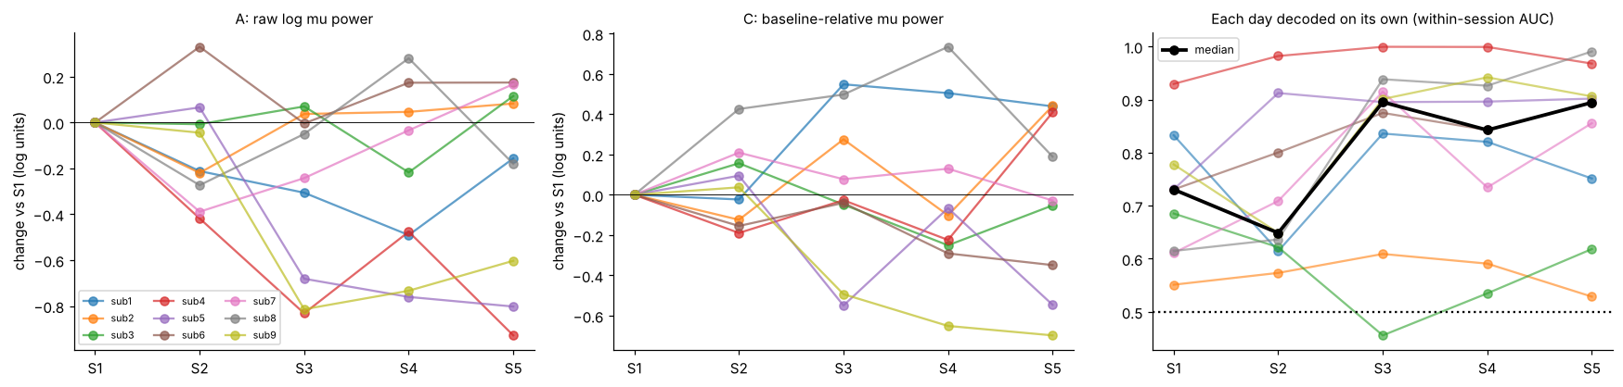
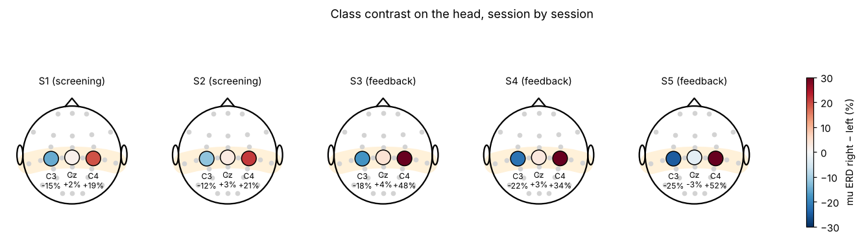
Drift we can see before decoding
No labels, no decoder: the overall power level moves between days, but the class pattern on the head stays.
Within-session AUC by day
S1 0.73 · S2 0.65
S3 0.90 · S4 0.84 · S5 0.89
Decoders across days
cosine similarity 0.63–0.84
Notes:
Drift you can see before decoding anything.
Top left and middle: mean log mu power at C3 and C4 in each session relative to session 1, one line per subject. With raw features (A) the overall power level clearly moves between days; the baseline-relative version (C) moves less. No labels, no decoder.
Top right: each day decoded on its own (within-session AUC). Median: S1 0.73, S2 0.65, S3 0.90, S4 0.84, S5 0.89 - subjects get much better once feedback starts.
Bottom: grand-average contrast of mu ERD (right-hand minus left-hand imagery) in the feature window, on the head for each session. A stable pattern is blue at C3 and red at C4 every day - and that is what we see.
Also (notebook section 9 iii): decoders fitted separately on each day point in similar directions - cosine similarity between weight vectors 0.63-0.84. So the level moves, but the discriminative pattern stays.

Slide 9
H1: Does performance drop on a new day?
NO MEASURABLE
AUC DRIFT
H1a & H1b
NOT SUPPORTED
H1a S1→S2: within 0.677 vs cross 0.656 · drift −0.002 · p = 0.55
H1b S3→S4/S5: within 0.872 vs cross 0.869 · drift +0.003 · p = 0.08
Cross-session decoding above chance in 7/9 subjects (both transfers)
What does drift is the threshold: balanced accuracy drops slightly in feedback sessions (+0.011, p = 0.014).
Notes:
Main result: no measurable drift in class separation. A decoder trained on an earlier day separated left from right hand on a new day as well as a decoder trained on that same day, once both had the same number of training trials.
H1a, S1 to S2 (about 79 training trials per decoder): within 0.677 vs cross 0.656 median AUC; median drift cost -0.002; positive in only 4 of 9 subjects; one-sided p = 0.55. Not supported.
H1b, S3 to S4/S5: within 0.872 vs cross 0.869; drift +0.003; 6 of 9 positive; p = 0.08. Not supported.
Cross-session decoding is still clearly above chance in 7 of 9 subjects for both transfers.
What does drift is the decision threshold, a little. In feedback sessions balanced accuracy at the default threshold drops slightly but consistently: +0.011, p = 0.014 (secondary metric). AUC ignores where the threshold sits; accuracy does not. So on a new day the whole score distribution shifts a bit while the left/right ordering stays.

Slide 10
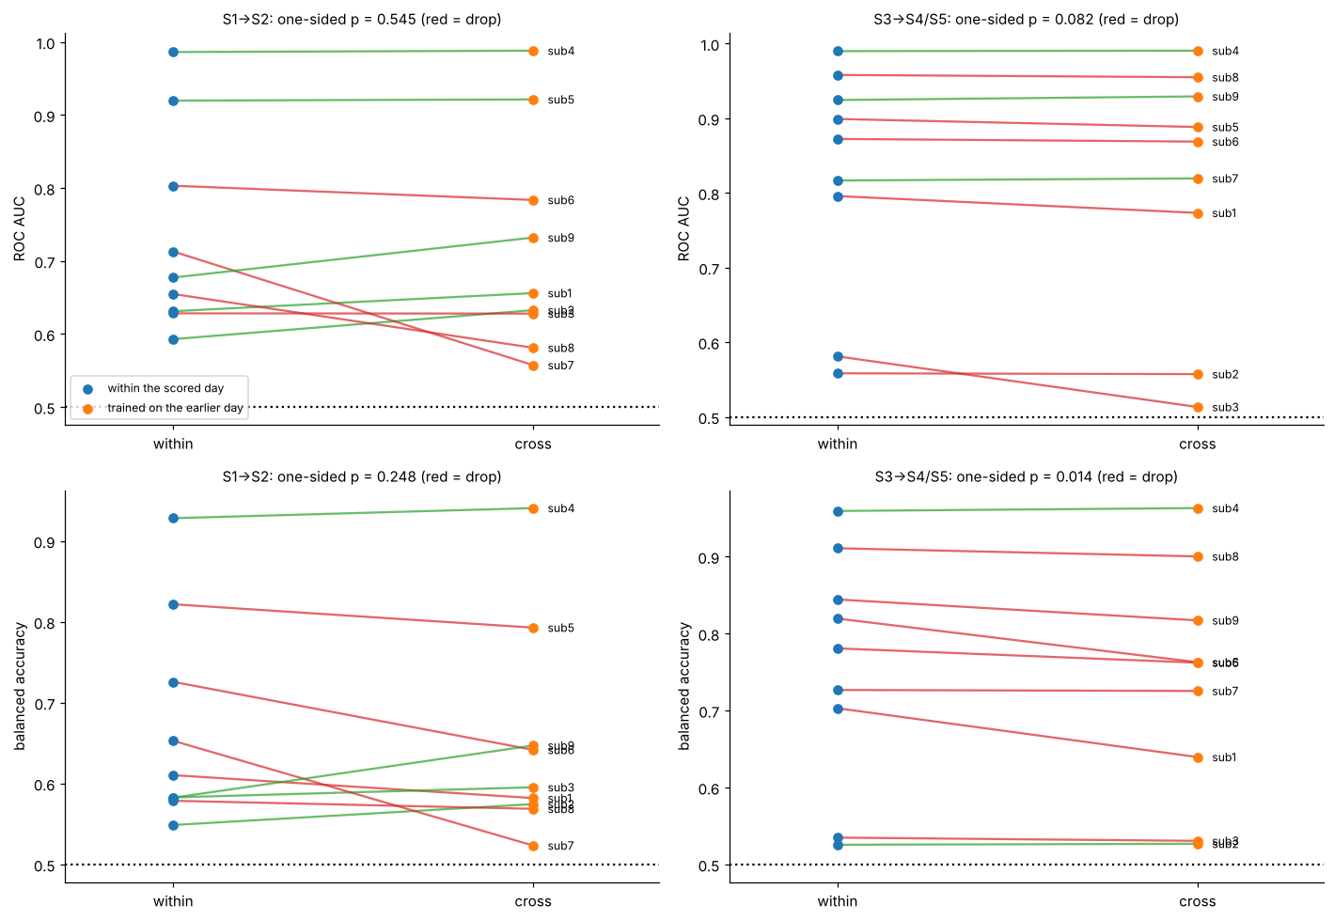
H1 subject by subject
Blue: decoder trained within the scored day
Orange: decoder trained on the earlier day
Red line = drop, green = gain
Top: ROC AUC — no consistent drop.
Bottom: balanced accuracy — mostly red in feedback sessions (p = 0.014): the scores shift, the ordering stays.
Notes:
Every subject, both transfers. Each line connects one subject's within-session score (blue, left) to the score of the decoder trained on the earlier day (orange, right); red means a drop, green a gain.
Top row is ROC AUC. For S1 to S2, 4 of 9 subjects drop and 5 do not; the big drops are sub7 (0.71 to 0.56) and sub8. For S3 to S4/S5 the lines are almost flat. One-sided p = 0.55 and 0.08.
Bottom row is balanced accuracy at the default threshold. In the feedback sessions nearly every line is red - a small but consistent drop, p = 0.014. That is the signature of a threshold or offset shift, not a loss of class separation.

Slide 11
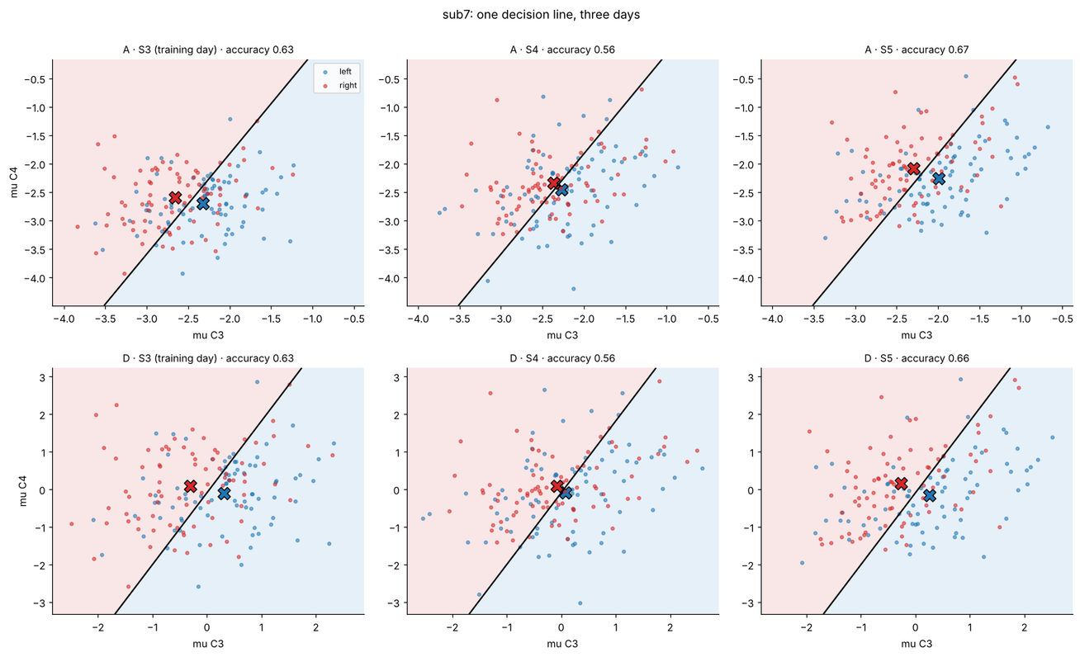
One subject, one decision line, three days
Subject 7 · largest mu-power shift · decoder fitted on S3 only and kept fixed
Scores shift together; left/right ordering is kept. AUC stays, while fixed-threshold accuracy moves.
Notes:
One subject, chosen by a fixed rule: among subjects decoded well on session 3 (within-session AUC at least 0.8), the one whose mean mu power moved most between session 3 and sessions 4-5 - no decoder involved. That is subject 7, with a mean shift of 0.31 log units.
Each panel is one day: trials as points in the plane of log mu power at C3 (x) and C4 (y). The black line is a 2-feature decoder fitted on session 3 only and kept fixed. Top row: raw features (A). Bottom row: session z-scored (D). Accuracy of the fixed line on each day is in the panel title. This is an illustration only - the real decoder uses all 6 features.
Take-away: the clouds move together across days, but left and right stay on the same sides relative to each other - so the ordering (AUC) survives while a fixed threshold can lose accuracy.

Slide 12
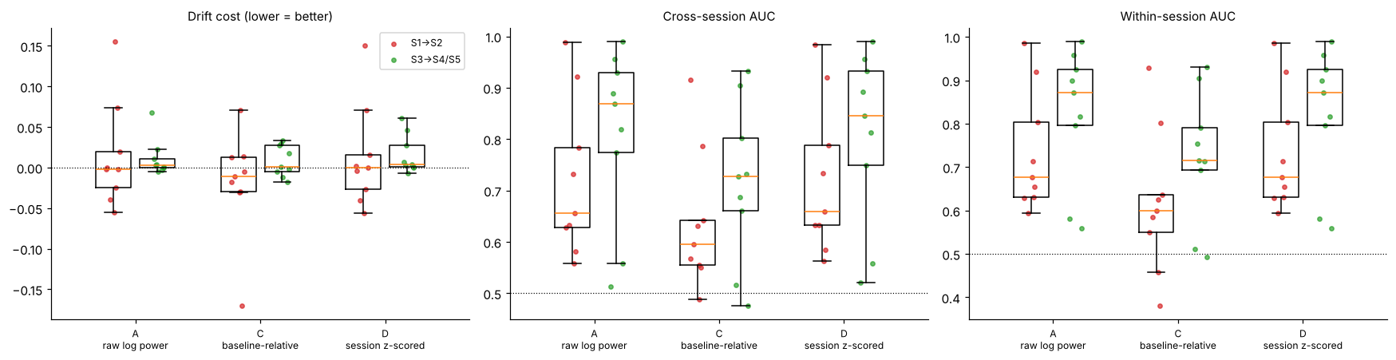
H2: Do the fixes reduce drift cost?
Neither fix is supported — as expected when there is no AUC drift to remove.
C · Baseline-relative
D · Session z-scoring
NOT SUPPORTED
NOT SUPPORTED
Made decoding worse: cross-session AUC −0.066 (p = 0.004), within-session −0.11. A 1-s single-trial baseline adds noise.
No change in AUC: drift reduction +0.000, Holm p = 0.91. The realistic first-run version was not better either.
Notes:
H2: do the two label-free fixes reduce the drift cost? Outcome per subject is the drift cost averaged over both transfers; one-sided Wilcoxon, Holm-corrected over the two fixes; a fix only counts if cross-session AUC does not drop significantly.
C, baseline-relative power, made decoding clearly worse: cross-session AUC -0.066 (p = 0.004) and within-session AUC -0.11. A 1-s single-trial baseline adds noise, and in feedback sessions that window falls on a rising and falling mu transition. Drift reduction -0.003, Holm p = 0.91.
D, per-session z-scoring - the hypothesis from our README - changed nothing in AUC: drift reduction +0.000, Holm p = 0.91, cross-session AUC unchanged. Within-session results for D equal A by construction, because the decoder standardises features anyway. The realistic online version that uses only the new day's first run (sensitivity c) was not better either.
Not supported, as expected when there is no AUC drift to remove. The figure shows drift cost, cross-session and within-session AUC for A, C and D, both transfers.

Slide 13
Why our first notebook found no drift for the wrong reason
MATCHED, PAST-ONLY TRAINING
S1 → S2: AUC 0.656 vs within 0.677
MOABB: 4 OTHER SESSIONS
incl. later days → AUC 0.697 on S2
the fair test of drift
beats the scored day itself in 7/9 subjects (+0.016)
More training data outweighs any day-to-day change, so leave-one-session-out hides drift. Only matched-size, past-only comparisons can test it.
Notes:
Why the team's first notebook found no drift - for the wrong reason.
Same scored day (S2), different training sets. Median AUC on S2: within S2 with matched size 0.677; trained on S1 with matched size 0.656; trained on all of S1 0.670; MOABB-style training on all four other sessions 0.697 (about 468 training trials).
MOABB's leave-one-session-out evaluation trains on four sessions, including days after the scored one. That beats training on the scored day itself in 7 of 9 subjects, median +0.016 AUC, because more data outweighs any day-to-day change. So it cannot test drift. Only matched-size, past-only comparisons can.

Slide 14
Robustness: does the conclusion depend on our choices?
Six pre-planned sensitivity analyses: H1a and H1b never reach significance; fix D never reduces drift.
01
No trial cleaning
02
No EOG regression
03
Online z-scoring
same conclusion
same conclusion
same conclusion
04
Unmatched training size
05
Pooled AUC (v1 method)
06
Leave-one-session-out
same conclusion
same conclusion
more data wins (7/9)
Notes:
Does the conclusion depend on our choices? Six analyses planned in advance.
(a) No trial cleaning: H1a p = 0.21, H1b p = 0.21.
(b) No EOG regression: H1a p = 0.59, H1b p = 0.08.
(c) New day z-scored from its first run only, runs 2+ scored - the realistic online version: H1a p = 0.50, H1b p = 0.065.
(d) Unmatched training size: H1a p = 0.59, H1b p = 0.18.
(e) MOABB-style leave-one-session-out training: training on four sessions beats the scored day itself (median -0.016 within minus LOSO; within wins in only 2 of 9).
(f) Pooled out-of-fold AUC, our v1 method: H1a p = 0.67, H1b p = 0.46.
In every case H1a and H1b stay non-significant and fix D never reduces drift (all D p-values 0.59-0.90). The shuffled-label check (V2) passed: mean AUC 0.502 within, 0.501 cross.

Slide 15
Conclusions and limitations
An honest negative result — bounded by this dataset, task and evaluation.
What the data support
What remains open
• Contralateral mu/beta ERD is present every day.
• The overall power level shifts between days.
• Left/right separation (AUC) does not drop once training size is matched.
• A small threshold shift in feedback sessions: recalibrate the bias, not the decoder.
• Only 9 subjects and 3 bipolar channels; no source localisation.
• One dataset, 5 sessions over a short period.
• Subjects improve with feedback (AUC 0.65–0.73 → 0.84–0.90), which may mask slow drift.
• Methods limited to notebooks 00–06.
Notes:
Answer: no measurable drift in class separation. A decoder trained on an earlier day separates left from right hand on a new day as well as one trained on that same day, once both have the same number of training trials. This holds in all six sensitivity analyses.
What does drift is the decision threshold, a little: in feedback sessions balanced accuracy drops slightly but consistently (p = 0.014). The whole score distribution shifts while the ordering stays - which matches the feature plots: overall mu power moves between days, while the class contrast on the head and the decoder weights stay similar (cosine similarity 0.63-0.84). Practical implication: re-estimate the bias on a new day, not the whole decoder.
Why no drift, physiologically: subjects improve with feedback - within-session AUC rises from 0.65-0.73 in screening to 0.84-0.90 in feedback. The contralateral mu pattern gets stronger rather than weaker, so a decoder from an earlier day still points the right way.
Limitations: 9 subjects, 3 bipolar channels (we cannot localise sources), one dataset, methods limited to notebooks 00-06. Deviations from the plan, all fixed before interpretation: after an independent code review we score both sides run by run instead of pooled out-of-fold AUC (pooled kept as sensitivity f); in sensitivity (c) only the scored day uses first-run statistics; a seeding bug in the V2 shuffle check was fixed.

Slide 16
Thank you —
questions?
Sultanbek · Aruzhan · Daniela · Aidarkhan
ROBT613 BCI Workshop notebooks 00–06
Dataset: BNCI2014-004
Notes:
Thank you. Methods follow notebooks 00-06 of the ROBT613 BCI Workshop (MNE data model, FIR filtering, EOG regression, epoching and QC, Welch log band power, logistic regression, grouped cross-validation); .mat loading as in the course lecture on motor-imagery decoding with CSP and LDA. All numbers are deterministic (fixed seeds) and reproducible from our notebook.
Likely questions: Why AUC as primary? It is threshold-free, so it isolates class separation from offset shifts. Why matched training size? Otherwise the larger training set wins regardless of drift. Why only 3 channels? That is what the dataset provides.

