Slide 1

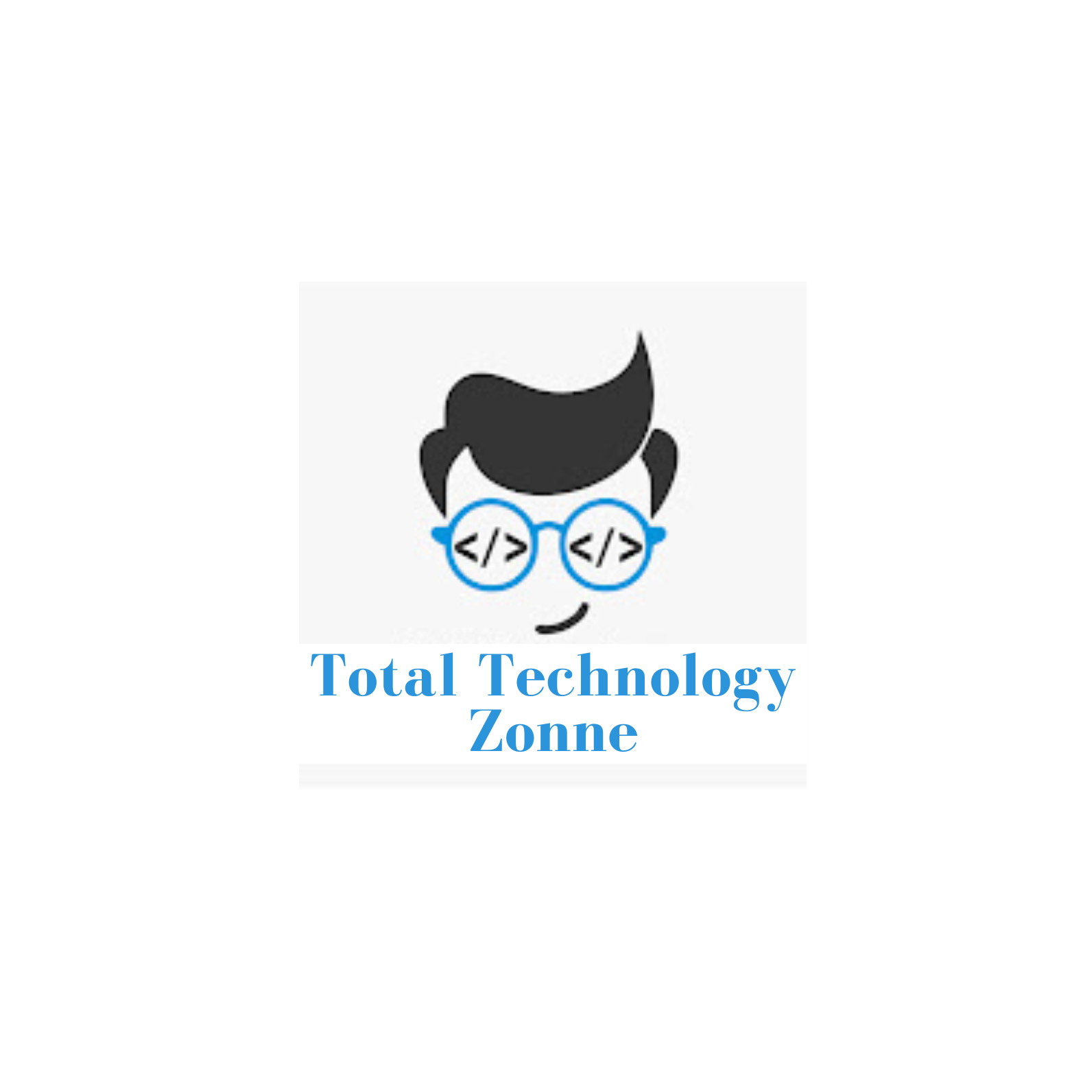
Langchain complete tutorial for beginners
Build Multi Modal RAG APP For Cooking Using Langchain ang OpenAI Vision
TUTORIAL : 34

Slide 2
What is multi-modal
multi-modal LLMs represent an advanced area of AI research focused on creating models that can understand and generate content across different data types(text,video,audio,image), leading to more versatile and human-like AI systems.

Slide 3
Multi modal rag for cooking

