Slide 1
Voice Enabled Web RESEARCH App Using Gpt-4o & Langchain
Tutorial:72

Slide 2
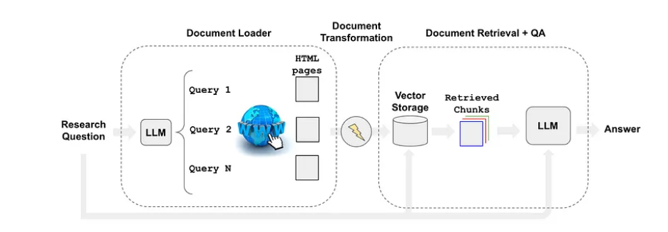
What will be build
diagram

Slide 3
Source code
https://github.com/ronidas39/LLMtutorial/tree/main/tutorial72

