Slide 1


Langchain complete tutorial for beginners
Introduction To Langchain
TUTORIAL : 1

Slide 2
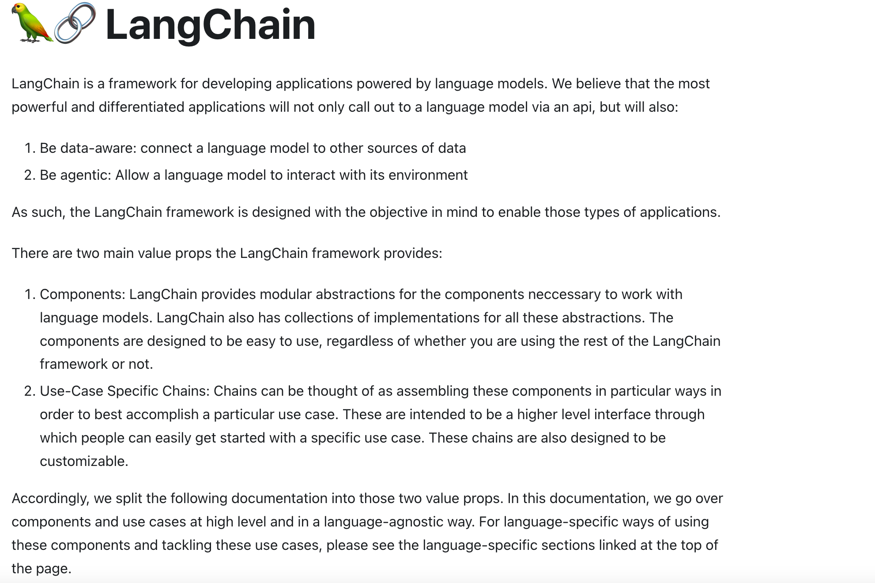
WHAT IS LANGCHAIN https://docs.langchain.com/docs/

Slide 3
Installation and configuration
pip install langchain
pip install openai
Setup openai api key from https://platform.openai.com/account/api-keys

Slide 4
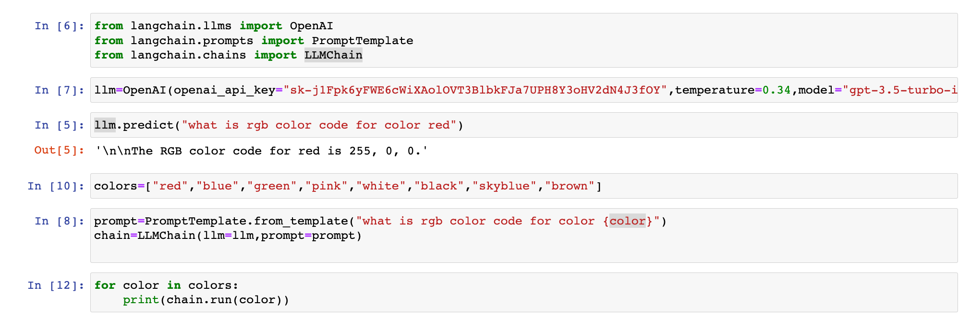
write your first code using Langchain and openai llm

