Slide 1
LangGraph with LangChain
Tutorial:106

Slide 2
Simple use case with langgraph

Slide 3
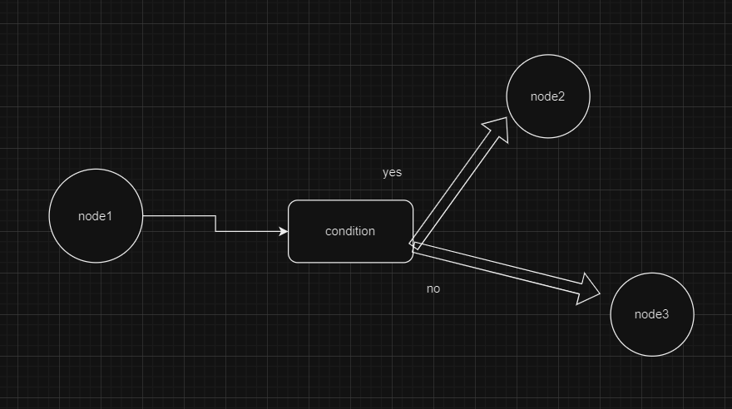
Simple graph

Slide 4
link
https://github.com/ronidas39/LLMtutorial/tree/main/tutorial106

