Slide 1


Langchain complete tutorial for beginners
Build advanced RAG on Ayurvedic medicines using langchain
TUTORIAL : 126

Slide 2
prerequisite
Little web scrapping knowledge

Slide 3
Source code
https://github.com/ronidas39/LLMtutorial/tree/main/tutorial126

Slide 4
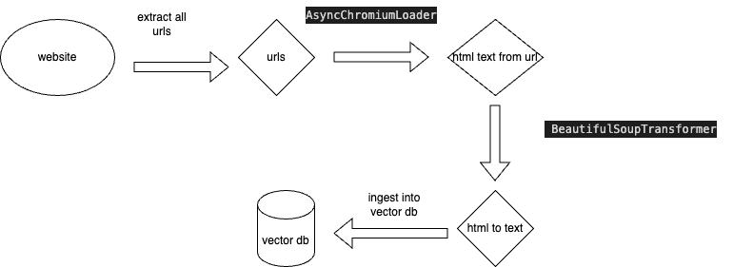
Use case

