Slide 1


Langchain complete tutorial for beginners
Langchain Runnable Deepdive
TUTORIAL : 128

Slide 2
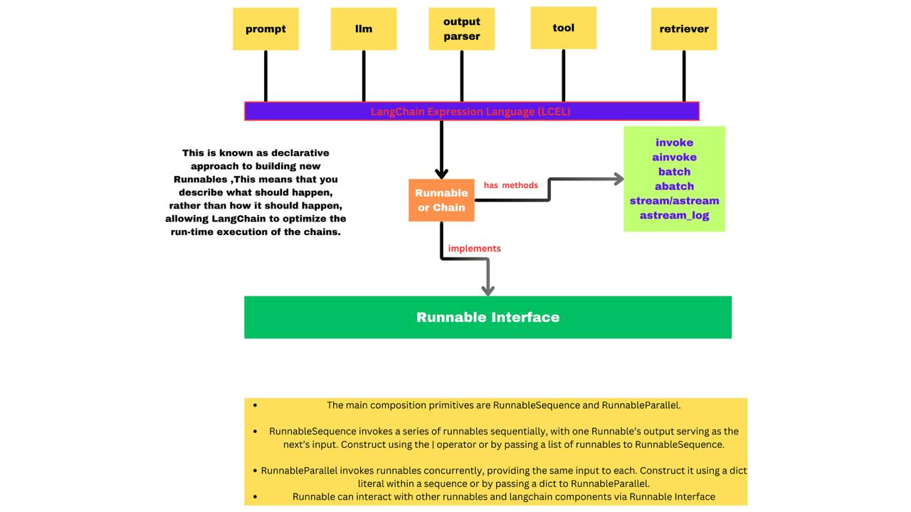

Slide 3
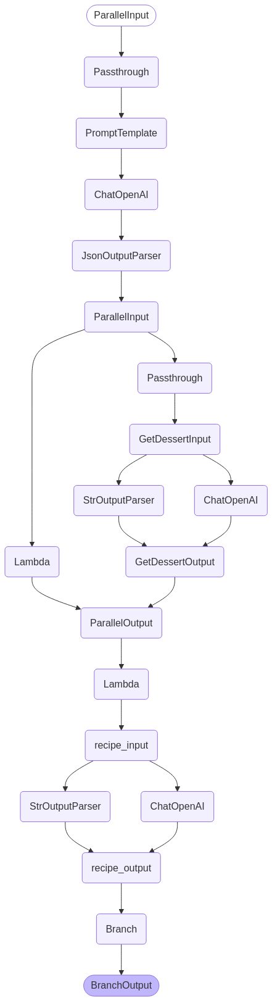
deepdive

Slide 4
Source code
https://github.com/ronidas39/LLMtutorial/tree/main/tutorial128

