Slide 1


Langchain complete tutorial for beginners
Youtube Video Summariser Streamlit App Using Langchain & OpenAI
TUTORIAL : 30

Slide 2
Streamlit app to summarise any youtube video
1.Langchain document loader
2. Openai
3. streamlit

Slide 3
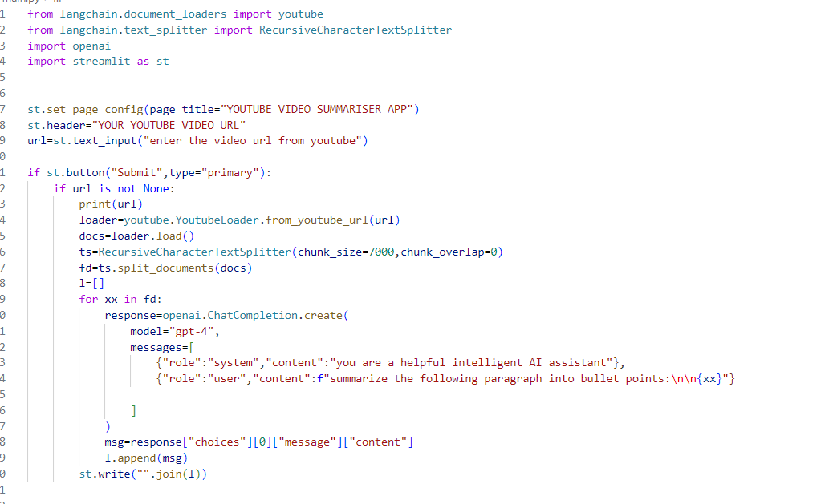
CODE:Streamlit app to summarise any youtube video

Slide 4
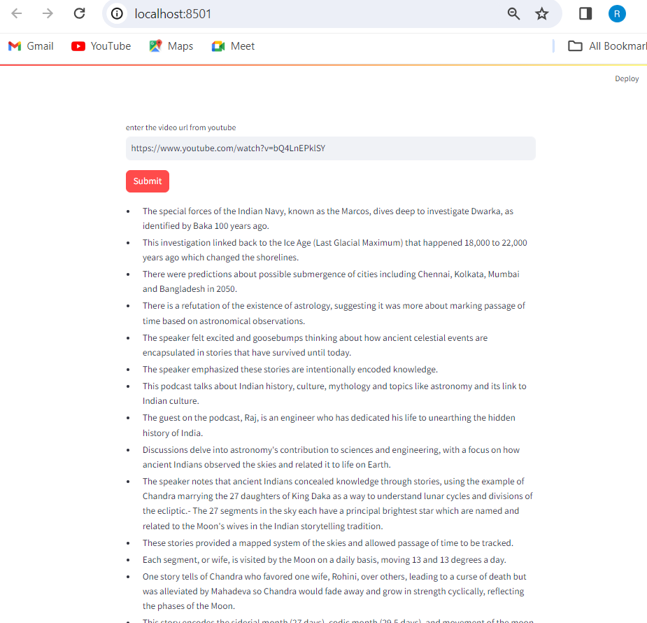
SNAPSHOT:Streamlit app to summarise any youtube video

