Slide 1


Langchain complete tutorial for beginners
Create Custom Tool For Langchain Agent To Perform Crypto Currency Price Analysis
TUTORIAL : 36

Slide 2
What we will do
1. Create a custom tool to call coincap api
2. Parse the api response to get the price of the desired crypto

Slide 3
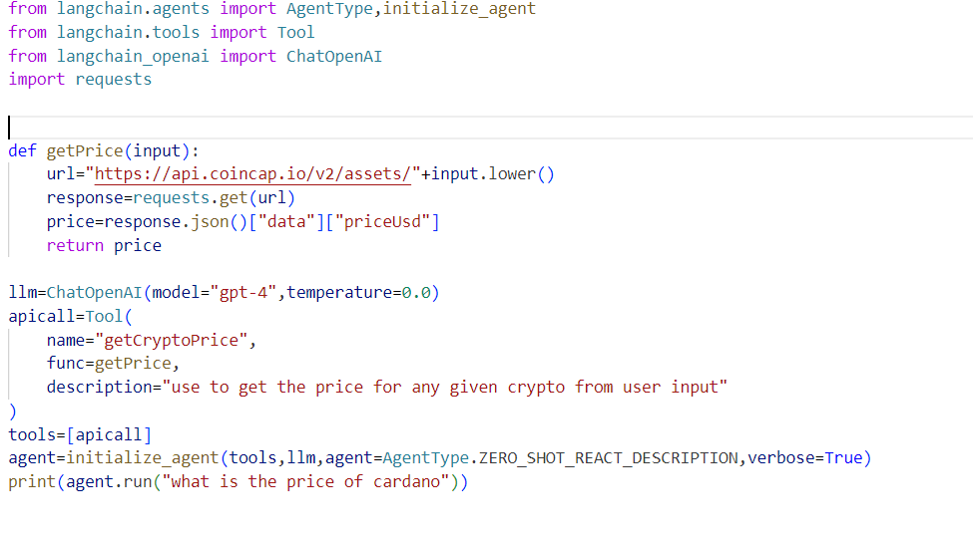
code

