Slide 1
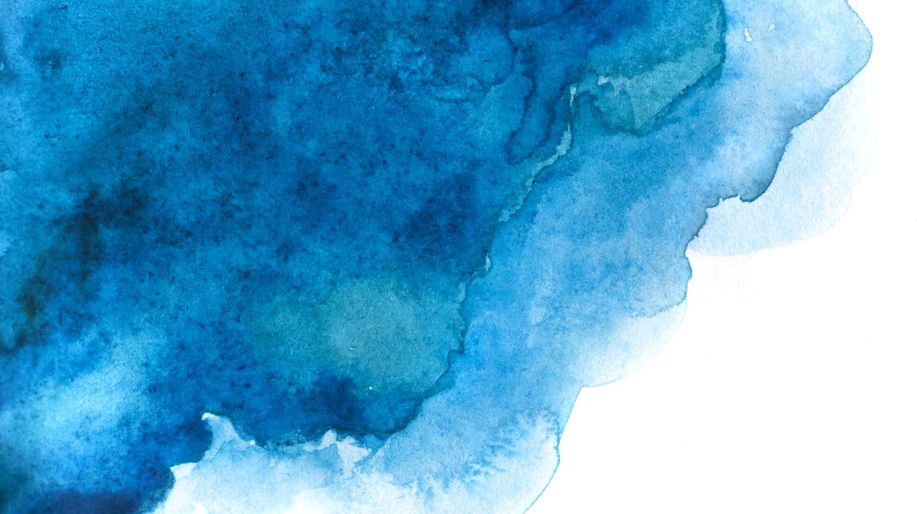

Langchain complete tutorial for beginners
Generate & Display Any Image On Streamlit Ui Using Custom Langchain Tool
TUTORIAL : 37

Slide 2
What we will do
1. Create a custom tool to use dalle-3
2. Parse the url from dalle-3 response
3.Generate image to display on streamlit

Slide 3
code
https://github.com/ronidas39/LLMtutorial/tree/main/tutorial37

