Slide 1
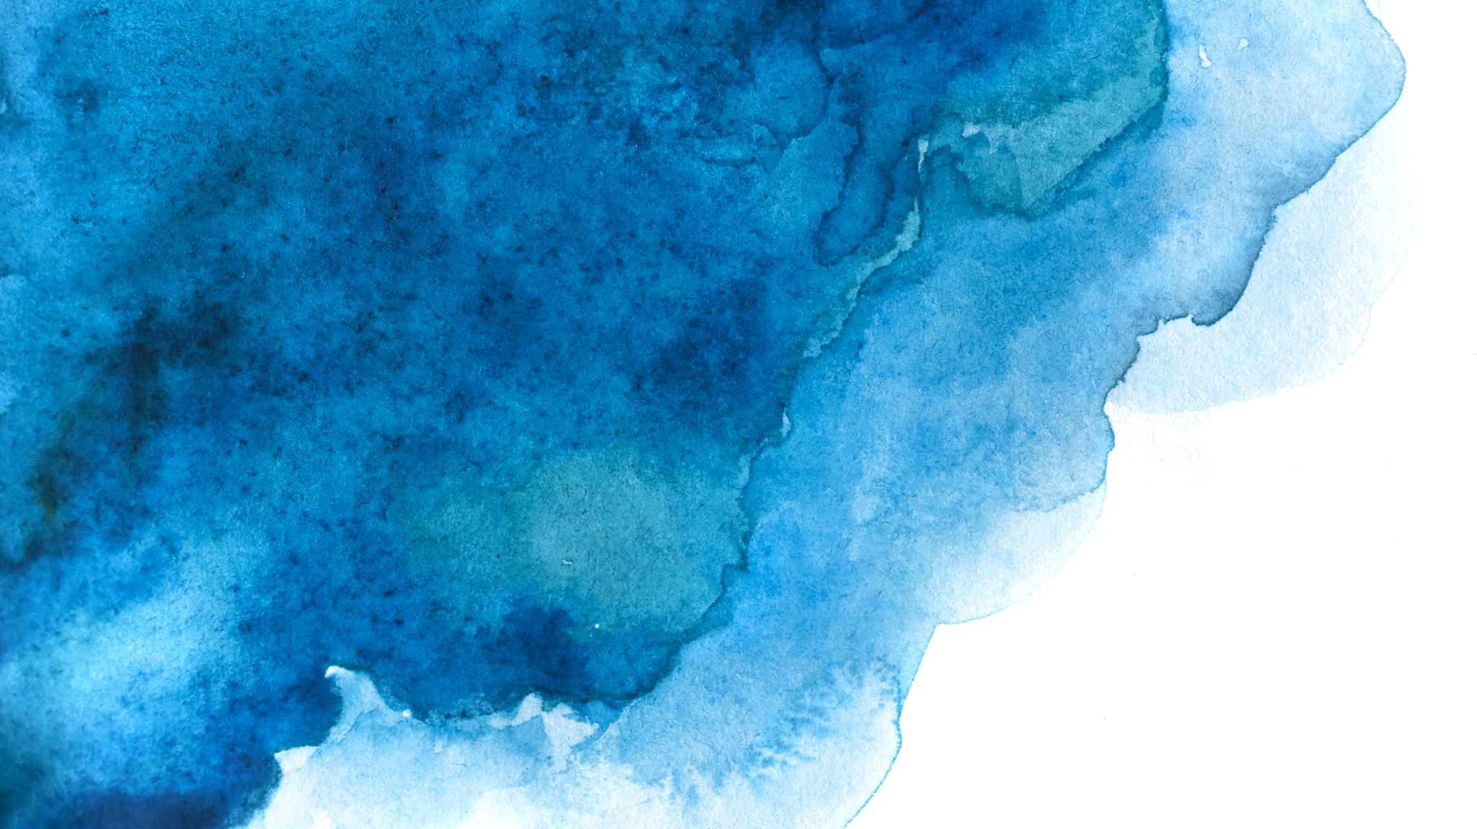

Langchain complete tutorial for beginners
Download Images with google search using langchain and opeai
=================
Tutorial:59

Slide 2
What we will do
We will using langchain utilities to search using Google Images
Generate image urls from search results
Download images from the response url

Slide 3
code
https://github.com/ronidas39/LLMtutorial/tree/main/tutorial59

