Slide 1
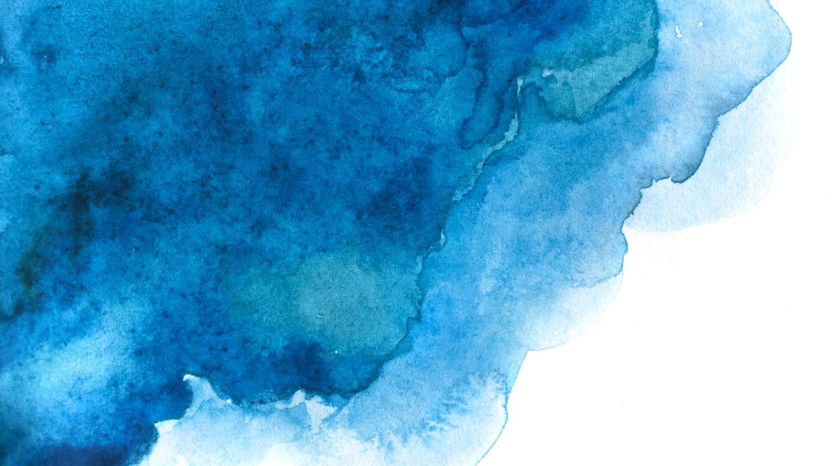

Langchain complete tutorial for beginners
Create Mermaid diagrams using langchain & openai =================
Tutorial:61

Slide 2
What we will do
Mermaid diagrams using langchain & openai

Slide 3
code
https://github.com/ronidas39/LLMtutorial/tree/main/tutorial61

