Slide 1
chat app from YouTube video using LangChain & gpt-4o
Tutorial:97

Slide 2
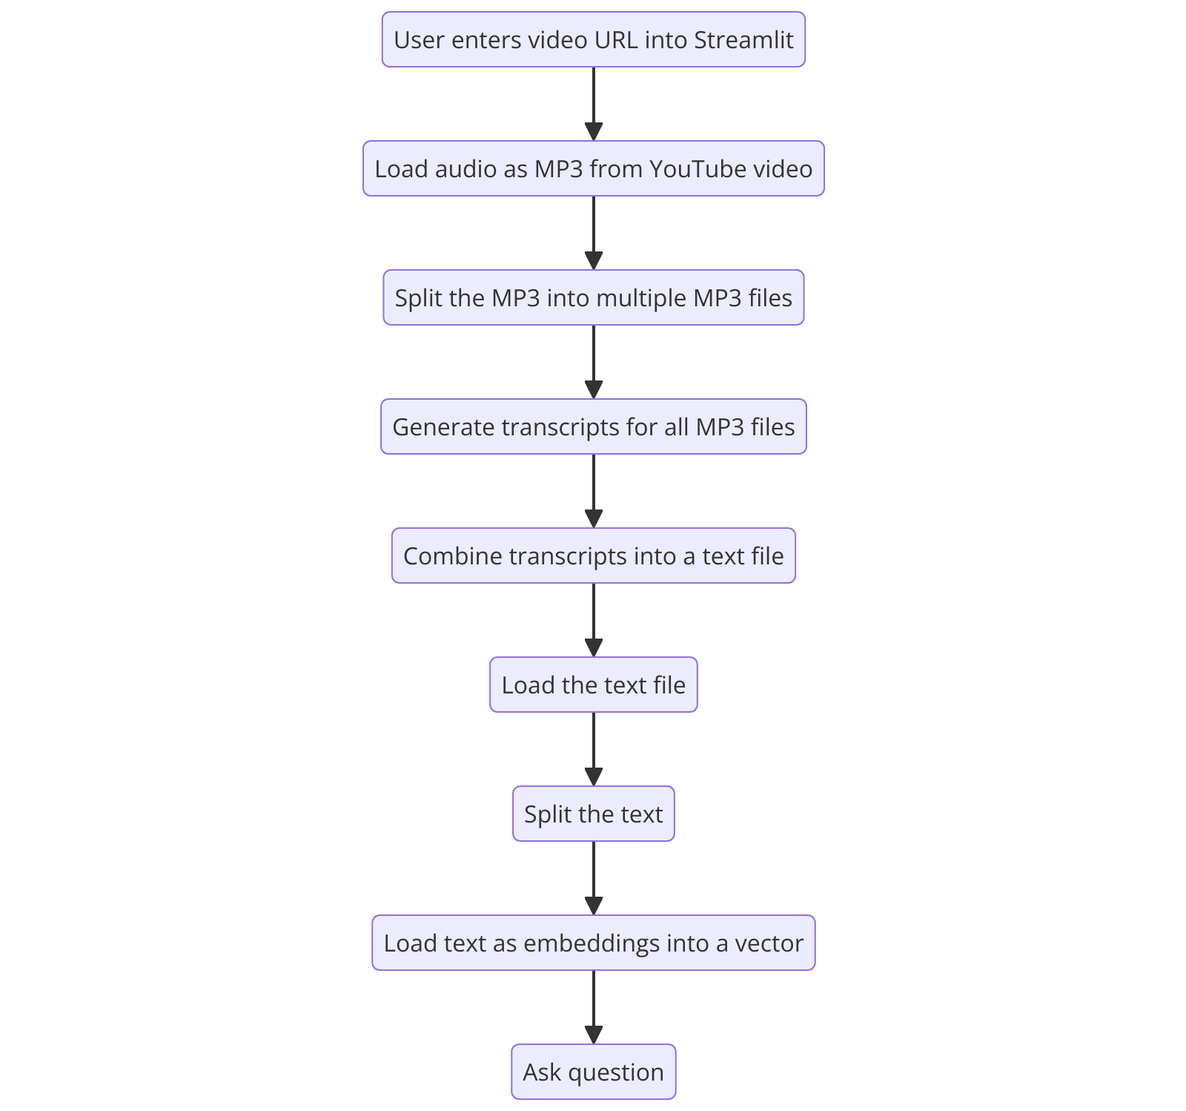
What we will do today ?

Slide 3
link
https://github.com/ronidas39/LLMtutorial/tree/main/tutorial97

