Slide 1

Iowa Distribution - Competitive Position, Risk Assessment & Growth Opportunity
By : Sultan Simsek

Slide 2
Scenario
I was hired as a data analyst consultant by Sazerac to evaluate their market performance across 99 counties of Iowa state.
The objective was to conduct a SWOT analysis using records from 2014 on sales, store distribution, and demographic data to identify growth opportunities, operational inefficiencies, and competitive positioning.

Slide 3
Data Summary
#2
In the market
%68
Of market in leading category
3rd
In number of stores across state

Slide 4
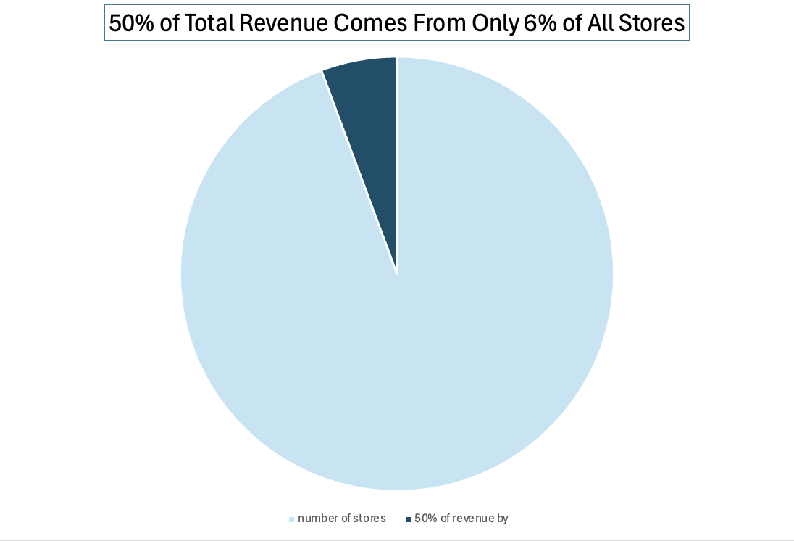
Strength:

Slide 5
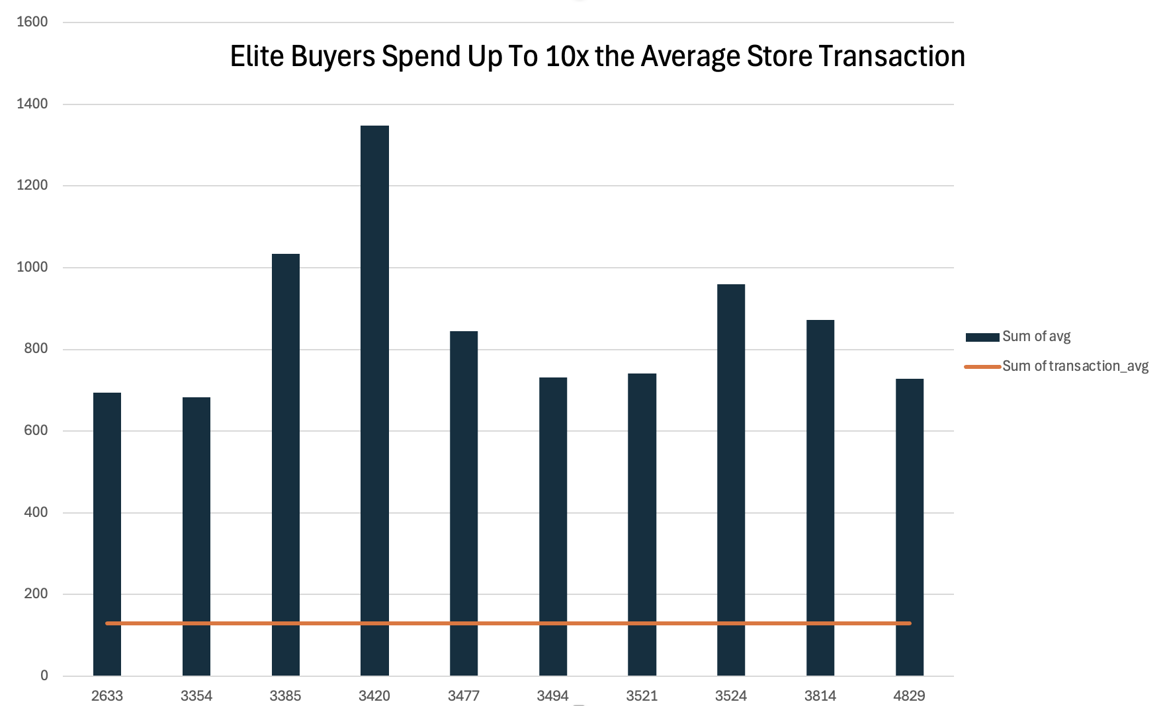
Strength 2:

Slide 6
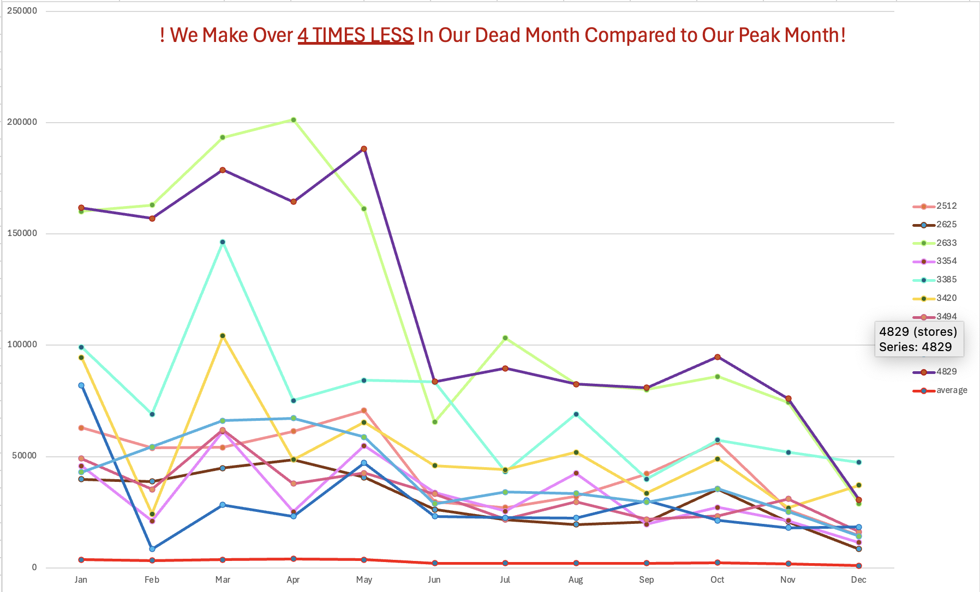
Weakness:

Slide 7
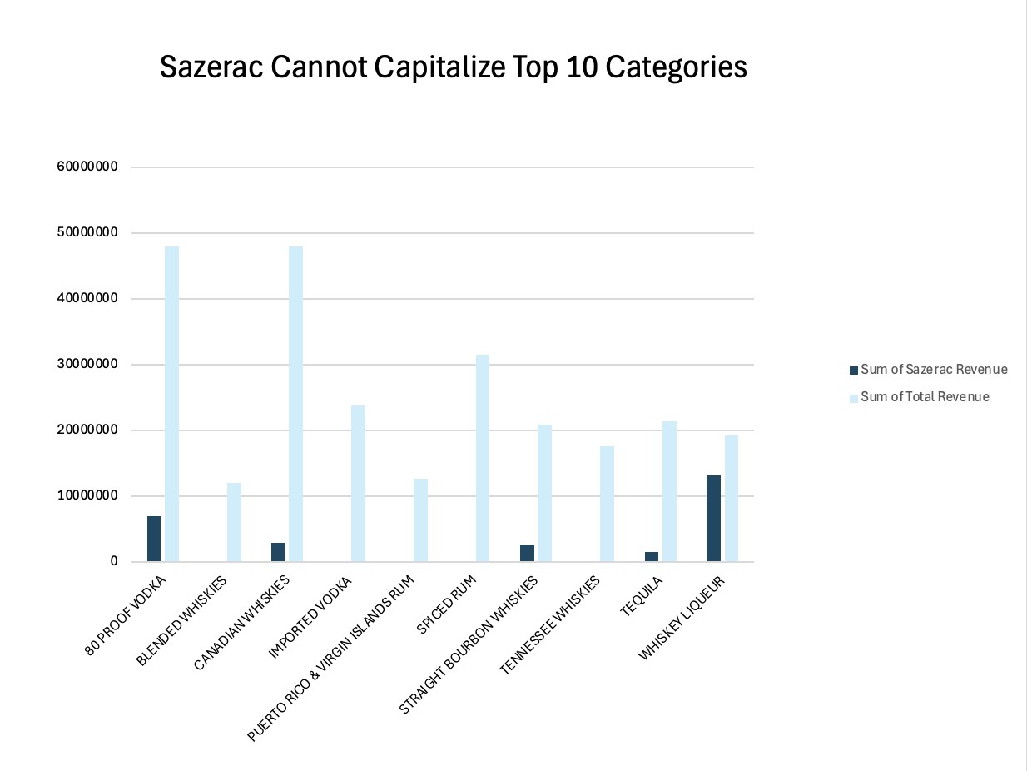
Weakness 2:

Slide 8
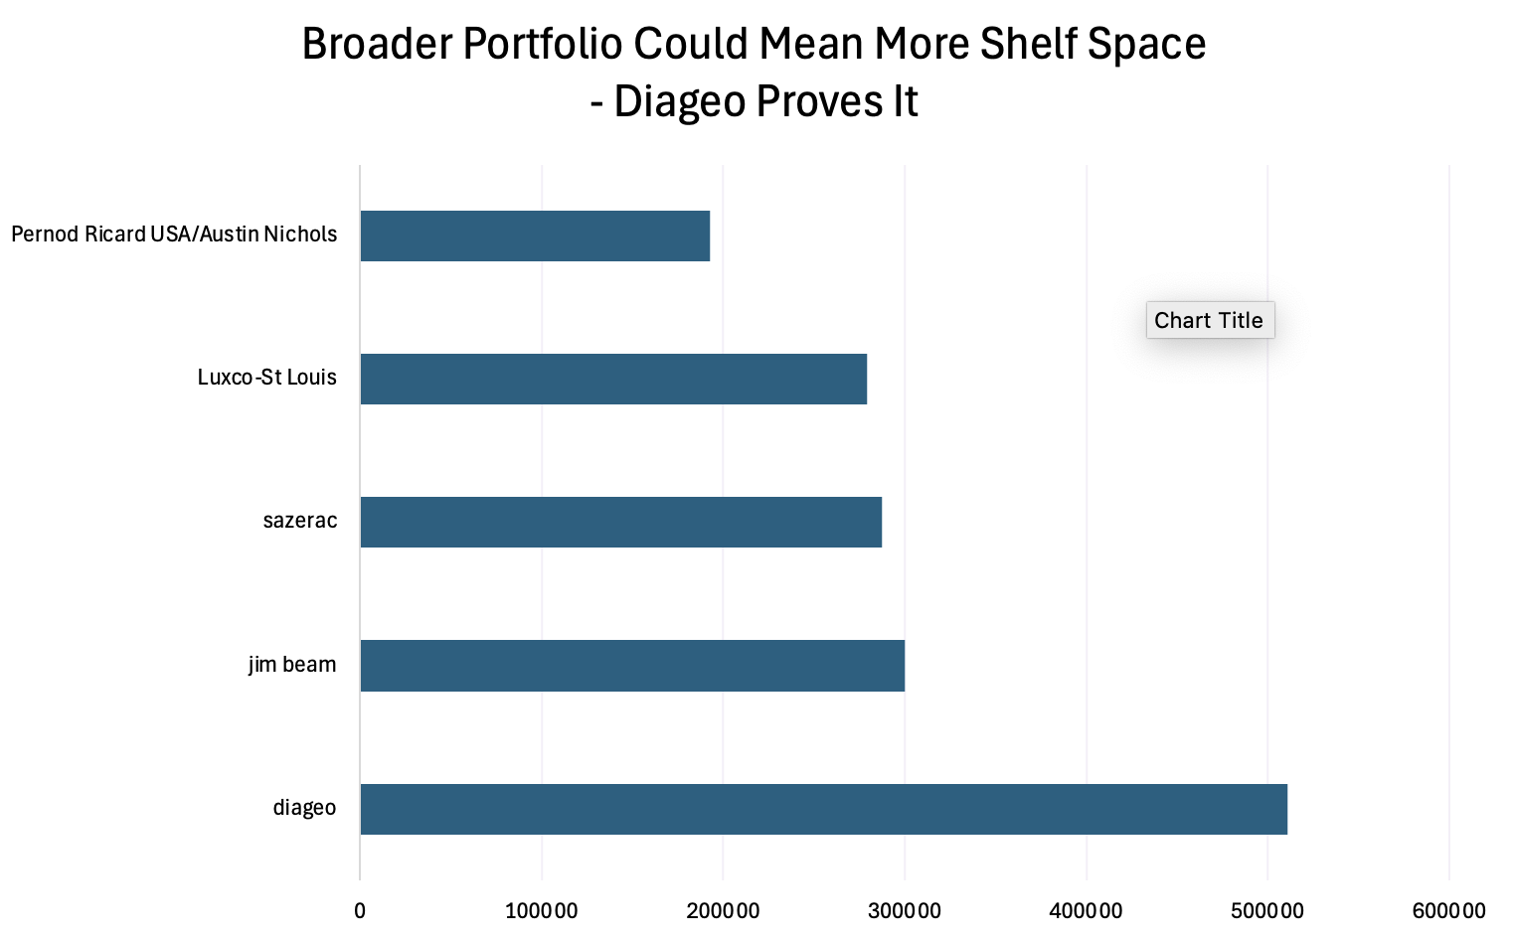
Opportunity:

Slide 9
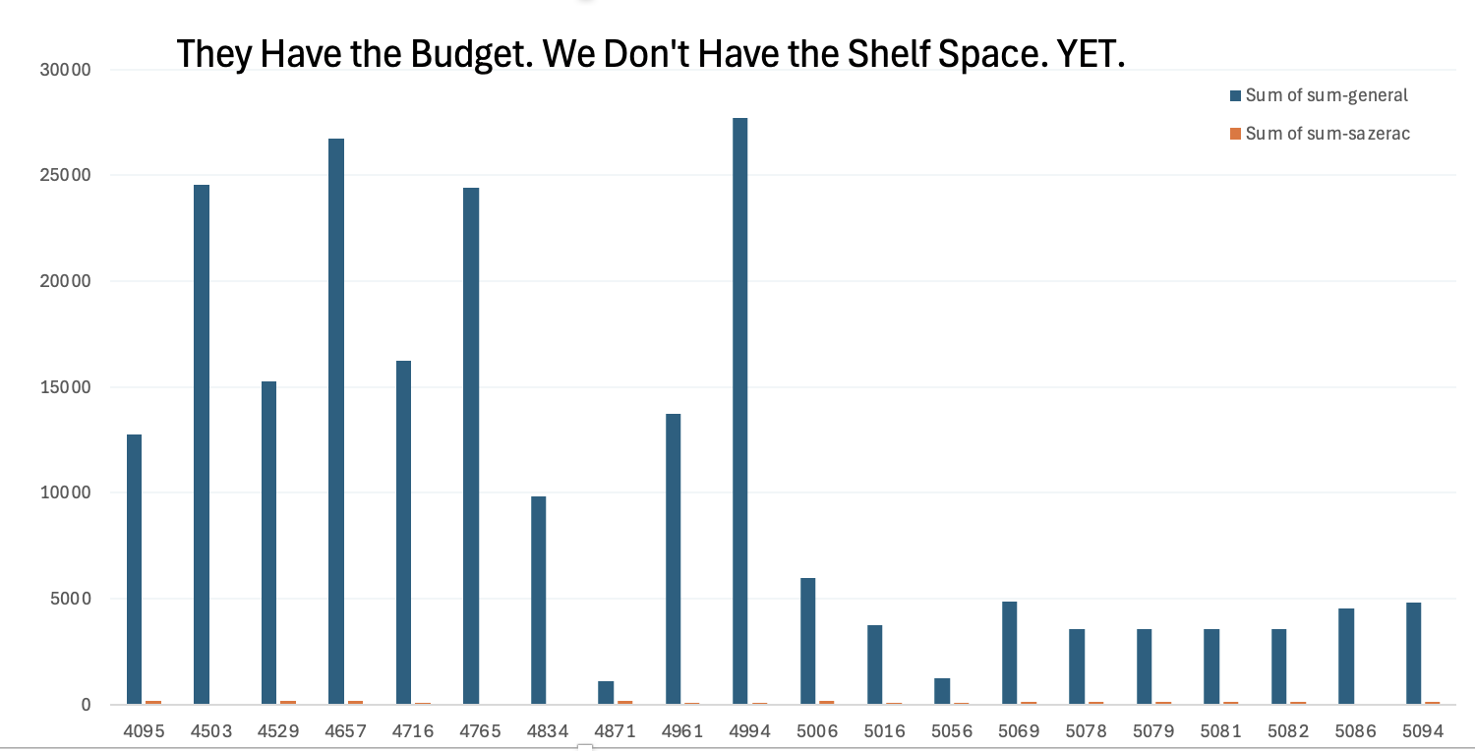
Opportunity 2:

Slide 10
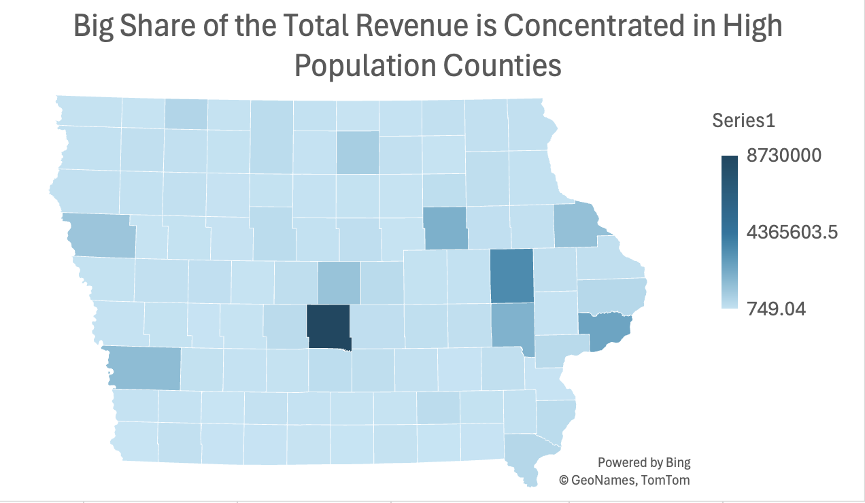
Threat:

Slide 11
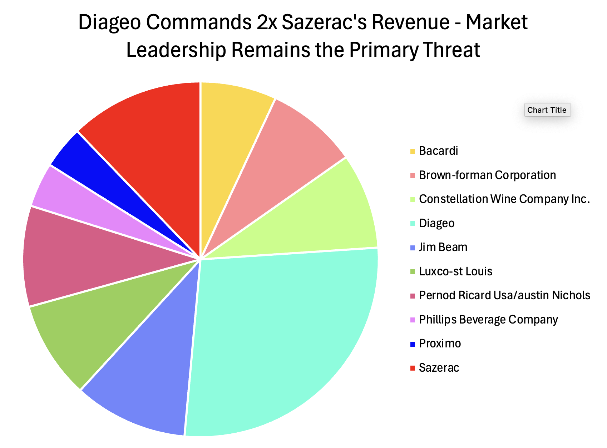
Threat 2:

Slide 12
Summary/ Recommendations
Do not start over.
Build on the relationships.
Enter 2 or 3 new categories.
Convert high-budget stores.

