Slide 1

POWERFUL
PRESENTATIONS!
tips & tricks
Notes:
To use this title animation slide with a new image simply 1) move the top semi-transparent shape to the side, 2) delete placeholder image,
3) click on the picture icon to add a new picture, 4) Move semi-transparent shape back to original position, 5) Update text on slide.

Slide 2
OUTLINES
Cover Letter
Results & Analytics
Reviews
Order Proof
Contact Information

Slide 3
Cover Letter
How are you doing? *** is my given name. An expert in Facebook and Instagram advertising. I've spent years aiding startups and companies in boosting their revenue with Facebook Ads.
If you're trying to develop your company using Facebook and Instagram advertisements, or if you're currently dealing with Facebook advertising and need help, you've come to the perfect spot. I Am Well-versed in the Secrets of High-Converting Funnels, from attracting a highly focused and relevant audience to improving CTR, User Flow, and Consumer Behavior, all of which contribute to a cheap cost per result and a higher return on investment (Return on Ad Spend). I'm pretty interested in running Facebook Ads and increasing your company's income, so let's get started.
If you hire me to advertise your company, I guarantee that I will provide the highest possible level of service and return on your investment via my marketing plan. How did you come to consider employing me? 1. I previously worked as a marketing manager for Facebook and Instagram. 2. I've been recognized as a Fiverr level 1 vendor (https://www.fiverr.com/). 3. I am capable of assisting your customers with the most difficult components of Facebook advertising, such as "pixel setup, conversion tracking, landing page tracking, retargeting, remarketing, custom audience, and email list management." 4. If you are really convinced of my abilities, kindly contact me to schedule an interview.

Slide 4
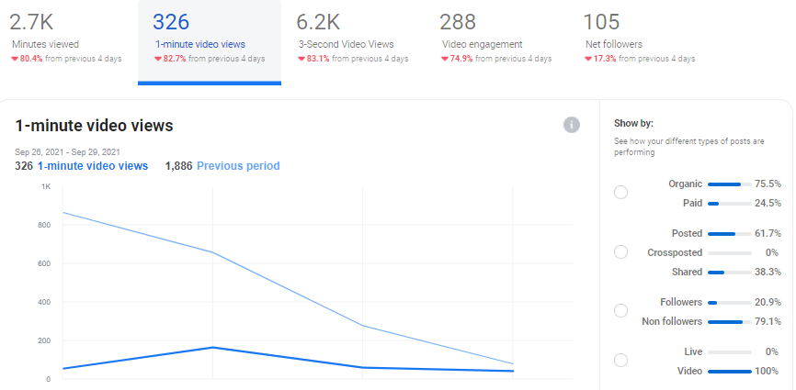
Results

Slide 5
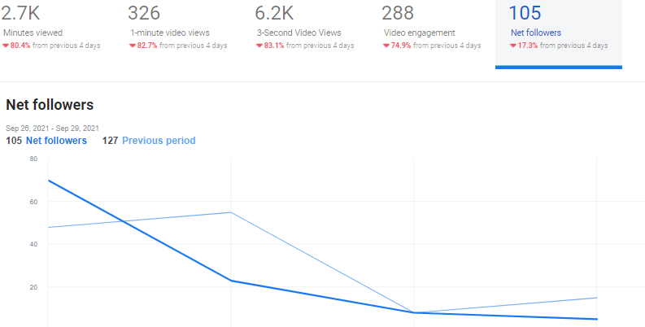
Results

Slide 6
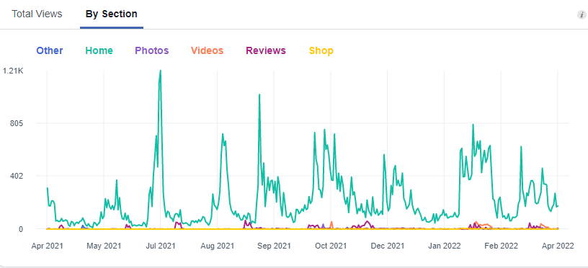
Results

Slide 7
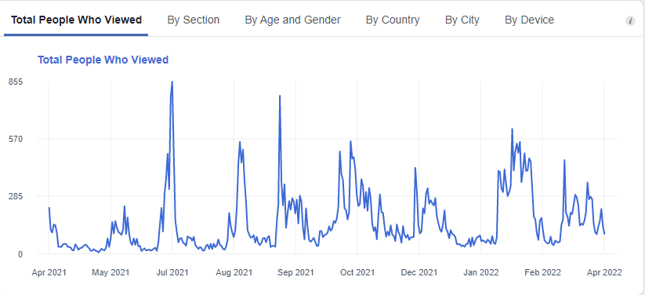
Results

Slide 8
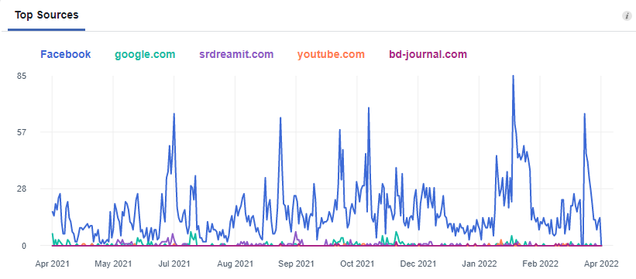
Results

Slide 9
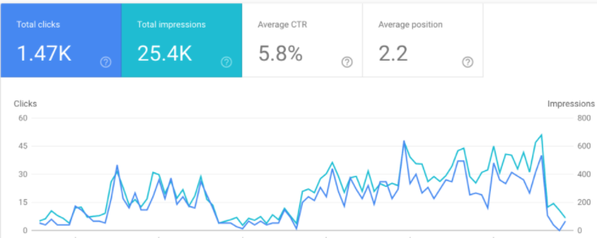
Results

Slide 10
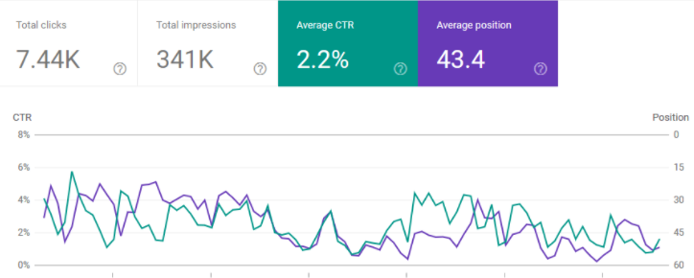
Results

Slide 11
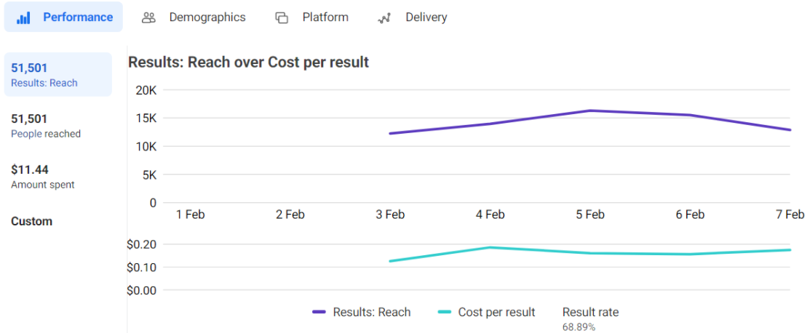
Results

Slide 12
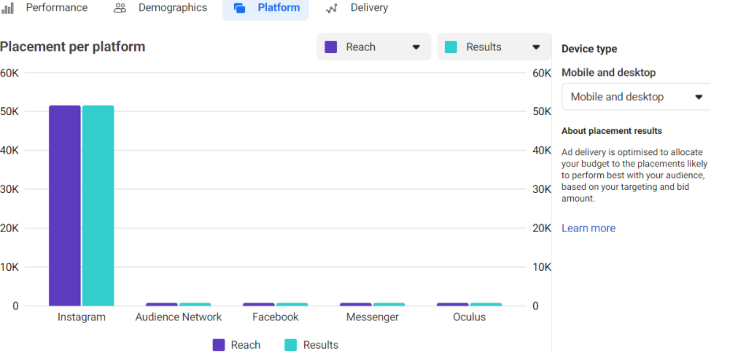
Results

Slide 13
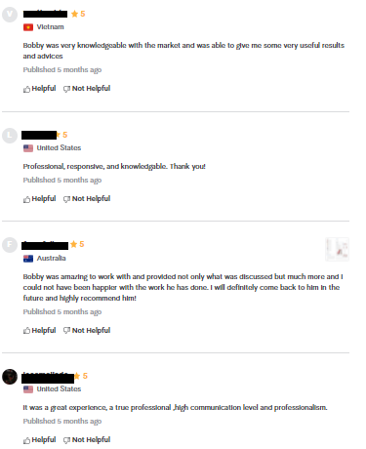
Reviews

Slide 14
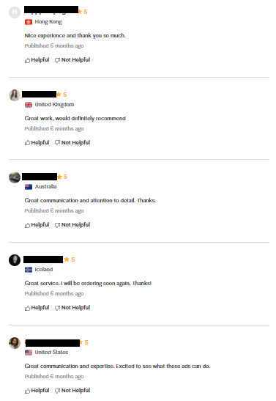
Reviews

Slide 15
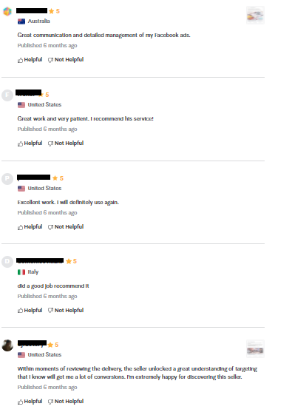
Reviews

Slide 16
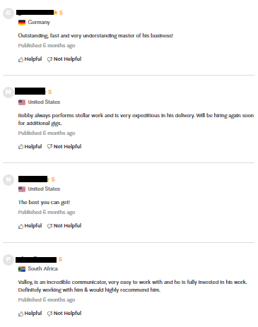
Reviews

Slide 17
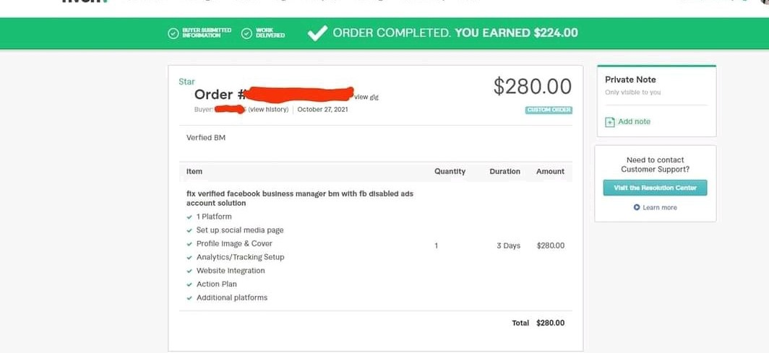
Order Proof
Notes:
Tip:
When using complex image as full-bleed background add a transparency (70%-90%) fill layer to give contrast to text.

Slide 18
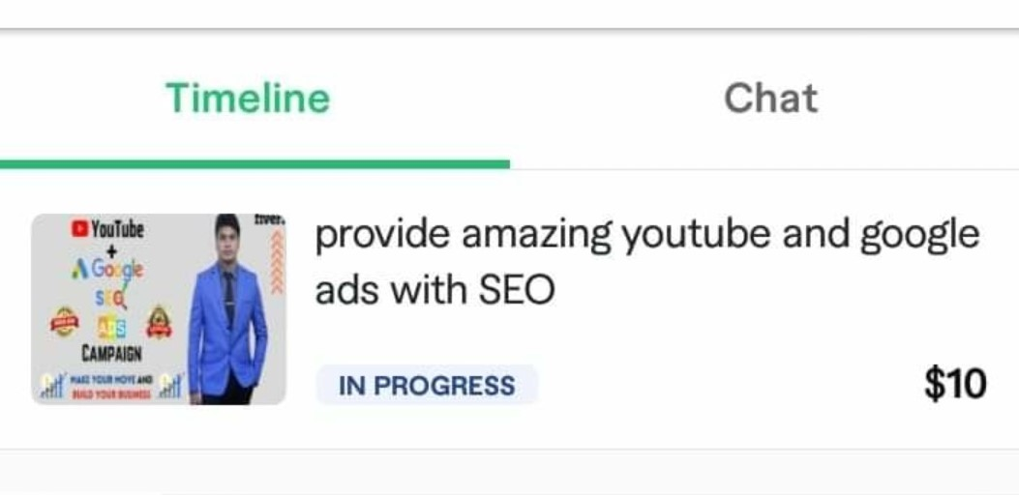
Order Proof
Notes:
Tip:
When using complex image as full-bleed background add a transparency (70%-90%) fill layer to give contrast to text.

Slide 19
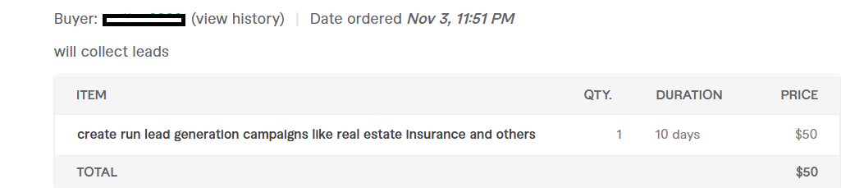
Order Proof
Notes:
Tip:
When using complex image as full-bleed background add a transparency (70%-90%) fill layer to give contrast to text.

Slide 20
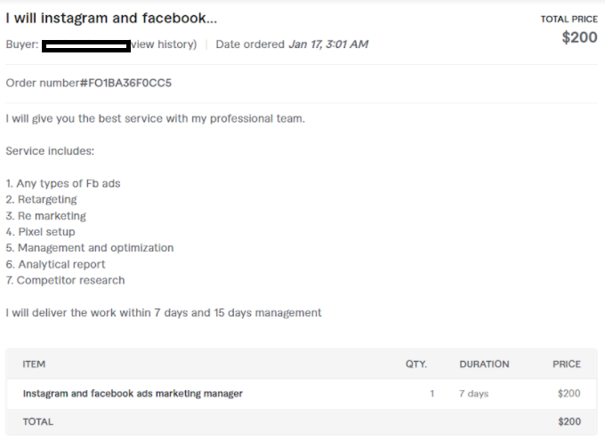
Order Proof
Notes:
Tip:
When using complex image as full-bleed background add a transparency (70%-90%) fill layer to give contrast to text.

Slide 21
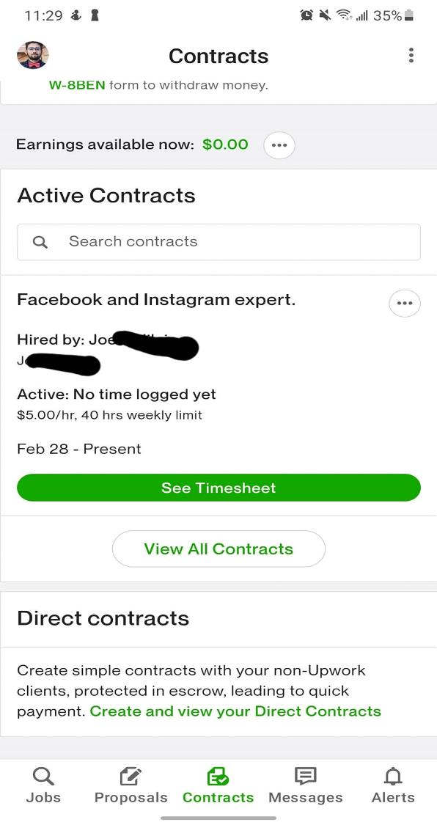
Order Proof
Notes:
Tip:
When using complex image as full-bleed background add a transparency (70%-90%) fill layer to give contrast to text.

Slide 22
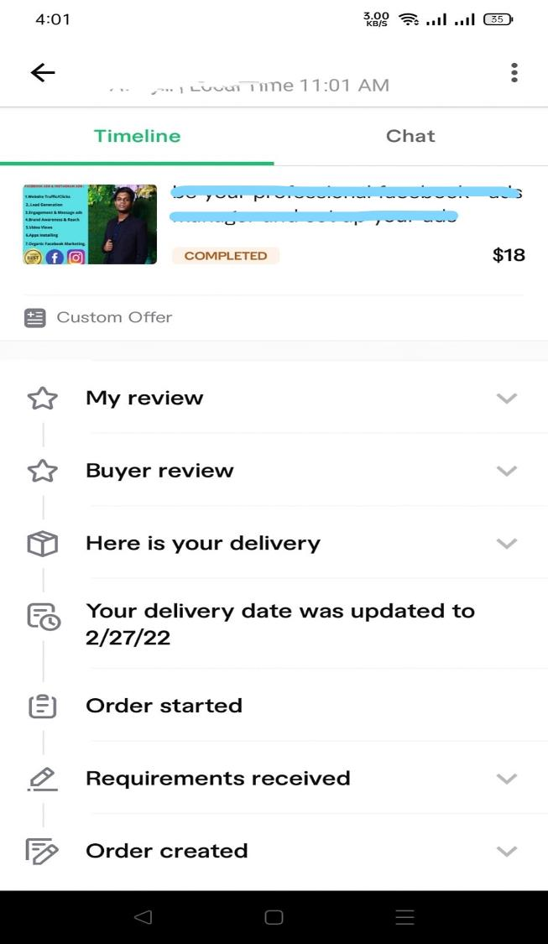
Order Proof
Notes:
Tip:
When using complex image as full-bleed background add a transparency (70%-90%) fill layer to give contrast to text.

Slide 23

Contact

