Slide 1
PITCH DECK
Mirjam Nilsson

Slide 2
oUTLINE
Cover Letter
Results & Analytics
Reviews
Order Proof
Contact Information

Slide 3
Cover letter
Hello
You should look for a Marketer with substantial experience. As a consequence, you've come to the right place! I am a skilled digital marketer with over four years of experience who is seeking for new chances. Everything I've seen has been great, and I'd love to assist you in growing your business and revenue through Facebook and Instagram marketing! I'll investigate your previous activity and conduct a complete audit of your ad account to help me find possible areas for improvement.
As a professional Virtual Assistant, I've worked on a wide range of corporate projects as well as various local client projects, some of which I've included in the portfolio's latter parts. I was in charge of all social media channels in such ventures. Based on the available budget, I designed a thorough marketing approach. In my marketing plan, one thing is certain: "minimum investment, maximum reward." I've been pretty effective at freelancing in my 5 years of experience; some of my sample outcomes may be found in the portfolio's latter part. I've also finished content design, writing, SEO, and other projects that were assigned to me.
I will handle all of your marketing chores with the highest care and skill. What motivates you to work with me? 1. I've spent a substantial amount of time as a Facebook and Instagram marketing manager. Second, I am now a level 1 seller on fiverr.com (https://www.fiverr.com/). 3. I can help your clients with their most difficult Facebook advertising problems, such as "pixel setup, conversion, landing page tracking+retargeting+remarketing+custom audience+email listing duties" and "pixel setup, conversion, landing page tracking+retargeting+remarketing+custom audience+email listing duties." 4. You may seek an interview with me if you are completely confident in my ability.

Slide 4
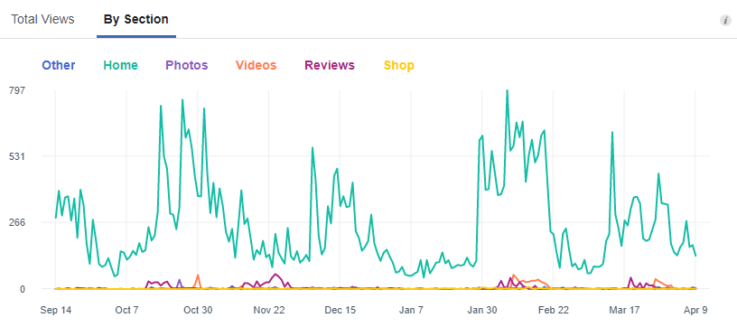
rESULTS

Slide 5
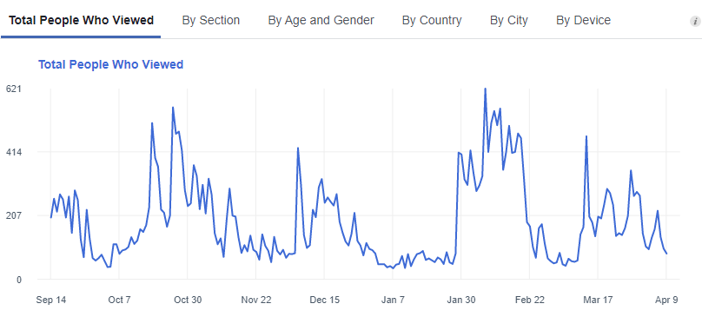
rESULTS

Slide 6
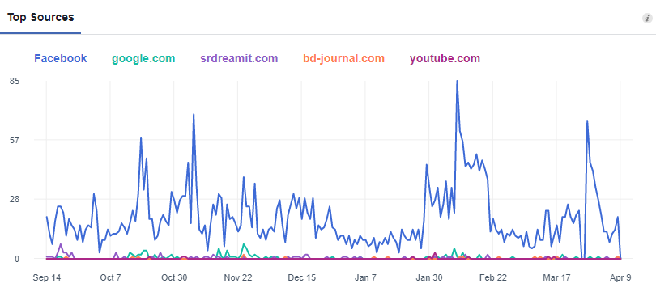
rESULTS

Slide 7
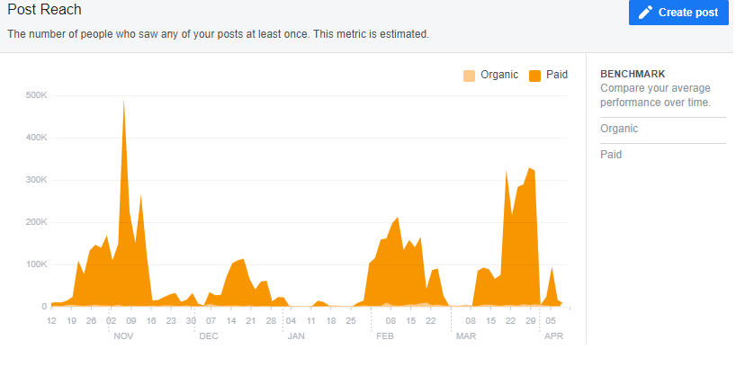
rESULTS

Slide 8
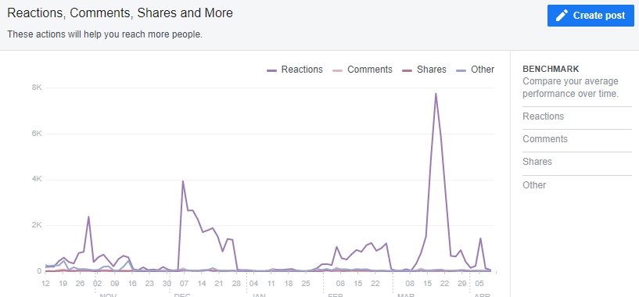
rESULTS

Slide 9
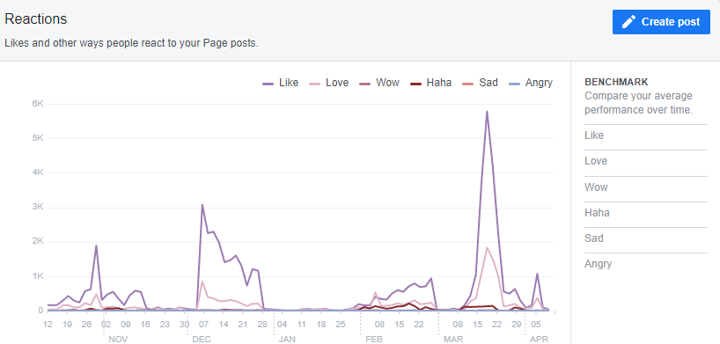
rESULTS

Slide 10
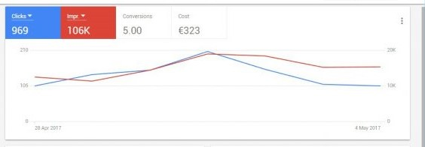
rESULTS

Slide 11
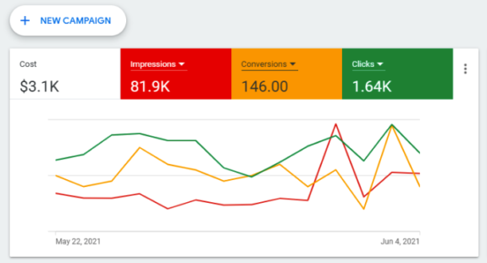
rESULTS

Slide 12
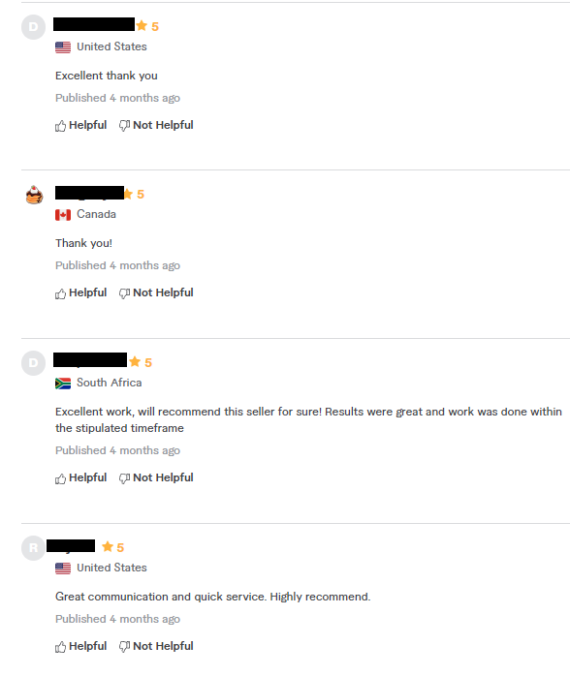
reviews

Slide 13
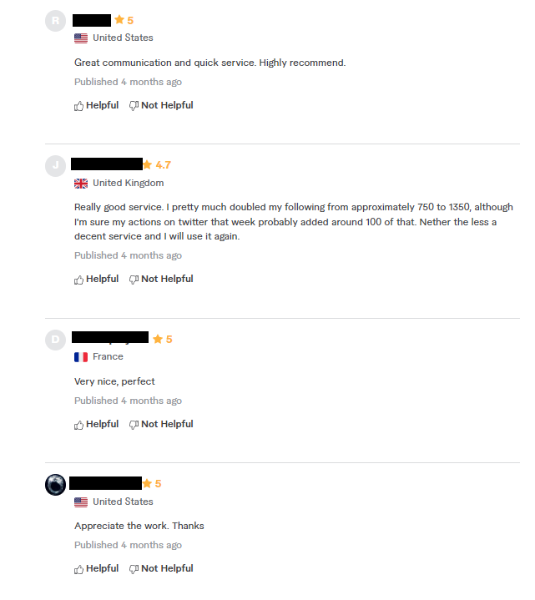
reviews

Slide 14
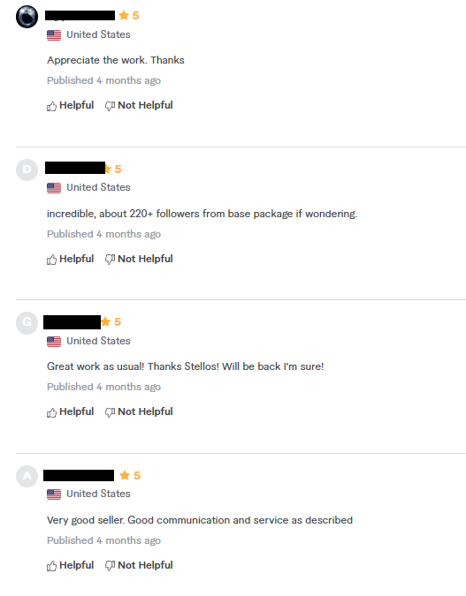
reviews

Slide 15
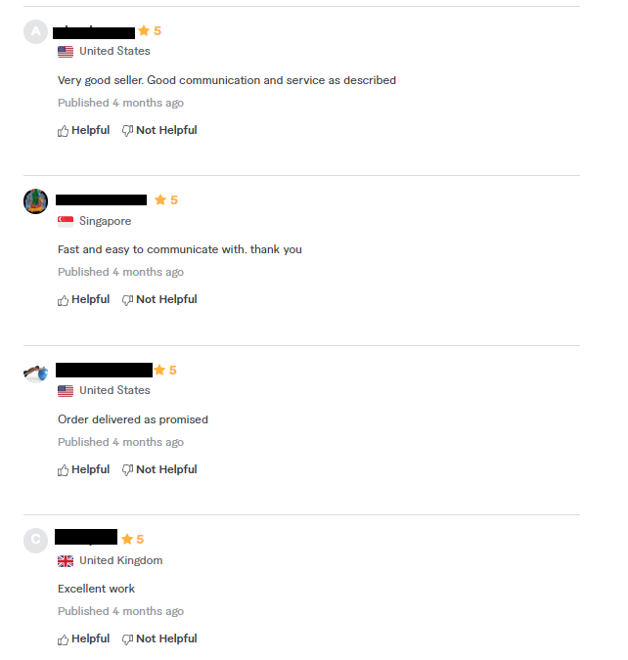
reviews

Slide 16
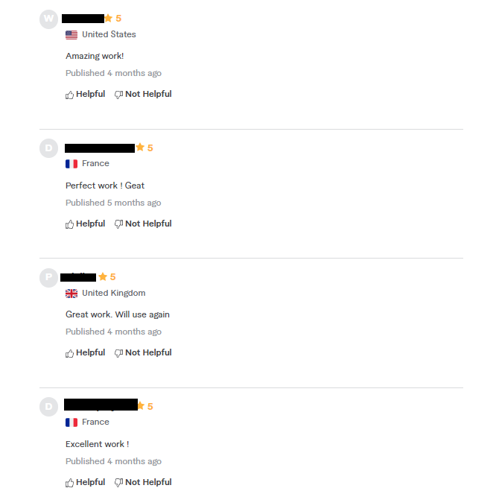
reviews

Slide 17
reviews

Slide 18
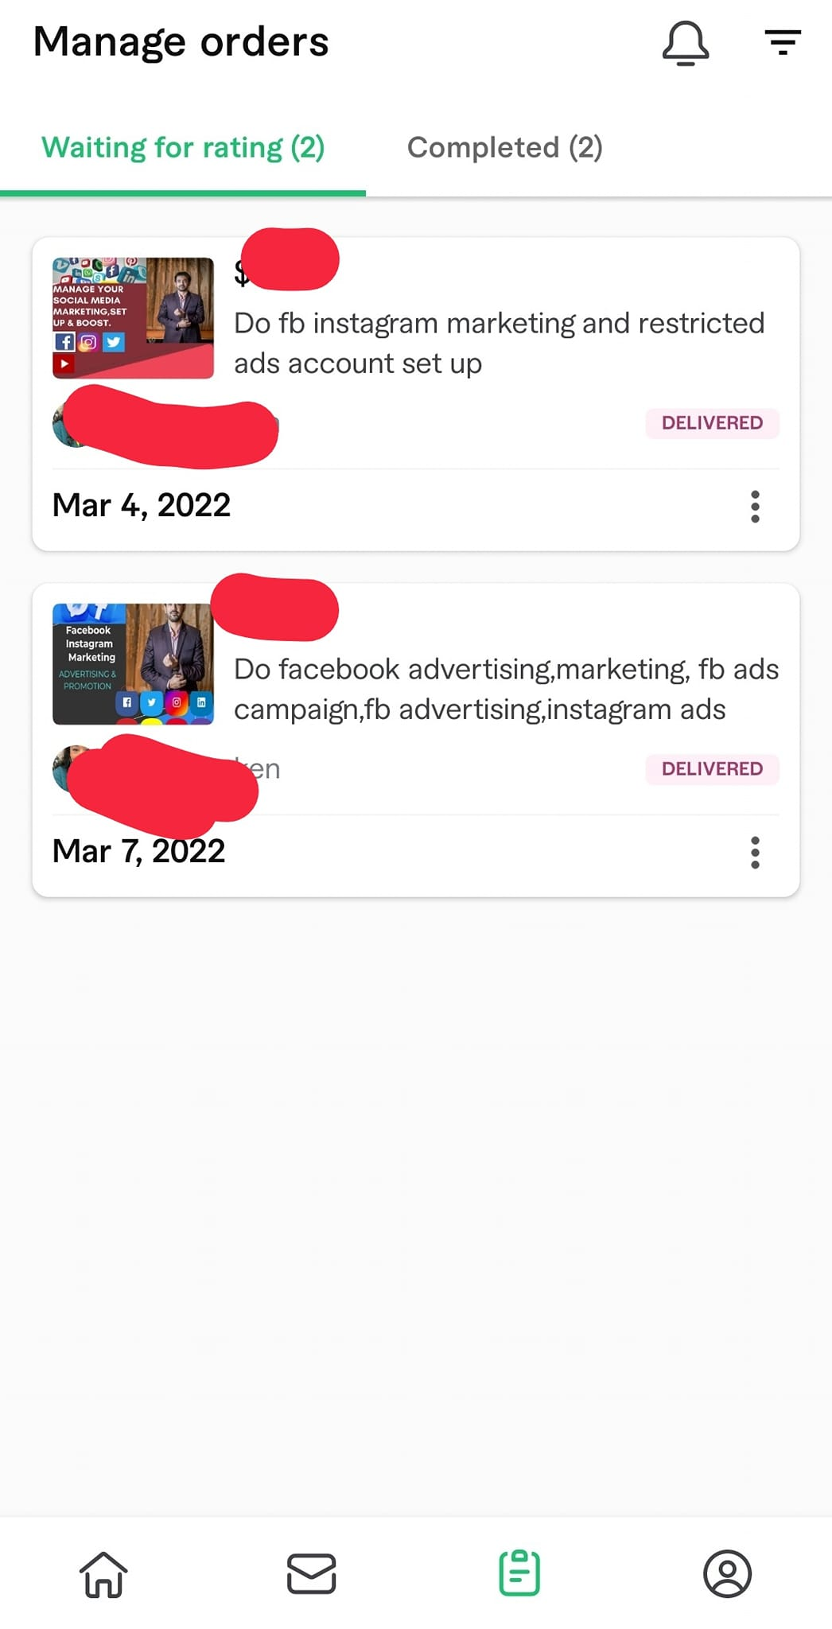
Order proof

Slide 19
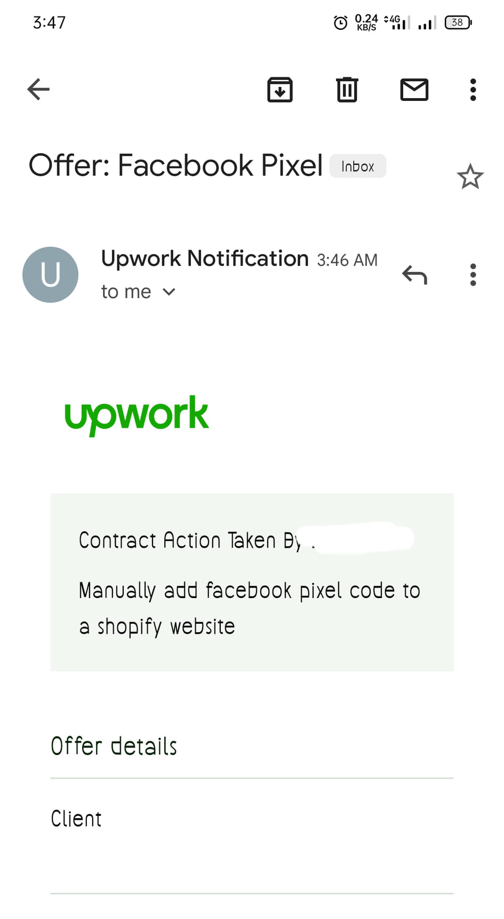
Order proof

Slide 20
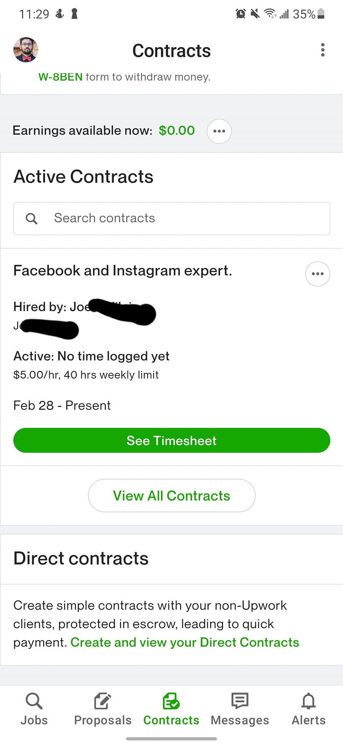
Order proof

Slide 21
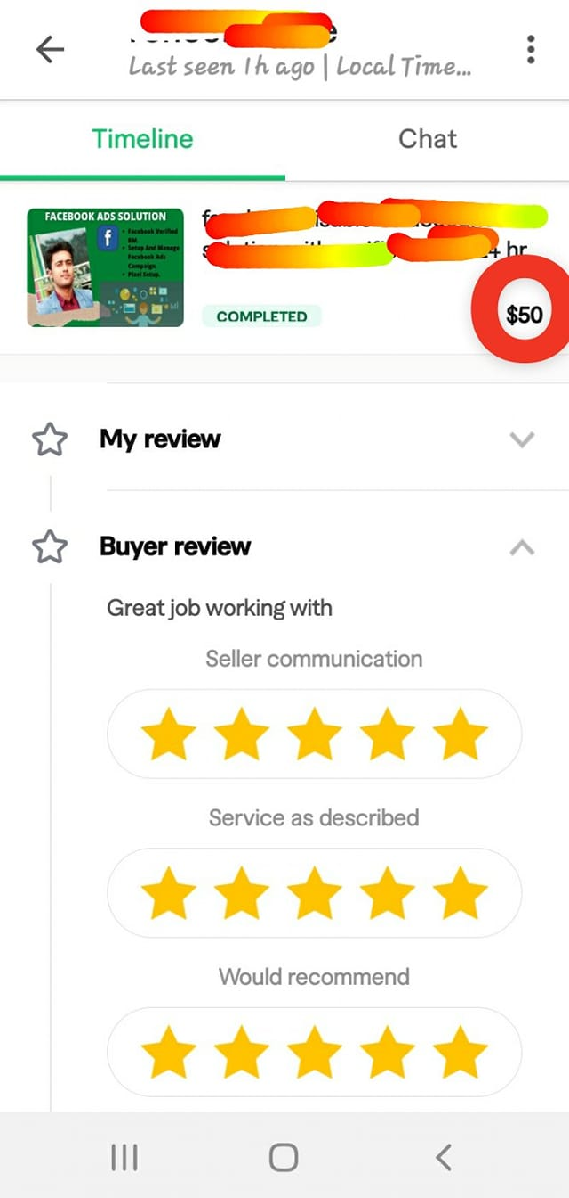
Order proof

Slide 22
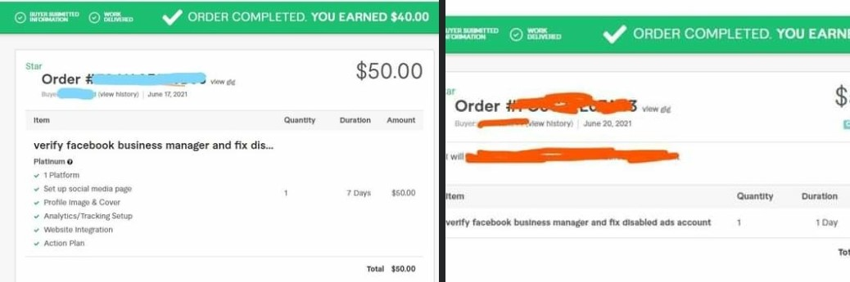
Order proof

Slide 23
THANK YOU
Mirjam Nilsson​
206-555-0146
mirjam@contoso.com
www.contoso.com

