Slide 1


PORTFOLIO PRESENTATION
Tipu Sultan
AI-Driven & Data-Driven Growth Architect
Verified Architect
Riyadh, KSA • Paid Acquisition & AI Marketing
sultantipu199.github.io/sultan-growth
Tipu Sultan — AI-Driven & Data-Driven Growth Architect
01 / 22
Notes:
Welcome everyone. This deck is a full offline mirror of my live portfolio at sultantipu199.github.io/sultan-growth. I'm Tipu Sultan, an AI and data-driven growth architect based in Riyadh, and over the next twenty-plus slides I'll walk you through the exact architecture I use to turn ad spend into predictable revenue.

Slide 2
Scale Predictable Revenue with
AI-Driven & Data-Engineered Ad Architecture
I architect full-funnel paid media campaigns powered by Meta Advantage+ AI, Google Smart Bidding, Server-Side CAPI tracking, and Predictive Algorithmic Creative Testing — turning erratic ad spend into measurable, scalable pipeline revenue.
MANAGED SPEND
TRACKED REVENUE
BLENDED ROAS
VERIFIED PROOFS
$188K+
$869K+
4.6x
56+
Across Verified Accounts
Attributed Purchases
Average Multiplier
Screenshots & Case Studies
AI & Data Engine
02 / 22
Notes:
The headline numbers: I've managed over 188 thousand dollars in verified ad spend and tracked more than 869 thousand dollars in attributed purchases, at a blended 4.6x ROAS — backed by 56-plus screenshot-verified proofs. The promise of this whole deck is in one line: turning erratic ad spend into measurable, scalable pipeline revenue.

Slide 3
NEXT-GEN PERFORMANCE ARCHITECTURE
AI-Driven & Data-Engineered Acquisition Engine
Meta Advantage+ ASC
Google Smart Bidding
Server-Side CAPI
Unit Economics / LTV
Moving beyond obsolete manual audience guessing into algorithm-led performance scaling. Leveraging machine learning bidding models, first-party server signals, and automated creative testing matrices.
Predictive AI Bidding
AI Creative Sandbox
Meta Advantage+ Shopping & Google Performance Max algorithmic budget allocation that auto-optimizes to highest marginal ROAS.
Systematic 3:2:2 Dynamic Creative Testing (3 Hooks, 2 Visuals, 2 Copy Angles) to feed algorithms high-converting creative variations.
Server-Side CAPI Signal
Data & LTV Unit Economics
Direct cloud-to-cloud tracking bypassing iOS14+ ad-blockers, boosting Meta Event Match Quality (EMQ) to 9.0+ for surgical attribution.
Granular MER (Marketing Efficiency Ratio), cohort retention, and profit-margin bidding rather than vanity click optimizations.
AI & Data Engine
03 / 22
Notes:
This is the operating engine. Four pillars replace manual audience guessing: predictive AI bidding across Meta Advantage+ and Google Performance Max; an AI creative sandbox running 3:2:2 dynamic testing; server-side CAPI for signal resilience; and LTV unit economics so decisions are made on profit, not vanity clicks.

Slide 4

ALGORITHMIC GROWTH INTELLIGENCE
Strategic Performance Playbooks
6 Scaled Protocols
Proprietary media-buying playbooks and data frameworks engineered by Tipu Sultan to scale monthly spend systematically with mathematical certainty.
AUCTION GAME THEORY · 4.6x - 6.4x ROAS
SIGNAL RESILIENCE · 9.4/10 EMQ Score
CREATIVE VELOCITY · Sub-$15 Cold CPA
REGIONAL DOMINATION · 1.4M+ SAR Generated
UNIT ECONOMICS · 4.2:1 LTV to CAC
SEARCH ARBITRAGE · 86.4% Impression Share
Growth Playbooks
04 / 22
Notes:
Now the six playbooks — each engineered for a different scaling problem. On the next six slides you'll see the protocol, its headline metric, and the tactical levers for each one.

Slide 5
AUCTION GAME THEORY
4.6x - 6.4x ROAS
Meta Advantage+ & Andromeda Auction Scaling
Machine learning bidding distribution protocol that predicts marginal ROAS pockets across 3B+ user signals, eliminating manual audience cannibalization.
Dynamic Asset Weighting: Auto-allocates 70% budget to top converting angles.
Cost Cap Bidding: Protects margins during auction volatility.
First-Party Exclusions: Zero budget wasted retargeting 7-day buyers.
ACTION: Discuss Andromeda Setup
Growth Playbooks — 6 Scaled Protocols
05 / 22
Notes:
First, Andromeda auction scaling: 4.6 to 6.4x ROAS by letting machine learning find marginal ROAS pockets across 3B+ user signals. Dynamic asset weighting auto-allocates 70% of budget to converting angles, cost caps protect margins, and first-party exclusions stop money going to 7-day buyers.

Slide 6
SIGNAL RESILIENCE
9.4/10 EMQ Score
Server-Side CAPI Triple-Attribution Protocol
Enterprise cloud-to-cloud tracking infrastructure recovering up to 35% under-reported iOS conversions with zero reliance on browser cookies.
SHA-256 Hashing: 8 user parameter match keys (email, phone, fbp, fbc).
Event Deduplication: Eliminates duplicate browser/server transaction claims.
Faster Learning Phase: Feeds Meta AI 100% clean purchase signals.
ACTION: Audit Your Signal Quality
Growth Playbooks — 6 Scaled Protocols
06 / 22
Notes:
Second, signal resilience: server-side CAPI triple attribution scores 9.4 out of 10 EMQ. SHA-256 hashing matches eight user parameters, dedupe kills duplicate transactions, and a clean signal stream gets Meta's AI into the learning phase faster — recovering up to 35% of iOS conversions.

Slide 7
CREATIVE VELOCITY
Sub-$15 Cold CPA
3:2:2 Dynamic Hook & Creative Sandbox
A disciplined mathematical testing matrix testing 3 pattern-interrupt hooks, 2 visual angle bodies, and 2 copy CTAs before scaling ad spend.
Isolated Variable Testing: Pinpoint exact hook driving lowest cost per click.
Graduated Budget Scaling: Only proven winners graduate to ASC campaigns.
Zero Ad Fatigue: Weekly modular updates maintain consistent 4.0x+ ROAS.
ACTION: Deploy 3:2:2 System
Growth Playbooks — 6 Scaled Protocols
07 / 22
Notes:
Third, creative velocity: the 3:2:2 sandbox — three hooks, two visuals, two CTAs — gets cold CPA under fifteen dollars. Isolated variable testing, graduated scaling, and weekly refreshes hold 4.0x-plus ROAS without ad fatigue.

Slide 8
REGIONAL DOMINATION
1.4M+ SAR Generated
GCC & Saudi Market Scaling Playbook
Engineered specifically for high-AOV consumers across Riyadh, Jeddah, Dammam, and Dubai with tailored checkout and payment architectures.
Tabby & Tamara Integration: BNPL lifts conversion by +44% on mobile.
Automated WhatsApp COD Confirmation: Slashes refused delivery to 7%.
Native Gulf Dialects: High-converting localized copy and video hooks.
ACTION: Discuss Saudi Strategy
Growth Playbooks — 6 Scaled Protocols
08 / 22
Notes:
Fourth, regional domination: the GCC and Saudi playbook has generated over 1.4 million SAR. Tabby and Tamara BNPL lift mobile conversion 44%, WhatsApp COD confirmation cuts refused delivery to 7%, and native Gulf dialects make the creative feel local, not translated.

Slide 9
UNIT ECONOMICS
4.2:1 LTV to CAC
Cohort Retention & 60-Day LTV Engine
Mathematical modeling of customer lifetime value, transforming day-0 break-even customer acquisition into compound, bankable EBITDA profit.
Day-0 CAC Break-Even: Self-funding customer acquisition model.
Replenishment Pacing: Automated WhatsApp & Email triggers at 45 days.
High-AOV Tiered Bundles: Boosts initial cart value by an average of 64%.
ACTION: Model Your Store LTV
Growth Playbooks — 6 Scaled Protocols
09 / 22
Notes:
Fifth, unit economics: this model holds a 4.2-to-1 LTV-to-CAC by engineering day-0 CAC break-even, pacing replenishment with WhatsApp and email triggers at day 45, and tiered bundles that lift initial cart value 64%.

Slide 10
SEARCH ARBITRAGE
86.4% Impression Share
Google Performance Max & Search Synergy
Capturing high-intent bottom-funnel buyers with 1:1 message-matched search ads while shielding ad spend with negative keyword hygiene.
Search Monopoly: 85%+ absolute top-of-page rank on buying queries.
PMax Negative Shield: Blocks low-value placements and click waste.
Cross-Channel Retargeting: High-retention YouTube bumper ads.
ACTION: Request Search Audit
Growth Playbooks — 6 Scaled Protocols
10 / 22
Notes:
Sixth, search arbitrage: with 86.4% impression share, the PMax-and-search system holds 85%-plus absolute top-of-page rank on buying queries, with a negative-keyword shield protecting spend and YouTube bumpers closing the retargeting loop.

Slide 11
INTERACTIVE FUNNEL SIMULATOR
Calculate Your Projected Revenue Lift with Optimized Ad Architecture
USD ($)
SAR (S.R.)
Model how restructuring your paid media campaigns, eliminating wasted broad clicks, and deploying high-LTV retargeting directly scales net revenue.
MONTHLY AD BUDGET
ESTIMATED MONTHLY NET LIFT
$10,000
+$18,000 / mo
slider: $1,000 → $100,000
CURRENT BLENDED ROAS
1.8x
Based on average account turnaround metrics: +1.8x to 3.6x ROAS lift via creative sandboxing and intent-match negative filtering.
slider: 1.0x → 5.0x
ACTION: Discuss This Projection
ROI Engine
11 / 22
Notes:
Here's the ROI engine from the site. Put in your budget and current blended ROAS — this example at ten thousand dollars a month and 1.8x shows the modeled result: an estimated net lift of eighteen thousand dollars per month, based on the typical 1.8x-to-3.6x turnaround.

Slide 12

PERFORMANCE CASE STUDIES
Verified Client Campaign Teardowns
Real accounts, real ad spend, real revenue. Each study includes the 3-layer architecture, CPA drops, and actual screenshots.
All Case Studies
AI & Data-Driven
Meta / FB Ads
Google PPC
E-Commerce
Lead Gen
Direct DM
YouTube / Video
Search available by keyword (e.g. ROAS, CPA, SaaS, DTC) on the live site
Case Studies
12 / 22
Notes:
Now the evidence: nine verified client teardowns, filterable on the live site by channel. Each one names the account, the metric, the three-layer architecture, and the actual screenshot.

Slide 13
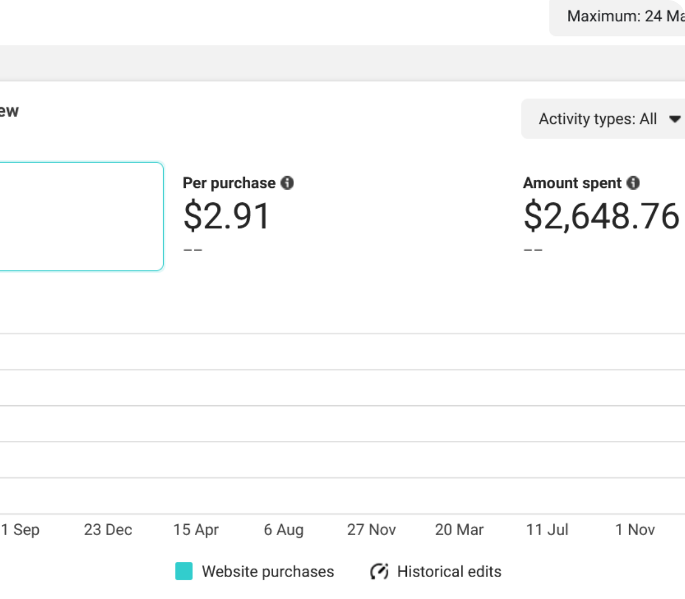
AI & DATA-DRIVEN SCALING
6.4x Peak AI ROAS
AI-Driven Meta Advantage+ & CAPI Architecture: Scaled to 6.4x Peak ROAS
Ad account suffered bid spikes from manual targeting; after iOS14 the post-purchase data was missing due to signal loss, and returning-customer acquisition was eroding margin.
ACTION: Deep Architecture Breakdown
Case Studies — 1 of 9
13 / 22
Notes:
The flagship: AI-driven Meta Advantage+ with CAPI, scaled to a 6.4x peak ROAS. The starting problem was classic — manual targeting bid spikes and post-iOS14 signal loss eroding margin.

Slide 14
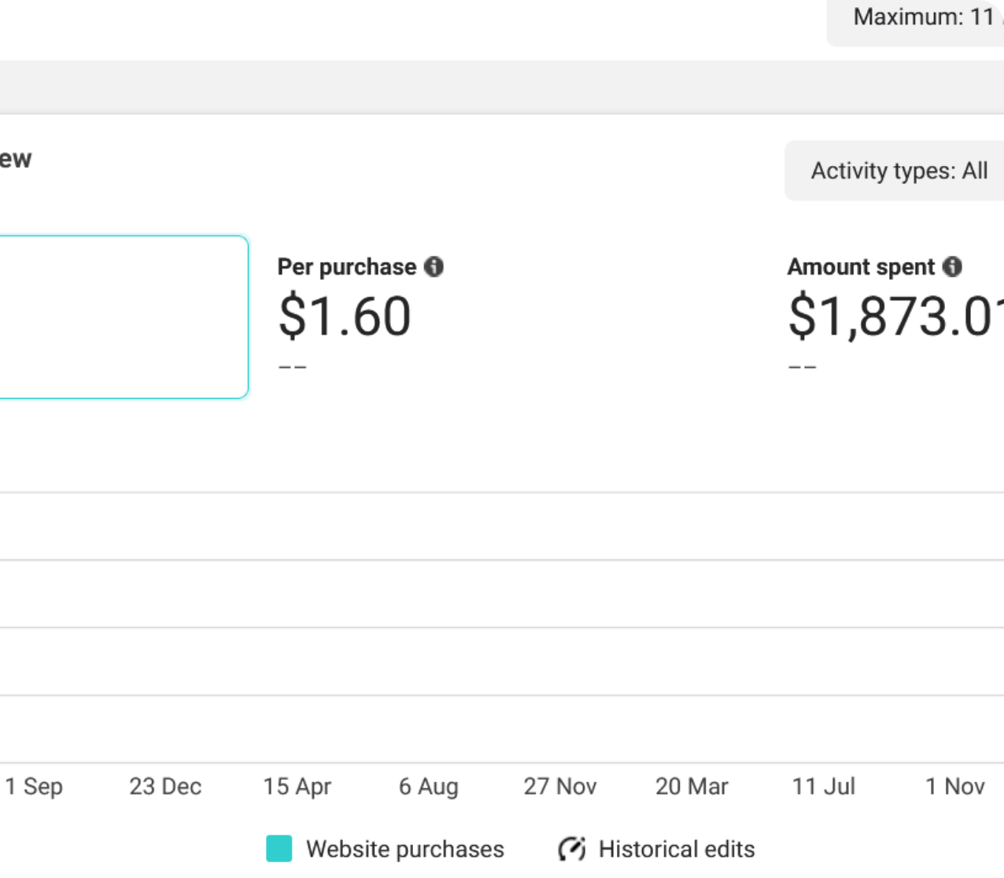
DTC E-COMMERCE
5.9x Peak ROAS
DTC Cycling & Sports Gear: 1.2x to 5.9x Peak ROAS Performance Architecture
The brand had no scalable performance acquisition architecture. Creative fatigue and high CAC made it impossible to scale ad spend.
ACTION: Deep Architecture Breakdown
Case Studies — 2 of 9
14 / 22
Notes:
Cycling and sports gear DTC: taken from 1.2x to a 5.9x peak. No scalable acquisition architecture existed; creative fatigue and high CAC blocked scaling until the sandbox and CAPI rebuild.

Slide 15
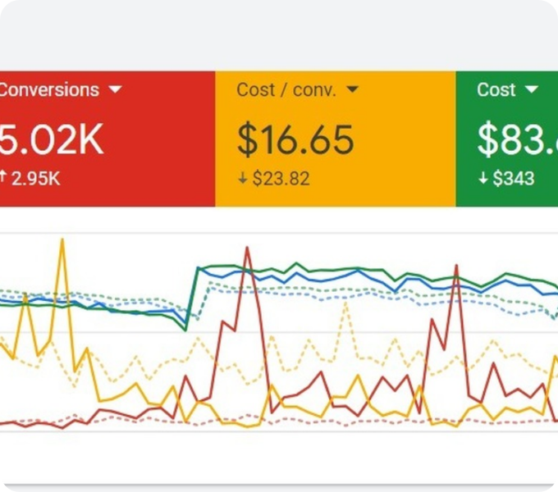
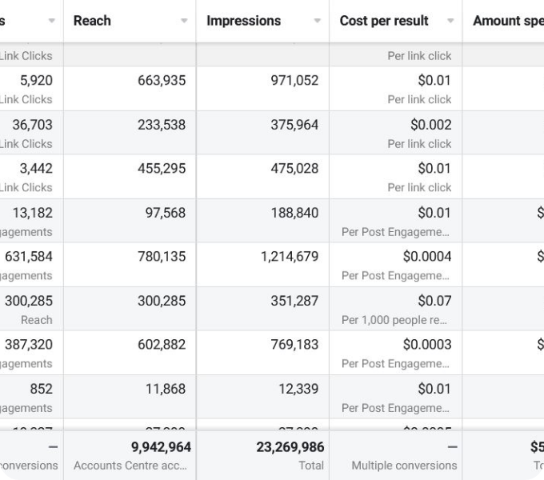
PERFORMANCE CASE STUDIES
GOOGLE PPC
META ADS
$31 Cost/SQL (64% Reduction)
4.6x Verified ROAS
Direct Response Meta Ads: High-ROAS Omnichannel Scaling System
B2B Enterprise SaaS Qualified Leads Pipeline & Cost Optimization
Scaling attempts doubled CPA and audience fatigue set in — rebuilt as a validated omnichannel system.
Low-intent broad keywords were wasting budget with unqualified leads flooding the sales pipeline.
Actions on live site: Deep Architecture Breakdown
Case Studies — 3–4 of 9
15 / 22
Notes:
Two more: an enterprise B2B SaaS pipeline rebuilt for 31-dollar cost per SQL — a 64% reduction after broad-keyword waste — and a direct-response Meta system at a verified 4.6x ROAS.

Slide 16
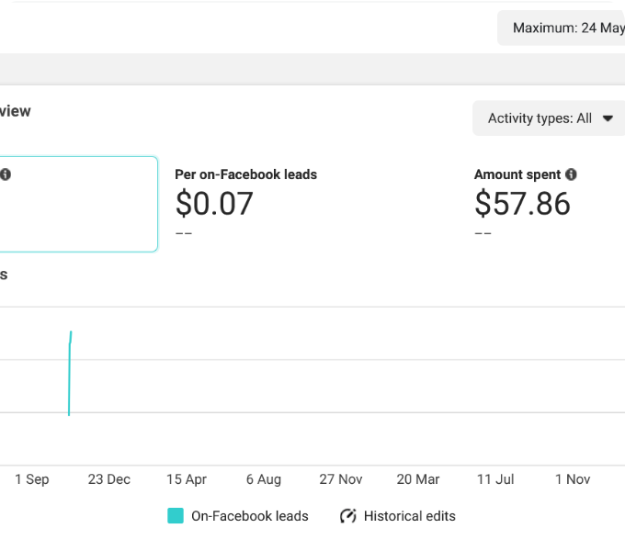
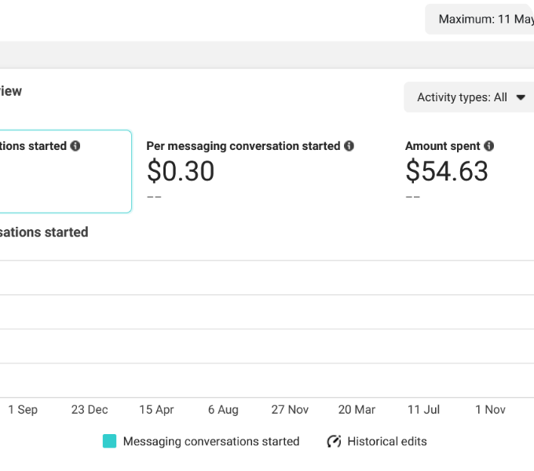
PERFORMANCE CASE STUDIES
DIRECT DM
LEAD GEN
82% Qualified Close Rate
$4.20 Cost / Qualified Lead
Conversational Commerce: High-Converting Messenger & WhatsApp Funnel
High-Ticket Consulting & Client Acquisition Qualified Pipeline
Low audience quality meant sales calls missed decision makers and no-show rates were high.
Direct site visits dropped conversion because customers needed instant trust and consultation.
Actions on live site: Deep Architecture Breakdown
Case Studies — 5–6 of 9
16 / 22
Notes:
Then high-ticket consulting at $4.20 per qualified lead after fixing decision-maker targeting and no-shows, and a Messenger-plus-WhatsApp conversational funnel converting at an 82% qualified close rate.

Slide 17
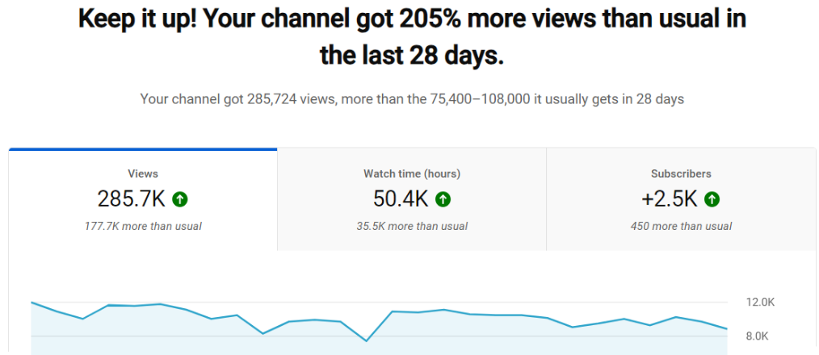
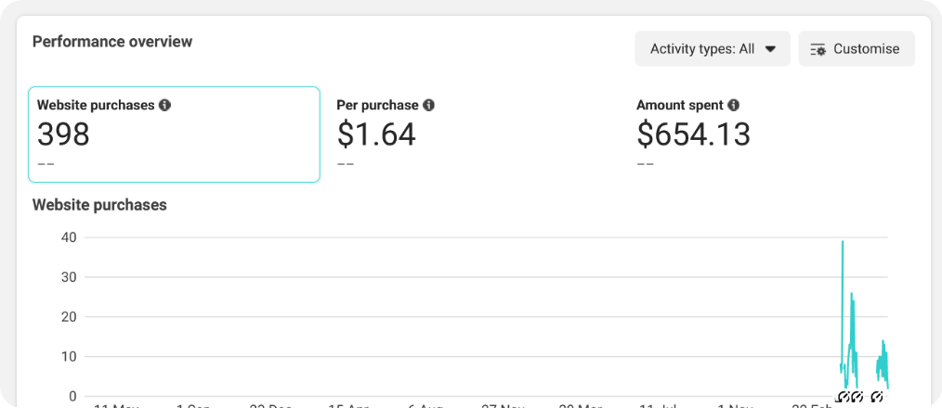
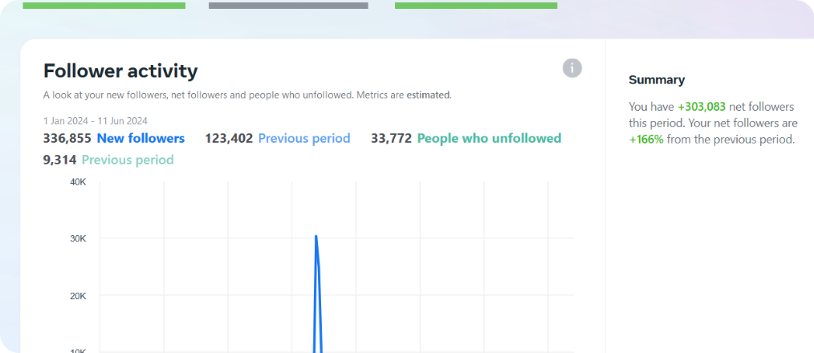
PERFORMANCE CASE STUDIES
YOUTUBE ADS
DTC E-COMMERCE
BRAND GROWTH
$0.012 Cost/View & 3.8x ROI
4.8x Blended ROAS
1,200,000+ Verified Reach
YouTube Action Ads: High-Retention Video Funnel & View Acquisition
Multi-SKU E-Commerce Dynamic Product Catalog (DPA) Scaling
Viral Organic & Paid Hybrid Reach: 1.2M+ Reach & Follower Growth
High skip rates — viewers dropped within the first 5 seconds of video ads.
Single-product campaigns spiked frequency, causing ad fatigue and shrinking margin.
Weak social proof kept paid-acquisition CAC high.
Case Studies — 7–9 of 9
17 / 22
Notes:
The last three: YouTube action ads at $0.012 per view and 3.8x ROI after fixing five-second drop-off; a multi-SKU DPA catalog scaled to 4.8x blended; and a viral organic-and-paid hybrid reaching over 1.2 million verified users with fast follower growth.

Slide 18
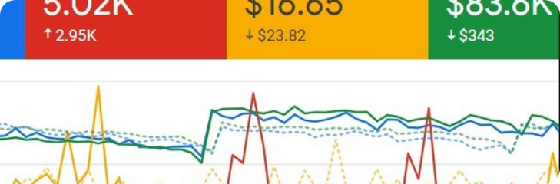
EMPIRICAL EVIDENCE VAULT
Raw Proof Gallery (59 Verified Screenshots)
All Proofs (59)
Uncut dashboard screenshots across Meta Ads Manager, Google Ads conversion metrics, Shopify purchase receipts, Messenger closes, and video retention.
6
5
5
2
Meta Ads — Manager Results, Campaign Results, Manager Performance, Trend Analytics, Conversion Results, High ROAS Results
Google PPC — Search Conversion, PPC Leadgen Analytics, Dashboard ROAS, Search Campaign Overview, Keywords Performance
DTC Purchases — Website Purchases ROAS 01–05
Lead Gen — High-Ticket Lead Acquisition, B2B Qualified Leads Funnel
7
9
22
Direct Chat — Messenger Sales Closing 01–05, Page Direct Inbox Conversion, Inbox Order Closing
YouTube / Video — Video Ads Metrics 01–03, Channel Campaign Overview, High-Retention Views, Cost-Per-View 06–09
Viral Reach — Organic Viral 01–06, Social Engagement 07–12, Page Growth 13–14, Account Growth 15, Loyalty 16, Monetization 17–18, Traffic 19–20, Instagram 21–22
59 verified screenshots · 7 categories · every metric empirically verifiable
Proof Vault
18 / 22
Notes:
Beyond the nine case stories there's the raw vault: 59 uncut dashboard screenshots organized into seven categories — six Meta, five Google, five DTC purchases, two lead gen, seven direct chat, nine YouTube/video, and twenty-two viral-reach proofs. On the live site every image opens full-size.

Slide 19
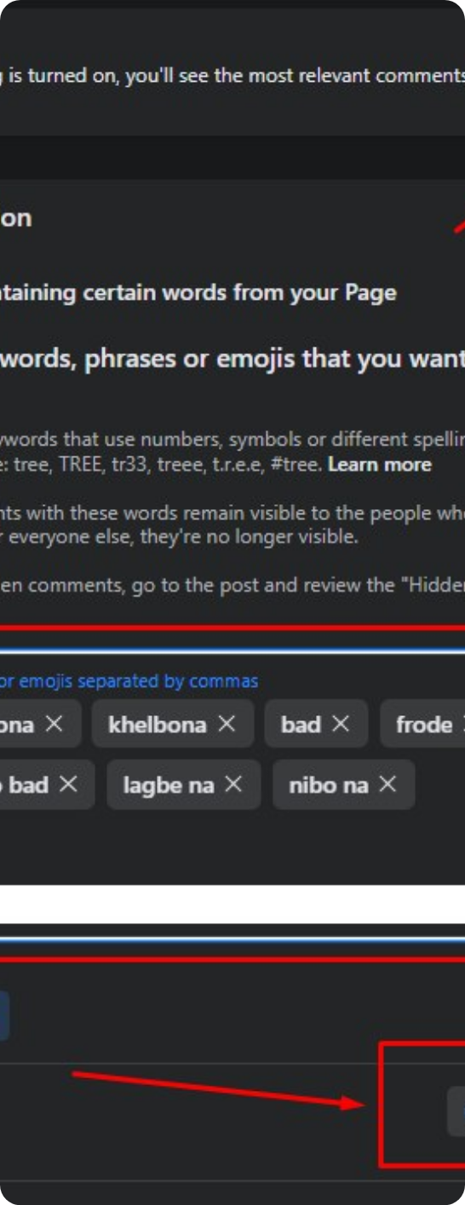
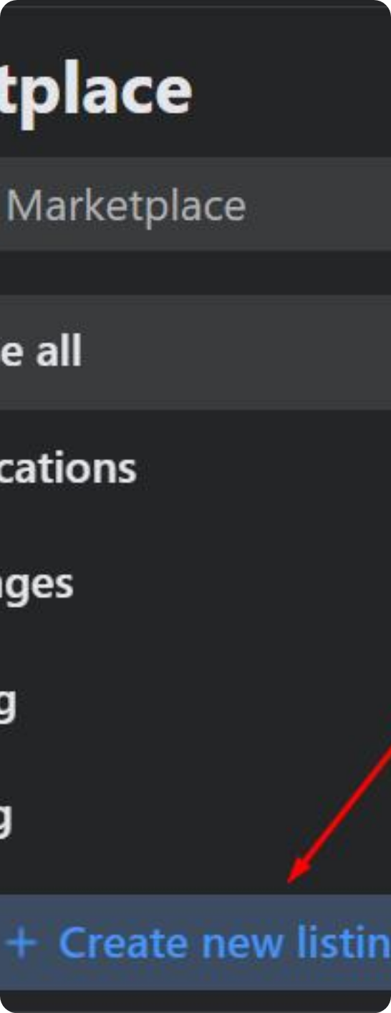
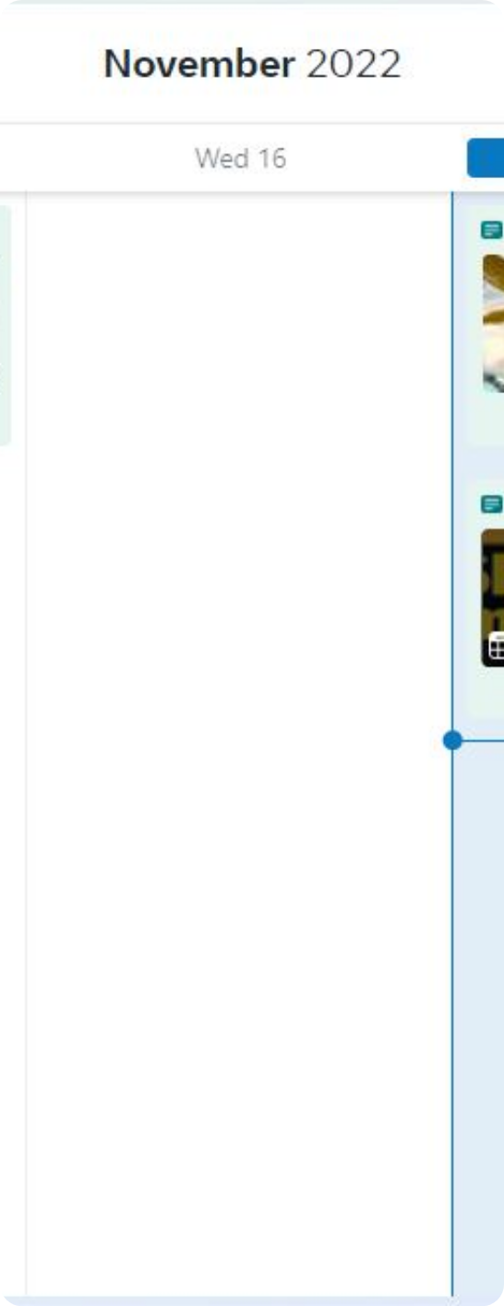
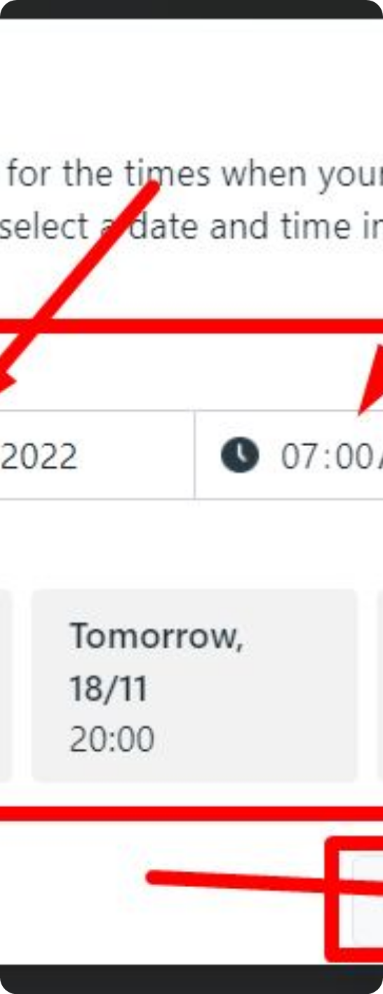
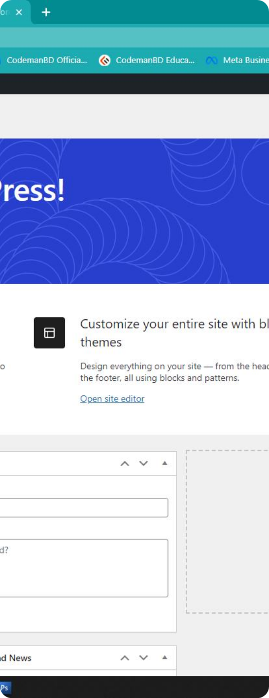

CREATIVE TESTING ENGINE
Ad Creative Sandbox & Angle Matrix
Showing 48 Top Performing Campaign Hooks
Sample high-converting creatives engineered for thumb-stopping feed disruption, social proof reinforcement, and objection resolution.
Angle #01
Angle #02
Angle #03
Angle #04
Angle #05
Angle #06
Ad Creatives (48) — Facebook Campaigns / Meta Creative Hook Angles
19 / 22
Notes:
The creative engine: 48 top-performing hook angles, engineered for thumb-stopping feed disruption, social proof, and objection resolution. These six samples map directly to the 3:2:2 matrix that feeds each account's proven, run-rate winners.

Slide 20
GROWTH STRATEGY PRESENTATIONS & AUDIT & DIAGNOSIS
Download Detailed Strategy & Portfolio Slide Decks
Audit & Diagnosis Tools
Two zero-cost tools on the live site: submit your brand or store URL for a 10-minute private video teardown, or take the 5-question self-assessment diagnostic below.
In-depth architectural breakdowns ready for internal review or stakeholder presentations.
Google Ads Deck (.pptx)
DOWNLOAD
1. Conversion & Pixel Tracking Setup — Server-Side CAPI Gateway with 9.0+ EMQ (Full Signal) / Basic Hybrid Setup / Standard Browser Pixel Only (High iOS 14+ Data Loss)
Case Studies Vol 1 (.pptx)
DOWNLOAD
2. Creative Testing Methodology — Structured 3:2:2 Dynamic Sandbox (Weekly Velocity) / Monthly Creative Refreshes / Ad-Hoc 1–2 Ads (Run Until Creative Fatigue)
3. Attribution & Unit Economics — Blended MER, Cohort LTV & Bank Reconciliation / Meta Ads Manager + Basic GA / In-Platform ROAS Only (Vanity Reporting)
Case Studies Vol 2 (.pptx)
DOWNLOAD
4. Meta Campaign & Bidding Structure — Advantage+ ASC with Cost Caps & 1st-Party Exclusions / Broad Targeting Standard Lowest Cost / Manual Interest Stacking (10+ Fragmented Ad Sets)
5. Store Offer & Cart AOV Architecture — Tiered Bundles, Free Shipping Ladder & 1-Click Post-Purchase Upsells / Basic Percentage Codes / Single Product Catalog, Zero Upsells
HEALTH SCORE
DIAGNOSIS
100 / 100
Scale Ready
High algorithmic readiness — ready for aggressive budget scaling.
Source repositories: assets/documents/*.pptx on sultantipu199.github.io/sultan-growth
Growth Strategy Presentations • Audit & Diagnosis
20 / 22
Notes:
The live site also ships three ready-made PPTX strategy decks — the Google Ads portfolio and two case-study volumes — plus the audit toolkit: my private video teardown and a five-question readiness diagnostic that scores your account out of 100. A fully-signal, sandboxed, MER-tracked account reads "scale ready" at the top of the curve.

Slide 21


ZERO-COST OPPORTUNITY ANALYSIS
Request Your 10-Minute Ad Account Teardown
Submit your brand or store URL. I will personally review your tracking setup, identify ad fatigue, and pinpoint where your budget is leaking — delivered via a private video teardown.
100% Confidential
Direct WhatsApp Response
Tipu Sultan
teardown input: https://yourbrand.com or your store link → Request Teardown
1-on-1 · Growth Architect
WhatsApp
Email
Audit & Diagnosis
21 / 22
Notes:
The offer: a zero-cost 10-minute ad account teardown. Send your store or brand URL and I'll review tracking, ad fatigue, and budget leaks, then reply via WhatsApp with the video — fully confidential.

Slide 22

FULL PORTFOLIO — 22 SLIDES
Tipu Sultan
High-Ticket Performance Marketer & Growth Architect
Built with Engineering Precision • All Metrics Empirically Verified
WhatsApp • Email — floating contact buttons on live site | Navigation: AI & Data Engine · Growth Playbooks · Case Studies · Proof Vault (59) · Ad Creatives (48) · ROI Engine · Audit & Diagnosis
Tipu Sultan — AI-Driven & Data-Driven Growth Architect
22 / 22
Notes:
That's the full mirror of my online portfolio. Every number here is screenshot-backed, from the 188K managed spend to the 59-proof vault. Reach out on WhatsApp or email and let's find where your account is leaking revenue. Thank you.

