Slide 1

Recurrent
Neural Networks

Slide 2
Deep Learning
We’ve used Neural Networks to solve Classification and Regression problems, but we still haven’t seen how Neural Networks can deal with sequence information.

Slide 3
Deep Learning
Just as CNNs were more effective for use with 2D image data, RNNs are more effective for sequence data (e.g. time-stamped sales data, sequence of text, heart beat data, etc…)

Slide 4
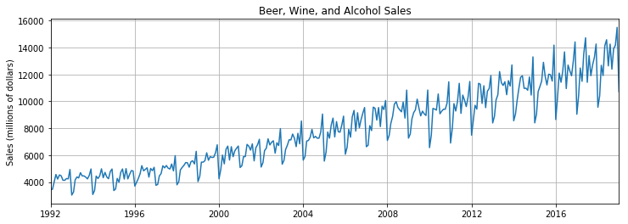
Deep Learning
Time Series

Slide 5
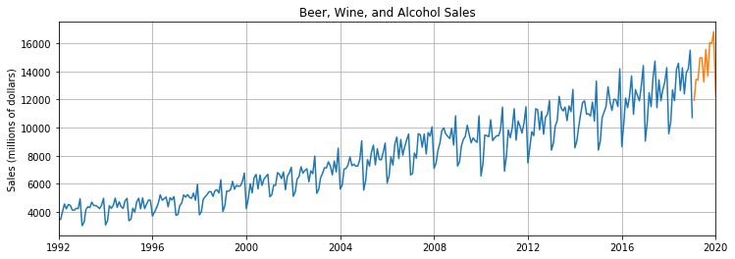
Deep Learning
Time Series

Slide 6
Deep Learning
Sequences
Hello | how | are | you
Hello | how | are | you | today?

Slide 7
Deep Learning
Section Overview
RNN Theory
LSTMs and GRU Theory
Basic Implementation of RNN
Time Series with an RNN
Exercise and Solution

Slide 8
Let’s get started!

Slide 9
Recurrent Neural Networks Theory

Slide 10
Deep Learning
Examples of Sequences
Time Series Data (Sales)
Sentences
Audio
Car Trajectories
Music

Slide 11
Deep Learning
Let’s imagine a sequence:
[1,2,3,4,5,6]
Would you be able to predict a similar sequence shifted one time step into the future?
[2,3,4,5,6,7]

Slide 12
Deep Learning
To do this properly, we need to somehow let the neuron “know” about its previous history of outputs.
One easy way to do this is to simply feed its output back into itself as an input!

Slide 13
Deep Learning
Normal Neuron in Feed Forward Network
Output
Activation Function
Σ
Aggregation of Inputs
Input

Slide 14
Deep Learning
Recurrent Neuron
Sends output back to itself!
Let’s see what this looks like over time!
Output
Σ
Input

Slide 15
Deep Learning
Recurrent Neuron
Output at t-1
Output
=
Σ
Σ
Input
Input
at t-1

Slide 16
Deep Learning
Recurrent Neuron
Output at t-1
Output
=
Σ
Σ
Input
Input
at t-1
Time

Slide 17
Deep Learning
Recurrent Neuron
Output at t-1
Output at t
Output
=
Σ
Σ
Σ
Input
Input
at t-1
Input at t
Time

Slide 18
Deep Learning
Recurrent Neuron
Output at t-1
Output at t
Output at t+1
Output
=
Σ
Σ
Σ
Σ
Input
Input
at t-1
Input at t
Input at t+1
Time

Slide 19
Deep Learning
Cells that are a function of inputs from previous time steps are also known as memory cells.
RNN are also flexible in their inputs and outputs, for both sequences and single vector values.

Slide 20
Deep Learning
We can also create entire layers of Recurrent Neurons...

Slide 21
Deep Learning
ANN Layer with 3 Neurons:
X
y

Slide 22
Deep Learning
RNN Layer with 3 Neurons:
X
y

Slide 23
Deep Learning
“Unrolled” layer.
Output at t=0
Output at t+1
Output at t+2
Input
at t=0
Input at t+1
Input at t+2
Time

Slide 24
Deep Learning
RNN are also very flexible in their inputs and outputs.
Let’s see a few examples.

Slide 25
Deep Learning
Sequence to Sequence (Many to Many)
Y₀
Y₁
Y₂
Y₃
Y₄
X₀
X₁
X₂
X₃
X₄

Slide 26
Deep Learning
Given 5 previous words, predict the next 5
Y₀
Y₁
Y₂
Y₃
Y₄
X₀
X₁
X₂
X₃
X₄

Slide 27
Deep Learning
Sequence to Vector (Many to One)
Y₀
Y₁
Y₂
Y₃
Y₄
X₀
X₁
X₂
X₃
X₄

Slide 28
Deep Learning
Given 5 previous words, predict next word
Y₀
Y₁
Y₂
Y₃
Y₄
X₀
X₁
X₂
X₃
X₄

Slide 29
Deep Learning
Vector to Sequence (One to Many)
Y₀
Y₁
Y₂
Y₃
Y₄
X₀
0
0
0
0

Slide 30
Deep Learning
Given 1 word predict the next 5 words
Y₀
Y₁
Y₂
Y₃
Y₄
X₀
0
0
0
0

Slide 31
Deep Learning
A basic RNN has a major disadvantage, we only really “remember” the previous output.
It would be great it we could keep track of longer history, not just short term history.

Slide 32
Deep Learning
Another issue that arises during training is the “vanishing gradient”.
Let’s explore vanishing gradients in more detail before moving on to discussing LSTM (Long Short Term Memory Units).

Slide 33
Exploding and Vanishing Gradients

Slide 34
Deep Learning
As our networks grow deeper and more complex, we have 2 issues arise:
Exploding Gradients
Vanishing Gradients
Recall that the gradient is used in our calculation to adjust weights and biases in our network.

Slide 35
Deep Learning
Let’s think about a network.
Hidden Layers

Slide 36
Deep Learning
For complex data we need deep networks
Hidden Layers

Slide 37
Deep Learning
Issues can arise during backpropagation
Hidden Layers

Slide 38
Deep Learning
Backpropagation goes backwards from the output to the input layer, propagating the error gradient.
For deeper networks issues can arise from backpropagation, vanishing and exploding gradients!

Slide 39
Deep Learning
As you go back to the “lower” layers, gradients often get smaller, eventually causing weights to never change at lower levels.
The opposite can also occur, gradients explode on the way back, causing issues.

Slide 40
Deep Learning
Let’s discuss why this might occur and how we can fix it.
Then in the next lecture we’ll discuss how these issues specifically affect RNN and how to use LSTM and GRU to fix them.

Slide 41
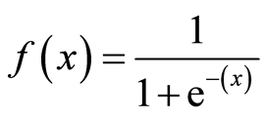
Deep Learning
Why does this happen?
1
Output
0
0
z = wx + b

Slide 42
Deep Learning
Why does this happen?
1
Output
0
0
z = wx + b

Slide 43
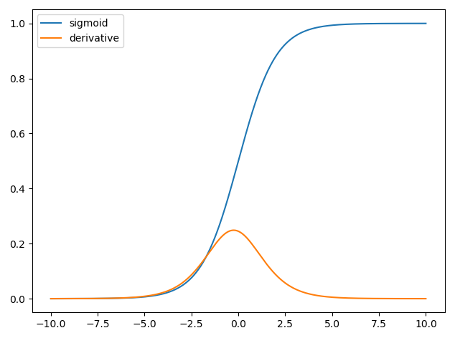
Deep Learning
The derivative can be much smaller!

Slide 44
Deep Learning
When n hidden layers use an activation like the sigmoid function, n small derivatives are multiplied together.
The gradient could decrease exponentially as we propagate down to the initial layers.

Slide 45
Deep Learning
Using Different Activation Functions
Output
0
z = wx + b

Slide 46
Deep Learning
The ReLu doesn’t saturate positive values.
Output
0
z = wx + b

Slide 47
Deep Learning
“Leaky” ReLU
Output
0
z = wx + b

Slide 48
Deep Learning
Exponential Linear Unit (ELU)
1
Output
0
-1
0
z = wx + b

Slide 49
Deep Learning
Another solution is to perform batch normalization, where your model will normalize each batch using the batch mean and standard deviation.

Slide 50
Deep Learning
Choosing different initialization of weights can also help alleviate these issues (Xavier Initialization).

Slide 51
Deep Learning
Apart from batch normalization, researchers have also used “gradient clipping”, where gradients are cut off before reaching a predetermined limit (e.g. cut off gradients to be between -1 and 1)

Slide 52
Deep Learning
RNN for Time Series present their own gradient challenges, let’s explore special LSTM (Long Short Term Memory) neuron units that help fix these issues!

Slide 53
LSTM and GRU Units

Slide 54
Deep Learning
Many of the solutions previously presented for vanishing gradients can also apply to RNN: different activation functions, batch normalizations, etc…
However because of the length of time series input, these could slow down training

Slide 55
Deep Learning
A possible solution would be to just shorten the time steps used for prediction, but this makes the model worse at predicting longer trends.

Slide 56
Deep Learning
Another issue RNN face is that after awhile the network will begin to “forget” the first inputs, as information is lost at each step going through the RNN.
We need some sort of “long-term memory” for our networks.

Slide 57
Deep Learning
The LSTM (Long Short-Term Memory) cell was created to help address these RNN issues.
Let’s go through how an LSTM cell works!

Slide 58
Deep Learning
A typical RNN
Output at t-1
Output at t
Output at t+1
Input
at t-1
Input at t
Input at t+1

Slide 59
Deep Learning
RNN
Output at t
Input at t

Slide 60
Deep Learning
RNN
Output t-1
Output t
Input t

Slide 61
Deep Learning
RNN
H_{t-1}
H_{t}
X_{t}

Slide 62
Deep Learning
RNN
H_{t-1}
H_{t}=tanh(W[H_{t-1},X_{t}]+b)
H_{t}
X_{t}

Slide 63
Deep Learning
LSTM

Slide 64
Deep Learning
LSTM
Output at time t
Long Term Memory
New Long Term Memory
Short Term Memory
New Short Term Memory
Input at time t

Slide 65
Deep Learning
LSTM
Output at time t
Long Term Memory
New Long Term Memory
Forget Gate
Output Gate
Input
Gate
Update Gate
Short Term Memory
New Short Term Memory
Input at time t

Slide 66
Deep Learning
Gates optionally let information through
σ
X
1
0

Slide 67
Deep Learning
LSTM
Output at time t
Long Term Memory
New Long Term Memory
Short Term Memory
New Short Term Memory
Input at time t

Slide 68
Deep Learning
LSTM
h_{t}
C_{t-1}
C_{t}
h_{t-1}
h_{t}
x_{t}

Slide 69
An LSTM Cell
Output at t
Here we can see the entire LSTM cell.
Let’s go through the process!
X
+
tanh
X
X
σ
σ
tanh
σ
Input at t
http://colah.github.io/posts/2015-08-Understanding-LSTMs/

Slide 70
An LSTM Cell
h_{t}
Here we can see the entire LSTM cell.
Let’s go through the process!
C_{t-1}
C_{t}
X
+
tanh
X
X
σ
σ
tanh
σ
h_{t-1}
h_{t}
x_{t}

Slide 71
An LSTM Cell
h_{t}
C_{t-1}
C_{t}
X
+
tanh
X
X
σ
σ
tanh
σ
h_{t-1}
h_{t}
x_{t}

Slide 72
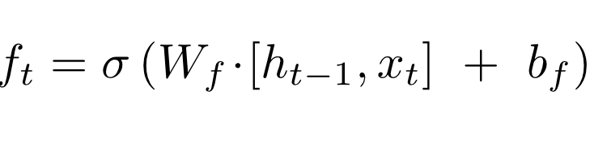
An LSTM Cell
h_{t}
C_{t-1}
C_{t}
X
+
tanh
f_{t}
X
X
σ
σ
tanh
σ
h_{t-1}
h_{t}
x_{t}

Slide 73
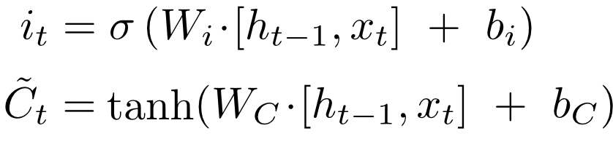
An LSTM Cell
h_{t}
C_{t-1}
C_{t}
X
+
tanh
i_{t}
X
~
C_{t}
X
σ
σ
tanh
σ
h_{t-1}
h_{t}
x_{t}

Slide 74
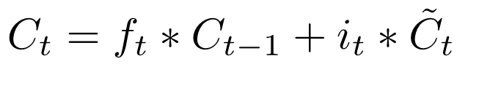
An LSTM Cell
h_{t}
C_{t-1}
C_{t}
X
+
tanh
f_{t}
i_{t}
X
~
C_{t}
X
σ
σ
tanh
σ
h_{t-1}
h_{t}
x_{t}

Slide 75
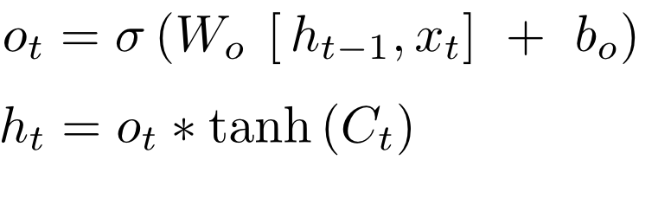
An LSTM Cell
h_{t}
C_{t-1}
C_{t}
X
+
tanh
X
X
σ
σ
tanh
σ
h_{t-1}
h_{t}
x_{t}

Slide 76
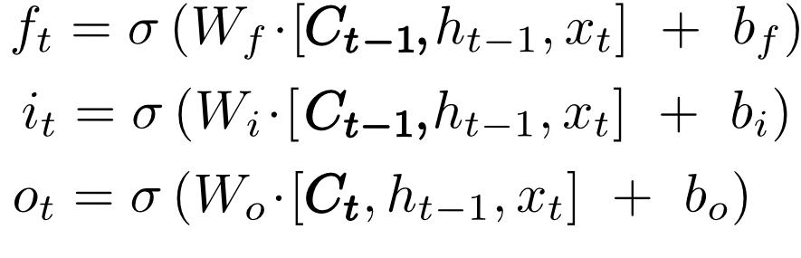
An LSTM Cell with “peepholes”
h_{t}
C_{t-1}
C_{t}
X
+
tanh
X
X
σ
σ
tanh
σ
h_{t-1}
h_{t}
x_{t}

Slide 77
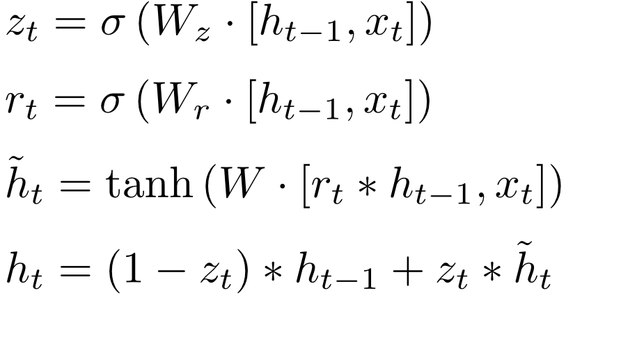
Gated Recurrent Unit (GRU)
h_{t}
h_{t-1}
C_{t}
X
+
X
r_{t}
1-
z_{t}
X
σ
σ
tanh
x_{t}

Slide 78
Deep Learning
Fortunately with our deep learning python library , we simply need to call the import for RNN or LSTM instead of needing to code all of this ourselves!
Let’s explore how to use LSTMs with Python code!

Slide 79
Basic RNN

Slide 80
Deep Learning
Let’s now explore how to use RNN on a basic time series, such as a sine wave.
Before we jump to the notebook, let’s quickly discuss what RNN sequence batches look like.

Slide 81
Deep Learning
Let’s imagine a simple time series:
[0,1,2,3,4,5,6,7,8,9]
We separate this into 2 parts:
[0,1,2,3,4,5,6,7,8] [9]
Given training sequence, predict the next sequence value.

Slide 82
Deep Learning
Keep in mind we can usually decide how long the training sequence and predicted label should be:
[0,1,2,3,4] [5,6,7,8,9]

Slide 83
Deep Learning
We can also edit the size of the training point, as well as how many sequences to feed per batch:
[0,1,2,3] [4]
[1,2,3,4] [5]
[2,3,4,5] [6]

Slide 84
Deep Learning
So how do we decide how long the training sequence should be?
There is no definitive answer, but it should be at least long enough to capture any useful trend information.

Slide 85
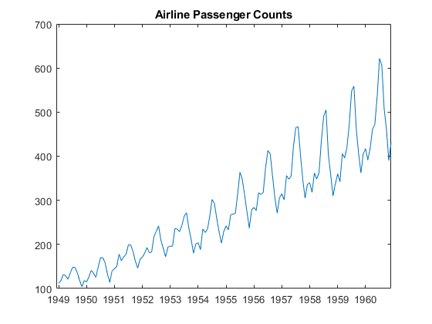
Deep Learning
For example, if dealing with seasonal data:

Slide 86
Deep Learning
If this is monthly, we should include at least 12 months in the training sequence

Slide 87
Deep Learning
This often takes domain knowledge and experience, as well as simply experimenting and using RMSE to measure error of forecasted predictions.
Typically a good starting choice for the label is just one data point into the future.

Slide 88
Deep Learning
How do we forecast with RNNs?
Let’s imagine all our data is:
[0,1,2,3,4,5,6,7,8,9]
And we trained on sequences such as:
[0,1,2,3] [4]
[1,2,3,4] [5]
[2,3,4,5] [6]

Slide 89
Deep Learning
Then our forecasting technique is to predict a time step ahead, and then incorporate our prediction into the next sequence we predict off of.
Let’s walk through a quick example!

Slide 90
Deep Learning
How do we forecast with RNNs?
Let’s imagine all our data is:
[0,1,2,3,4,5,6,7,8,9]
And we trained on sequences such as:
[0,1,2,3] [4]
[1,2,3,4] [5]
[2,3,4,5] [6]

Slide 91
Deep Learning
[6,7,8,9] [10] Forecast prediction!

Slide 92
Deep Learning
[6,7,8,9] [10] Forecast prediction!
Then to keep predicting further:

Slide 93
Deep Learning
[6,7,8,9] [10] Forecast prediction!
Then to keep predicting further:
[7,8,9,10] [11.2]

Slide 94
Deep Learning
[6,7,8,9] [10] Forecast prediction!
Then to keep predicting further:
[7,8,9,10] [11.2]
[8,9,10,11.2] [12.4]

Slide 95
Deep Learning
[6,7,8,9] [10] Forecast prediction!
Then to keep predicting further:
[7,8,9,10] [11.2]
[8,9,10,11.2] [12.4]
[9,10,11.2,12.4] [14]

Slide 96
Deep Learning
[6,7,8,9] [10] Forecast prediction!
Then to keep predicting further:
[7,8,9,10] [11.2]
[8,9,10,11.2] [12.4]
[9,10,11.2,12.4] [14]
[10,11.2,12.4,14] Completed Forecast

Slide 97
Deep Learning
Let’s explore this further with Python!

Slide 98
Basic RNN on a
Sine Wave

Slide 99
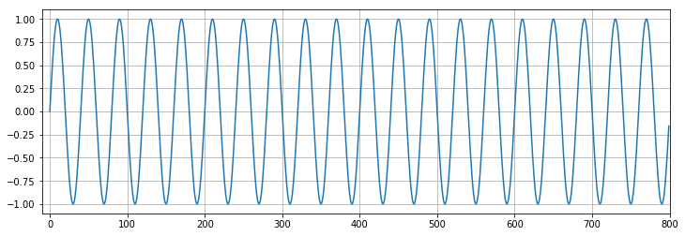
Deep Learning
Let’s now train and evaluate our RNN
Recall our original data:

Slide 100
Deep Learning
We split this into train_set and test_set:

Slide 101
Deep Learning
During training, we could evaluate performance on the test data.

Slide 102
Deep Learning
Let’s zoom in on that range!

Slide 103
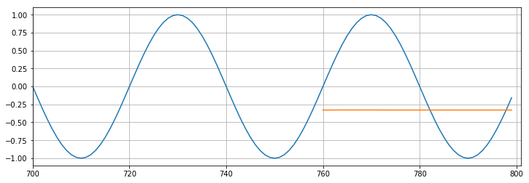
Deep Learning
As we train, we will forecast on this range to visually see the training.

Slide 104
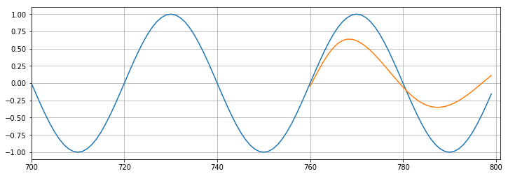
Deep Learning
As we train, we will forecast on this range to visually see the training.

Slide 105
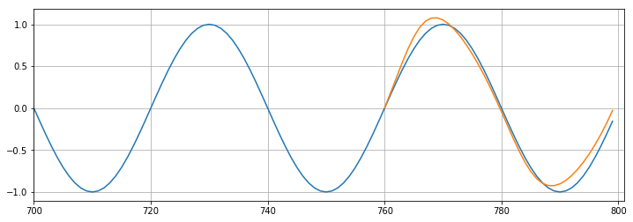
Deep Learning
As we train, we will forecast on this range to visually see the training.

Slide 106
Deep Learning
Eventually once we are satisfied with the results on the test portion, it will be time to forecast into the unknown future.
This means retraining on all available data (both train and test) and forecasting beyond the scope of the original data.

Slide 107
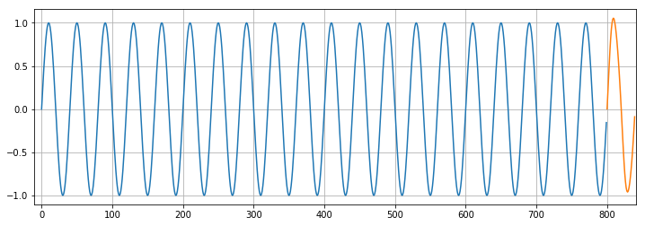
Deep Learning
Keep in mind, for real data, we would no longer have values to compare these predictions to!

Slide 108
RNN on a
Time Series

Slide 109
RNN Exercises

Slide 110
RNN Exercises
Solutions

Slide 111
Multivariate Time Series with LSTM RNNs

Slide 112
Deep Learning
As a quick bonus, we’ll discuss how to use LSTMs and RNNs to predict multivariate time series.
Keep in mind, there are a few cons to using LSTMs for this approach!

Slide 113
Deep Learning
As with all neural networks, the model is essentially a black box, difficult to interpret.
Also there are many well-studied alternatives that are simpler, such as SARIMAX and VARMAX models.

Slide 114
Deep Learning
We highly recommend you try those more conventional approaches before settling on LSTMs or RNNs for multivariate time series data.
Fortunately, setting up for multivariate data only requires 2 main changes.

Slide 115
Deep Learning
Multivariate Time Series:
Change input shape in LSTM layer to reflect 2-D structure
Final dense layer should have a neuron per feature/variable.
Let’s explore these changes!

