Slide 1
★ SUMMER INTERNSHIP-1 • REVIEW 1 • 4 CREDITS
SparkCV
AI-Powered Job Description Analyzer & Resume Optimization Engine
An intelligent NLP system that bridges the gap between student resumes and corporate Applicant Tracking Systems (ATS) through automated skill taxonomy matching and mathematical semantic evaluation.
STUDENT PRESENTER
Name: Shaik Sulthan
Roll No: 23691A37B6
Department: Computer Science & Engineering
Institution: Madanapalle Institute of Technology & Science (MITS)
Academic Year: 2026-2027 (B.Tech CSE)
INTERNSHIP & MENTORSHIP
Organization: Slash Mark IT Solutions (OPC) Pvt. Ltd.
Domain: Machine Learning & NLP
Duration: 20 May 2026 – 20 July 2026 (2 Months)
Internal Guide: Mr. Bhabaani Sankar Samantray
Recognition: DPIIT Recognized • ISO 9001:2015 Certified

Slide 2
MADANAPALLE INSTITUTE OF TECHNOLOGY & SCIENCE • DEPT. OF CSE
02
My Internship Profile
Academic Credentials, Organization Overview & Project Objectives
Candidate Information
Name:
Shaik Sulthan
Roll No:
23691A37B6
Department:
Computer Science & Engineering
Institution:
MITS, Madanapalle
Degree:
B.Tech (CSE)
Academic Status:
CGPA: 8.0 (Till III-II)
Target Career:
AI / Full-Stack Engineer
Internship Organization
Company:
Slash Mark IT Solutions
Legal Entity:
(OPC) Private Limited
Accreditation:
ISO 9001:2015 Certified
Government:
DPIIT Recognized Startup
Duration:
20 May – 20 July 2026
Internship Mode:
Online / Virtual
Academic Credits:
4 Credits Awarded
Project & Mentorship
Project Title:
SparkCV Resume Engine
Internal Guide:
Mr. Bhabaani Sankar Samantray
Domain:
Natural Language Processing
Core Tech:
Python, Streamlit, Scikit-learn
Live URL:
sparkcv.streamlit.app
Source Code:
github.com/sulthan-shaik77
Deliverables:
Web App, Tests, Presentation

Slide 3
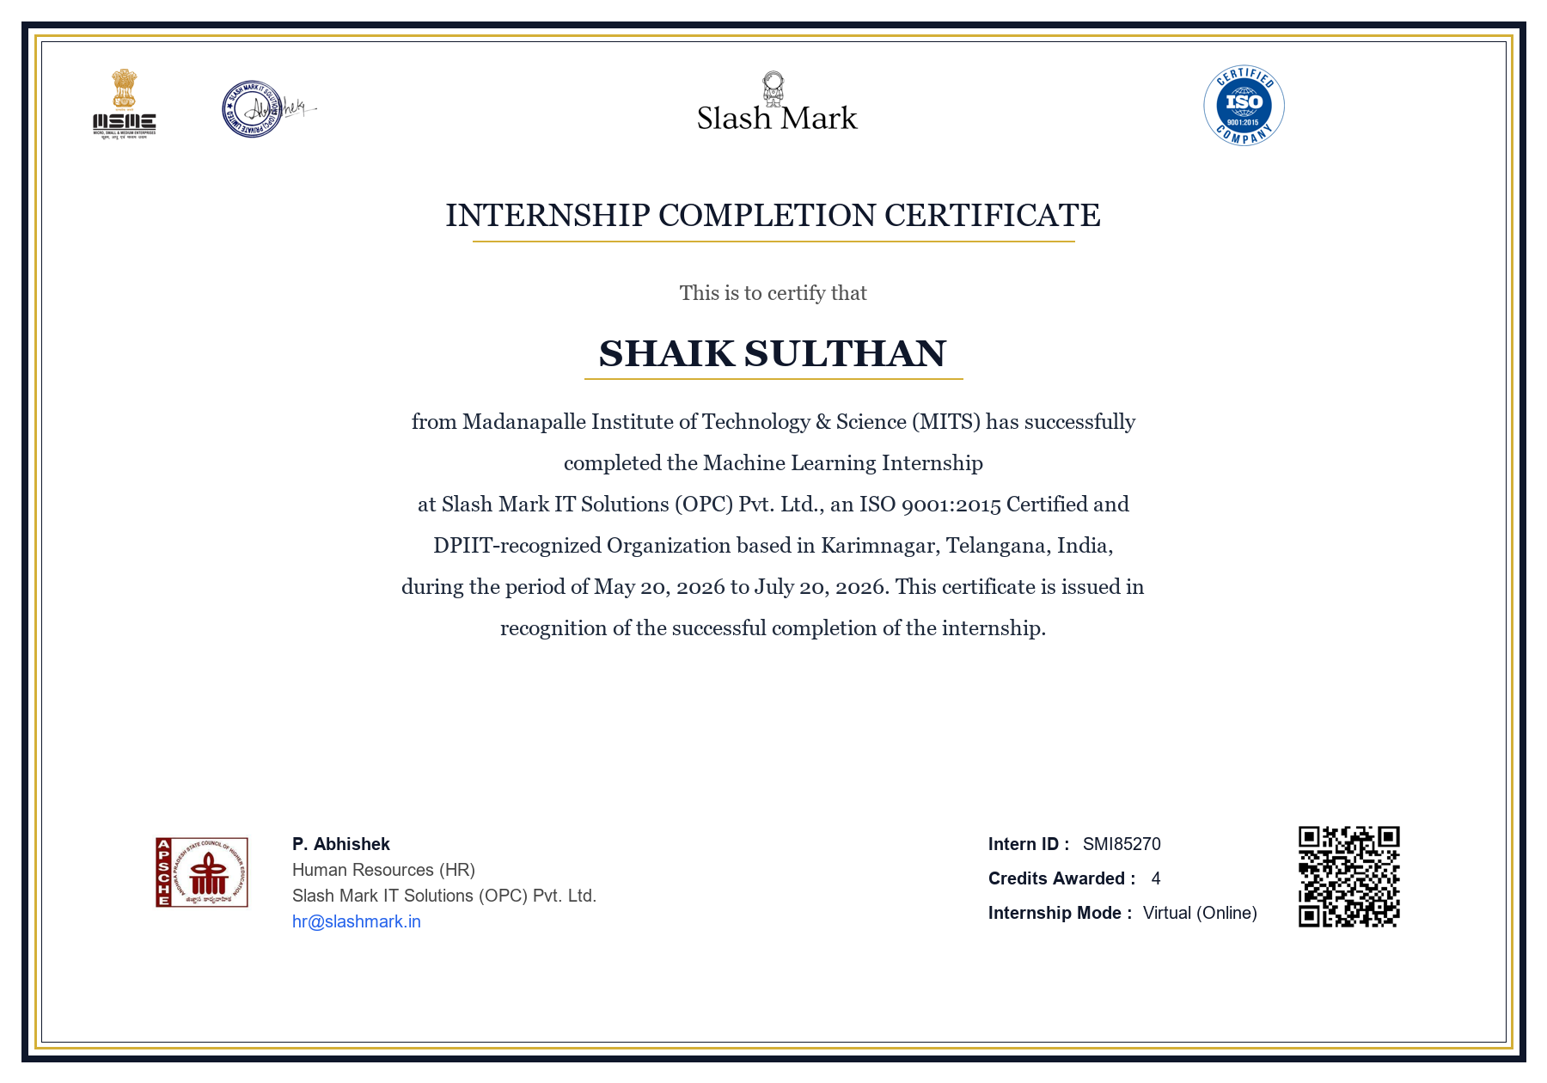
MADANAPALLE INSTITUTE OF TECHNOLOGY & SCIENCE • DEPT. OF CSE
03
Internship Completion Certificate
Official Verification & Authentication from Slash Mark IT Solutions
OFFICIAL VERIFICATION
Status : ✔ Officially Verified & Approved
Candidate : Shaik Sulthan (23691A37B6)
Intern ID : SMI85270
Company : Slash Mark IT Solutions (OPC) Pvt. Ltd.
Registration : ISO 9001:2015 • DPIIT Recognized
Domain : Machine Learning Internship
Internship Period : 20 May 2026 – 20 July 2026 (2 Months)
Academic Credits : 4 Credits Awarded
Signatory : P. Abhishek, Human Resources (HR)
Verification Email : hr@slashmark.in
Affiliations : AICTE, APSCHE, MSME, #startupindia

Slide 4
MADANAPALLE INSTITUTE OF TECHNOLOGY & SCIENCE • DEPT. OF CSE
04
What I Learned: Machine Learning & NLP
Key Technical Skills Acquired During the 2-Month Internship
01. Data Preprocessing & NLP
Text Ingestion & Normalization
• Extracted raw text from PDF & Word documents
• Cleaned text by removing stopwords, symbols & punctuation
• Handled special technical terms (C++, .NET, SQL) using regex
02. Skill Taxonomy & Gap Analysis
Domain Categorization & Filtering
• Curated a library of 250+ technical skills
• Grouped into Languages, AI/ML, Cloud & Databases
• Identified missing skills automatically using set-difference
03. TF-IDF Feature Engineering
Word Importance & Vector Modeling
• Converted textual resumes into numerical feature vectors
• Down-weighted common words; highlighted rare tech skills
• Captured both single keywords & 2-word phrases (bigrams)
04. Cosine Similarity & Deployment
Mathematical Scoring & Cloud App
• Calculated mathematical similarity score (0% to 100%)
• Balanced 50% skill match + 50% overall context match
• Built interactive web UI with Python and deployed on Streamlit

Slide 5
MADANAPALLE INSTITUTE OF TECHNOLOGY & SCIENCE • DEPT. OF CSE
05
The Problem
Why Qualified Job Applicants Get Rejected Before an Interview
[ 75% FILTERED OUT ]
Robots Reject Resumes
Over 75% of resumes are rejected by Applicant Tracking Systems (ATS) before any human recruiter ever reads them due to missing keywords.
[ NO CLEAR FEEDBACK ]
The Black Box Dilemma
Students and candidates cannot tell which specific skills or qualifications are missing, leading to blind, random keyword stuffing.
[ GENERIC ADVICE ]
Lack of Actionable Help
Existing tools only give vague suggestions like 'add more skills' without showing candidates how to rephrase bullet points or fix gaps.

Slide 6
MADANAPALLE INSTITUTE OF TECHNOLOGY & SCIENCE • DEPT. OF CSE
06
Our Solution: How It Works
4-Stage Automated Pipeline from Resume Parsing to Instant Optimization
01
Upload
Candidate uploads resume (PDF/Word) and pastes the target job description.
02
Find Skills
Engine automatically scans and extracts 250+ technical skills from both texts.
03
Get Score
Mathematical TF-IDF and Cosine Similarity calculate a transparent match score.
04
Fix & Optimize
System provides missing skill checklist and generates Google XYZ bullet rewrites.
Built with Python, Scikit-learn, and Streamlit • Fast, responsive & works on phones, laptops and desktops

Slide 7
MADANAPALLE INSTITUTE OF TECHNOLOGY & SCIENCE • DEPT. OF CSE
07
How the Score Works
Balanced Mathematical Scoring Engine Combining Skill Coverage & Semantic Similarity
Skills Match (50%)
Direct Skill Coverage
Checks if you have the exact tools, programming languages and frameworks required in the JD.
Meaning Match (50%)
TF-IDF Cosine Distance
Measures contextual semantic alignment between project descriptions and role responsibilities.
Final Score (100%)
Anti-Gaming Balance
Prevents artificial keyword stuffing by requiring both explicit skills and real contextual experience.
Below 50%
Weak Match • Requires significant rework before submitting.
50% - 75%
Moderate Match • Getting close; needs missing skills added.
Above 75%
Strong Match • High interview readiness; optimal ATS alignment.

Slide 8
MADANAPALLE INSTITUTE OF TECHNOLOGY & SCIENCE • DEPT. OF CSE
08
What You Get
Actionable Deliverables and Immediate Guidance Provided by SparkCV
Skill Gap Checklist
Identifies exactly which tools and skills are missing from the resume, categorized by domain.
Google XYZ Bullet Rewriter
Transforms weak bullet points into high-impact accomplishment statements using Google's formula.
Targeted Project Suggestions
Provides high-value project concepts that directly fill candidate skill deficiencies.
ATS Format Health Check
Validates resume layout, headings, and font compatibility to ensure seamless robotic parsing.

Slide 9
MADANAPALLE INSTITUTE OF TECHNOLOGY & SCIENCE • DEPT. OF CSE
09
Why It Is Safe and Practical
Key Engineering & Architecture Advantages Over Heavy LLM APIs
[ ZERO DATA STORAGE ]
100% Private & In-Memory
Resumes are parsed strictly in RAM. Files are never saved to disk, logged, or transmitted to third-party commercial cloud APIs.
[ ULTRA-FAST RESULTS ]
Sub-Second Speed (< 0.2s)
Deterministic mathematical algorithms execute in under 200 milliseconds, eliminating slow API wait times and network lag.
[ $0 INFRASTRUCTURE COST ]
Zero Recurring Costs
No expensive token billing or API paywalls. Completely free to run for thousands of students and university placement drives.

Slide 10
MADANAPALLE INSTITUTE OF TECHNOLOGY & SCIENCE • DEPT. OF CSE
10
Impact & Metrics
Real-World Performance Indicators and Production Evaluation
75%+
Resumes rejected by ATS robots without human review
< 0.2s
Turnaround time to scan and score complete resumes
$0
Cost per scan with zero external API dependencies
8 / 8
Automated test suites passed with 100% reliability
MISSION: Free, accessible, and privacy-first career empowerment for students and engineering job seekers everywhere.

Slide 11
MADANAPALLE INSTITUTE OF TECHNOLOGY & SCIENCE • DEPT. OF CSE
11
Thank You!
Summer Internship-1 Review 1 • Questions & Discussion
Thank You Respected Faculty & Reviewers!
I am ready for your valuable questions, feedback, and technical evaluation.
🌐 Live Deployed Application: https://sparkcv.streamlit.app
💻 Open-Source GitHub Repository: https://github.com/sulthan-shaik77/Sparkcv
👤 Presenter: Shaik Sulthan (Roll No: 23691A37B6)
🎓 Institution: Madanapalle Institute of Technology & Science (MITS)

