Slide 1
Student Payment App
Advance Web Programming – Arif Laksito

Slide 2
Description
This system used to manage financial at school.
For example students payment for each month, single students payment, reporting payment for student, reporting payment each month, and so on.
This system also used to manage student profile.

Slide 3
Features
Login admin
Manage Master Data
Payment Type
Students
Nationality
Manage Payment
Reporting
Daily Report Payment
Students Report Payment
Printout Reporting

Slide 4
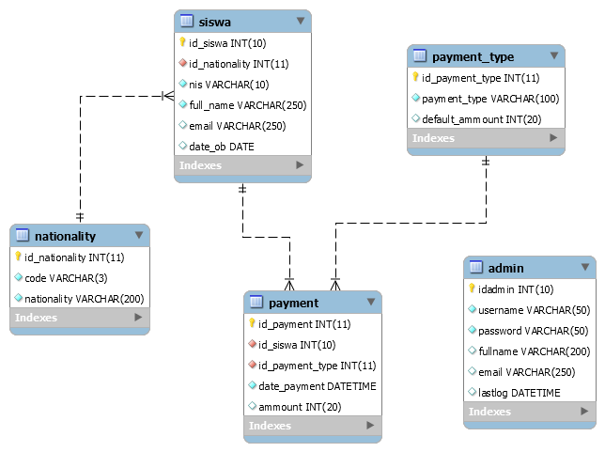
ERD
There are 4 tables for this application
Admin
Siswa
Nationality
Payment
Payment_type

Slide 5
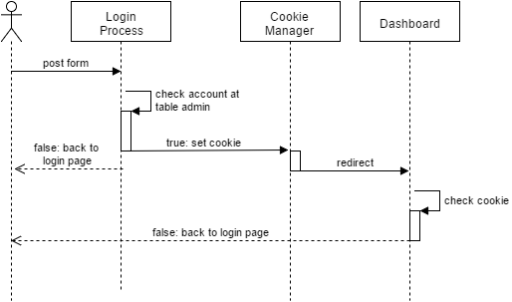
Login Process
Controllers file :
index.php as login page, contains form and auth process. Declaring cookie also write at this file after user submit login form
Dashboard.php as dashboard admin page

Slide 6
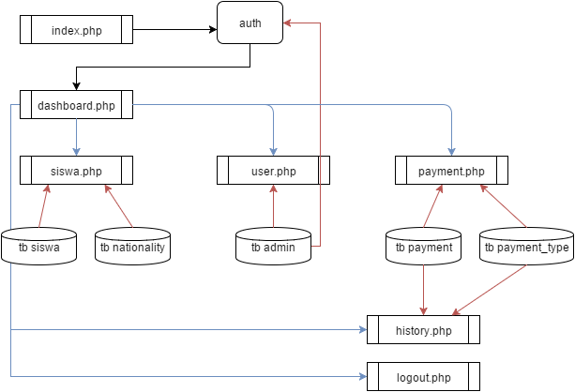
PHP File Diagram
index.php -> auth -> set cookie -> dashboard
Dashboard link to: siswa, user, payment, history, logout
Siswa uses tb.siswa & tb.nationality
User uses tb.admin
Payment and history use tb.payment & tb.payment_type
Logout -> clear cookie

