Slide 1


Specialized Logistics for Critical Cargo
Warranty Parts · Urgent Air Freight · Pharmaceuticals · Precision Machinery
ROK SHIPPING CO., LTD.
알 오 케 이 쉬 핑

Slide 2
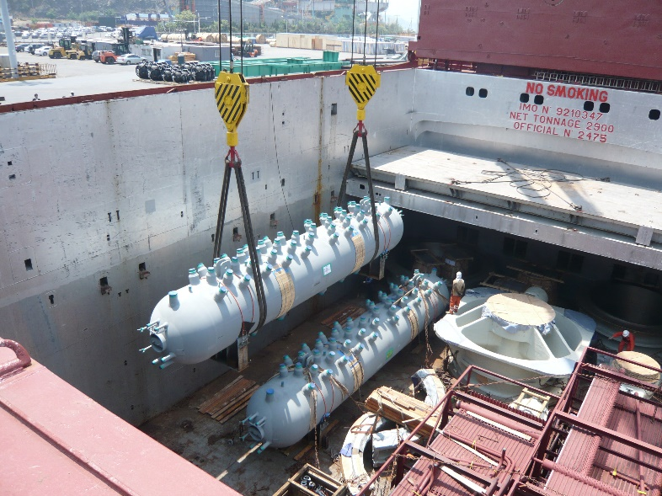
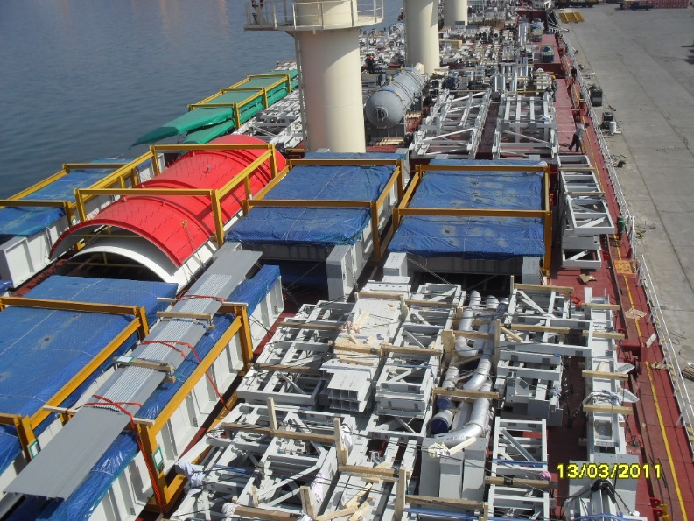
Introduction
ROK SHIPPING CO., LTD. is a sister company of NeoKorTrans Co., Ltd., established to provide specialized logistics services for time-critical, high-value, and sensitive cargo.
While NeoKorTrans focuses on large-scale plant and project logistics, including oversized and heavy cargo, ROK SHIPPING supports such projects with warranty cargo, urgent replacement parts, repair and return shipments, and emergency air freight.
Our core expertise also includes pharmaceutical products, medical-related cargo, precision machinery, high-value equipment, and other sensitive cargo requiring careful handling and close operational control.
ROK SHIPPING CO., LTD.
알 오 케 이 쉬 핑

Slide 3
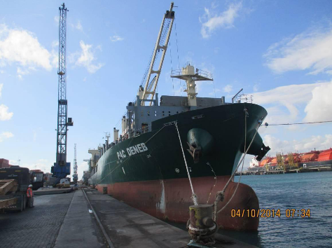
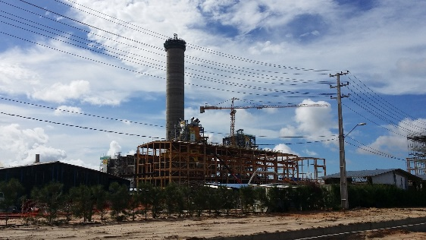
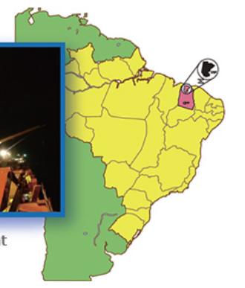
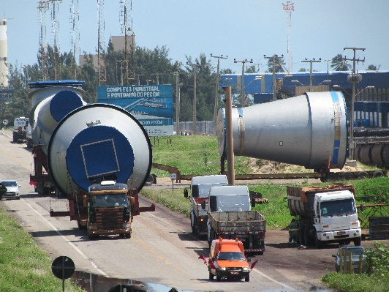
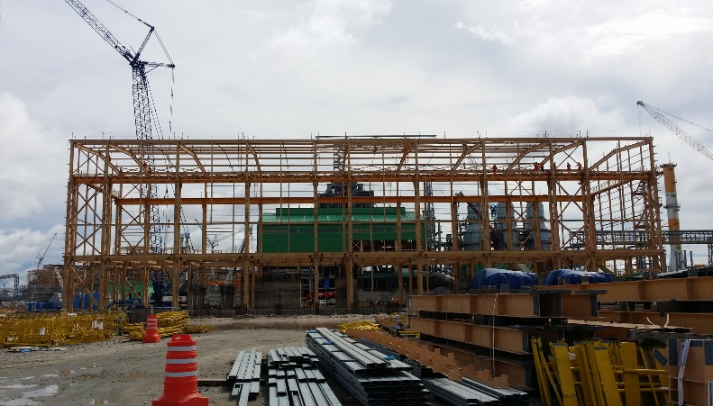
Project Logistics Heritage from NeoKorTrans
ROK SHIPPING is backed by the project logistics experience and global network of NeoKorTrans and its predecessor KorTrans.
This heritage includes major plant and industrial projects for electric power stations, steel mill plants, petrochemical plants, and other heavy industries.
Based on this foundation, ROK SHIPPING focuses on critical supporting logistics where speed, safety, documentation, and precise communication are essential.
PLANT & PROJECT LOGISTICS HERITAGE
ROK SHIPPING CO., LTD.
알 오 케 이 쉬 핑

Slide 4
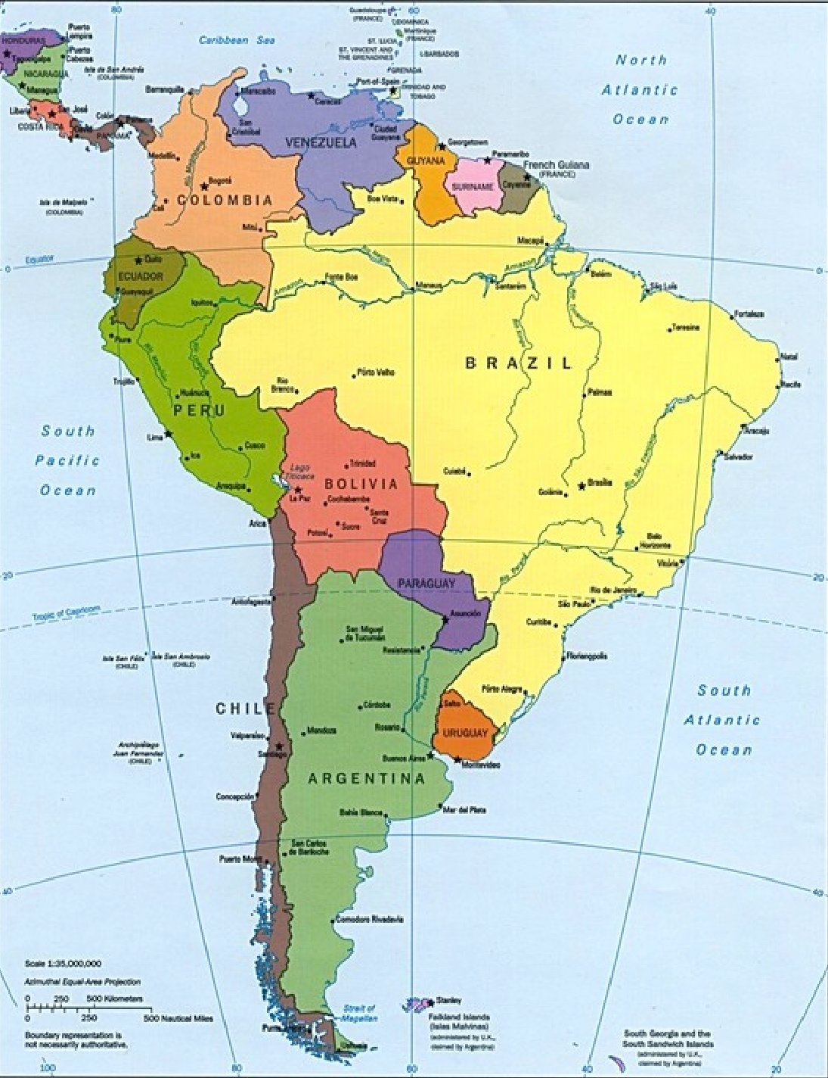
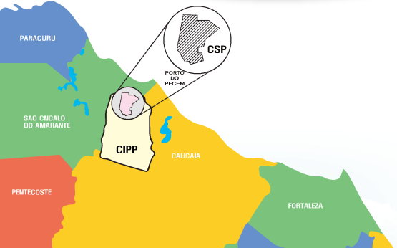
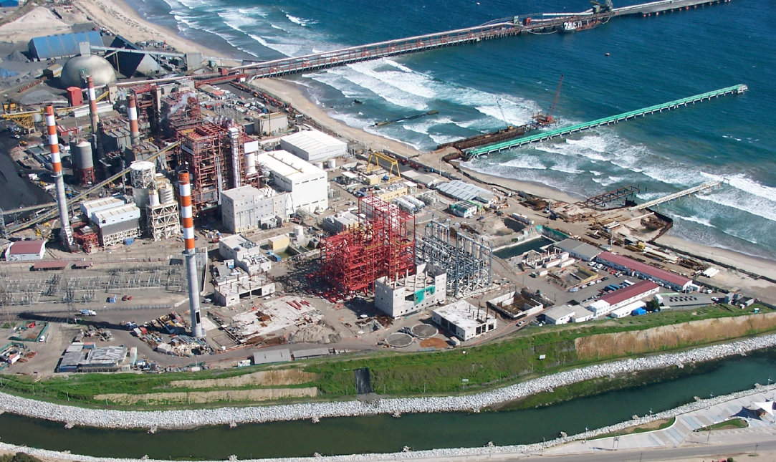
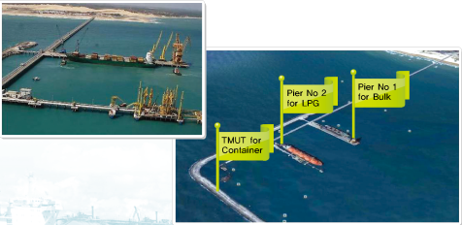
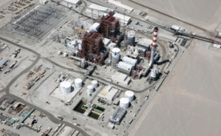
Project Reference Sites with NeoKorTrans Experience
Brazil, CSP
Chile, Angamos
Chile, Campiche
Chile, Ventanas
Chile, Boccamia
ROK SHIPPING CO., LTD.
알 오 케 이 쉬 핑

Slide 5
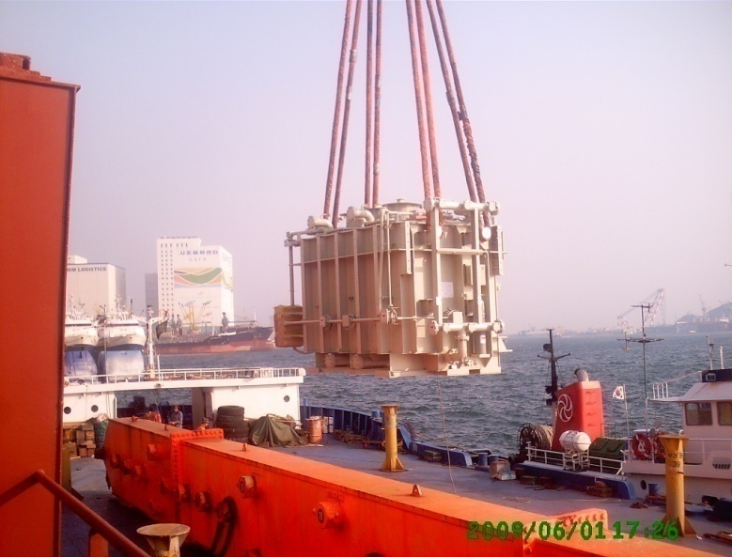
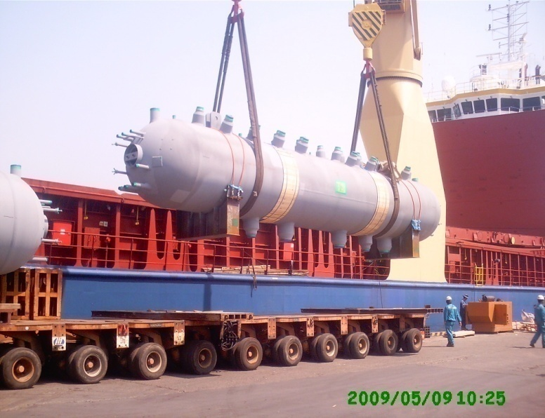
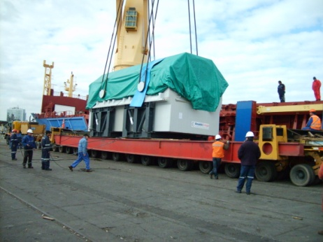
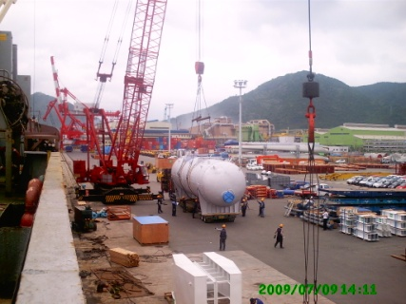
<< POWER PLANT PROJECT EXPERIENCE >>
Angamos I 240MW Ttransformer
Angamos II 240MW Steam Drum
Ventanas 240MW Steam Turbine
Campiche 240MW Condenser
ROK SHIPPING CO., LTD.
알 오 케 이 쉬 핑

Slide 6
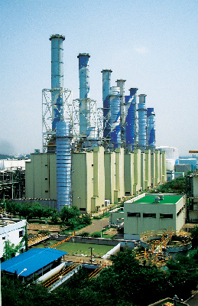
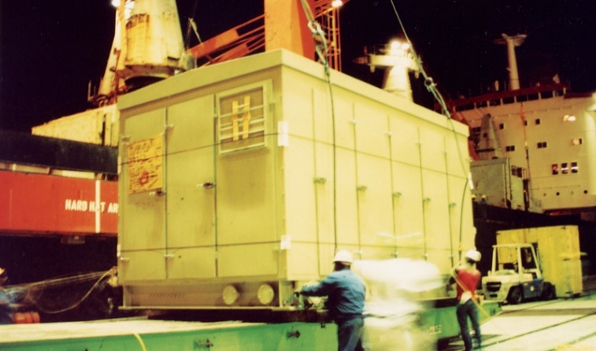
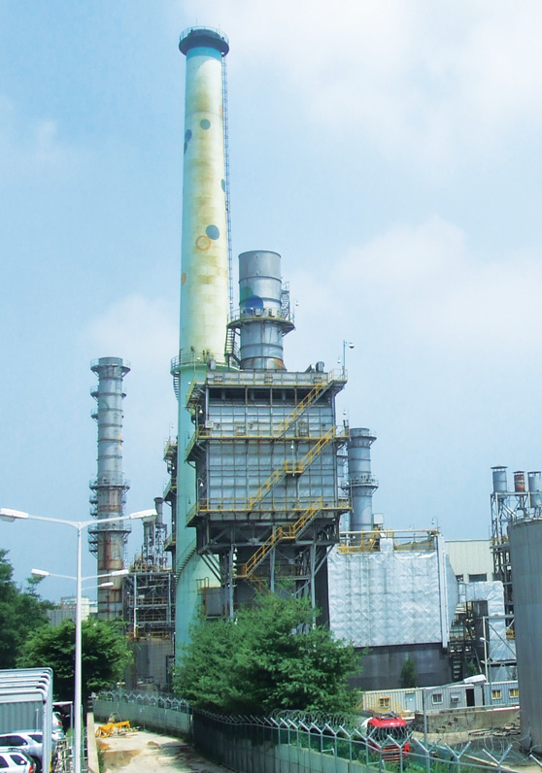
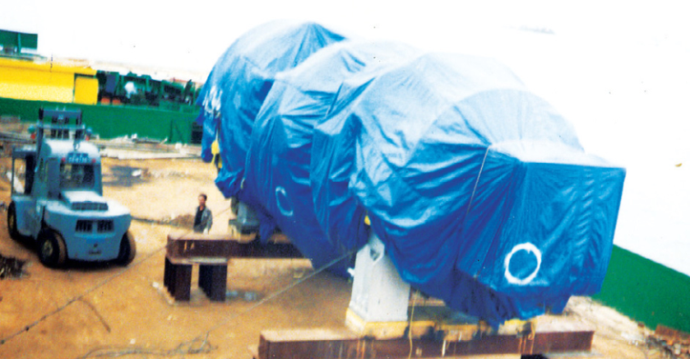
<< PROJECT SUPPORT / INDUSTRIAL EQUIPMENT >>
Electric Control Cabinet
Gas Turbine Unit 147tons
KEPCO BUCHEON CCPP 300MW PROJECT
ROK SHIPPING CO., LTD.
알 오 케 이 쉬 핑

Slide 7
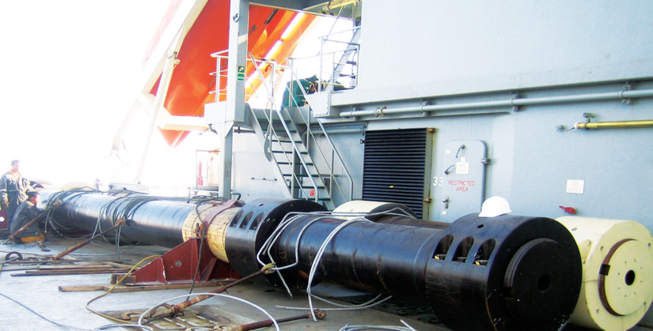
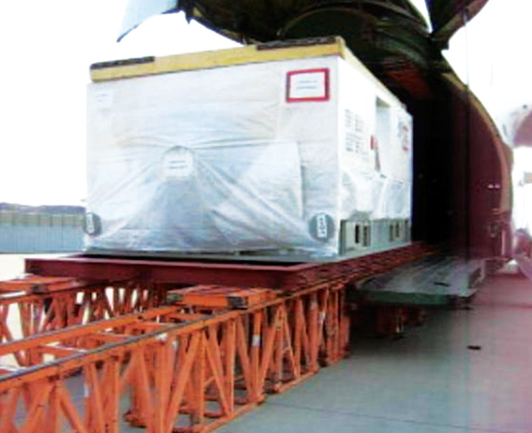
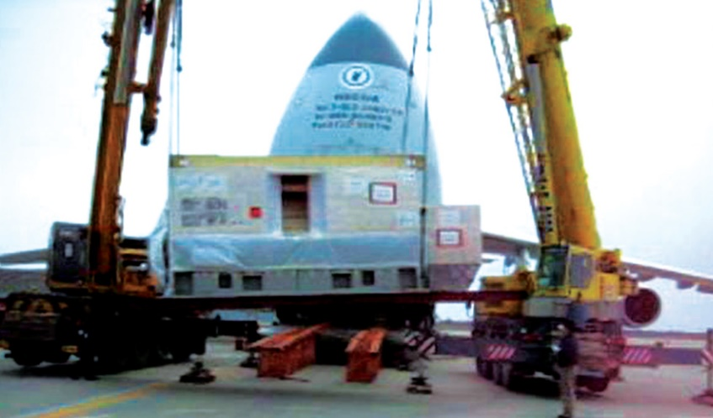
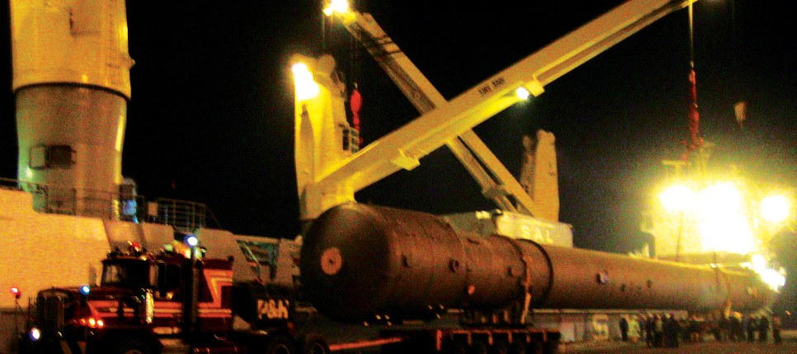
<< IRON & STEEL / HEAVY INDUSTRY PROJECTS >>
7,000 TONS FORGING PRESS PROJECT
Areoflot AN124 Chart
Press shaft 150tons for Forging Press
FINEX Pohang OXYGEN PLANT
POSCO Finex Synchronize Motor 60ton
Columns package 250tons
ROK SHIPPING CO., LTD.
알 오 케 이 쉬 핑

Slide 8
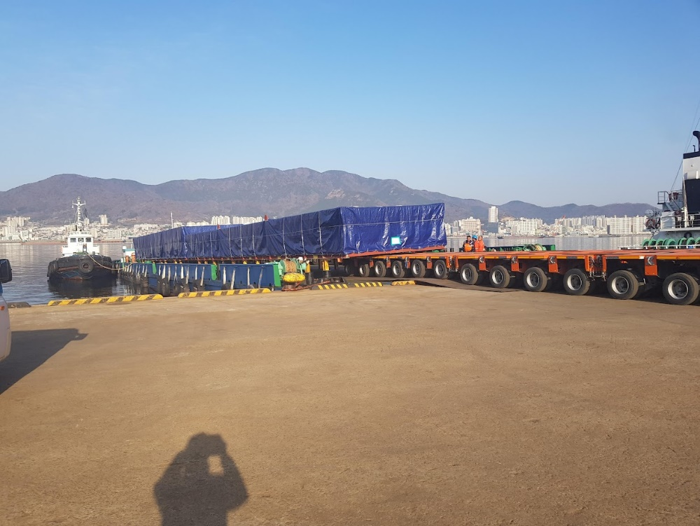
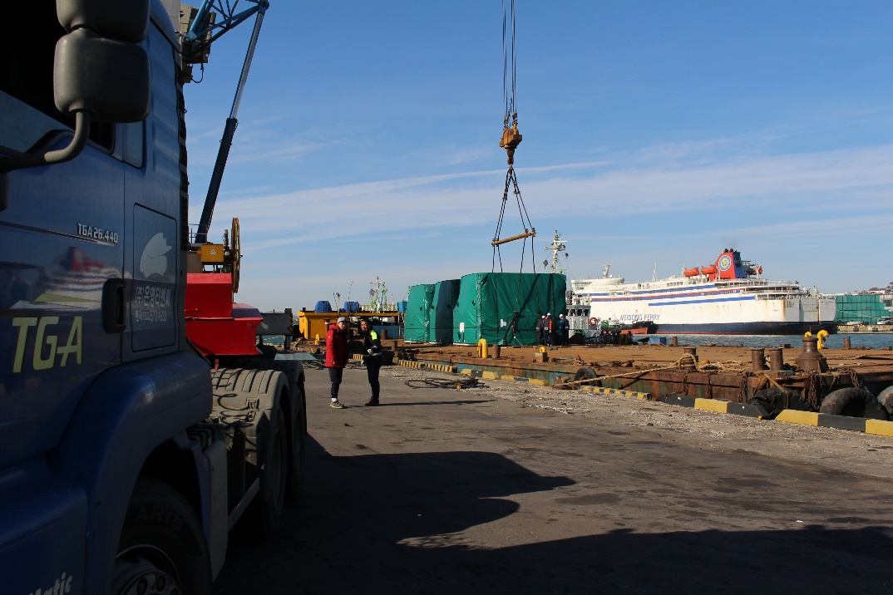
<< MULTIMODAL PROJECT LOGISTICS EXPERIENCE >>
MODULE BY BARGE TRANSPORT
FUEL CELL BY BARGE TRANSPORT
ROK SHIPPING CO., LTD.
알 오 케 이 쉬 핑

Slide 9
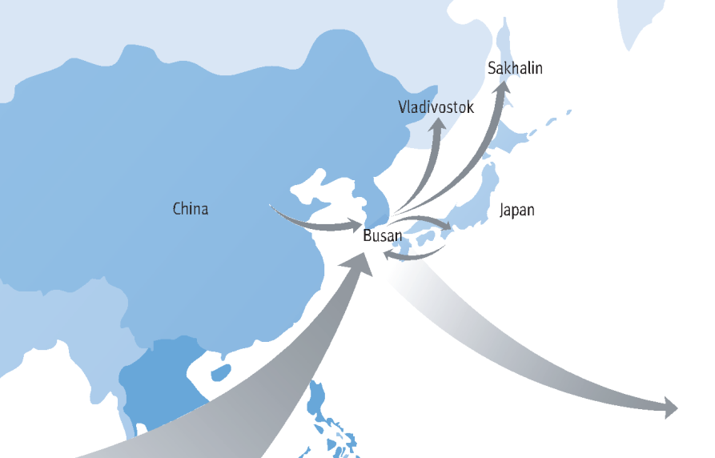
With the project logistics experience and worldwide agent network developed together with NeoKorTrans, ROK SHIPPING provides reliable and flexible solutions by air, ocean, and multimodal transportation.
We are particularly strong in urgent and sensitive shipments where fast response, accurate documentation, airline/carrier coordination, customs support, and close operational control are critical.
ROK SHIPPING connects Korea with global destinations, with practical strength across Japan, China, Southeast Asia, Europe, the Americas, and project sites worldwide.
ROK SHIPPING CO., LTD.
알 오 케 이 쉬 핑

Slide 10
ROK SHIPPING CO., LTD. specializes in Critical & Specialized Logistics.
Core Services
• Project Support & Warranty Cargo
- Warranty replacement parts / emergency spare parts
- Repair and return shipments
- Time-critical project support cargo
• Urgent Air Freight
- Next-flight-out arrangements
- Critical cargo coordination
- Door-to-door expedited service
• Pharmaceutical & Healthcare Logistics
- Pharmaceutical raw materials
- Temperature-sensitive and documentation-sensitive cargo
• Precision & High-Value Cargo
- Precision machinery and control equipment
- Sensitive equipment requiring special handling
We will do our best to move every critical shipment safely, quickly, and accurately.
ROK SHIPPING CO., LTD.
알 오 케 이 쉬 핑

