Slide 1

Methane Emissions Status for Manure Management across USA
Environmental Data Analytics | Spring 2021
Kendra Sultzer | Nadia Swit

Slide 2

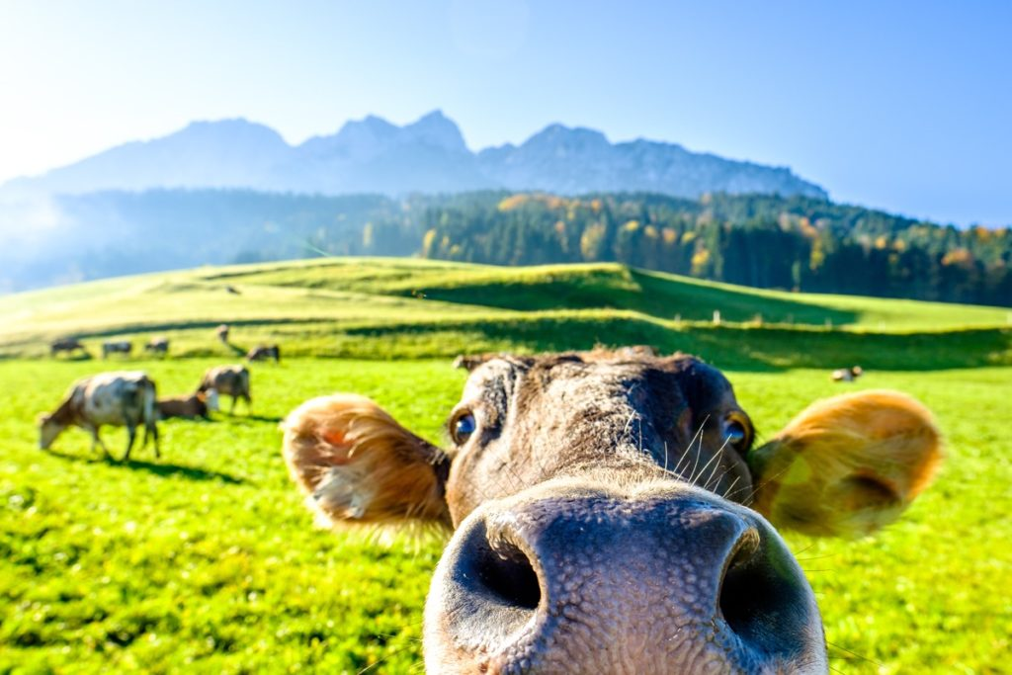
Metadata
Manure management across USA
13 Animal Categories (dairy cows, chickens, turkeys, etc.)
Green house gas emission data – total emissions and emissions rates for CH4, NO2, CO2

Slide 3
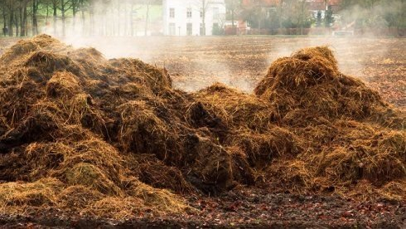
Research Questions
1. Have methane emissions changed over time?

Slide 4
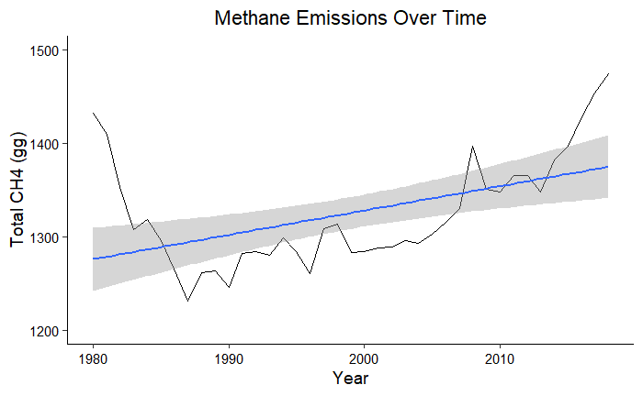

Slide 5
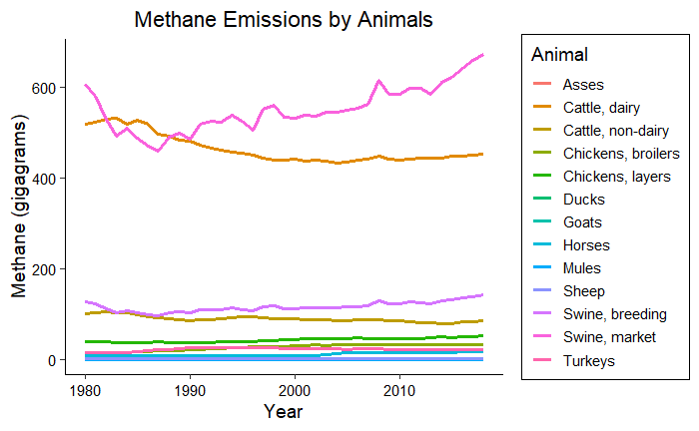

Slide 6
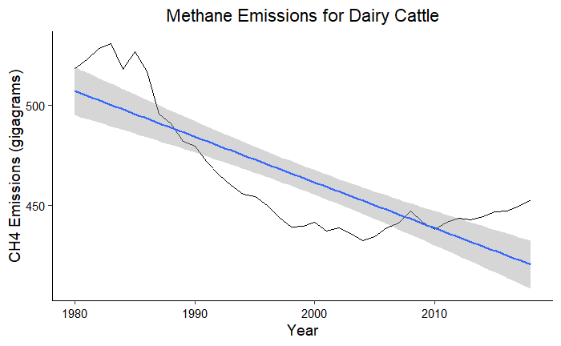
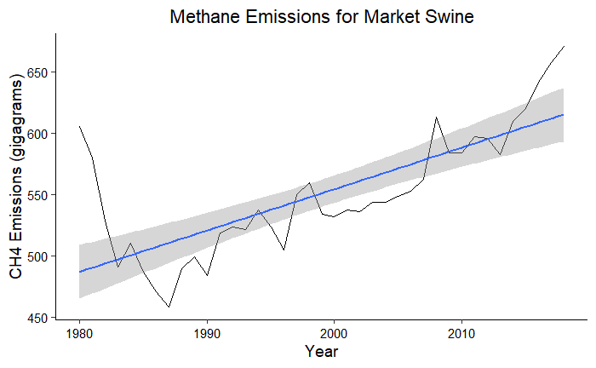

Slide 7
Research Questions
2. Does the average methane emission rate differ between each animal category?

Slide 8
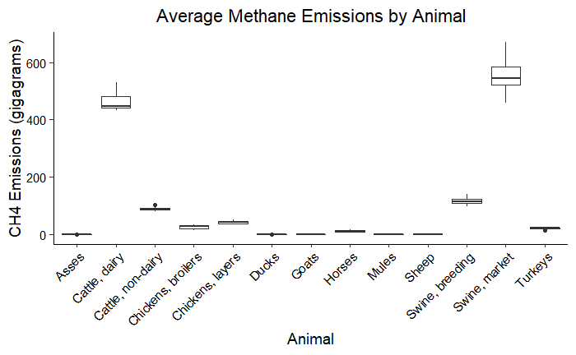

Slide 9
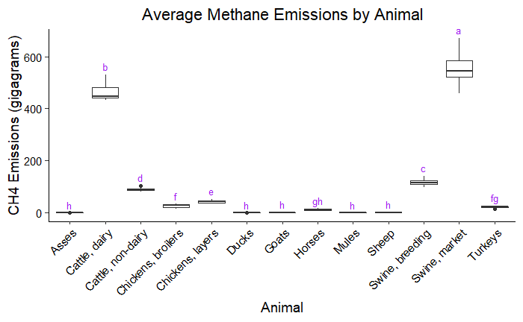

Slide 10
Picture Credits
Title page: https://uradafrique.wordpress.com/
Metadata: https://bestlifeonline.com/cute-cow-photos/

