Slide 1
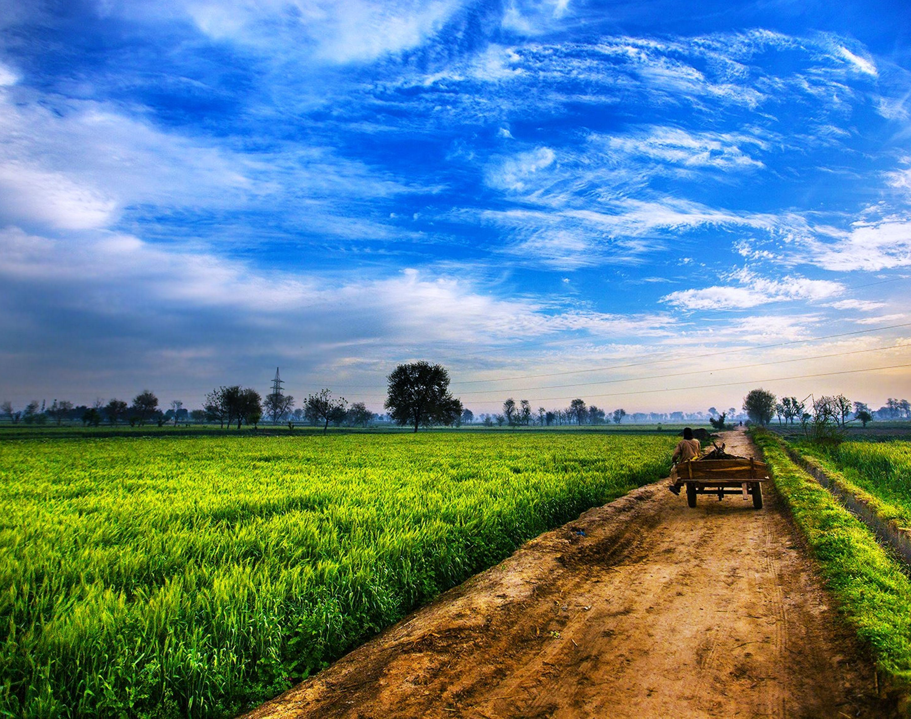
Methane Emissions Status for Manure Management across USA
Environmental Data Analytics | Spring 2021
Kendra Sulzer | Nadia Swit

Slide 2

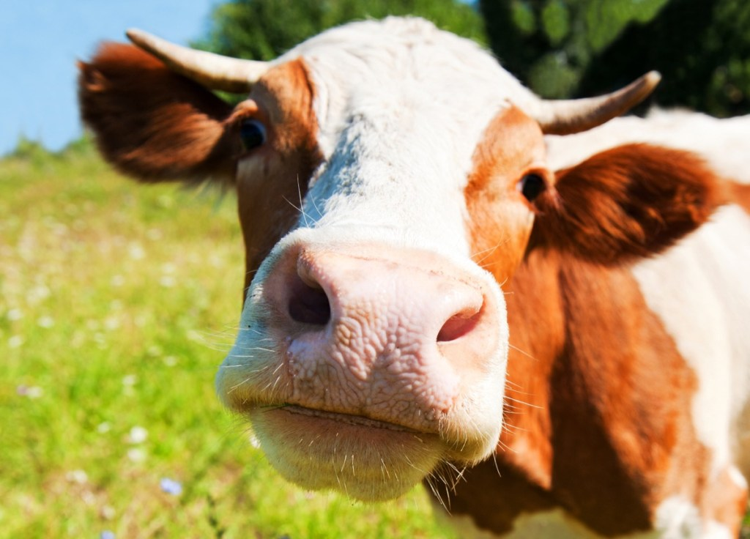
Metadata
Manure management across USA
13 Animal Categories (dairy cows, chickens, turkeys)
Green house gas emission data – total emissions and emissions rates for CH4, NO2, CO2

Slide 3
Research Questions
How have methane emissions changed across time?
Is there a difference in rate produced by each animal?

Slide 4
Total Methane Emissions across Animals
(insert general line graph)
Talk about overall
See there is an obvious difference in dairy cattle and market swine

Slide 5
Time Series Trends
(insert trend graphs for methane emissions side by side for dairy cattle and market swine)
Data is not seasonal but according to Mann-Kendall test there is a significant trend

Slide 6
Methane Emission Rates per Animal
(insert bar chart of rates per animal)

Slide 7
Findings?
How have methane emissions changed across time?
**summarize overall trend
**group by year, sum
Is there a difference in rate produced by each animal?
Visually can see there is a difference in rate

Slide 8
Picture Credits
Title page: https://uradafrique.wordpress.com/

