Slide 1
World cup EDA

Slide 2
Team wise Analysis
- Explore team-wise performance metrics.
- Analyze runs scored, wickets taken, and batting/bowling styles.
- Identify top-performing teams and their strengths.

Slide 3
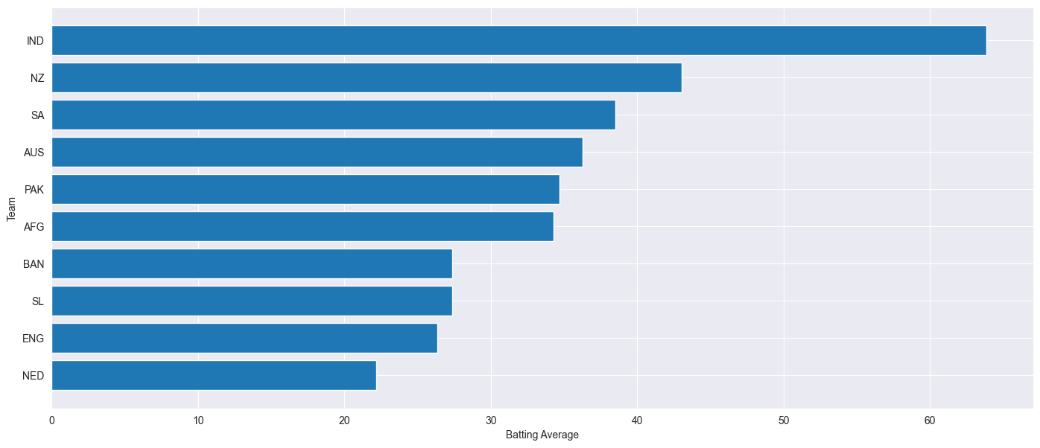
Batting Average

Slide 4
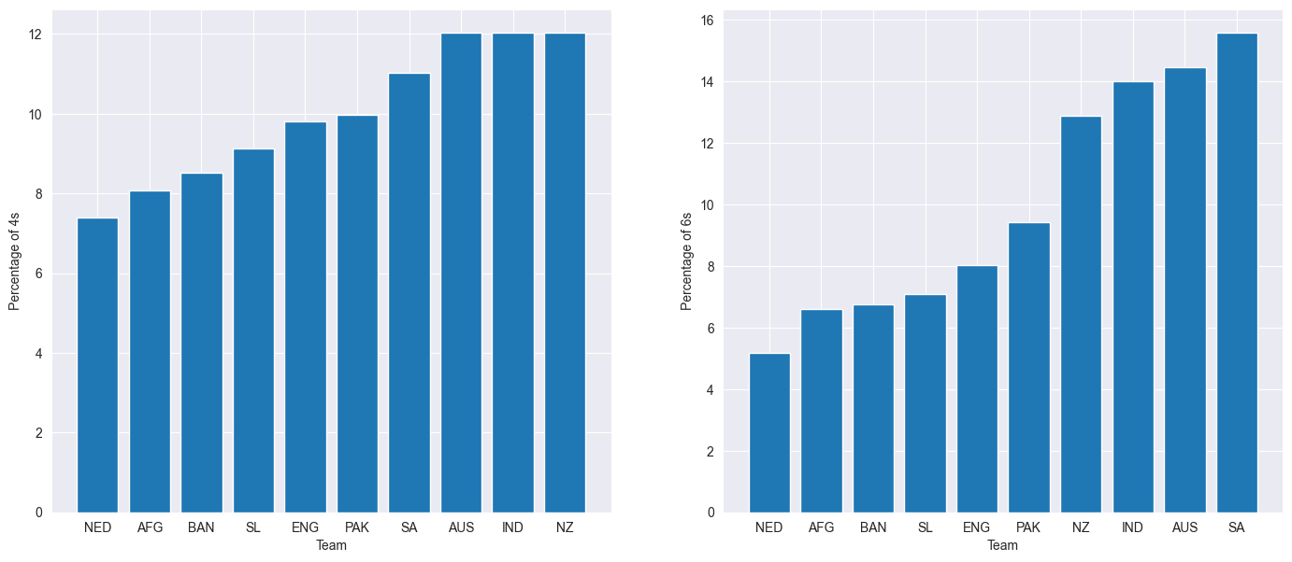
Team's ability to score boundaries and maintain a healthy run rate

Slide 5
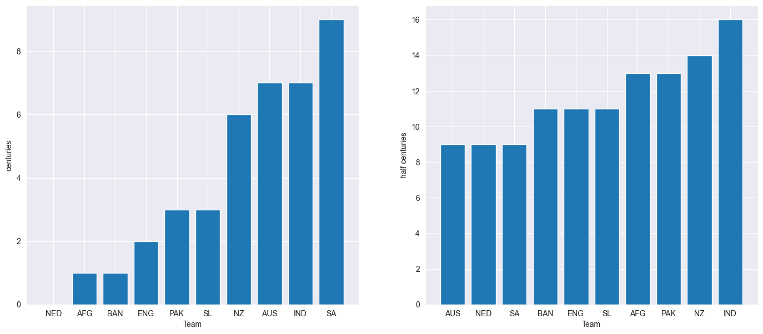
Percentage of Centuries/Fifties:Indicates how frequently the team's batsmen convert starts into significant scores.

Slide 6
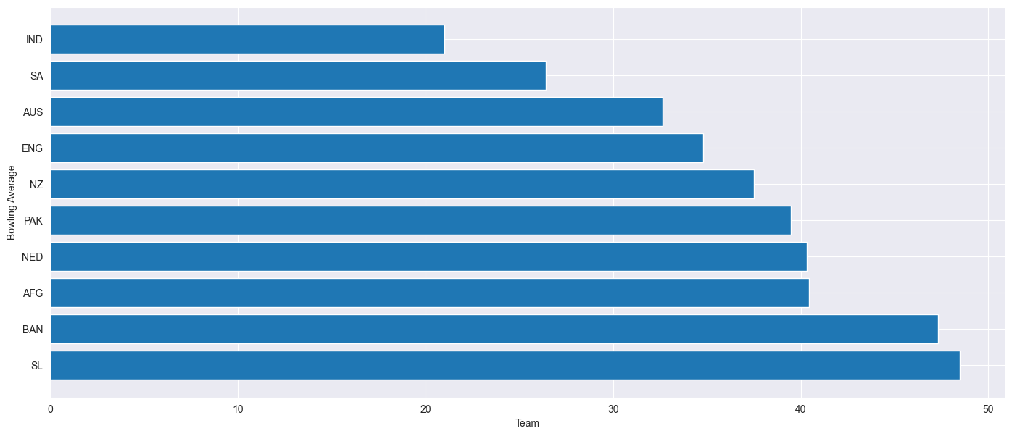
Bowling Average: The average number of runs conceded per wicket taken, indicating the effectiveness of the bowling unit

Slide 7
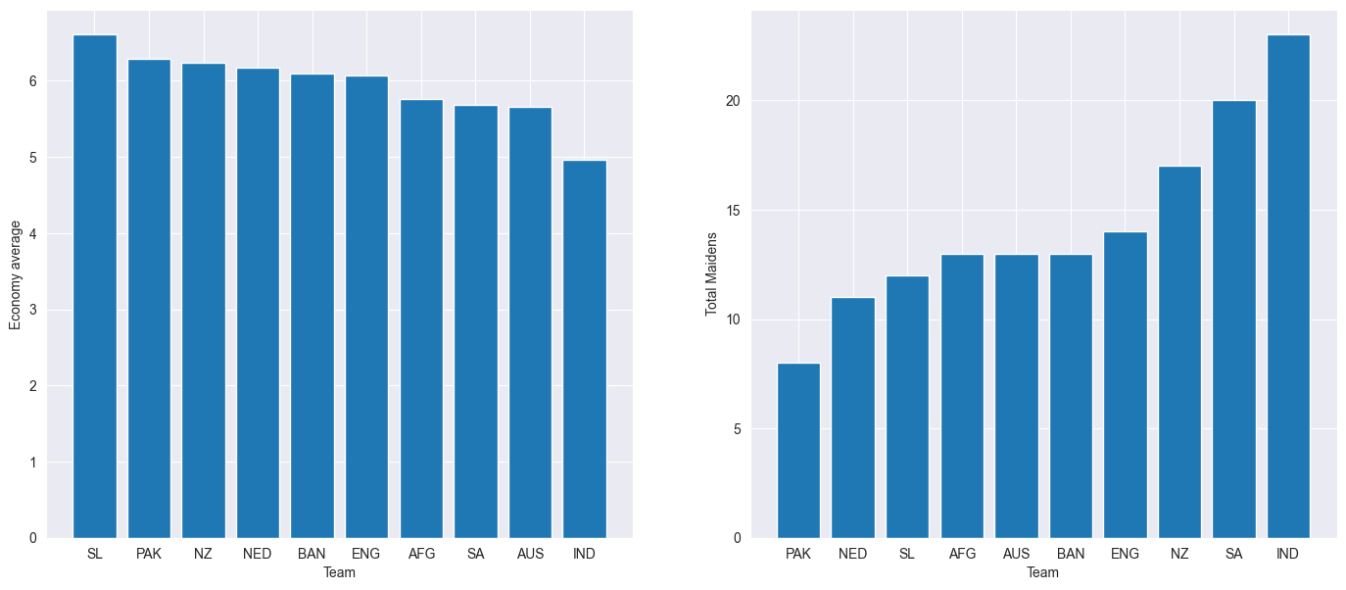
average economy throughout tournament and total madains

Slide 8
Player Performance Analysis:
- Evaluate individual player statistics for both batting and bowling.
- Identify leading run-scorers and wicket-takers.
- Assess the impact of players on their team's performance.

Slide 9
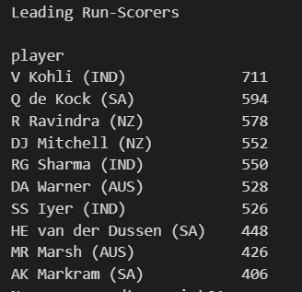
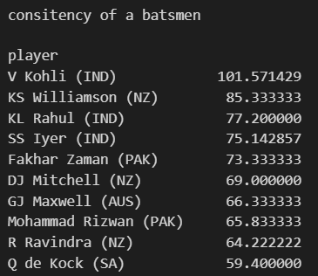

Slide 10
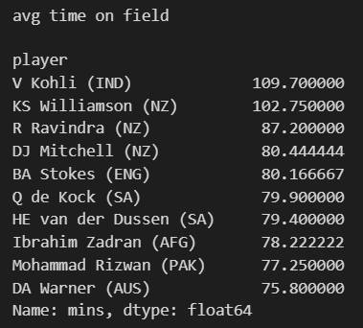

Slide 11

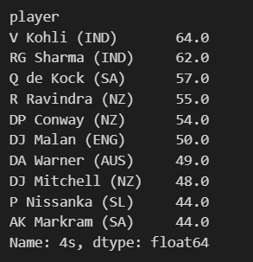
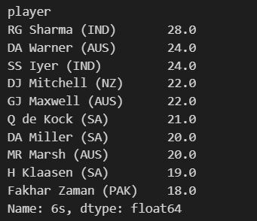

Slide 12
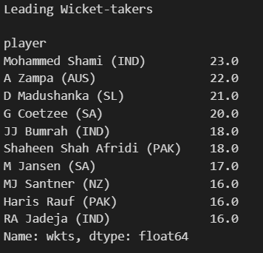
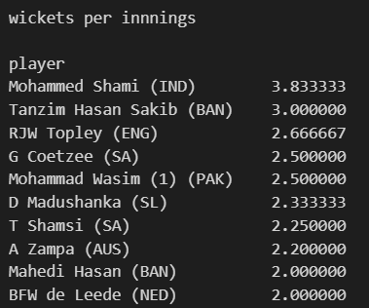

Slide 13
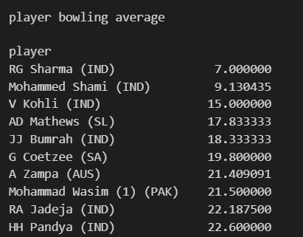
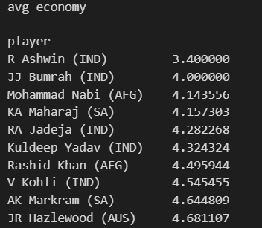

Slide 14
Opposition and Ground Analysis:
- Investigate how teams and players perform against different oppositions.
- Examine performance variations across different playing grounds.
- Identify if there are specific teams or players that excel in certain conditions

Slide 15
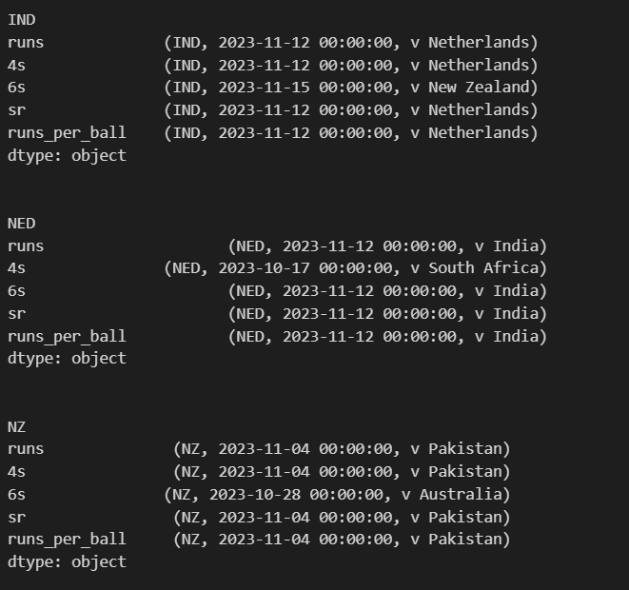
Team-opposition analysis: batting (excellent match-ups)

Slide 16
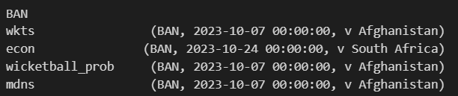
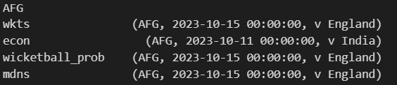
Team-opposition analysis: bowling (excellent match-ups)

Slide 17
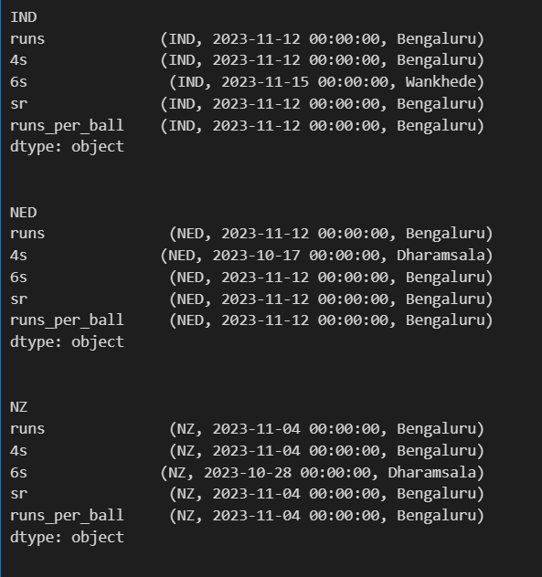
Team -ground analysis: batting (excellent match-ups)

Slide 18
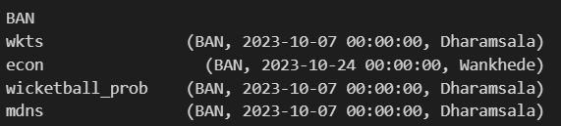
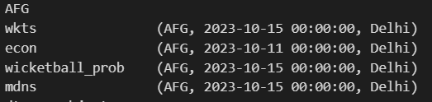
Team -ground analysis: bowling (excellent match-ups)

Slide 19
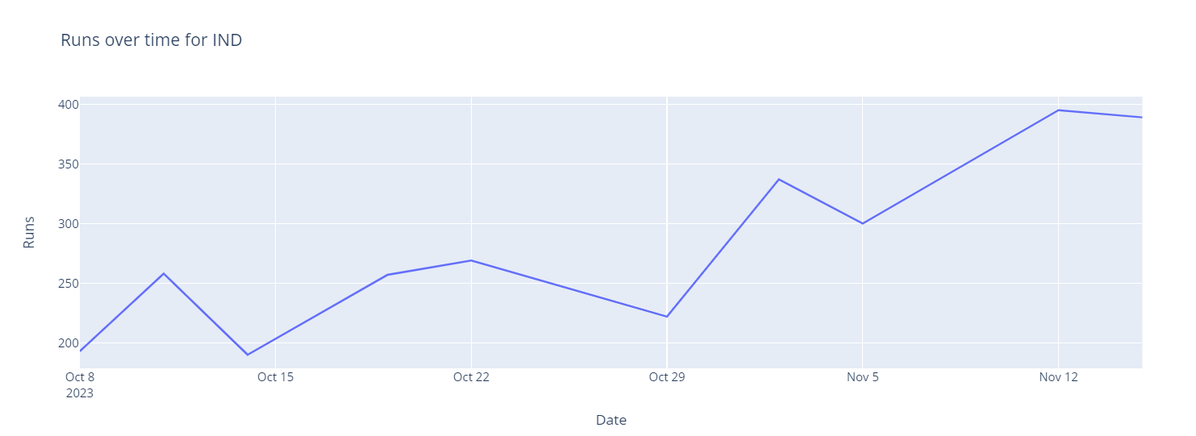
Cyclical uptrend for IND

Slide 20
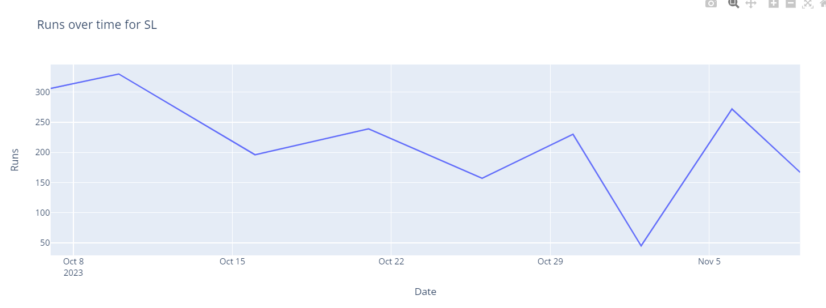
Down trend for SL

Slide 21
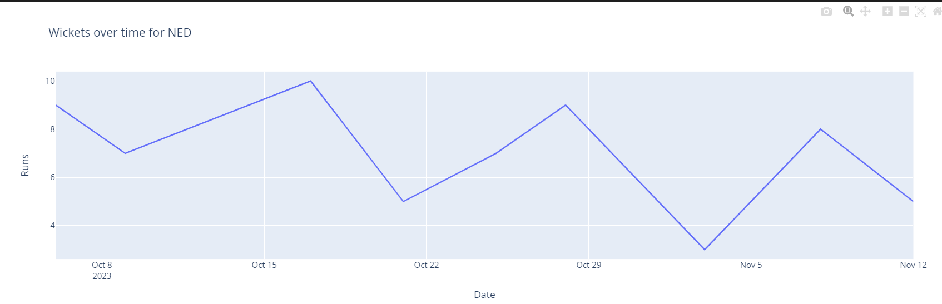
Cyclical down-trend for NED

